Slide 1


DPRELAY
Revolutionizing OTP & Bulk SMS in Bangladesh
Hardware-Authenticated Delivery for Unmatched Reliability
Presented by: dpRelay Team

Slide 2




THE PROBLEM: UNRELIABLE SMS GATEWAYS
Low Delivery Rates
Slow OTP Speeds
Traditional gateways often get blocked by carriers due to shared, generic numbers and suspicious routing.
Verification codes arrive too late or not at all, leading to high user drop-off and frustration.
Inconsistent Sender IDs
High Costs
Customers see random, untrusted numbers, which reduces brand credibility and user trust.
International routing and complex per-request fee structures make traditional services expensive for local businesses.

Slide 3




THE SOLUTION: DPRELAY'S UNIQUE ARCHITECTURE
Direct SIM Connection
Bypasses unreliable third-party aggregator gateways by sending directly from dedicated Android devices.
Consistent Sender ID
Every message comes from your own dedicated number, building trust and brand recognition.
Built for Bangladesh
Hardware-Authenticated Delivery
Optimized for local carriers, character sets, and payment methods like bKash.

Slide 4





HOW IT WORKS: SIMPLE & SECURE
1
2
3
4
Dedicated Hardware
Developer-First API
API Playground
Real-Time Webhooks
Connect your own Android device as a trusted hardware anchor for SMS delivery.
Integrate in minutes using our RESTful API, SDKs, and ready-to-copy code examples.
Test your credentials and functionality live in the dashboard before going to production.
Receive instant delivery reports and verification callbacks via signed HMAC payloads.

Slide 5





KEY DIFFERENTIATOR: HARDWARE ADVANTAGE
Trusted Hardware Anchor
Not just another cloud gateway. Every message is physically sent from a dedicated device you control.
No Shared Infrastructure
Eliminates the risk of being flagged as spam due to the poor reputation of shared gateway numbers.
TOTAL HARDWARE CONTROL
Scalable Throughput
You own the device. You own the SIM. You own the delivery.
Need more volume? Simply add more devices to your account to increase sending capacity instantly.

Slide 6





PRODUCT FEATURES: BUILT FOR BUSINESS
Separate Credit Pools
Per-App API Keys
Independent buckets for OTP and Bulk SMS. Ensure critical verification messages are never delayed by high-volume marketing campaigns.
Create multiple apps under one account. Manage different clients, environments (dev/prod), or services with unique credentials and webhooks.
Fine-Grained Rate Limiting
Bulk Campaign Manager
Protect your system and users from abuse. Set custom limits per phone number or application to prevent spam and control costs.
Upload CSV lists, schedule sends, and track real-time progress. A powerful tool for promotions, alerts, and customer engagement.

Slide 7

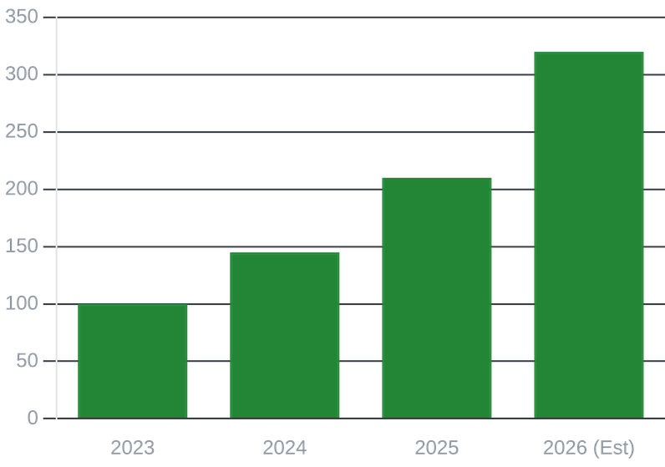


MARKET OPPORTUNITY: BANGLADESH & BEYOND
Rising Verification Demand
Growing Digital Economy
Rapid digitization across Bangladesh is driving an exponential increase in the need for secure user authentication and phone verification.
E-commerce & Fintech Boom
Critical infrastructure for the booming e-commerce, ride-hailing, and mobile financial services (MFS) sectors requiring 99.9% reliability.
Projected OTP Volume Growth (Index)
Significant Local Market Gap
Existing providers are often unreliable or prohibitively expensive, leaving a massive opening for a hardware-backed, developer-first solution.

Slide 8



COMPETITIVE LANDSCAPE: WHY DPRELAY WINS
FEATURE
DPRELAY
GLOBAL GATEWAYS
LOCAL PROVIDERS
Delivery Speed
~2-5 Seconds
5-15 Seconds
10-30 Seconds
Sender ID
Consistent
Often Changes
Generic / None
Local Payment (bKash)
Signed Webhooks
Hardware Control
Full Control
Cloud Only
Shared Only
dpRelay combines the technical sophistication of global platforms with the local reliability and payment integration required for the Bangladesh market.

Slide 9

TRACTION & MILESTONES
99.9%
50+
UPTIME
APPS INTEGRATED
Proven reliability for mission-critical apps
Growing ecosystem of local developers
1M+
200+
OTPS DELIVERED
HAPPY DEVELOPERS
Successfully handling high message volumes
Trusted by the Bangladesh tech community

Slide 10







BUSINESS MODEL: PAY-AS-YOU-GO
OTP Credits
Bulk SMS
Free Tier
1 BDT / OTP
Volume Based
50 Free OTPs
High-reliability transactional verification. No subscriptions, no hidden fees. Pay only for what you use.
Cost-optimized marketing campaigns. Competitive rates starting from 0.35 BDT for high-volume sends.
Get started instantly with 50 free credits to test our API and hardware delivery system.
LOCAL PAYMENTS SUPPORTED:
bKash
Bank Transfer
Local Cards

Slide 11




THE TEAM & THE FUTURE
OUR EXPERTISE
ROADMAP 2026-2027
Deep Technical Roots: Decades of combined experience in software engineering and hardware integration.
Q3 2026
Automated bKash API
Streamlining credit top-ups with instant, automated payment verification.
Local Market Insight: Unmatched understanding of Bangladesh's carrier landscape and regulatory environment.
Q4 2026
Advanced Analytics
Deep insights into delivery rates, latency, and user behavior patterns.
Developer-Centric: Committed to building the best developer experience (DX) for the local ecosystem.
Q1 2027
Regional Expansion
Scaling our hardware-backed model to other emerging markets in South Asia.

Slide 12



JOIN THE REVOLUTION
Ready to experience reliable SMS delivery?
dprelay.digital-papyrus.xyz
support@dprelay.com
Start your free trial today with 50 free OTPs. No credit card required.

