Slide 1
COVID-19 2022 | Quantifying Impact - Chicago
Epi Summary
Produced by: Dano Aasland
Distribution: PUBLIC
Version: Feb 12, 2022

Slide 2
Overview
Purpose of This Study:
To quantify the impact of COVID-19 upon the population within the city of Chicago
Method(s) Used:
Years of Potential Life Lost (YPLL) was the measure selected as its useful from a social, economic, and public health viewpoint when viewing stratified data
YPLL End Point:
For age groups under 70 years old, the average life expectancy for Chicago was used (78.8 years) | For those 70-79 the remaining life expectancy was used (81.3 years) | For those 80+ years old the remaining life expectancy was used (88.6 years)
Date Range:
Onset (2020) – Current (2/9/2022)
Data Source:
Chicago Data Portal data.cityofchicago.org

Slide 3
Nearly a 100,000 Years of Potential Life Lost
To Date in Chicago

Slide 4
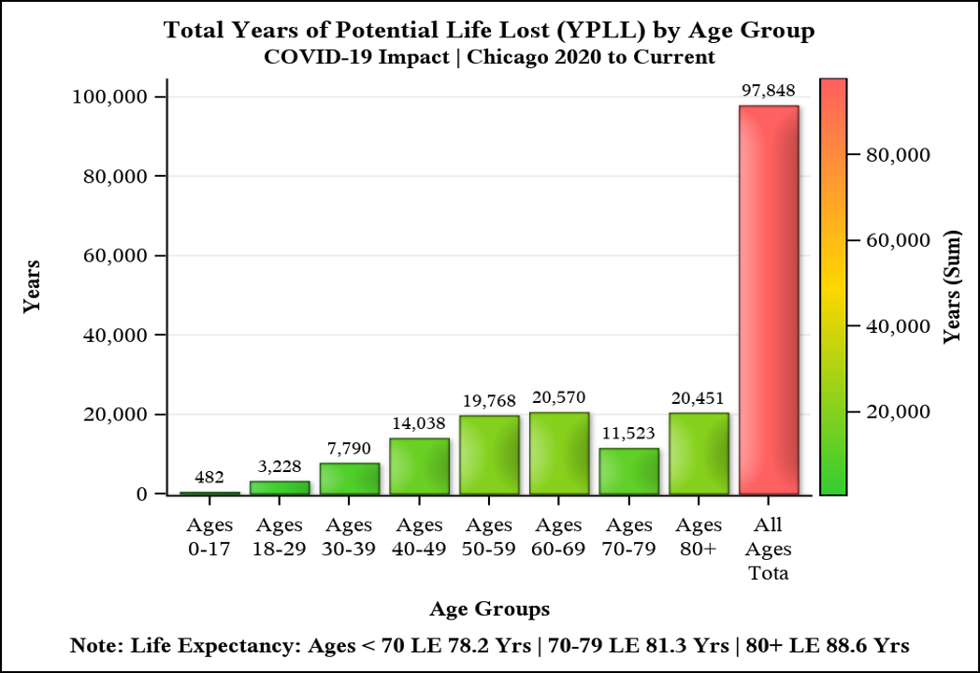
YPLL_{LE} Total (Years) by Age Group
YPLL places more emphasis on lives lost at a younger age than those in their later stages of life.
Impact can be inferred by how many years of potential life expected has been lost due to death.
There’s a notable diminished impact to the 70-79 age group as compared to the adjacent age groups.

Slide 5
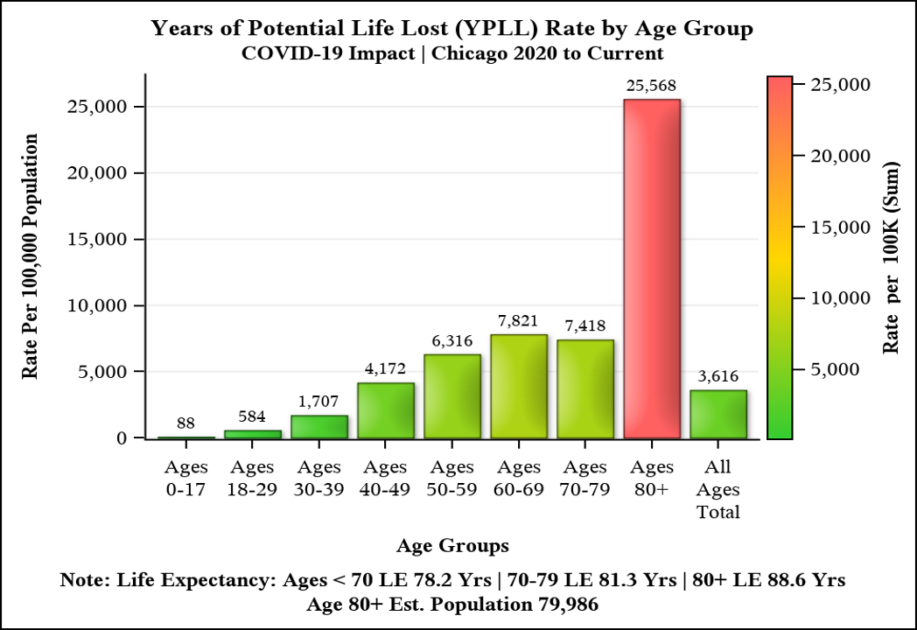
YPLL_{LE} Rate (Unadjusted) by Age Group
Rate is expressed as YPLL (Years) per 100,000 persons.
Age 80+ has the highest rate, but only has an estimated population count of 79,986 (2020 census).
The increase in rate from 40-49 to 50-59 is 54%. Whereas 50-59 to 60-69 only is a 24% increase.

Slide 6
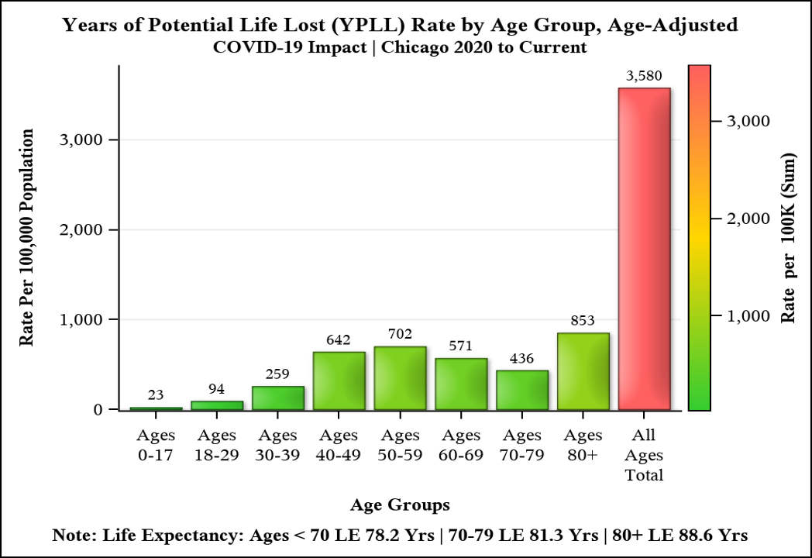
YPLL_{LE} Rate (Age-Adjusted) by Age Group
Rate is expressed as YPLL (Years) per 100,000 persons.
YPLL rates were adjusted to the 2000 U.S. Census weights.
Overall, the age range impacted greatly by premature death due to COVID-19 is when one would be a parent (40-49) to those 13-20 years old. This age group has a 148% increase in rate compared to the 30-39 year old range.

Slide 7
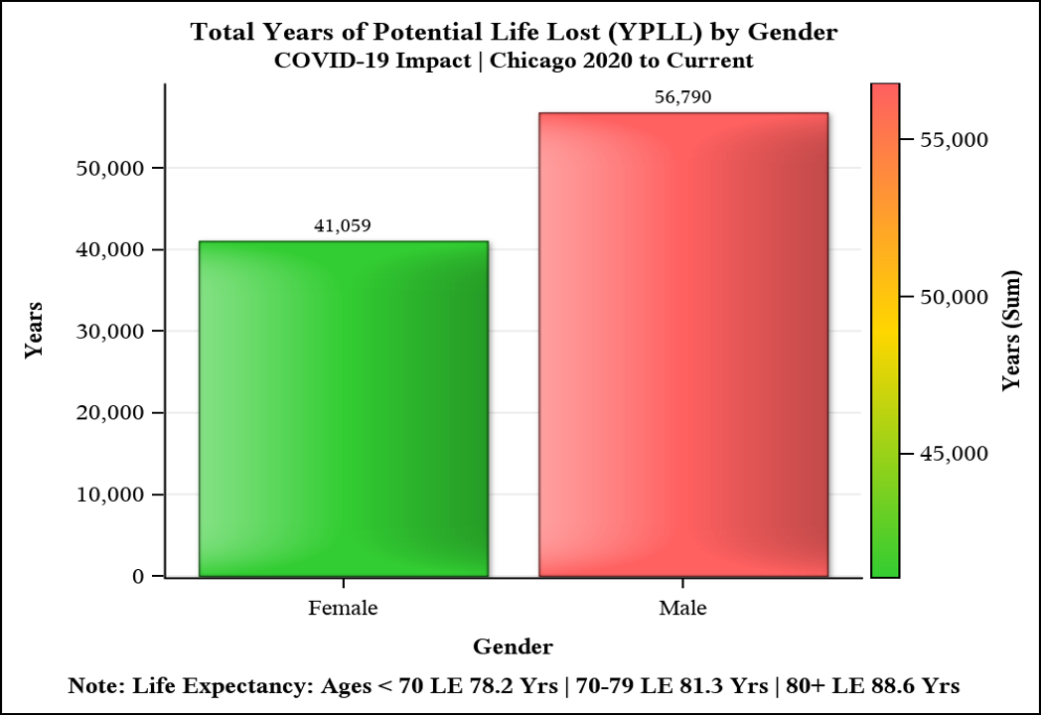
YPLL_{LE} Total (Years) by Gender
Males are suffering the largest number of years of potential life lost when compared to females.
A disparity of 15,731 years more than females.
Both genders represent all age groups within the population of Chicago.
Note: There were no ”unknown” gender observations in the dataset.

Slide 8
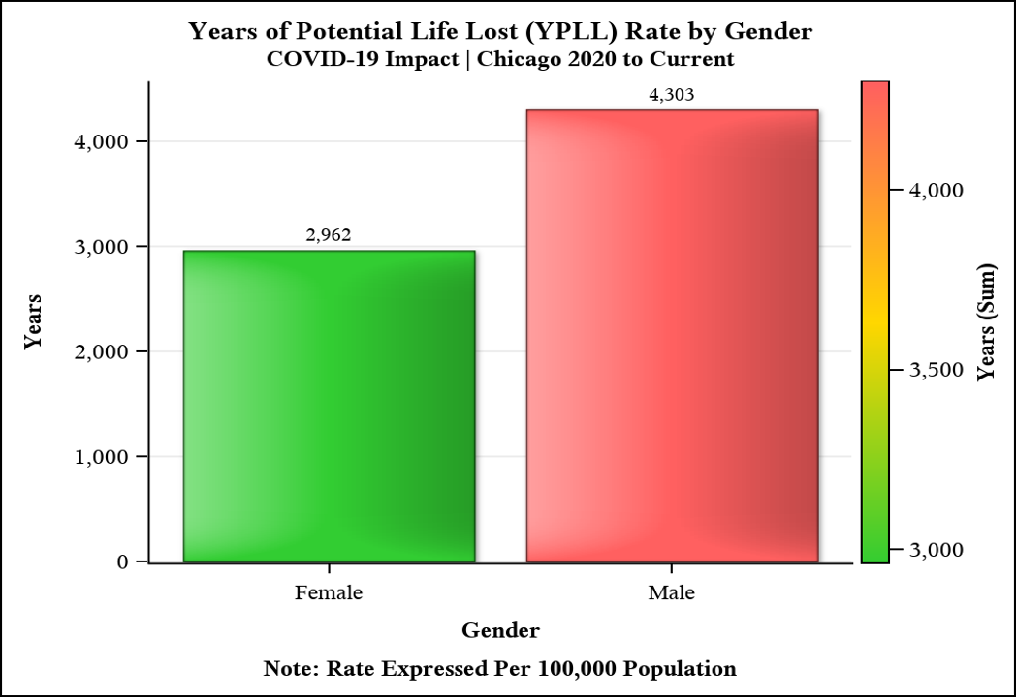
YPLL_{LE} Rate (Unadjusted) by Gender
The YPLL rate was 1.5 times larger when compared to females.
The rate increases by 45% when one is a male as compared to the rate for females.

Slide 9
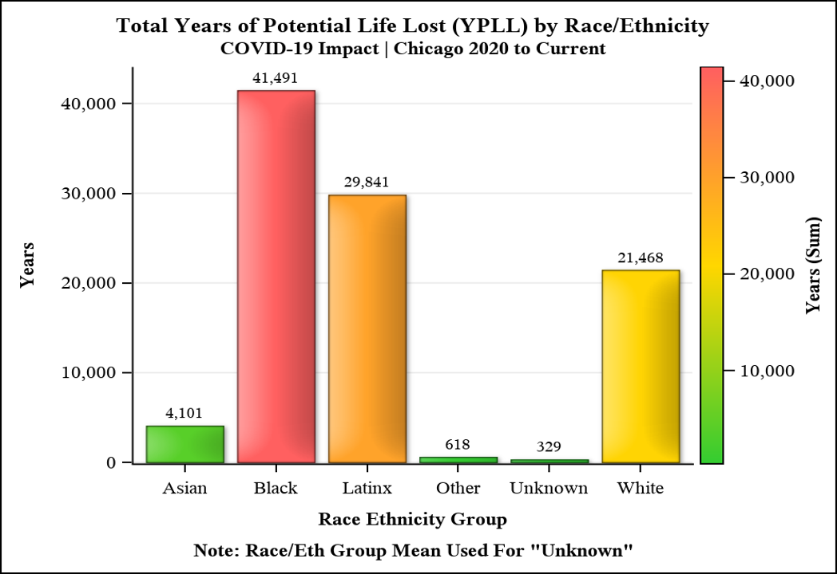
YPLL_{LE} Total (Years) by Race/Ethnicity
The YPLL difference was 1.9 times larger for Black Chicagoans compared to White Chicagoans.
The YPLL difference was 1.4 times larger for Black Chicagoans compared to Hispanic Chicagoans.
Asian Chicagoans had the lowest YPLL, 1/10th as compared to Black Chicagoans.

Slide 10
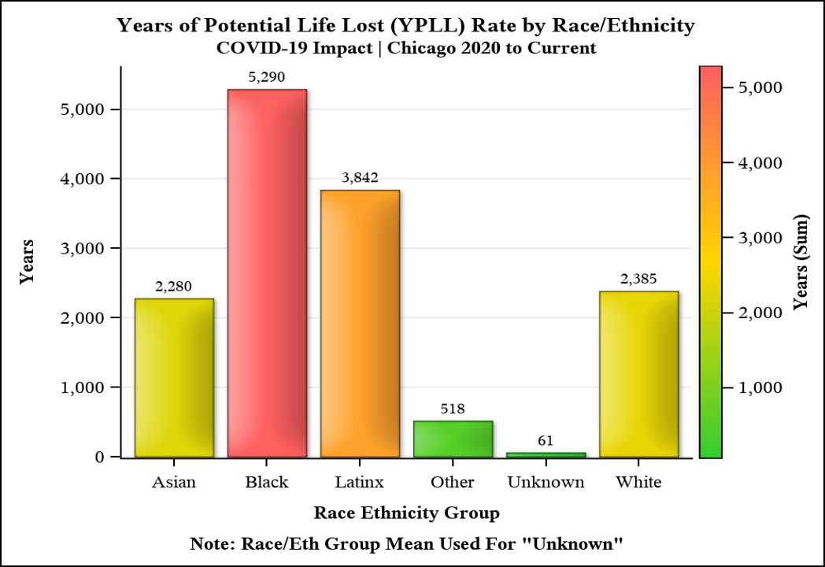
YPLL_{LE} Rate (Unadjusted) Race/Ethnicity
For Black Chicagoans the rate difference compared to Hispanic Chicagoans is 1,448
For Black Chicagoans the rate difference compared to White Chicagoans is 2,905
For White Chicagoans the rate difference compared to Asian Chicagoans is 105
The two largest minority groups in Chicago are impacted the greatest.

Slide 11
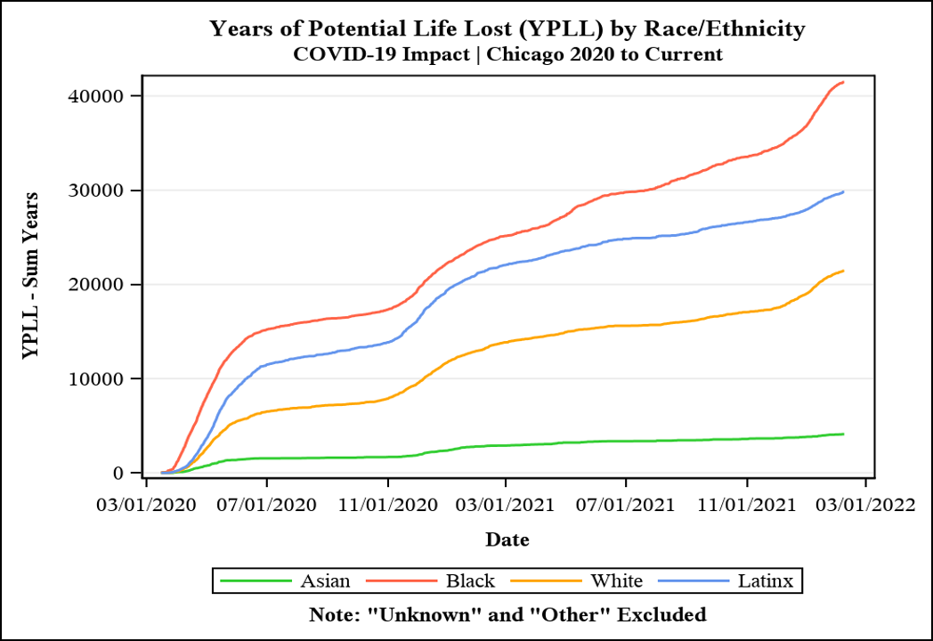
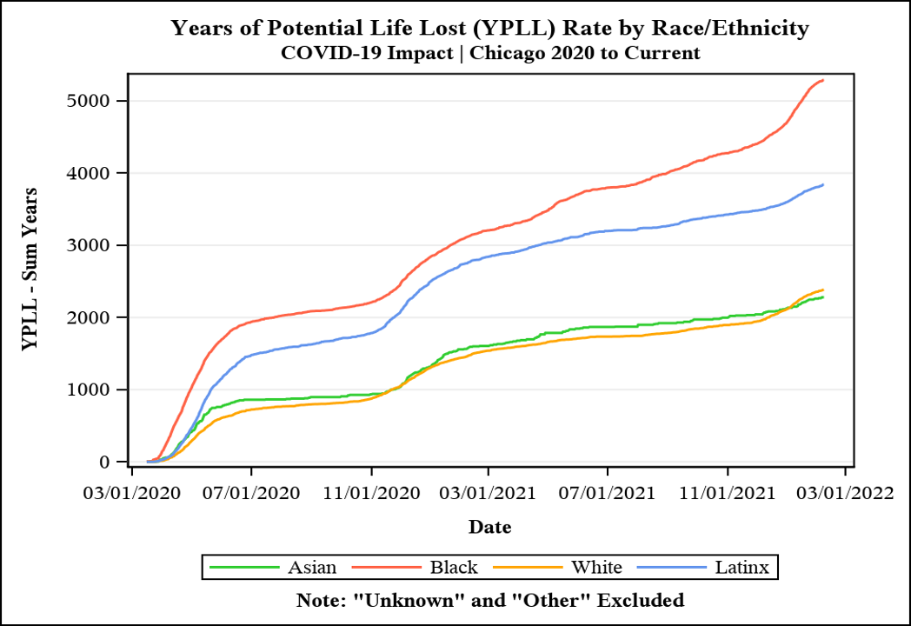
YPLL_{LE} Trends (Years|Rate) by Race/Ethnicity
Both graphs indicate a widening divergence between White/Asian Chicagoans and Black/Hispanic Chicagoans
with an increasing momentum for Black/White Chicagoans beginning around the New Year (2022)

Slide 12
Limitations of Study
Inherit rounding errors as values were rounded to one significant digit.
Due to delays in reporting, values that are more recent may change.
Unadjusted rates are calculated using the estimated population data for Chicago 2020.
YPLL each year of life lost equally rather than each death equally.
Life Expectancy (LE) for under 70 years old used the mean LE for Chicago. However, that value can vary from 72.4 years to 84.7 years. The age of death by race/eth was not available for this analysis, and thus the mean for Chicago as a whole was used.
Days with no deaths were excluded from this study.
Exact age at time of death was not available, data was only available by age groups, thus the midpoint age for each age group was used to derive remaining expected years of life.
YPLL is not useful in differentiating the most healthy and least healthy populations overall.

