Slide 1



CareerCupid
A Swipe-Based Job Matching App
By Jason Glancy ( C22374581)
Mobile Software Development CMPU3036
Course Code: TU858/3

Slide 2
Purpose of the App
"CareerCupid is a swipe-based job matching app designed to connect job seekers and employers in a quick, easy, and interactive way. With CareerCupid, users simply swipe right to show interest or left to pass, turning the job search process into a smooth, streamlined experience."
What the App Does:
"CareerCupid aims to simplify the local job search and recruitment process. Job Seekers can swipe through job listings from nearby companies, while Employers can browse candidate profiles. When both swipe right, it’s a match – they can connect directly within the app."

Slide 3
Main Features and Target Users
Swipe-Based Matching – Users swipe right if they’re interested in a job or candidate and left to pass.
Two Account Types – Separate experiences for Job Seekers and Employers.
Location-Based Filtering – Connects users with opportunities nearby.
In-App Messaging – Enables communication once there’s a match.
Target Users:
Job Seekers: Local job seekers looking for a fast, engaging way to find opportunities.
Employers: Companies and recruiters who want a quick way to screen and connect with local talent.

Slide 4
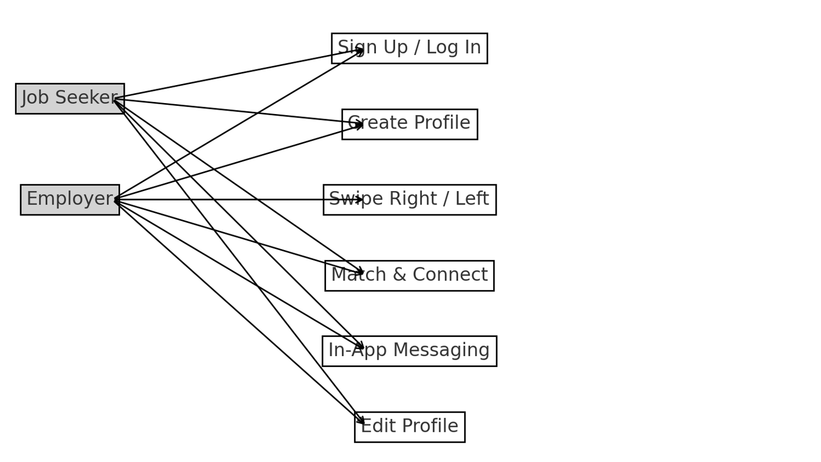
Use Case Diagram

Slide 5
Use case descriptions
Sign Up / Log In: "Users create an account or log in to access the app. This allows them to select their role (Job Seeker or Employer) and start using CareerCupid.“
Create Profile: "Both Job Seekers and Employers create profiles. Job Seekers list skills, experience, and location, while Employers add job details like title, location, and requirements.“
Swipe Right / Left: "Users swipe right to express interest or left to pass. Job Seekers swipe through job listings, and Employers swipe through candidate profiles.“
Match & Connect: "If both Job Seeker and Employer swipe right on each other, they’re matched, allowing them to view each other’s profiles in detail.“
In-App Messaging: "Once matched, users can message each other directly within the app to discuss job details and set up interviews.“
Edit Profile: "Users can update their profiles as needed, such as adding new skills or changing job descriptions."

Slide 6

Screen flow and mockups

Slide 7

CareerCupid's main screens are designed for a simple, intuitive experience. Users can swipe through profiles, view details, connect upon mutual interest, and communicate directly within the app.
Here’s a flow overview and a look at each screen.

Slide 8
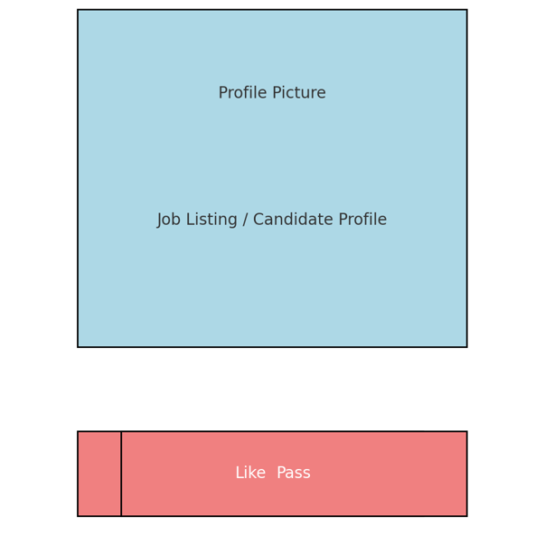
Home / Swipe Screen
This is the main screen where users swipe through profiles. They swipe right to like a job or candidate and left to pass. Clicking on a profile brings up the detailed profile view.

Slide 9
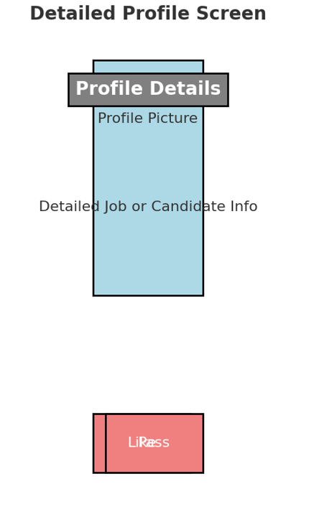
Detailed Profile Screen
The Detailed Profile Screen provides more information about a job or candidate. Users can swipe right to show interest or left to pass directly from this screen.

Slide 10
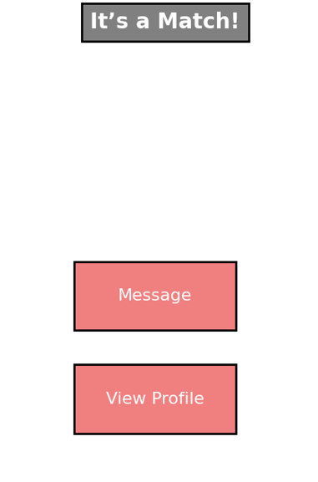
Match Screen
This screen appears when there’s a mutual match. Users can choose to message each other or view the matched profile.

Slide 11
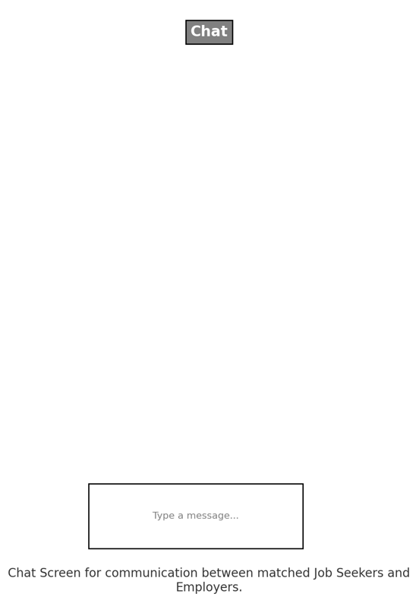
Chat Screen
The Chat Screen enables communication between matched users. They can send messages to discuss the job opportunity or schedule interviews.

Slide 12
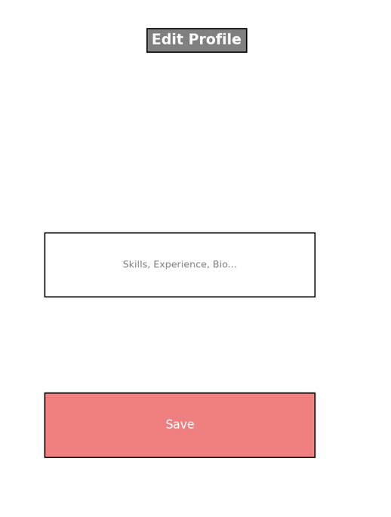
Edit Profile Screen
Users can update their profile information, such as skills, experience, and bio. Employers can also update job listings.

Slide 13
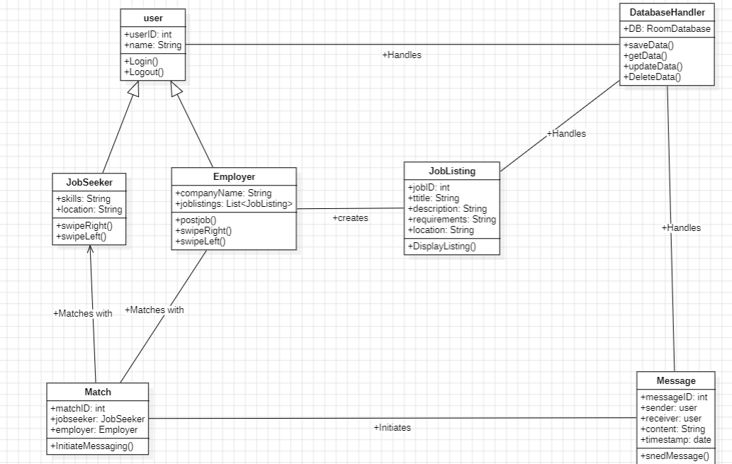
Class Diagram

Slide 14
Class Diagram Overview
The CareerCupid Class Diagram provides a structural overview of the main components in our app, showing how each class interacts to enable core functionality like user matching, job posting, and messaging. This diagram represents relationships, inheritance, and the main operations handled by each class.
Diagram Purpose and Overview: In CareerCupid, each class represents a critical function or entity in the app. For Example, the user class is the foundation for both job seekers and employers, providing shared attributes and methods such as login and logout. From there, JobSeeker and Employer inherit from User to represent two distinct user types, each with specialised methods for swiping, posting jobs, and more.
Additional classes, such as JobListing, Match, and Message, allow for targeted functionality- job listings for employers, matches between job seekers and employers, and messages for communication once matched. The DatabaseHandler class ties everything together by managing the data storage and retrieval operations essential to the app’s functioning

Slide 15
User and Inherited Classes (JobSeeker and Employer)
User Class:
The User class is the base class, representing common properties for all users, such as userID and name. It includes core methods like login() and logout() that allow users to access and exit the app.
JobSeeker Class:
The JobSeeker class inherits from User and includes specific properties like skills and location. This class has methods such as swipeRight() and swipeLeft(), allowing job seekers to show interest in or pass on job listings.
Employer Class:
The Employer class also inherits from User but includes additional properties and methods relevant to job providers, such as companyName and jobListings. Employers can post jobs and swipe on candidates using the postJob(), swipeRight(), and swipeLeft() methods.

Slide 16
JobListing and Match Classes
JobListing Class:
The JobListing class represents job posts created by employers. It includes properties like jobID, title, description, requirements, and location. Employers use the displayListing() method to show the job details to job seekers.
Match Class:
The Match class represents a successful match between a job seeker and an employer. It connects the JobSeeker and Employer classes through mutual interest. The class includes attributes like matchID, jobSeeker, and employer, as well as the initiateMessaging() method, which allows communication between matched users.

Slide 17


Message and DatabaseHandler Classes
Message Class:
The Message class manages the messaging feature in the app. It includes properties like messageID, sender, receiver, content, and timestamp. The sendMessage() method is used to send messages between matched users, enabling direct communication.
DatabaseHandler Class:
The DatabaseHandler class is responsible for managing database interactions, including saving, retrieving, updating, and deleting data. This class interacts with User, JobListing, and Message classes to handle their CRUD operations, using methods like saveData(), getData(), updateData(), and deleteData().

Slide 18

Relationships and Interactions
Inheritance: JobSeeker and Employer classes inherit from the base User class, sharing common attributes and methods but also including their specific functionalities.
Associations:
Employer creates instances of JobListing as job postings.
JobSeeker and Employer connect through the Match class, representing mutual interest.
Match initiates instances of the Message class to allow communication.
Database Handling: DatabaseHandler manages CRUD operations for main entities, ensuring data persistence for users, job listings, and messages.

Slide 19
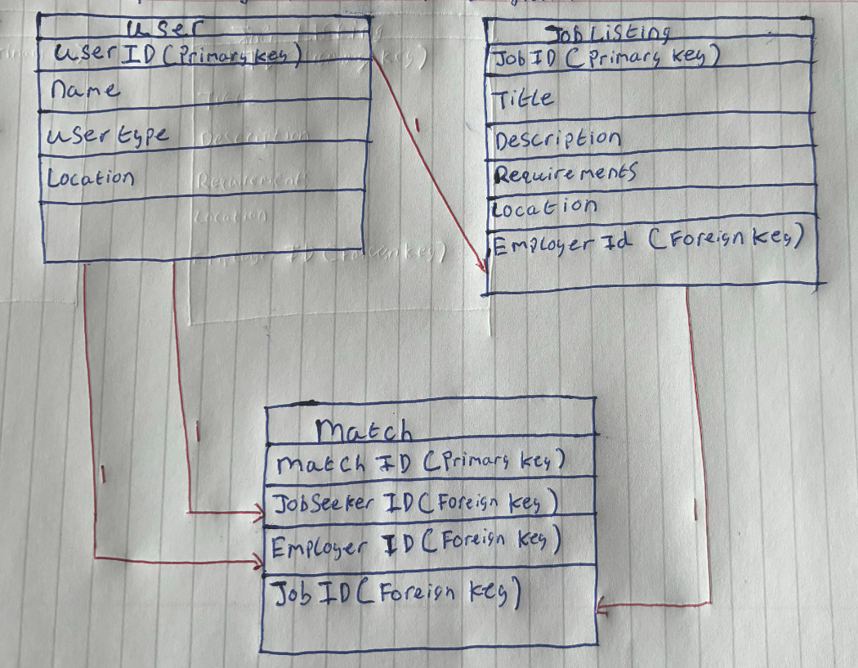
Entity-Relationship Diagram
Overview: The CareerCupid Entity-Relationship Diagram (ERD) showcases the main tables in the database and their relationships, capturing the essential data structure for the app’s functionality. This ERD includes three tables: User, JobListing, and Match, each playing a crucial role in supporting job seeker and employer interactions.

Slide 20

Table Explanations:

Slide 21
User Table
The User table serves as the foundation for managing both job seekers and employers. Each user has a unique userID, which is the primary key, as well as common attributes such as name, userType, and location.
Relationships:
User is linked to the JobListing table through a 1
relationship via employerID, meaning one employer can create multiple job listings.
The User table is also linked to the Match table through 1
relationships via jobSeekerID and employerID, allowing multiple matches for each job seeker and employer.

Slide 22
JobListing Table
The JobListing table represents job posts created by employers. Each listing has a unique jobID as the primary key and additional details like title, description, requirements, location, and a foreign key employerID linking back to the User table.
Relationships:
The JobListing table is associated with the User table (specifically employers) through employerID, showing which employer posted each job.
Each job listing can also be linked to multiple entries in the Match table, indicating which job seekers have shown interest or been matched.

Slide 23
Match Table
The Match table records successful matches between job seekers and employers, connecting them through specific job listings. The matchID is the primary key, while jobSeekerID, employerID, and jobID are foreign keys.
Relationships:
The Match table links back to the User table through both jobSeekerID and employerID, associating a specific job seeker with an employer for a particular job.
Additionally, the Match table links to the JobListing table via jobID, indicating which job listing is associated with each match.

