Slide 1
Flora Friend
Title: Design Diagrams for the MSD App
By Daniel Carson Student No: C21431136
Mobile Software Design

Slide 2
1.- Purpose of the App
FloraFriend is an innovative mobile application designed for indoor plant enthusiasts seeking to gain a better understanding of plant care. As users track and manage their plants, FloraFriend supports users with regular reminders and weather dependent advice.
The app addresses the common challenges of plant care, such as remembering watering schedules, ensuring optimal sunlight, and identifying plants’ needs. By centralising all plant-related activities, FloraFriend simplifies the task of maintaining a thriving plant collection, whether you're a beginner or an experienced gardener.

Slide 3
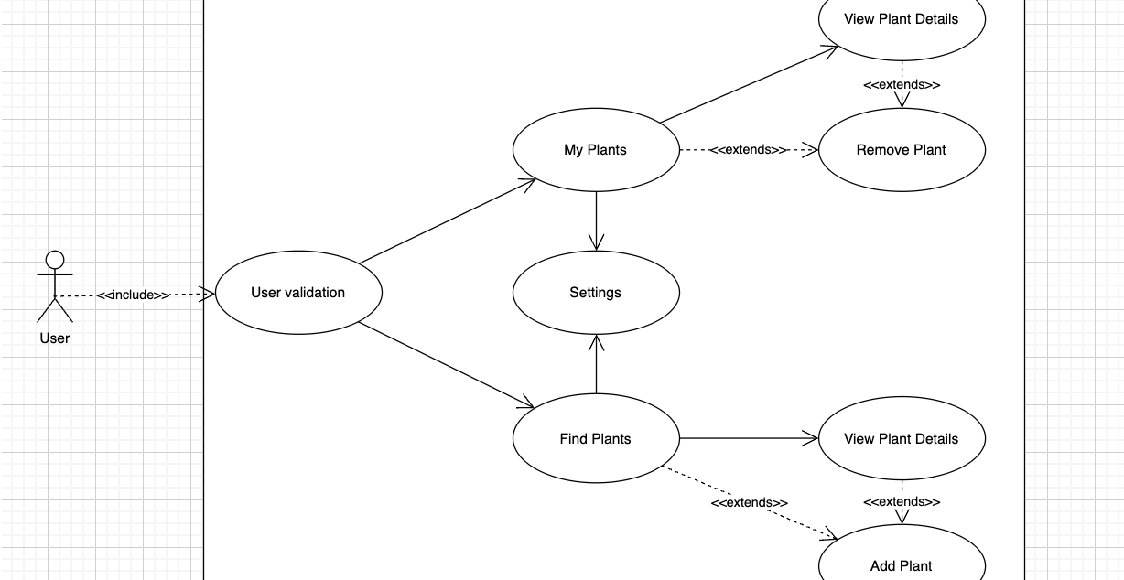
2.- Use-Case Diagram

Slide 4
2. Use Case Diagram Explained
User Validation: Ensures the user is properly authenticated before accessing features such as ‘My Plants’, ‘Find Plants’, or ‘Settings’. This functionality is triggered once the users opens the app.
My Plants: Allows the user to view and manage their personal plant collection. This is the default screen and will be triggered once the user has been authenticated.
View Plant Details (Extends ‘My Plants’): This tab will provide specific information about a plant within the user’s collection. This function is optional and will only be triggered when queried by the user. Detailed information on plant care such as watering schedules and growth history will be displayed.

Slide 5
2. Use Case Diagram Explained
Remove Plant: Allows the user to delete a plant from their personal collection. This option is only available from the ‘My Plants’ screen and will trigger a deletion of data related to that plant.
Settings: This options allows for the configuration of preferences and settings by the user. It is triggered when the user clicks on the settings icon which is available on both the ‘My Plants’ page and the ‘Find Plants’ page.
Find Plants: This feature enables the user to browse or search for new plants to add to their collection and is triggered once the user selects the ‘Find Plants’ tab. A catalogue of plants will be displayed with an option to view additional details or to add a plant to their collection.

Slide 6
2. Use Case Diagram Explained
View Plant Details: (Extends ‘Find Plants’): This tab will provide specific information about a plant within the apps collection. This function is optional and will only be triggered when queried by the user. Detailed information on plant care such as recommended watering schedules before they opt to add the plant to their collection.
Add Plant: Allows the user to add a selected plant from the ‘Find Plants’ catalogue to their personal collection. Once the plant is added, it becomes available on the ‘My Plants’ tab.

Slide 7
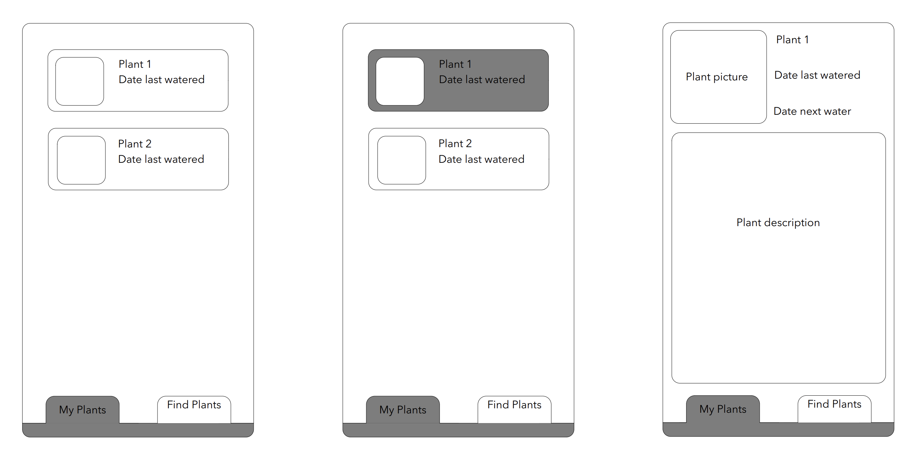
3.- Screen flow – My Plants

Slide 8
3. Screen flow – My Plants
RecyclerView: Displays a dynamic list of plants with key details such as the name, scientific name and the date last watered.
Additional info: Users are welcome to click into the plant card to view additional information such as the next water date and plant description.

Slide 9
3. Screen flow – My Plants
RecyclerView: Displays a dynamic list of plants with key details such as the name, scientific name and the date last watered.
Additional info: Users are welcome to click into the plant card to view additional information such as the next water date and plant description.
Delete: Users can delete plants from their portfolio on the additional info screen.

Slide 10
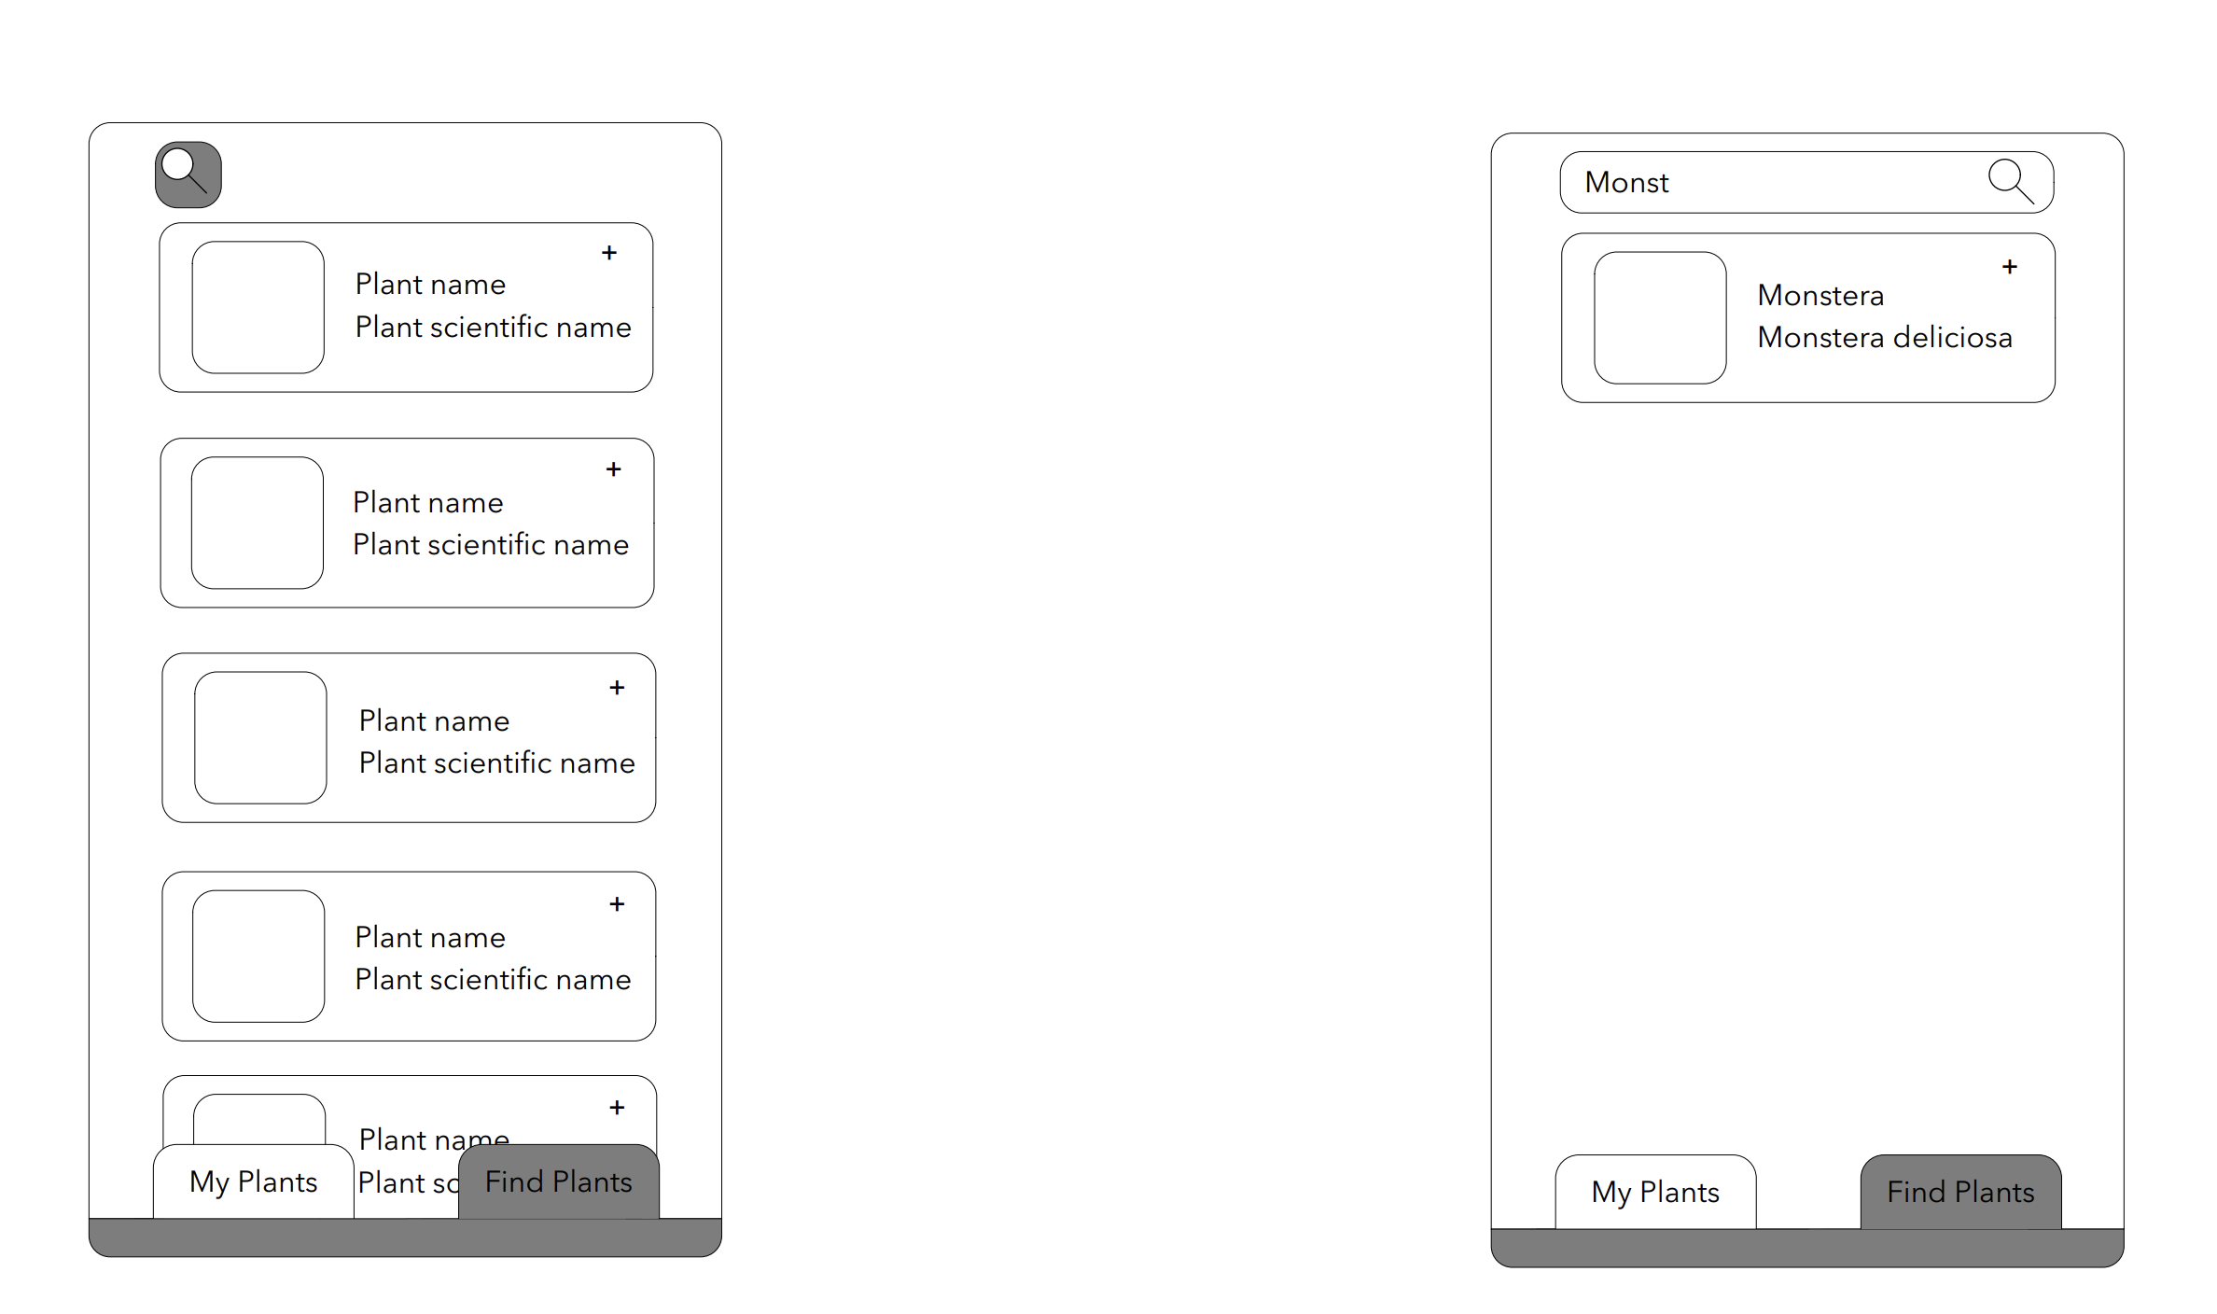
3. Screen Flow – Find Plants

Slide 11
3 Screen Flow – Find Plants
Search Button: An extendable button is located on the top left corner.
Search function: On click, the button will expand to allow user input. Partial matches and incorrect capitalisation are accepted.
Filter: Once a match is found, all plants except the matching result are dropped from the Recycler view in a user friendly way.

Slide 12
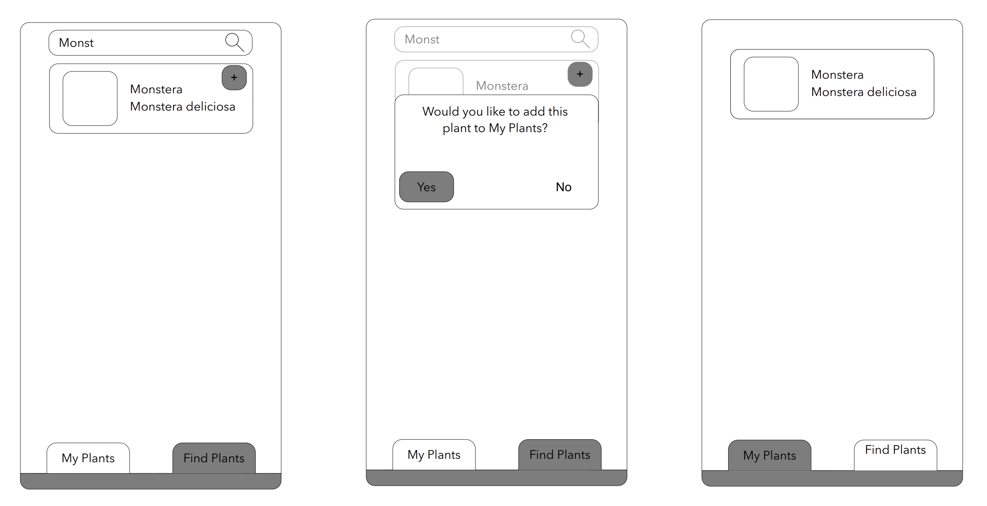
3. Screen Flow – Find Plants

Slide 13
3 Screen Flow – Adding Plants
Fragments: The tab bar invokes the use of fragments to allow for seamless navigation throughout the app.
Add Button: Once the desired plant is identified, the user is encouraged to add it to their ‘My Plants.
Confirmation: A confirmation menu is used to ensure the user has made the right choice.
Fragments 2: Once the user has added the plant, it appears within their existing portfolio on the ‘My Plants’ fragment.

Slide 14
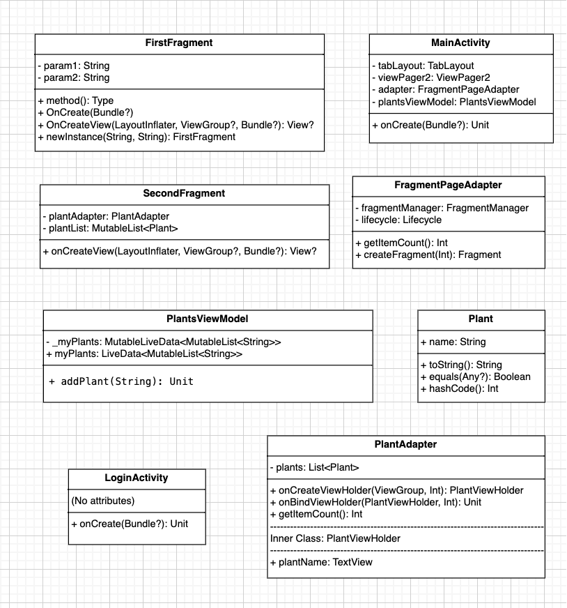
4.- Class Diagrams

Slide 15
4.- Class Diagrams
FirstFragment: This represents a UI fragment within the app and is specifically associated with the tab functionality.
SecondFragment: Represents another UI fragment within the system and similar to the FirstFragment, is associated with tab functionality.
FragmentPageAdapter: Serves as an adapter for managing multiple fragments – tabs in this case – within the FloraFriend system. More specifically, FragmentPageAdapter manages fragment lifecyles, displays the appropriate fragment and tracks the number of fragments.

Slide 16
4.- Class Diagrams
Main Activity: Main activity is the central activity of the app and is responsible for managing the main interface elements such as tabs and fragments. It coordinates classes such as TabLayout, ViewPager2 and FragmentPageAdapter to provide seamless navigation throughout.
LoginActivity: Provides a simple login screen for the application. Specifically, LoginActivity loads activity_login.xml and handles and login related logic.
Plant: This class was designed as a data model to represent a plant.

Slide 17
4.- Class Diagrams
PlantAdapter: This custom adapter was designed to manage the list of plants provided for by RecylerView. It binds a list of Plant objects to views for display purposes.
PlantsViewModel: This view model was developed for managing the plant data shared between the MainActivity and fragments. It maintains a list of plants as live data to enable reactive data updates.

Slide 18
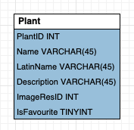
5.- Database Design

Slide 19
5.- Database Design -
PlantID: Unique identifier for each plant in the database.
Name: Common name of the plant (e.g., "Aloe Vera").
LatinName: Scientific name of the plant (e.g., "Aloe barbadensis").
Description: Brief description or additional details about the plant.
ImageResID: Reference to the drawable resource for the plant's image.
IsFavourite: Boolean flag (1 for true, 0 for false) indicating if the plant is marked as a favourite by the user.

