Slide 1
HomeScope
Title: Design Diagrams for the MSD App
By Tadhg Roche Student No: C22348761 Mobile Software Design

Slide 2
1.- Purpose of the App
HomeScope simplifies real estate management by enabling users to add, view, and track property listings effortlessly. With advanced map integration and an owner leaderboard, users can make informed decisions and connect with top property owners. Ideal for buyers, sellers, and real estate enthusiasts, HomeScope offers an all-in-one platform for seamless property exploration.
Key Features:
Property Management: Add and manage property details with images.
Map Integration: View properties on a map, with clickable markers for more details.
Dynamic Updates: Auto-update markers when properties are added or removed.
Owner Leaderboard: Sort by rating or properties sold to discover top property owners.
Contact Page: Simple and direct communication channel.
Buyers, sellers, and real estate enthusiasts looking for a comprehensive property management and exploration tool.

Slide 3
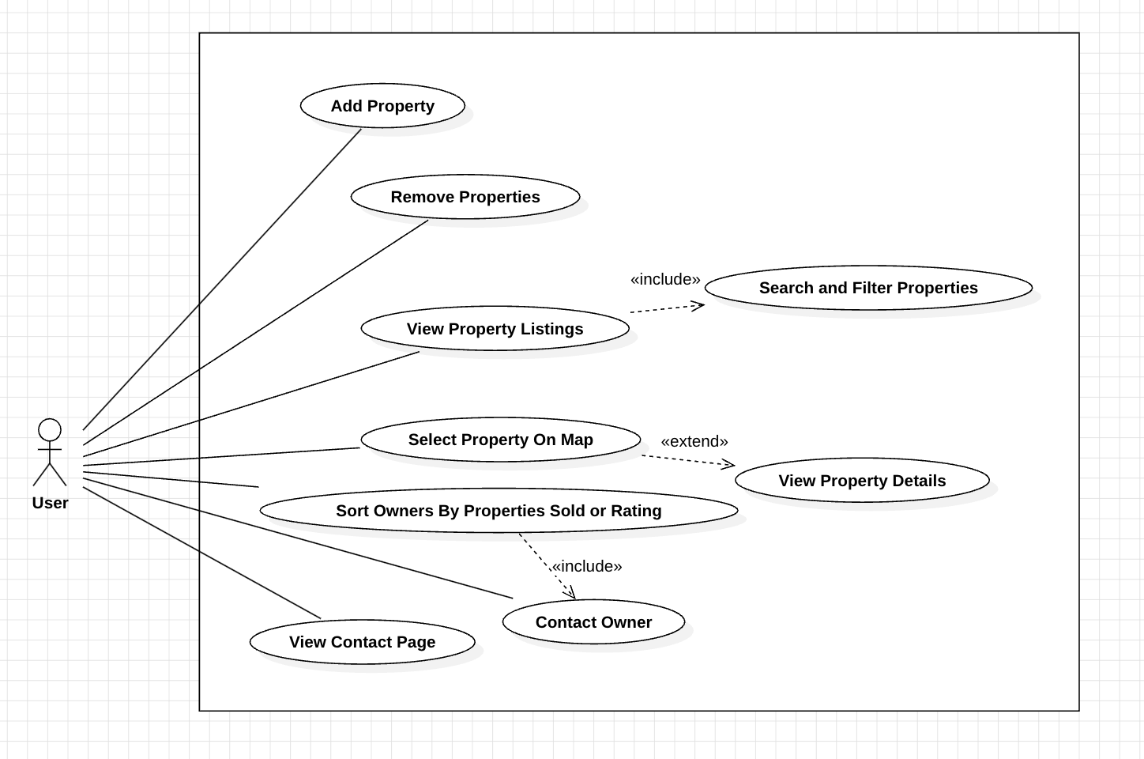
2.- Use-Case Diagram - 1
This use case diagram illustrates the main functionalities of the HomeScope app. Further explanation of each feature will be included on the next slide.

Slide 4
2.- Use Case Diagram Explained
Add Property: Users can add a new property to the app by entering essential details such as title, price, location, type, and image. This feature allows users to manage and expand their property listings, ensuring their database is comprehensive and up-to-date.
Remove Properties: Users have the option to remove properties from the existing listings, which helps them maintain accuracy and relevancy within the app's property data.
View Property Listings: This feature enables users to browse through a list of available properties, displaying key information like price, location, and type. Users can easily access detailed property information, enhancing their search experience. This use case includes the ability to Search and Filter Properties for a more refined view.

Slide 5
2.- Use Case Diagram Explained
Search and Filter Properties: Users can perform searches for specific properties based on title or location and apply filters such as price range, property type, or year built. This allows users to quickly locate properties that match their criteria and preferences. This use case is part of View Property Listings to make searching more efficient.
Select Property On Map: Users can select property markers displayed on an interactive map. Clicking on a marker shows basic property information, offering a visual way to explore properties by their geographical location. This use case extends View Property Details for those wanting more comprehensive information.
View Property Details: Users can view in-depth details of a selected property, including images, price, location, and property type. This use case provides users with all relevant information to make informed decisions and is extended by the Select Property on Map feature.

Slide 6
2.- Use Case Diagram Explained
Sort Owners by Properties Sold or Rating: Users can sort the list of property owners based on the number of properties sold or by their ratings. This functionality helps users identify top-performing owners quickly and efficiently.
Contact Owner: Users can contact property owners directly from the owner's page, which displays a list of owners and allows direct communication for inquiries or potential deals.
View Contact Page: Users can access a static contact page within the app that provides general information on how to reach the app's support or administrative team. This use case helps users who need assistance or want to make general inquiries.

Slide 7
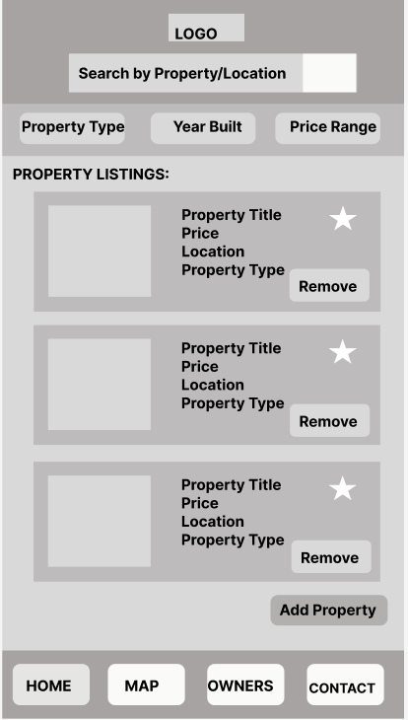
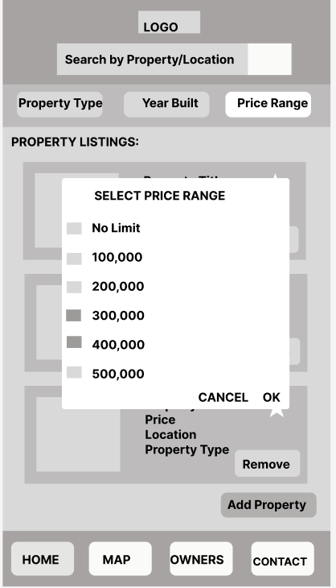
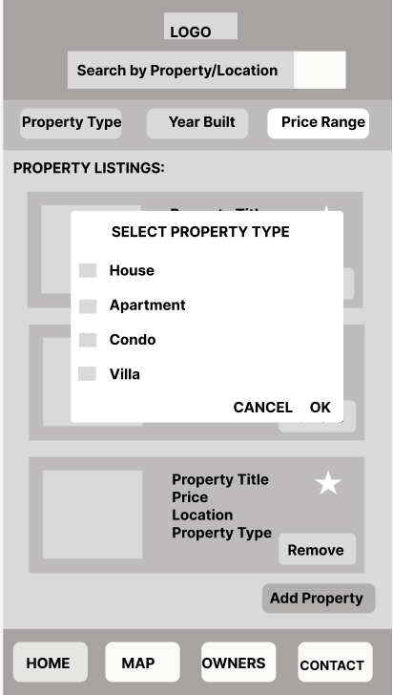
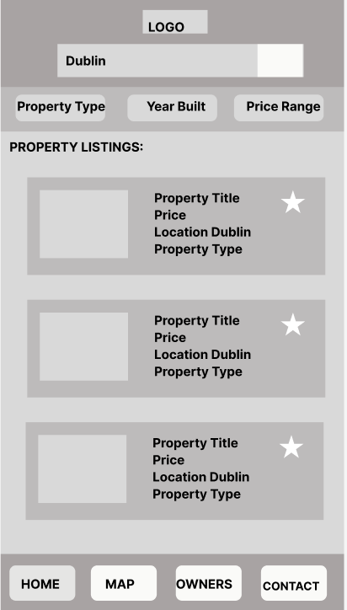
3.- Screen flow – Home Page

Slide 8
3.- Screen flow – Home Page Explained
RecyclerView: Displays a dynamic list of properties with key details (title, price, location, type, image) and allows users to remove or favorite properties directly.
Live Search: A search bar enables real-time filtering by keywords (e.g., location, title), streamlining the process of finding specific properties.
Filter Options: Includes buttons for filtering by property type, year built, and price range, helping users narrow down results.
Add Property Button: A dedicated button allows users to add new property details seamlessly.
Fragment Navigation: A bottom navigation bar provides quick access to the Home, Map, Owners, and Contact sections for easy navigation.

Slide 9
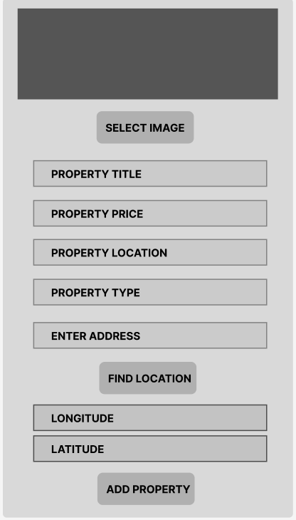
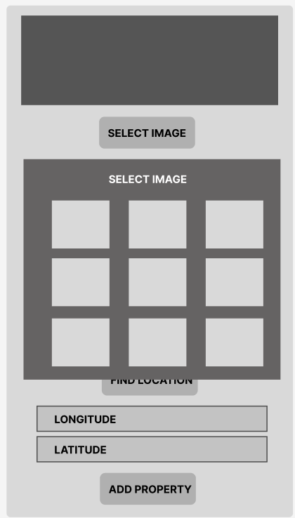
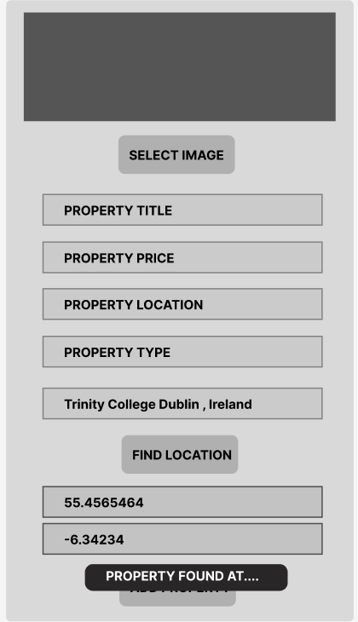
3.- Screen flow – Add Property Page

Slide 10
3.- Screen flow – Add Property Page Explained
Select Image Button: Users can pick images from a pre-set gallery to visually represent the property.
Input Fields: Includes fields for property title, price, location, and type, ensuring comprehensive property data is captured.
Enter Address & Find Location: A dedicated address input field works with the Find Location button to utilize geocoding, automatically filling in latitude and longitude for accurate mapping.
Add Property Button: Finalizes the process, adding the property to the home page listings and map.

Slide 11
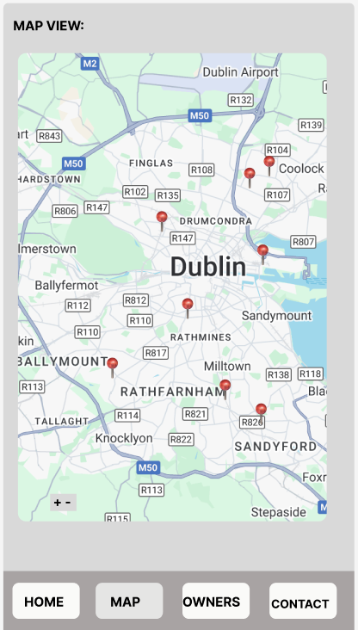
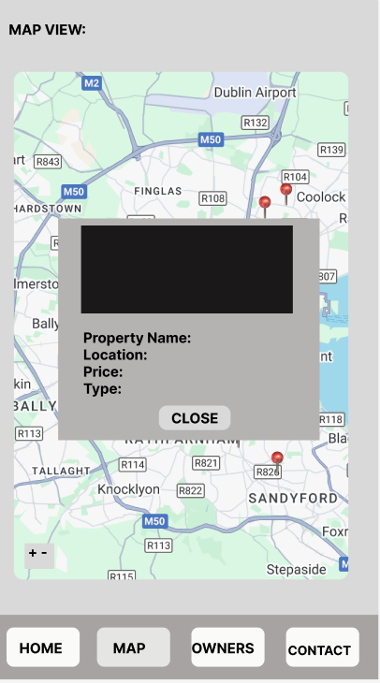
3.- Screen flow – Map Page

Slide 12
3.- Screen flow – Map Page Explained
Property Markers: Displays pins for each property, enabling users to visually identify property locations at a glance.
Clickable Markers: Selecting a marker shows a detailed popup with the property’s name, location, price, and type.
Detailed Popups: Enhances user interaction by presenting essential property information directly on the map view.
Close Button: Allows users to exit the property details popup seamlessly and continue browsing other map markers.

Slide 13
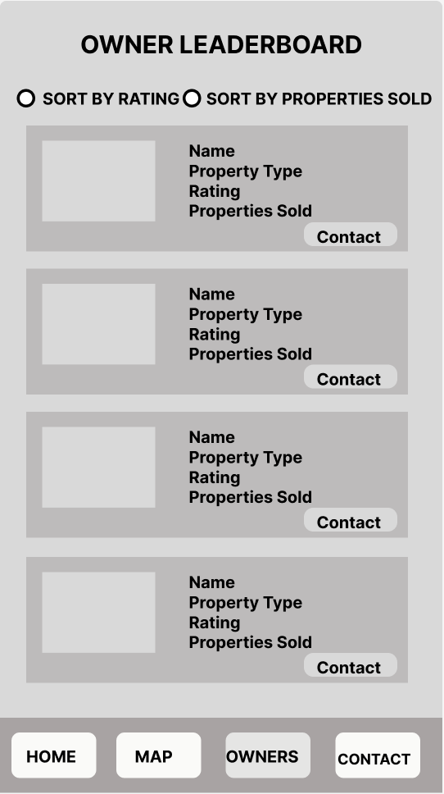
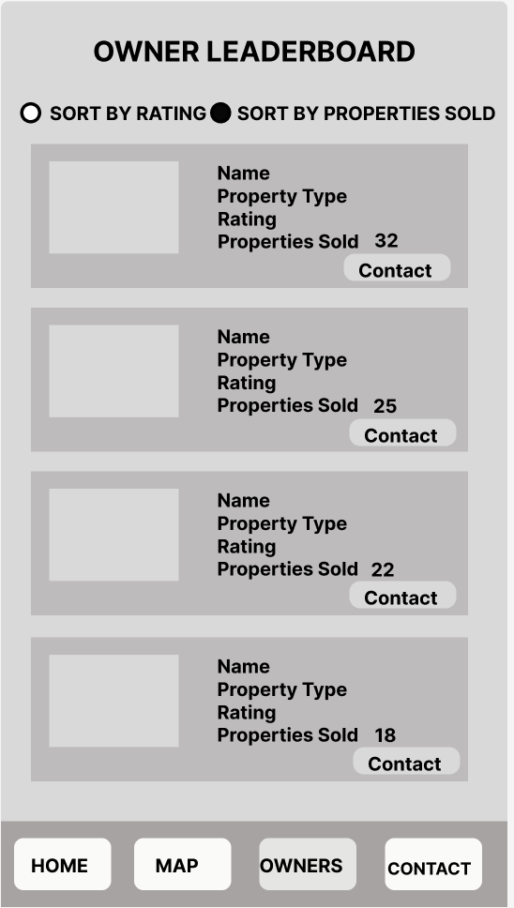
3.- Screen flow – Owners Page

Slide 14
3.- Screen flow – Owners Page Explained
Owner Leaderboard: Displays each owner's name, property type, rating, and total properties sold for a quick performance overview.
Sorting Options: Users can switch between sorting by rating or number of properties sold, allowing customized insights into top performers.
Contact Button: Each owner entry includes a Contact button. When clicked, it displays a pop-up with the owner's contact information, facilitating easy communication for further inquiries or deals.

Slide 15
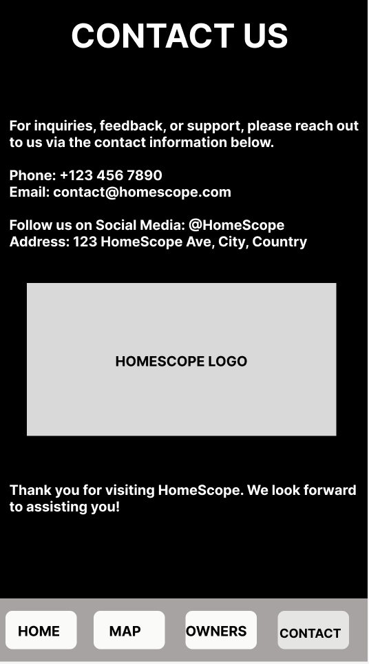
3.- Screen flow – Contact Page

Slide 16
3.- Screen flow – Contact Page Explained
Contact Information: Includes a phone number, email address, and social media handle, ensuring users have multiple ways to get in touch.
Company Address: Offers a clear address for physical correspondence if needed.
Logo: Displays the HomeScope Logo.
Footer Message: Displays a friendly note inviting future communication.

Slide 17
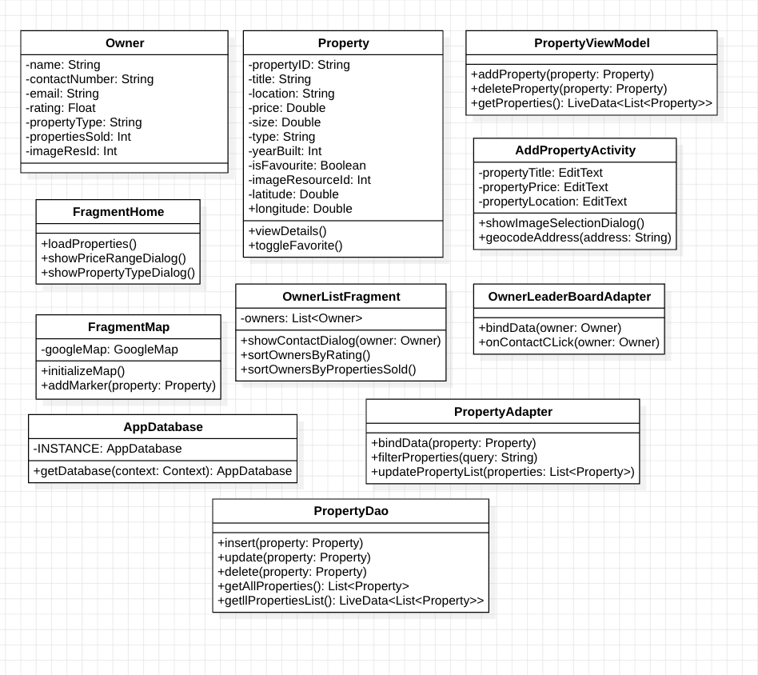
4.- Class Diagrams

Slide 18
4.- Class Diagrams Descriptions
Owner: Represents property owners and their associated information such as contact details, rating, and property type.
Property: Defines the structure for property listings, including essential details like title, location, price, type, and coordinates for mapping.
PropertyViewModel: Acts as a bridge between the UI components and the data layer, managing the lifecycle of Property data and facilitating operations like adding or deleting properties.
AddPropertyActivity: Provides a user interface for adding new properties, including functions for image selection and geocoding addresses to obtain latitude and longitude.

Slide 19
4.- Class Diagrams Descriptions
FragmentHome: Displays the main list of properties, enables searching and filtering, and manages interactions like adding or deleting properties.
FragmentMap: Integrates with Google Maps to display property markers based on their coordinates, allowing users to visualize property locations and access details.
OwnerListFragment: Displays a leaderboard of property owners with sorting options based on properties sold or ratings, and allows viewing contact information for each owner.
OwnerLeaderBoardAdapter: Binds owner data to the RecyclerView in the OwnerListFragment and manages user interactions like clicking to view contact details.

Slide 20
4.- Class Diagrams Descriptions
PropertyAdapter: Binds property data to the Recycle View in FragmentHome and supports filtering properties by query, type, or price.
AppDatabase: Serves as the main access point for the app's Room database, holding a reference to PropertyDao for performing CRUD operations.
PropertyDao: Provides methods for database operations such as inserting, updating, deleting, and retrieving properties, supporting the AppDatabase for CRUD functionality.

Slide 21
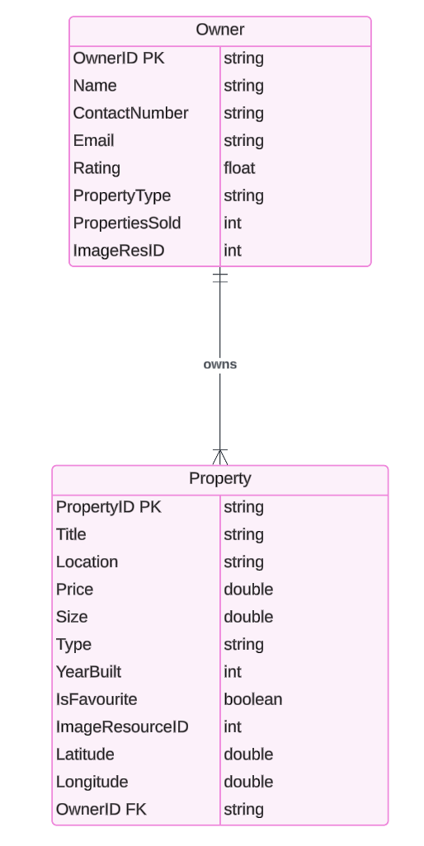
5.- Database Design

Slide 22
5. ERD Diagram Explanation
Owner Table
Purpose: This table represents property owners within the HomeScope app. It contains all relevant details about each owner.
Attributes:
OwnerID (Primary Key): Unique identifier for each owner.
Name: The name of the property owner.
ContactNumber: Phone number for contacting the owner.
Email: Owner's email address.
Rating: Average rating of the owner.
PropertyType: The type of properties the owner manages (e.g., Apartment, House).
PropertiesSold: Total number of properties sold by the owner.
ImageResID: Reference to the owner's image.

Slide 23
5. ERD Diagram Explanation
Property Table
Purpose: This table holds information related to the properties listed in the app.
Attributes:
PropertyID (Primary Key): Unique identifier for each property.
Title: Title or name of the property.
Location: Address or location of the property.
Price: Price of the property.
Size: Size of the property in square meters/feet.
Type: Type of property (e.g., House, Condo).
YearBuilt: The year the property was constructed.
IsFavourite: Indicates whether the property is marked as a favorite.
ImageResourceID: Reference to an image of the property.
Latitude: Geographical latitude of the property.
Longitude: Geographical longitude of the property.
OwnerID (Foreign Key): References the OwnerID in the Owner table, linking each property to its owner.

Slide 24
5. ERD Diagram Explanation
Relationship:
One-to-Many: The relationship between the Owner and Property tables indicates that one owner can have multiple properties, but each property can only be owned by one owner. This is represented by the foreign key OwnerID in the Property table, which references the primary key OwnerID in the Owner table.

