Slide 1
DSC 680 Milestone 3
Level 2 Charging Infrastructure Planning
for Commercial Fleets
Core question
What charging infrastructure will the fleet need — and what should it plan to spend before moving into detailed engineering?
A planning model for charger needs, feasibility, and early infrastructure cost ranges
Dan Morrow
Bellevue University | Applied Data Science
DSC 680 Milestone 3 | Level 2 charging infrastructure planning
1
Notes:
Open by framing this as a planning problem, not an engineering design. The point of the project is to help fleet planners get an early answer on charging need, feasibility, and cost before they commit to detailed site work.

Slide 2
Business problem
Fleets need a clearer early estimate of infrastructure spending.
The fleet decision is not just “Which EV?”
Level 2 only
It is also “What charging infrastructure will we need, and what will it cost?”
Audience question: Why not DCFC?
Because this project reports Level 2 constraints instead of changing the scope.
• Infrastructure costs vary by daily energy demand, charger power, charging window, and site complexity.
• Underbuilding can create operational bottlenecks; overbuilding can waste capital upfront.
• This project creates a planning-level way to estimate charger count, feasibility, and cost ranges.
Planning ranges
Costs are screening estimates, not site-specific quotes.
Budget first pass
The output helps decide what should move to site assessment.
DSC 680 Milestone 3 | Level 2 charging infrastructure planning
2
Notes:
This slide is the practical business case. Fleets may have interest in electrification, but the hard question is what infrastructure they need and what it might cost. This project keeps the scope intentionally narrow: Level 2 infrastructure planning, cost ranges, and screening feasibility.

Slide 3
How the model works
A transparent scenario model, not a black-box prediction.
1
2
3
4
5
Fleet DNA
Primary cohort
Energy demand
Level 2 scenarios
Cost range
Vehicle-day data
from public fleet
operating records
373 selected
vehicles across
53 deployments
90th-percentile
mileage × class
kWh/mile ÷ 90%
7.2, 11.5, and
19.2 kW across
8, 10, and 12 hours
Low, typical, and
high equipment +
installation estimates
Audience question: What does screening-feasible mean?
Audience question: Why scenarios instead of prediction?
It means aggregate energy, highest-demand vehicle, and port-count checks all pass. It does not prove the site is buildable.
The data do not include observed charger count, final installed cost, or project success. The model keeps assumptions visible and auditable.
DSC 680 Milestone 3 | Level 2 charging infrastructure planning
3
Notes:
Summarize this quickly. The analysis starts with Fleet DNA operating data, selects operationally suited vehicles, converts mileage to grid energy, tests Level 2 power and charging windows, and then applies cost assumptions. The key is transparency: these are scenarios, not learned predictions.

Slide 4
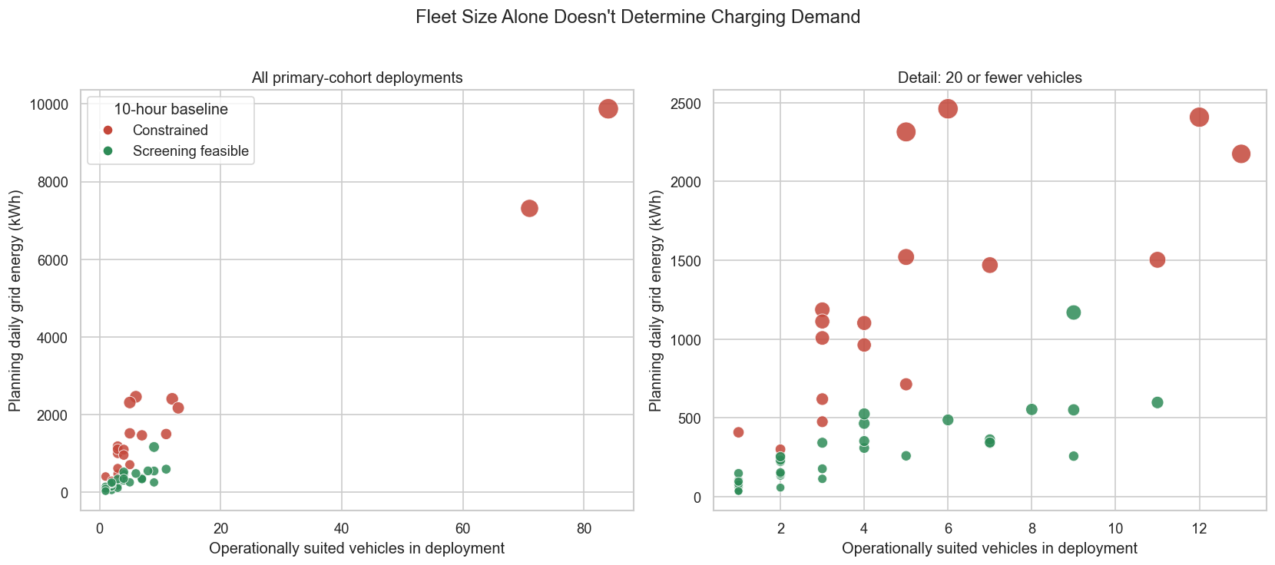
Finding 1: fleet size alone is not enough
Similar fleet sizes can create very different charging needs.
Audience question
Can fleet size alone budget chargers? No. Vehicle count is only a starting point because mileage, class, and duty cycle change daily energy demand.
Audience question
What should fleet planners use instead of fleet size alone?
Use operating data before budgeting chargers. Similar-sized depots can land in very different cost and feasibility ranges.
Figure 2: Fleet Size Alone Does Not Determine Planning Energy.
DSC 680 Milestone 3 | Level 2 charging infrastructure planning
4
Notes:
Use this figure to show why the model is needed. The dots show primary-cohort deployments, with colors based on the 10-hour baseline. The takeaway is that fleet size matters, but it does not determine energy demand by itself.

Slide 5
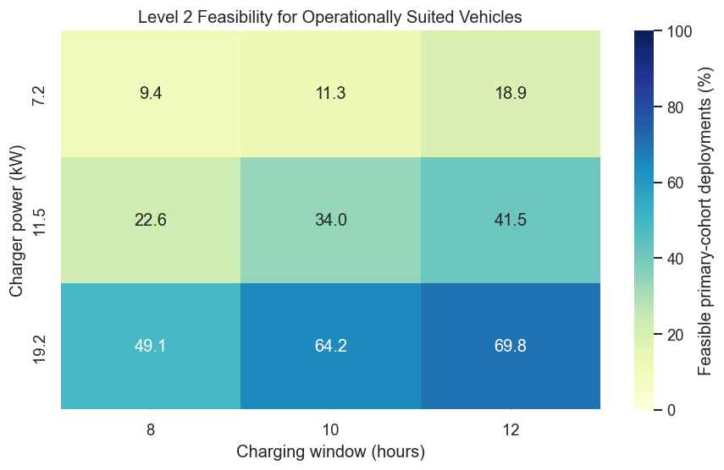
Finding 2: charger power drives feasibility
Audience question: Would longer windows solve constrained cases? They help, but higher Level 2 power mattered more in this range.
34 of 53
deployments were screening-feasible under the 10-hour baseline.
64.2%
feasible at 19.2 kW and 10 hours.
26 of 34
baseline-feasible deployments required the 19.2 kW option.
Figure 3: Screening Feasibility Improves With Charger Power and Time.
DSC 680 Milestone 3 | Level 2 charging infrastructure planning
5
Notes:
This is the centerpiece of the results. At the 10-hour baseline, the lower-power chargers do not cover many deployments, while 19.2 kW reaches about 64 percent. Longer dwell windows improve the result, but charger power is the bigger lever across the tested cases.

Slide 6
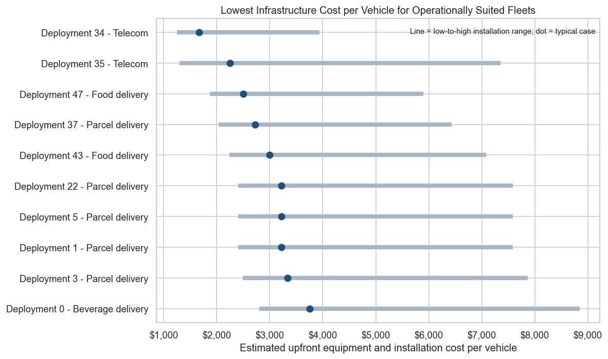
Finding 3: costs need to be shown as ranges
A single dollar estimate would create false precision.
Median feasible deployment
Typical upfront estimate: about $15,000. Low-to-high planning range: about $11,200 to $35,400.
Median per vehicle
Typical estimate: about $4,500 per vehicle. Low and high medians: about $2,800 and $13,275.
Audience question
Is this a final quote? No. The range is a planning estimate; sites still need utility, electrical, layout, and vendor review.
Figure 4: Lowest Planning Cost per Vehicle Under the 10-Hour Baseline.
DSC 680 Milestone 3 | Level 2 charging infrastructure planning
6
Notes:
Bring the story back to the business problem. The model provides budget ranges instead of one exact number. This is important because installation can vary widely by site conditions. The chart shows the lower-cost examples, but it is not a priority ranking.

Slide 7
Recommendation
Use the model as an early project-screening tool.
Move forward when...
Pause or redesign when...
• The deployment passes the 10-hour Level 2 baseline.
• Cost range is reasonable for the planning stage.
• Operations can confirm dwell time and parking assumptions.
• Facilities and the utility can review electrical capacity.
• Level 2 cannot meet planning energy in the tested window.
• The highest-demand vehicle fails the individual energy check.
• Required ports exceed selected vehicles or layout looks unrealistic.
• Cost range suggests a site-specific assessment is needed first.
Audience question: What must be verified before buying equipment? Actual schedules, parking layout, electrical capacity, permits, and vendor quotes. Because in the end, this is a budgeting and screening model, not a construction-ready charging design.
DSC 680 Milestone 3 | Level 2 charging infrastructure planning
7
Notes:
The recommendation is intentionally cautious. Feasible deployments should move to detailed assessment. Constrained deployments should not be discarded immediately, but they should be reviewed for longer windows, managed charging, staggered schedules, or other charging strategies.

