Slide 1
DSC670 FINAL PROJECT
Commercial Fleet EV
Incentive Assistant
A Streamlit prototype using my fully fine-tuned model
and the official DTE eFleet Level 2 program
Dan Morrow
Bellevue University
November 9, 2026
Notes:
Fleet charging incentives can help with a project’s cost, but a useful conversation depends on knowing which requirements apply and what still needs confirmation. I built a Streamlit application around a model I fully fine-tuned for that planning workflow. The final version uses a dated official DTE eFleet agreement and fictional customer examples. I tested the saved model in Colab and then in the running application on my Mac. Those two evaluations tell different parts of the story.
Sources: https://www.dteenergy.com/us/en/business/service-request/pev/efleet-charger-rebate.html; https://www.dteenergy.com/content/dam/dteenergy/deg/website/business/service-request/pev/efleet-charger-rebate/eFleetChargerRebateAgreement.pdf; executed DSC670_DTE_Full_Fine_Tuning_Morrow_D.ipynb; dte_live_checks_mps.json.

Slide 2
PURPOSE AND SCOPE
The business problem
Sales teams need a clearer way to discuss potential charging incentives without overlooking a requirement or promising unsupported savings.
The planning workflow
Official rules, fictional customers
The assistant reviews customer facts and asks for missing information.
Python checks calculation inputs against the supplied rules.
DTE eFleet Level 2 agreement, September 2026 revision. Reviewed November 8.
Amounts remain subject to DTE caps and review. No live funding lookup.
Dan Morrow, DSC670 Generative AI, November 9, 2026
2
Notes:
The business problem is uncertainty during early project planning. The application narrows the task to one official program so it can make requirements visible instead of guessing at possible savings. The DTE snapshot uses a published ceiling of up to $2,500 per Level 2 port, or $875 for Electric Choice customers. It does not apply the fictional percentage limit or fixed cap from my earlier work. Customer confirmations are supplied inputs, and the application does not independently verify them. DTE still controls compliance, documents, discretionary caps and funding.
Sources: https://www.dteenergy.com/us/en/business/service-request/pev/efleet-charger-rebate.html; September 2026 agreement https://www.dteenergy.com/content/dam/dteenergy/deg/website/business/service-request/pev/efleet-charger-rebate/eFleetChargerRebateAgreement.pdf; source_review/program_snapshot.json and receipt.json.

Slide 3
IMPLEMENTATION
The fine-tuned model and application
Qwen2.5-0.5B-Instruct
All 494,032,768 parameters trainable
Full supervised fine-tuning, without LoRA
Training record | Completed run
Training / validation / test cases | 320 / 64 / 64
Epochs / optimizer steps | 4 / 160
Training time on a Tesla T4 | 32.3 minutes
Streamlit loads verified local weights from run 1bcf2a3b1d8e.
The model proposes a next step. Python checks the facts and any handoff.
Dan Morrow, DSC670 Generative AI, November 9, 2026
3
Notes:
I trained a fresh copy of the same Qwen architecture for the official DTE workflow. All parameters were trainable, so this was full supervised fine-tuning rather than a LoRA adapter. The notebook kept related project variants within their own splits, selected the lowest-validation-loss checkpoint and checked saved file hashes. It then reloaded the exported model for generated-answer testing. The Streamlit loader verifies that same model identity before inference. The three screenshots show the application running on my Mac using MPS.
Sources: Executed notebook cells 6 through 13; recorded_training_summary.json; model manifest fingerprint b7db5471e05d48dd21359849ea9b08ebc337e32ce0b1f395afd938729f35fc0d; model_runtime.py; training_contract.py.

Slide 4
EVALUATION
Notebook tests and live results
Measure | Notebook test | Live app checks
Valid JSON | 64 / 64 | 6 / 6
Correct decision labels | 64 / 64 | 5 / 6
Structured workflow checks | 64 / 64 | 5 / 6
Ready cases with usable handoffs | 24 / 24 | 1 / 2
Manual review: 4 of 6 live cases had an appropriate decision and explanation.
The test cases follow authored templates. The six live development cases use different inputs.
CPU reproduced the MPS responses exactly. These counts do not establish real-world accuracy.
Dan Morrow, DSC670 Generative AI, November 9, 2026
4
Notes:
The notebook’s held-out synthetic cases all passed the decision and structured checks. That set contains four project groups with 16 counterfactual variants each, so it is narrower than 64 independent customers. On the six live development examples, one of two ready cases supplied usable inputs. Manual review found that only four of six cases also gave an appropriate explanation. Electric Choice received an incorrect rejection, while the different-utility case received the right label for the wrong reason. CPU reproduced the same response text as MPS in every case. I reviewed the 16 displayed notebook explanation samples, not a separate file containing all 64 raw generations. There is no before/after generated-answer DTE baseline, so the validation token improvement should not be presented as an answer-accuracy gain.
Sources: Executed notebook generated test metrics; dte_live_checks_mps.json; dte_live_checks_cpu.json; dte_live_manual_review.json.

Slide 5
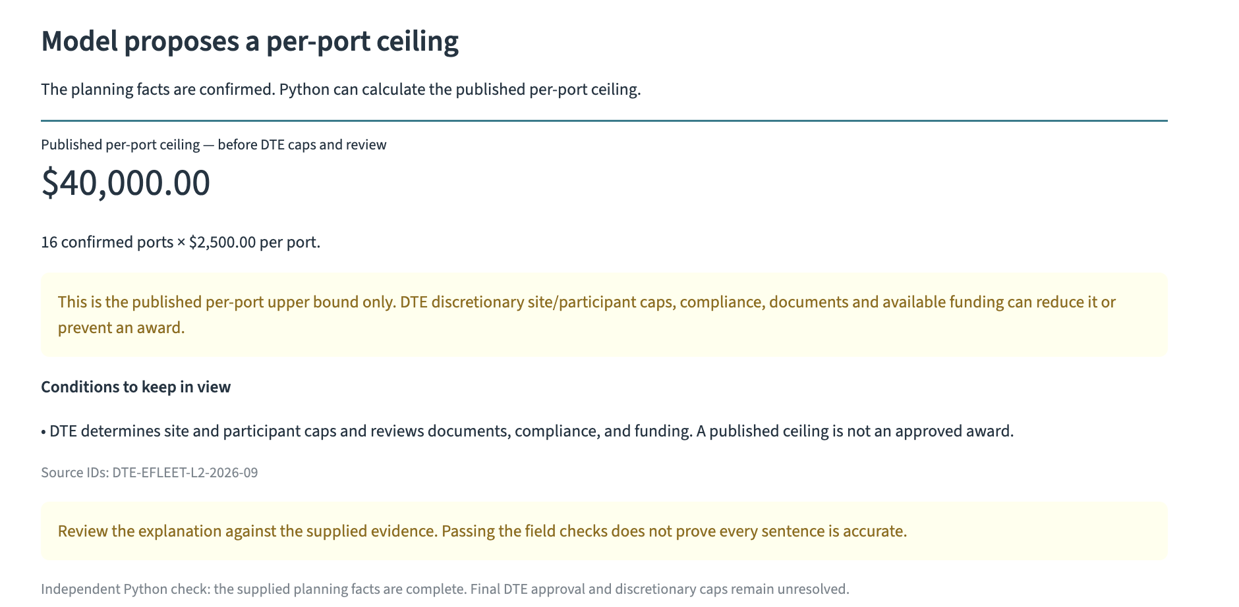
RUNNING APPLICATION
Complete planning example
16 confirmed ports × $2,500 = $40,000 before DTE caps and review. Response: 3.72 seconds.
Dan Morrow, DSC670 Generative AI, November 9, 2026
5
Notes:
The complete standard-customer example worked as intended. The model handed off 16 ports at $2,500 per port, and Python calculated a published ceiling of $40,000. The interface keeps the distinction between that upper bound and a final award visible. DTE caps, funding or compliance review can reduce the amount or prevent payment. The screenshot is a real application result, with the matching raw JSON review retained. This individual review took 3.718 seconds and used 891 input tokens and 137 generated tokens.
Sources: dte_complete_review.json; actual screenshot dte_complete_result.png; https://www.dteenergy.com/content/dam/dteenergy/deg/website/business/service-request/pev/efleet-charger-rebate/eFleetChargerRebateAgreement.pdf.

Slide 6
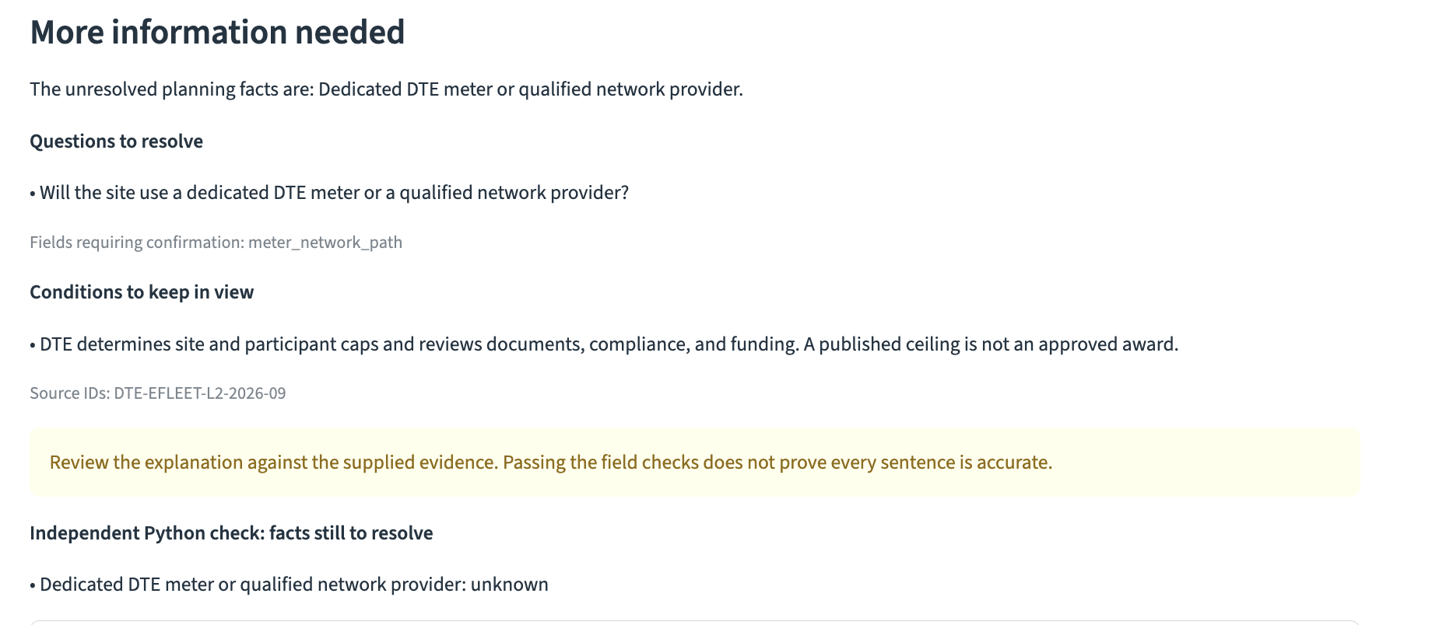
RUNNING APPLICATION
Meter or network path unconfirmed
The model asks about either qualifying option. Python also identifies the missing fact. No amount is calculated.
Dan Morrow, DSC670 Generative AI, November 9, 2026
6
Notes:
With the meter or network arrangement unconfirmed, the assistant asked whether the site would use a dedicated DTE meter or a qualified network provider. That wording preserves the alternative in the program rules. It did not demand both or invent a project-cost prerequisite. Python independently identified the same missing field, and no calculation inputs or amount were produced. This review took 3.145 seconds, with 889 input tokens and 118 generated tokens.
Sources: dte_meter_unknown_review.json; actual screenshot dte_meter_unknown_result.png; https://www.dteenergy.com/content/dam/dteenergy/deg/website/business/service-request/pev/efleet-charger-rebate/eFleetChargerRebateAgreement.pdf.

Slide 7
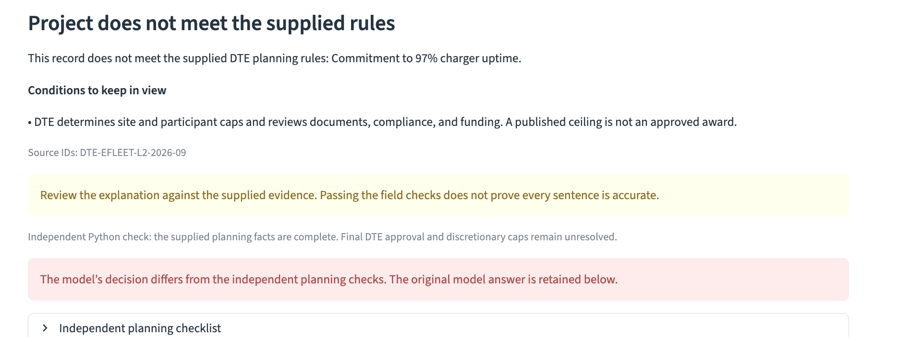
RUNNING APPLICATION
Electric Choice exposes a model error
Uptime is confirmed in the input. The model still rejects it. Python flags the decision disagreement.
Dan Morrow, DSC670 Generative AI, November 9, 2026
7
Notes:
This is the failure I need to keep visible. The customer’s Electric Choice status and uptime commitment are both confirmed, but the model incorrectly rejects the project and blames uptime. The independent Python checklist finds the supplied planning facts complete and flags the decision disagreement. Because the model did not provide calculation inputs, the app displays no amount. The reference published ceiling would be 16 times $875, or $14,000 before caps and review. The separate wrong-utility example reveals another limitation: its rejection label is correct but its uptime explanation is wrong. The current decision comparison does not detect that explanation-only error. This Electric Choice review took 2.565 seconds.
Sources: dte_electric_choice_review.json; actual screenshot dte_electric_choice_disagreement.png; dte_live_manual_review.json; https://www.dteenergy.com/content/dam/dteenergy/deg/website/business/service-request/pev/efleet-charger-rebate/eFleetChargerRebateAgreement.pdf.

Slide 8
CONCLUSION
What the prototype demonstrates
The application runs my fully fine-tuned model against official program evidence and makes its mistakes visible.
What worked
What needs more work
The complete case supplied a supported calculation handoff.
The meter/network case asked for the missing information. Independent checks exposed a conflicting model decision.
The model still makes unsupported claims about confirmed facts.
Broader scenario testing and explanation review are necessary before using it with real customers.
Program source: DTE Energy, eFleet Charger Rebate Agreement, September 2026
Dan Morrow, DSC670 Generative AI, November 9, 2026
8
Notes:
I finished with a working course prototype that uses the saved fully fine-tuned model. The useful result is the combination of a model review, an independent checklist and a visible record of the model’s original answer. The 64-case result alone would have overstated how well the model handled new inputs. The live tests showed why decision labels and explanations need separate assessment. Further development should cover unfamiliar wording, multiple missing requirements and broader combinations of confirmed and failed facts. The current scope stays with fictional customers and one dated official program snapshot. It cannot establish an approved award or replace DTE’s review.
Sources: DTE Energy. (2026, September). eFleet charger rebate agreement. https://www.dteenergy.com/content/dam/dteenergy/deg/website/business/service-request/pev/efleet-charger-rebate/eFleetChargerRebateAgreement.pdf; DTE eFleet program page https://www.dteenergy.com/us/en/business/service-request/pev/efleet-charger-rebate.html (reviewed November 8, 2026); executed notebook; six-case live reports; matching application screenshots.

