Slide 1
Query Evaluation Techniques for Cluster Database Systems
Andrey V. Lepikhov, Leonid B. Sokolinsky
South Ural State University
Russia

Slide 2
Outline
Motivation
Problem Statement
Background
Partial mirroring method
Results
Future work

Slide 3
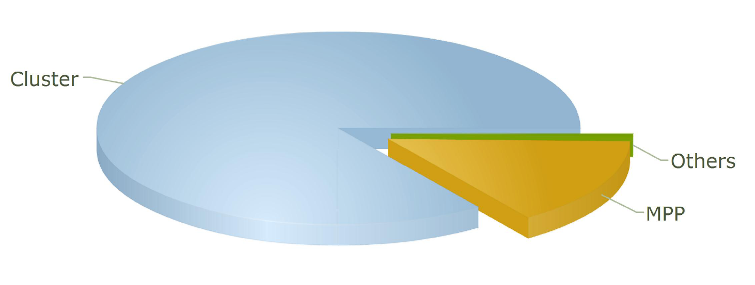

Motivation
Top500
Cluster: 84.8%
MPP: 14.8%
Others: 0.4%
Notes:
This chart is taken from top five hundred list.
We can see that clusters have more then eighty percents.
Why?
Because they are not expensive.

Slide 4
Problem Statement
Not expensive parallel hardware needs not expensive parallel database management system
Today we have no such chip parallel database management system
Notes:
Not expensive parallel hardware needs not expensive parallel database management system.
Today we have no such chip parallel database management system.
I’ll try to explain how we can build not expensive parallel DBMS.

Slide 5
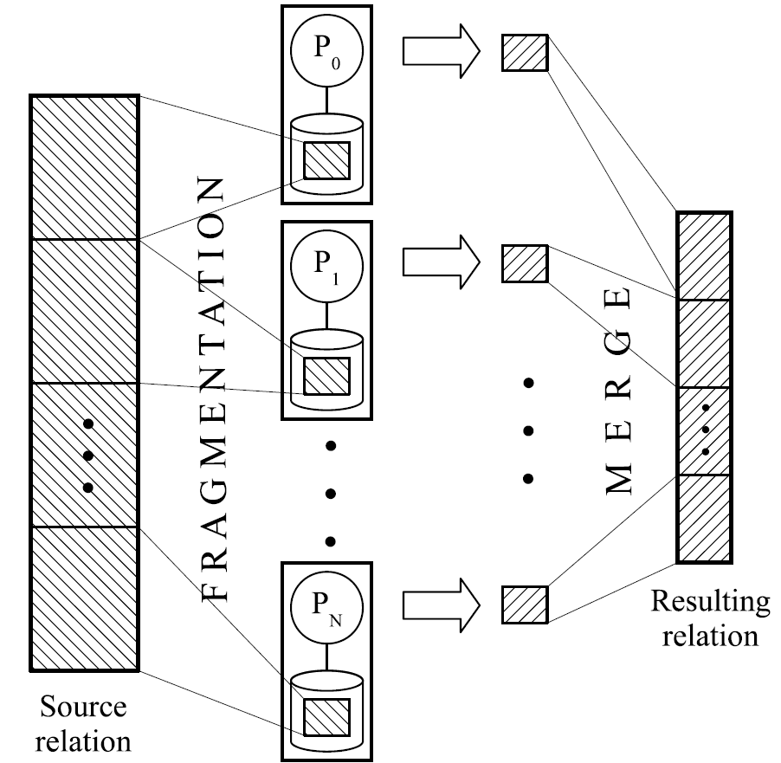
Background
Notes:
Main idea is very simple.
Each relation is divided into a number of disjoint horizontal fragments, which are partitioned into different disk units of cluster.
The query is executed on all cluster nodes by parallel agents. Each agent processes it’s own fragments of
the relations and generates partial query result. These partial results are merged in the resulting relation.

Slide 6
Exchange operator
p: port
ψ: distributing function
Notes:
In general case, it is necessary to perform passing tuples between the cluster nodes in order to obtain the correct result. For managing these communications, we insert the special exchange operator in appropriate points of query execution plan tree. Exchange operator has two parameters:
Port is the index number of the exchange operator in query tree.
Distributing function calculates the number of the cluster node where tuple has to be processed.

Slide 7
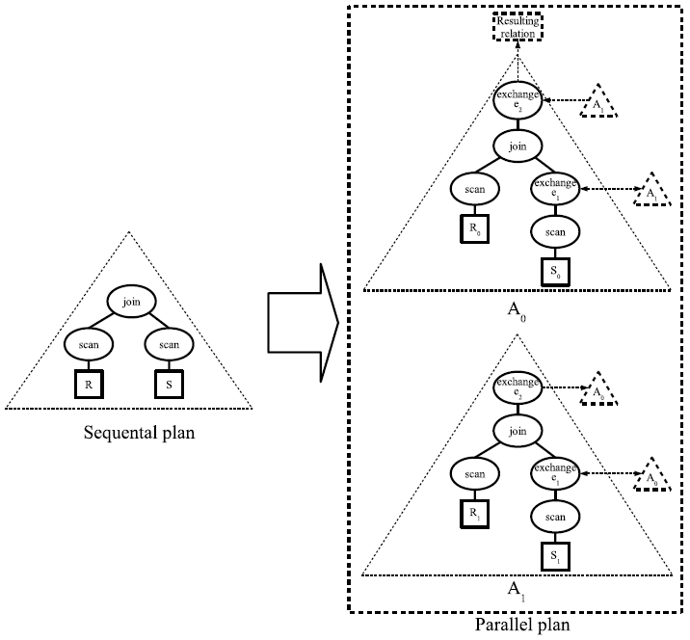
Parallel plan for query Q = RS
Notes:
R is fragmented by join attribute. S is fragmented by another attribute.
We must insert the exchange operator e₁ between the join operator and S scan operator.
To assemble the resulting relation on the dedicated node with number zero, we insert e₂ exchange operator into the root point of the query tree.

Slide 8
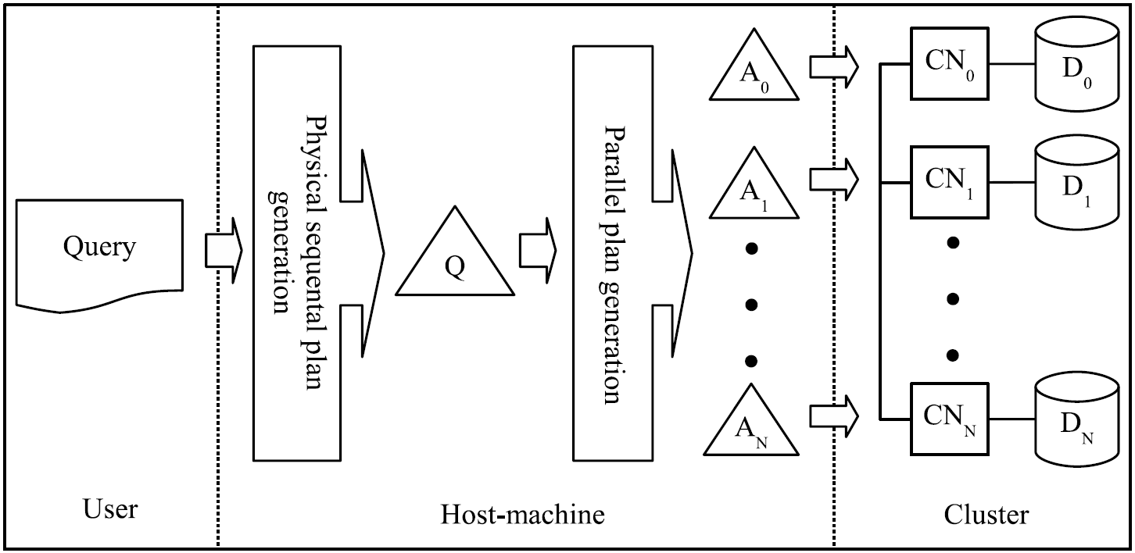
Query processing in cluster system
Notes:
SQL-query processing consists of three stages.
At the first stage, the SQL query is translated into a sequential physical plan.
At the second stage, the sequential physical plan is transformed to the parallel plan being a set of parallel agents. It is obtained by inserting the exchange operator in appropriate points of the plan tree. All parallel agents have the same structure.
At the third stage, parallel agents are spread among cluster nodes where each of them is interpreted by the query executor. Resulting relations produced by the agents are merged through the root exchange operators on the some dedicated node.

Slide 9
The problem
Load balancing
Notes:
To provide high performance we must manage the problem of load balancing.

Slide 10
Partial mirroring method
Fragmentation strategy
Replication strategy
Notes:
To do that we use the partial mirroring method.
It includes fragmentation strategy & replication strategy.

Slide 11
Fragmentation strategy
Source relation
P₀
Relation is divided into fragments distributed among cluster nodes
Each fragment is divided into sequence of segments with an equal length
Segment is the minimal unit of replication

. . .
FRAGMENTATION
. . .
P₁
. . .
. . .
P_{n}
Notes:
Each relation is divided into disjoint horizontal fragments, which are distributed among cluster nodes. We suppose that tuples in the fragment are ordered in a certain way. This order defines the sequence, in which the tuples are being read by the scan operator. We called this order as natural order. In practice, the natural order can be defined by a physical sequence of tuples or by an index.
At the logical level, each fragment is divided into sequence of segments with an equal length. The length of the segment is measured in tuples. This is a system parameter. Dividing tuples into segments is performed by the natural order beginning from the first tuple. The last segment of a fragment can be incomplete.

Slide 12
Replication strategy
R_{i}
ρ_{j} = 50%
Disk D_{i}
Disk D_{j}
Notes:
For each fragment R_{i} allocated on disk D_{i} we build on each disk D_{j} (i <> j) a partial replica R_i_j, which contains some (may be empty) subset of tuples of fragment R_{i}. The size of replica R_i_j is determined by the replication factor p_{j}.

Slide 13
Load balancing method
D₁
D₂
D₁
D₂
- scheduled to process
P₁
- processed
- not used
P₁
P₂
P₂
t₁
t₂
D₁
D₂
D₁
D₂
P₁
P₁
P₂
P₂
t₃
t₄
Notes:
At time t₁ processor P₁ is scheduled to process fragment S1, processor P₂ is scheduled to process fragment S₂.
At time t₂ processor P₁ has done its work. Processor P₂ has done only part of its work.
At time t₃ processor P₁ is scheduled to process replica S12. Processor P₂ is scheduled to process half of the rest.
At time t₃ all parts of the relation are processed.

Slide 14
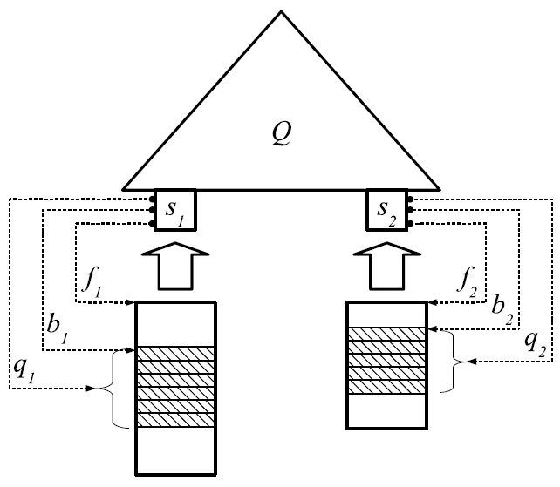
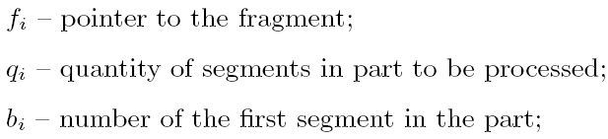
Parallel agent with two input streams
Notes:
f_{i} – pointer to the fragment;
q_{i} – quantity of segments in part to be processed;
b_{i} – number of the first segment in the part;

Slide 15
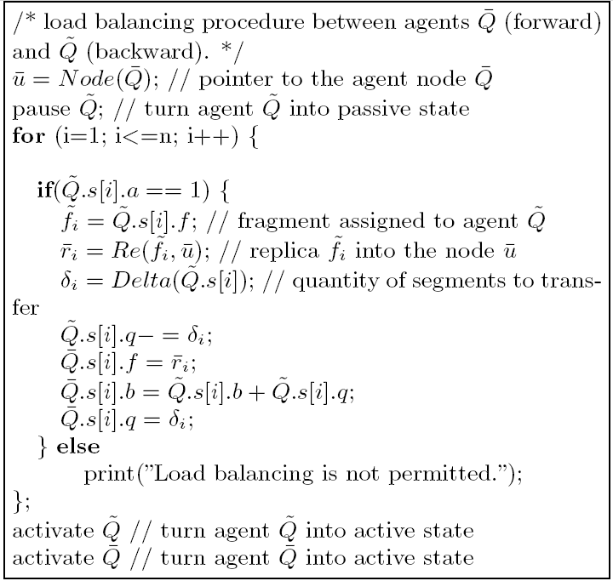
Load balancing algorithm

Slide 16
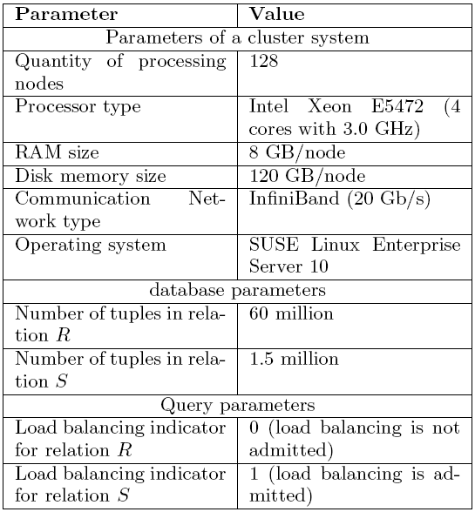
Parameters of experiments

Slide 17
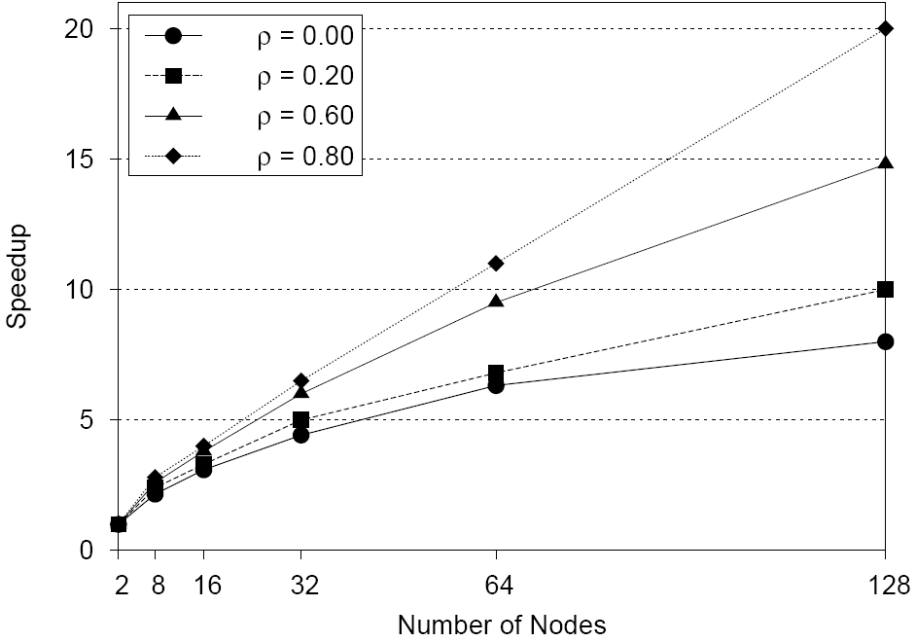
Speedup versus replication factor
Notes:
In all cases we have visible sppedup.

Slide 18
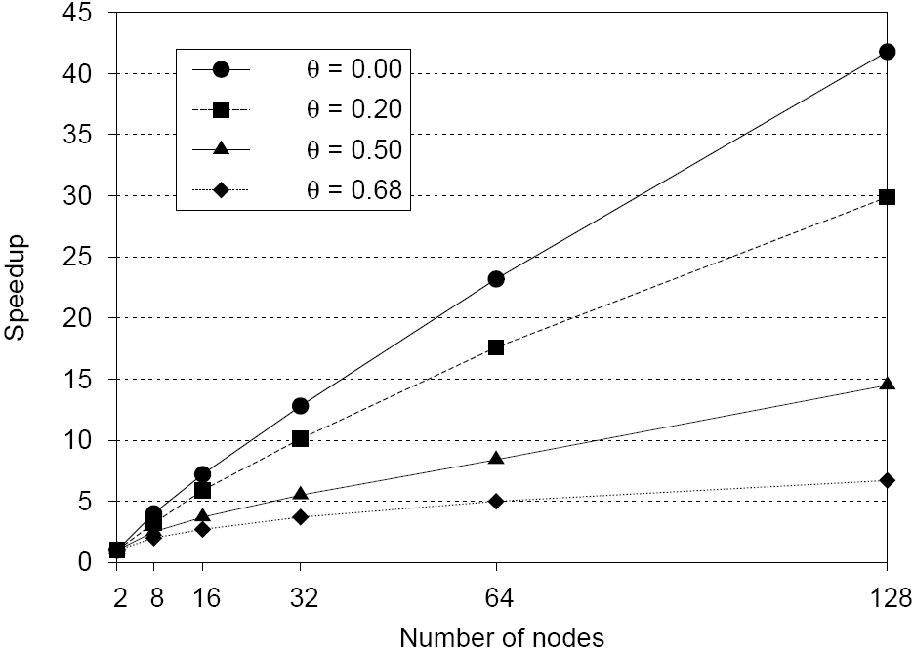
Speedup versus skew factor θ
0.68 corresponds to the ”80-20” rule (80 percents of tuples of the relation will be stored in 20 percents of fragments)
0 corresponds to the uniform distribution
Notes:
Value 0.68 corresponds to the rule ”80-20”. According it, 80 percents of tuples of the relation will be stored in 20 percents of fragments. Skew factor θ = 0.5 corresponds to the ”45-20” rule. Value 0.2 corresponds to the rule ”25-15”. Value 0 corresponds to the uniform distribution.
We can see that load balancing provides a significant speedup even at presence of severe data skew.

Slide 19
Future Work
To incorporate the proposed technique of parallel query execution into open source PostgreSQL DBMS.
To extend this approach on GRID DBMS for clusters with multicor processors.

Slide 20
Thank you

