Slide 1

Clayton Long
Michael Nachtigal

Slide 2
Overview
What is a k-d Tree?
Binary Search Trees
Multidimensional k-d Trees
k-d Tree Algorithms
Exact Match Queries
Partial Match Queries
Region Queries
Performance of k-d Trees
Homogeneous vs. Non-Homogeneous k-d Trees

Slide 3
What is a k-d Tree?
A k-d Tree is a Multi-dimensional Binary Search Tree
  k is the number of keys or dimensions where each key is an element of a finite totally ordered set
  A binary search tree is a k-d tree where k = 1
M
I
U
D
K
P
W
Binary Search Tree

Slide 4
Binary Search Trees
Binary Search Trees can be Used to Organize Data Where Records Contain One Key Field
Binary Search Trees Evaluate Nodes Recursively
search(tree, value) {
if (tree == null)
return null;
if (value == tree->key)
return tree;
if (value > tree->key)
return search(tree->right, value);
return search(tree->left, value);
}
Binary Search Tree Pseudo code

Slide 5
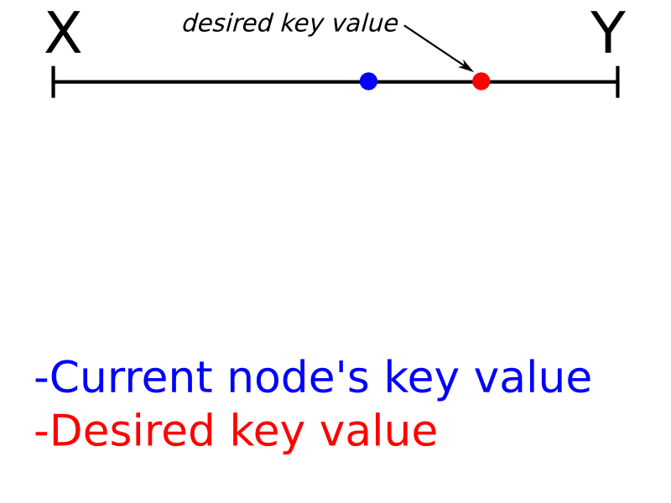
Binary Search Tree (k=1) Example

Slide 6
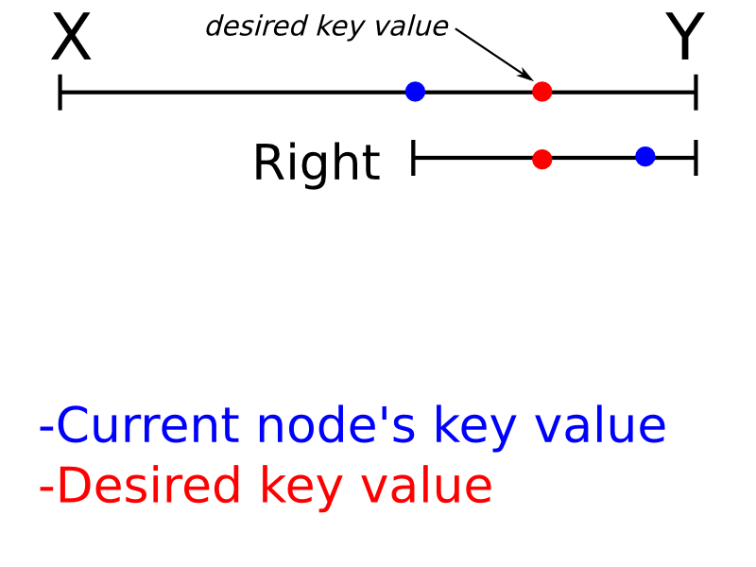
Binary Search Tree (k=1) Example

Slide 7
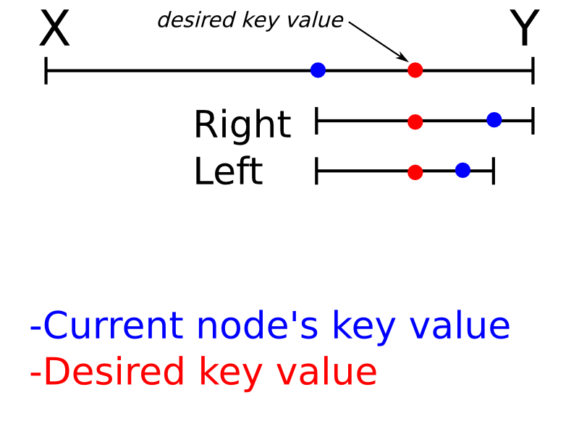
Binary Search Tree (k=1) Example

Slide 8
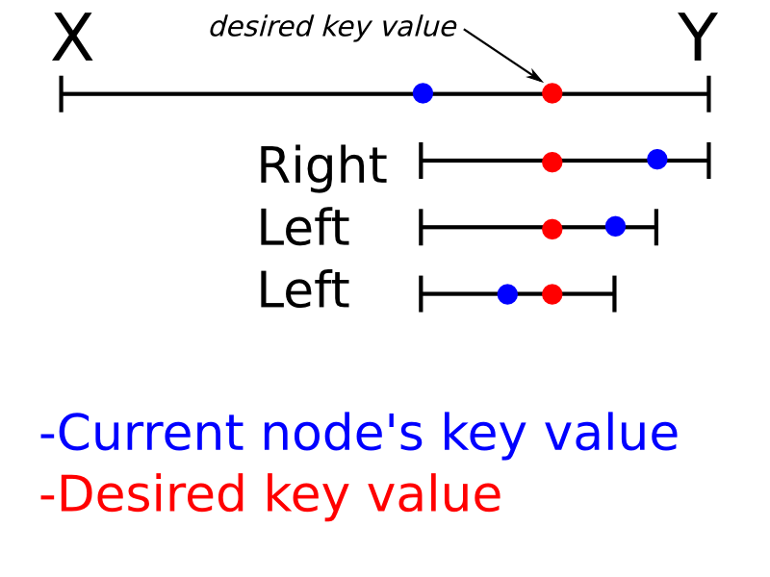
Binary Search Tree (k=1) Example

Slide 9
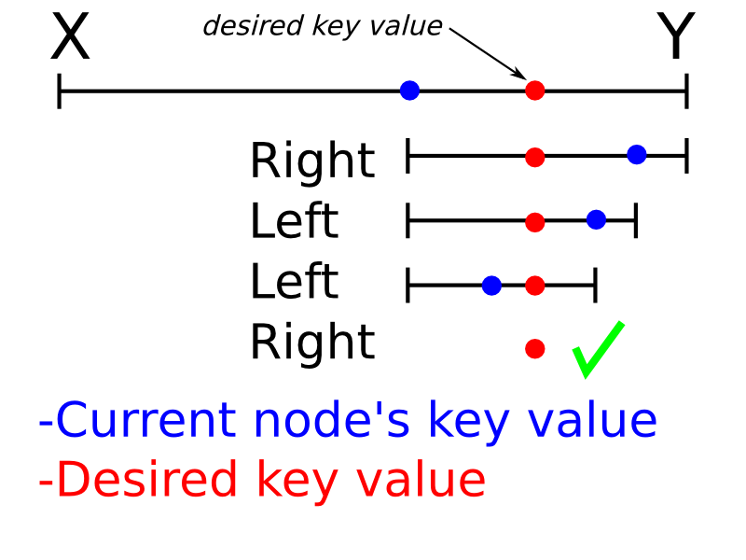
Binary Search Tree (k=1) Example

Slide 10
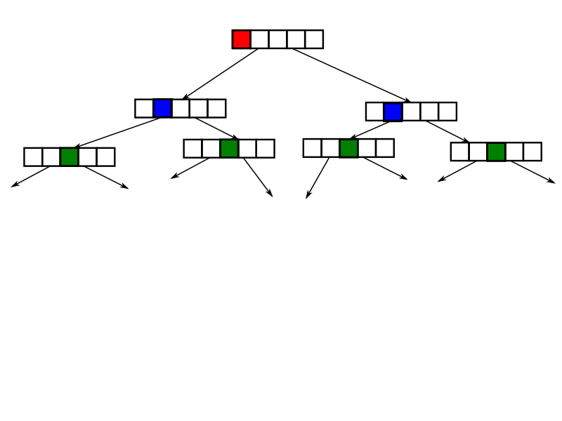
Multidimensional k-d Trees
k-d Trees Can be Used to Organize Data Where Records Contain One or More Key Fields
A Discriminator is an Index to a Key
Each Level Uses a Different Discriminator
  A new discriminator is chosen at each level based on an algorithm
k-d Tree

Slide 11
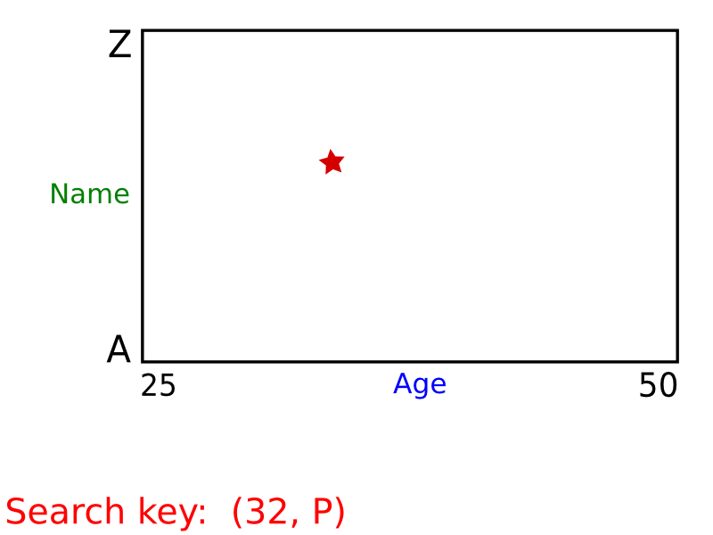
k-d Tree (k=2) Example

Slide 12
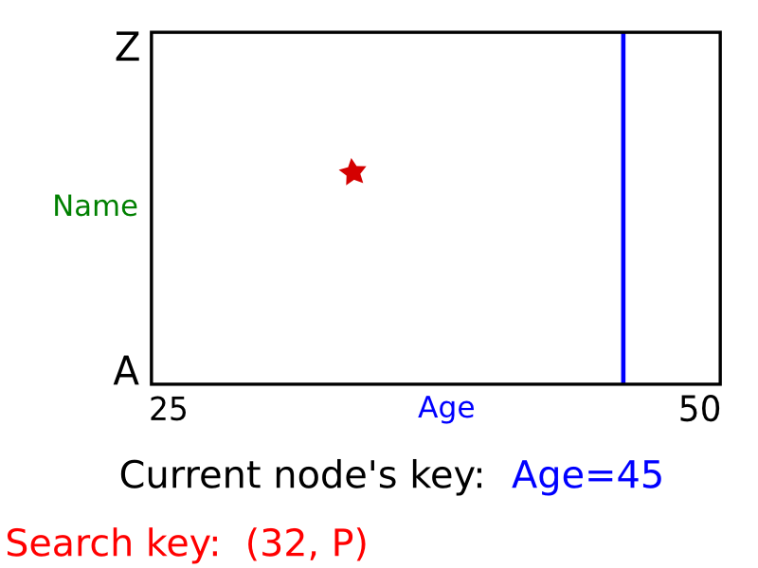
k-d Tree (k=2) Example

Slide 13
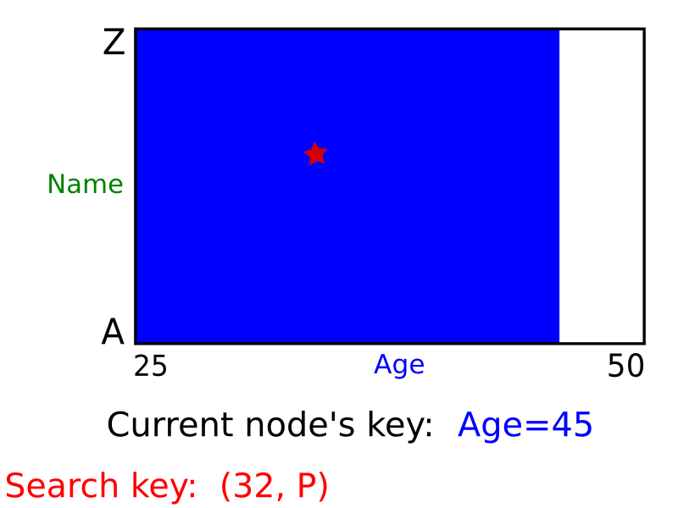
k-d Tree (k=2) Example

Slide 14
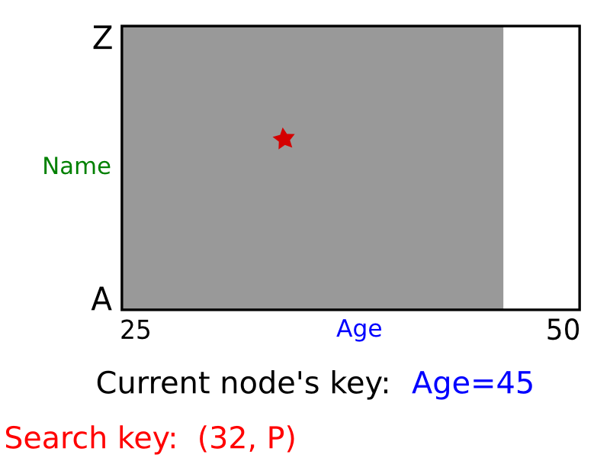
k-d Tree (k=2) Example

Slide 15
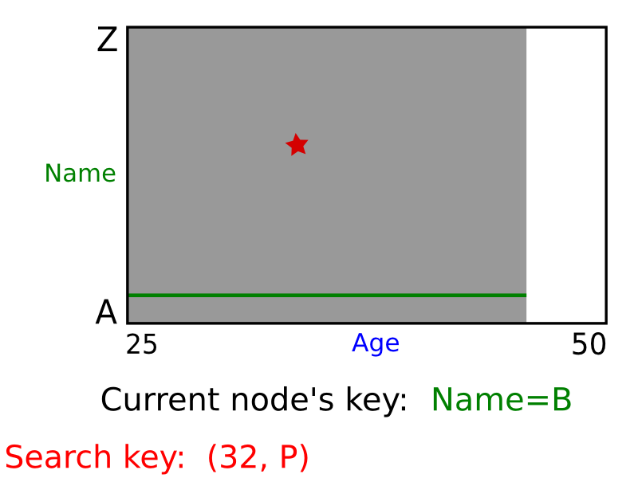
k-d Tree (k=2) Example

Slide 16
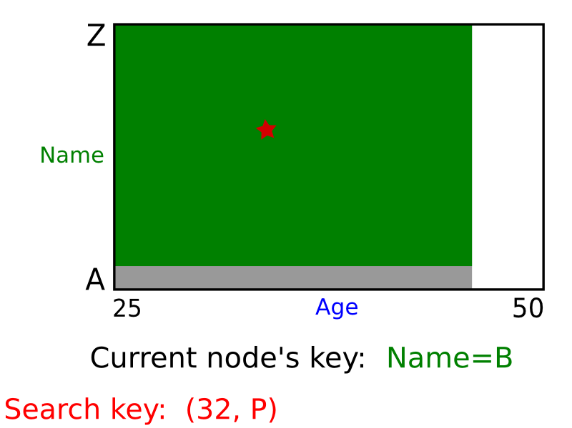
k-d Tree (k=2) Example

Slide 17
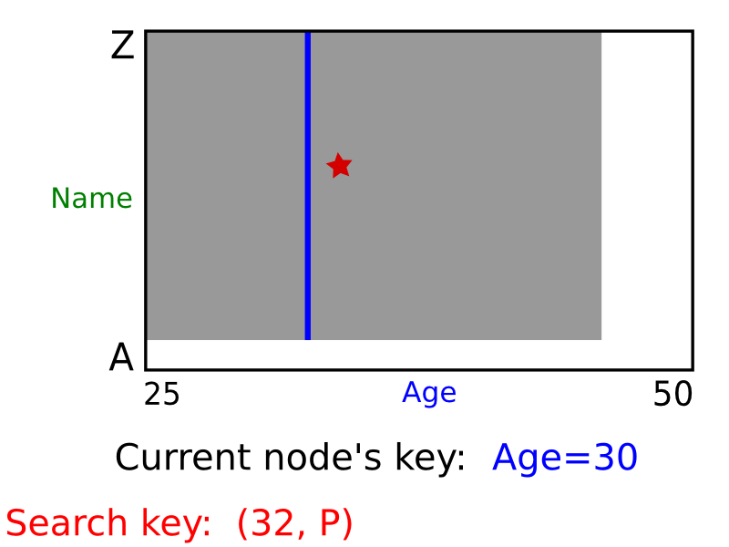
k-d Tree (k=2) Example

Slide 18
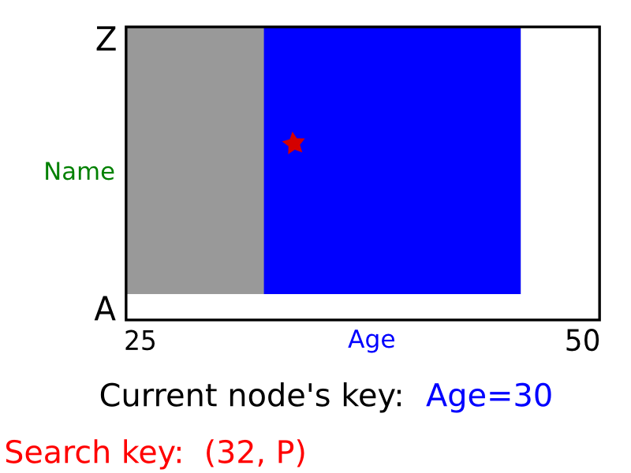
k-d Tree (k=2) Example

Slide 19
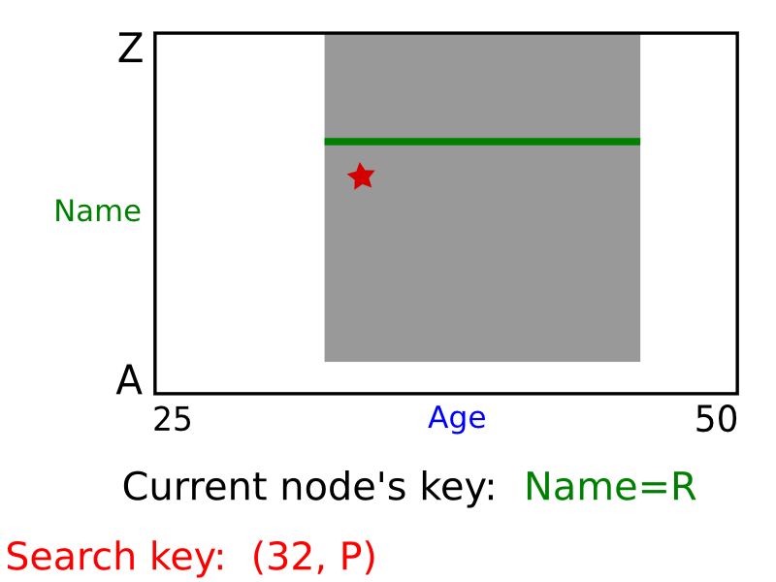
k-d Tree (k=2) Example

Slide 20
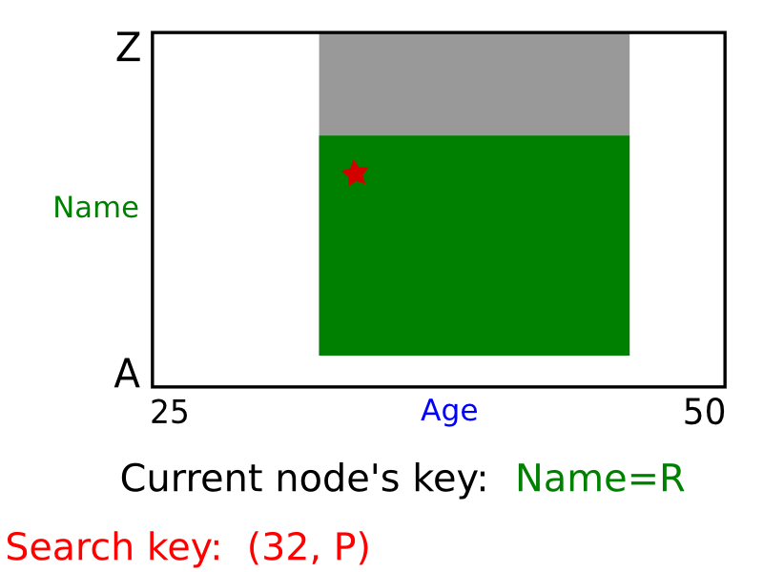
k-d Tree (k=2) Example

Slide 21
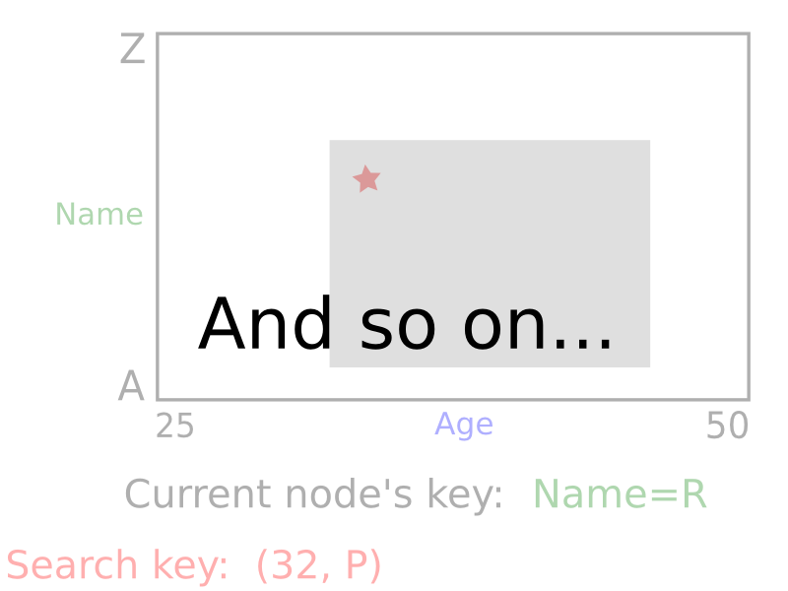
k-d Tree (k=2) Example

Slide 22
k-d Tree Algorithms
insertAndSearch(node, value) {
if (node->parent == null)
return new KdTreeNode(node, 0);
if (value[node->desc] == node->key[node->disc])
return tree;
if (value[node->desc] < node->key[node->disc]) {
if (node->left == null) {
node->left = new KdTree(value, [node->disc+ 1] % MAXD);
return null;
}
return insertAndSearch(root, node->left, value);
}
if (node->right == null) {
node->right = new KdTree(value, [node->disc+ 1] % MAXD);
return null;
}
return insertAndSearch(root, node->right, value);
}

Slide 23
k-d Tree Algorithms
delete(node) {
if (node->right == null && node->left == null)
return null;
if (node->right != null) {
targetNode = getMinNode(node->right, node->disc);
parentNode = targetNode->parent;
}
else {
targetNode = getMaxNode(node->left, node->disc);
parentNode = targetNode->parent;
}
if (parentNode->right == targetNode)
parentNode->right = delete(targetNode);
else
parentNode->left = delete(targetNode);
targetNode->disc = node->disc;
targetNode->left = node->left;
targetNode->right = node->right;
return targetNode;
}

Slide 24
k-d Tree Algorithms
buildKdTree (nodeList, disc) {
if (nodeList == null)
return 0;
node = getMedianNode(node, disc);
nodeListLeft = getLeftNodeList(nodeList, node, disc);
nodeListRight = getRightNodeList(nodeList, node, disc);
node->disc = disc;
/* build KdTree recursively */
node->left = buildKdTree(nodeListLeft, [node->disc+ 1] % MAXD);
node->right = buildKdTree(nodeListLeft, [node->disc+ 1] % MAXD);
return node;
}

Slide 25
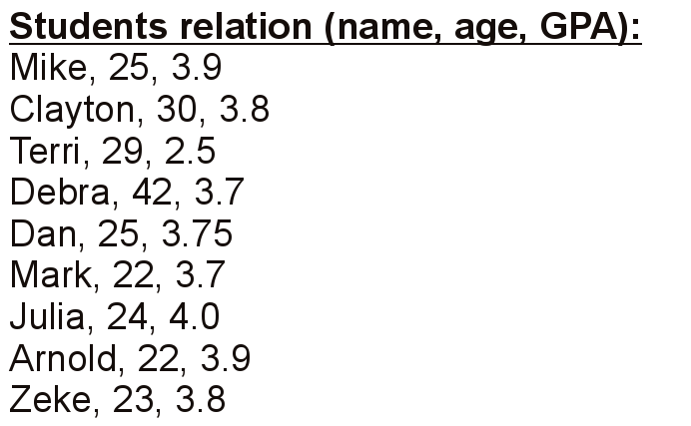
k-d Tree Build Example

Slide 26
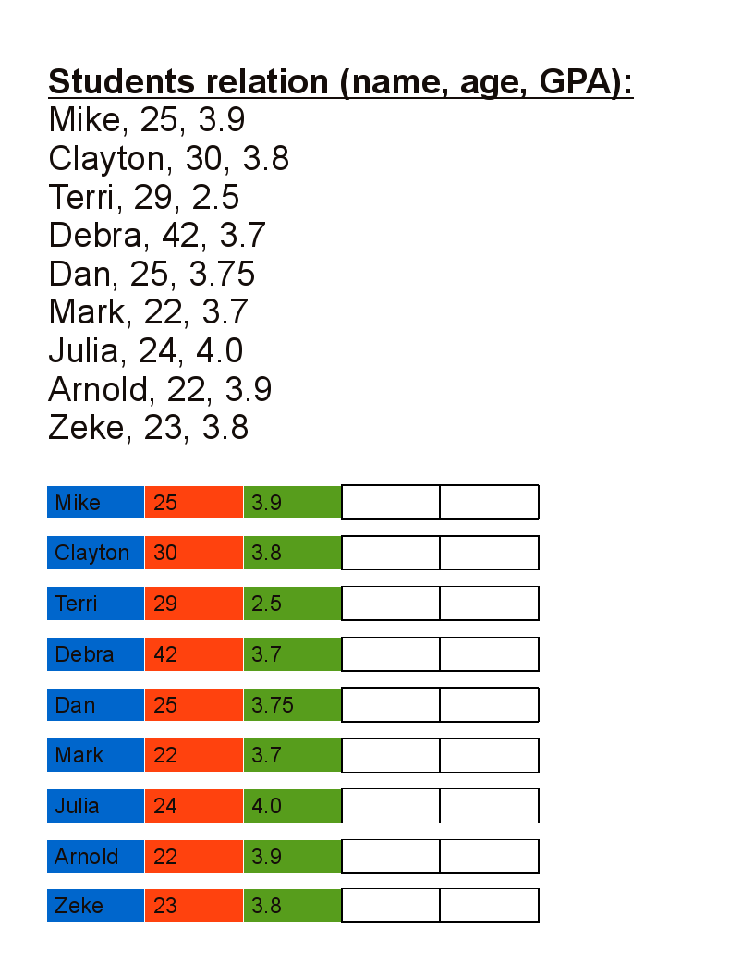
k-d Tree Build Example

Slide 27
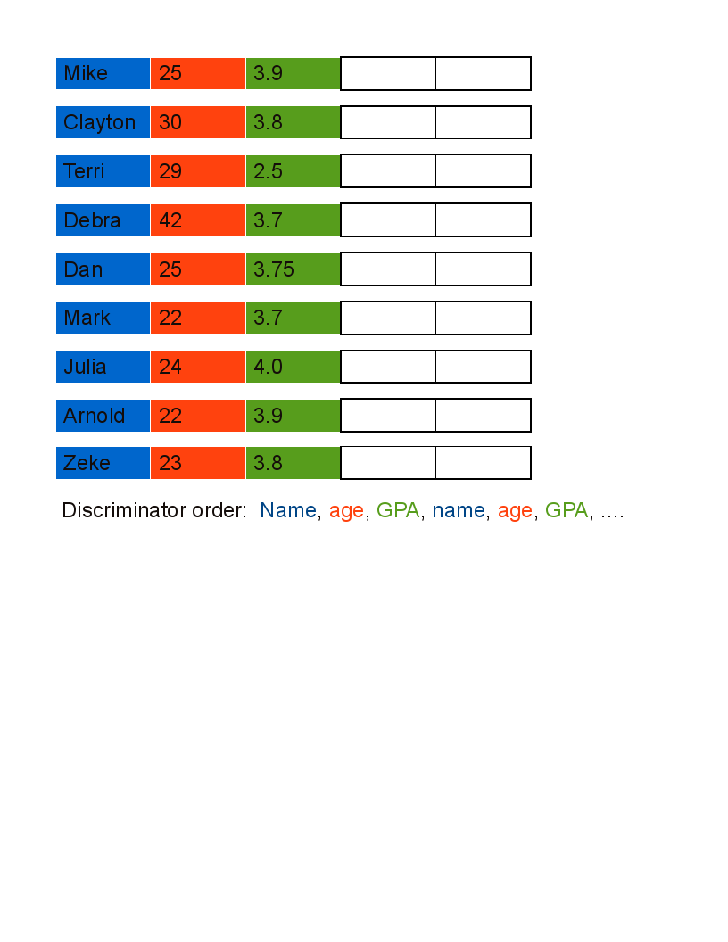
k-d Tree Build Example

Slide 28
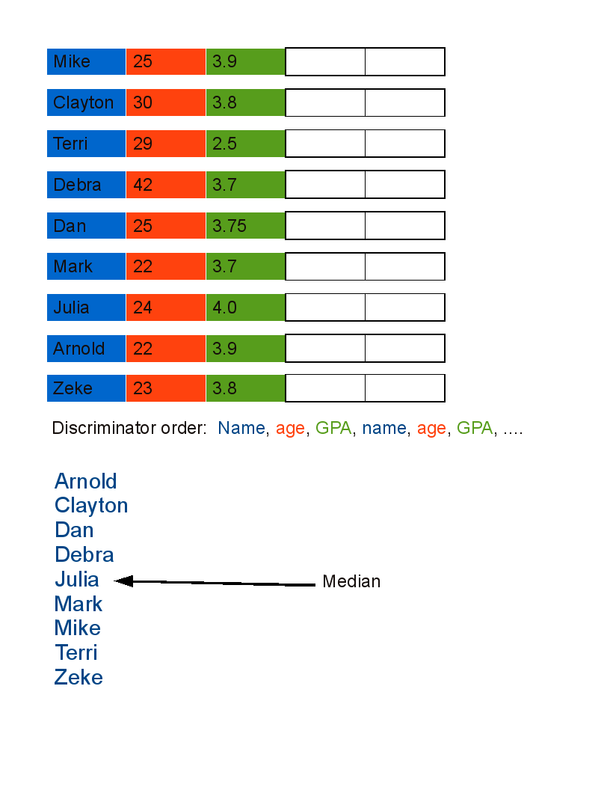
k-d Tree Build Example

Slide 29
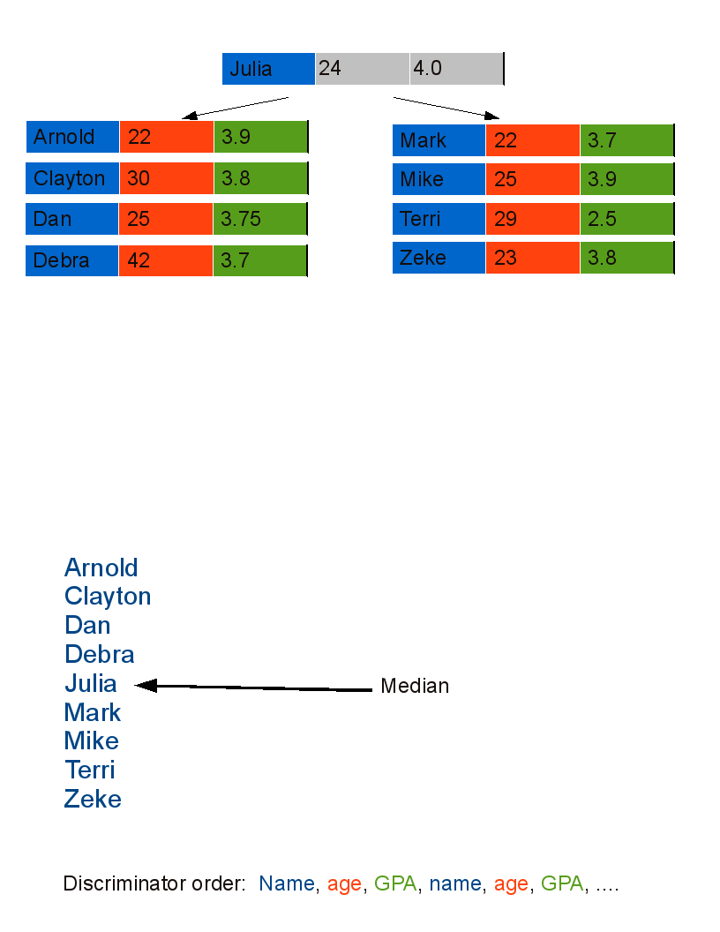
k-d Tree Build Example

Slide 30
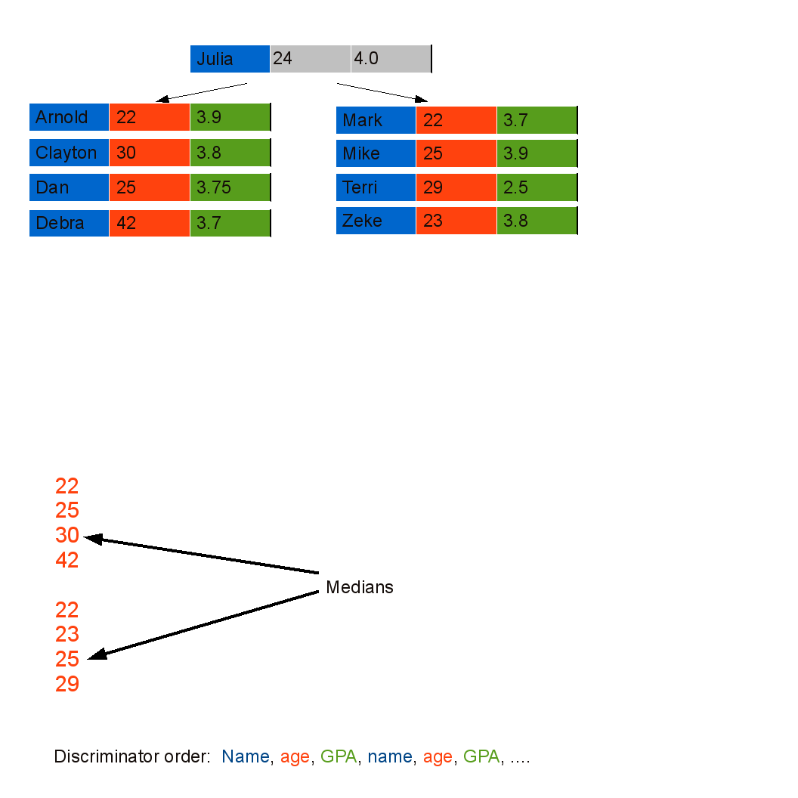
k-d Tree Build Example

Slide 31
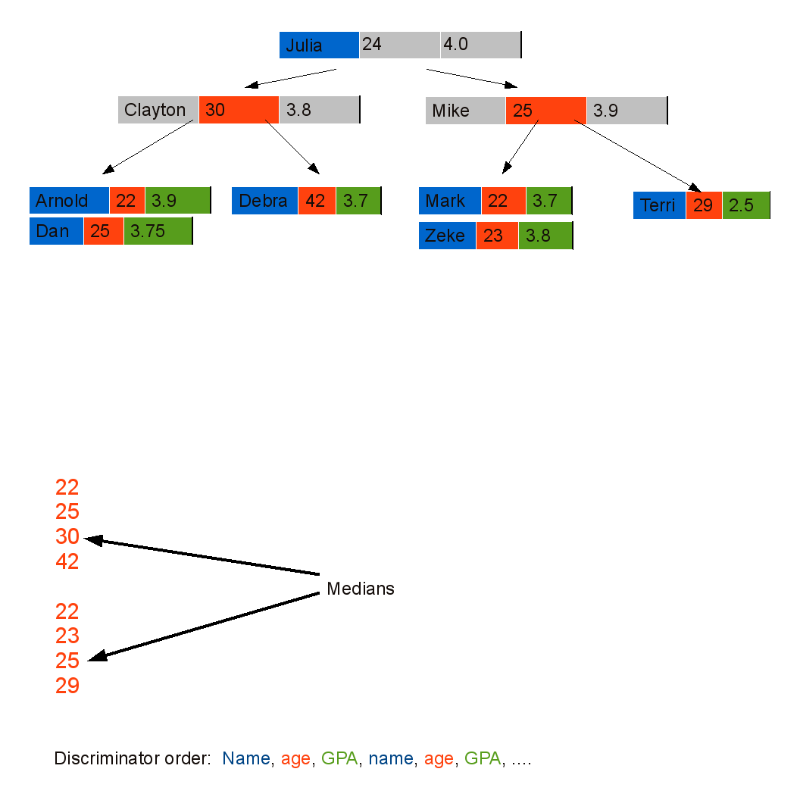
k-d Tree Build Example

Slide 32
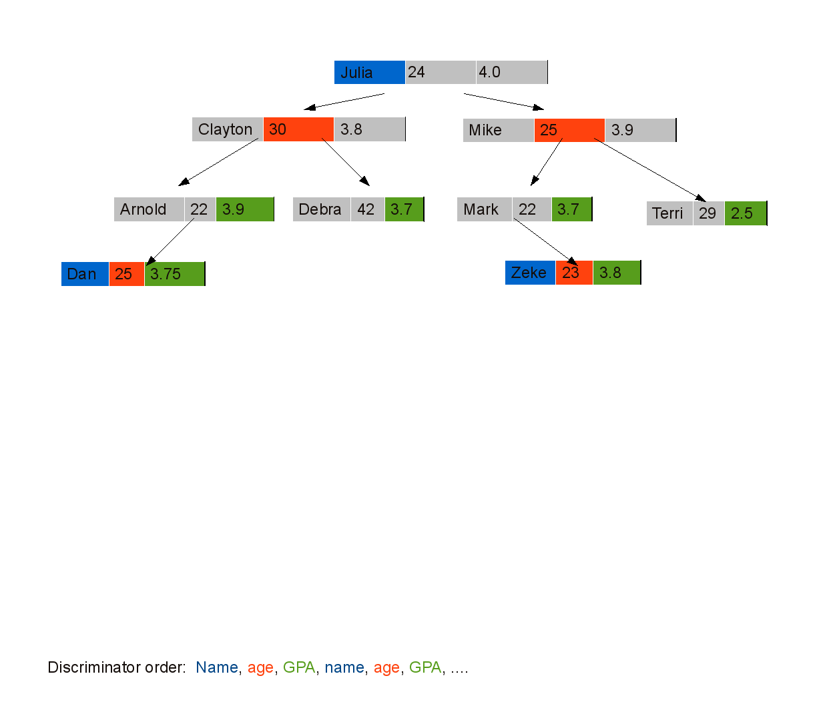
k-d Tree Build Example

Slide 33
Exact Match Queries
If Only Exact Match Queries are to be Issued, k-d Trees are not a Good Choice
The Algorithm for Exact Match Search Query is the Same as the Insert Algorithm

Slide 34
Partial Match Queries
Use a recursive function REGIONSEARCH(node P)
If P satisfies the query, report P
Otherwise, if P discriminates on one of the keys specified in the query, call REGIONSEARCH() on the appropriate child node
Otherwise, call REGIONSEARCH() on both child nodes

Slide 35
Region Queries
Use a recursive function REGIONSEARCH(node P, boundaries B)
If P is within the boundaries of the query, report P
If P discriminates on one of the keys specified in the query (J)
  Call REGIONSEARCH() on the left child if Key_{J} is greater or equal to the maximum J bound of the query range
  Call REGIONSEARCH() on the right child if Key_{J} is less than or equal to the minimum J bound of the query range
Otherwise, call REGIONSEARCH() on both child nodes

Slide 36
Temporal Complexity
 | k-d Trees
Equality Search | logN
Range Search | logN + k
Nearest Neighbor | logN
Insert | logN
Delete | logN
Build | NlogN
*Assumption: The Tree is Perfectly Balanced

Slide 37
Spatial Complexity
The k-d Data Structure Requires Enough Space to Accommodate the Key Values and Two Pointers for Every Record

Slide 38
Homogeneous vs. Non-Homogeneous
Homogeneous k-d Tree
  Data is stored in the tree nodes
Non-homogeneous k-d Tree
  Internal nodes contain keys and pointers to other nodes
  External nodes contain data

Slide 39
Summary
k-d Tree is a Generalization of Binary Search Tree
  Binary Search Tree is a k-d Tree where k=1
k-d Trees Can be Used to Organize Data Based on Multiple Keys
k-d Trees Use an Algorithm to Determine Discriminators at Each Level
k-d Trees Have Spatial and Temporal Complexity That is Comparable to Binary Search Trees

Slide 40

Questions

