Slide 1
Nearest Neighbor Finding Using Kd-tree
Ref: Andrew Moore’s PhD thesis (1991)

Slide 2
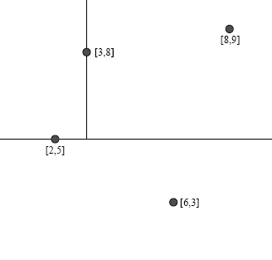
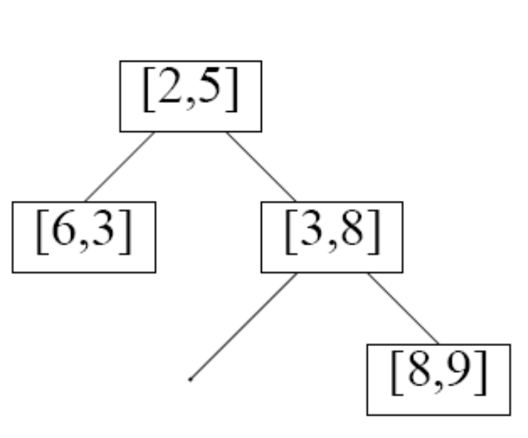
Kd-tree [Bentley ’75]

Slide 3
On the NN Problem
Existing packages exist
  ANN (U. of Maryland)
  Ranger (SUNY Stony Brook)
Only work for R^{n}. Configuration spaces can have R and S

Slide 4
Algorithm NN(kd,target)
b
[Global output: nearest, min-dist-sqd = ∞]
If kd is leaf: compute d2 = d2(target,leafnode)
  if d2 < min-dist-sqd
    nearest ← leafnode
    min-dist-sqd ←d2
  Return
Determine nearer-kd and further-kd
NN (nearer-kd, target)
Check d2(pivot_node,target); update min-dist-sqd & nearest if necessary
Check whether further-kd need to be checked
  {find p – closest pt in hr w.r.t. target, check if d2(p,target) < min-dist-sqd}
  If so, call NN(further-kd, target)
pivot
c
target
d2: distance squared
e
c
nearer
further
e
b
hr: hyper-rectangle

Slide 5
a
Nearest = ?
dist-sqd = ∞
NN(c, x)
b
c
nearer
further
f
e
b
c
d
g
a
f
e
g
d
Nearer = e
Further = b
NN (e, x)

Slide 6
a
Nearest = ?
dist-sqd = ∞
NN(e, x)
b
c
f
e
b
c
further
nearer
d
g
a
f
e
g
d
Nearer = g
Further = d
NN (g, x)

Slide 7
a
Nearest = ?
dist-sqd = ∞
NN(g, x)
b
c
f
e
b
c
r
d
g
a
f
e
g
d
Nearest = g
dist-sqd = r

Slide 8
a
Nearest = g
dist-sqd = r
NN(e, x)
b
c
f
e
b
c
r
d
g
a
f
e
g
d
Check d2(e,x) > r
No need to update

Slide 9
a
Nearest = g
dist-sqd = r
NN(e, x)
b
c
f
e
b
c
p
r
d
g
a
f
e
g
d
Check further of e: find p
d (p,x) > r
No need to update

Slide 10
a
Nearest = g
dist-sqd = r
NN(c, x)
b
c
f
e
b
c
r
d
g
a
f
e
g
d
Check d2(c,x) > r
No need to update

Slide 11
a
Nearest = g
dist-sqd = r
NN(c, x)
b
c
f
e
b
c
p
r
d
g
a
f
e
g
d
Check further of c: find p
d(p,x) < r !!
NN (b,x)

Slide 12
a
Nearest = g
dist-sqd = r
NN(b, x)
b
c
f
e
b
c
r
d
g
a
f
e
g
d
Nearer = f
Further = g
NN (f,x)

Slide 13
a
Nearest = g
dist-sqd = r
NN(f, x)
b
c
f
e
b
r’
c
d
g
a
f
e
g
d
r’ = d2 (f,x) < r
dist-sqd ← r’
nearest ←f

Slide 14
a
Nearest = f
dist-sqd = r’
NN(b, x)
b
c
f
e
b
r’
c
d
g
a
f
e
g
d
Check d(b,x) < r’
No need to update

Slide 15
a
Nearest = f
dist-sqd = r’
NN(b, x)
b
c
f
e
b
p
r’
c
d
g
a
f
e
g
d
Check further of b; find p
d(p,x) > r’
No need to update

Slide 16
a
Nearest = f
dist-sqd = r’
NN(c, x)
b
c
f
e
b
r’
c
d
g
a
f
e
g
d

Slide 17
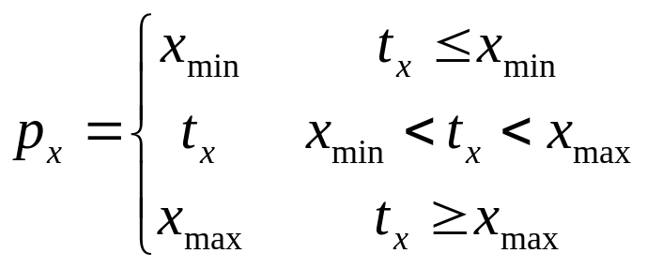
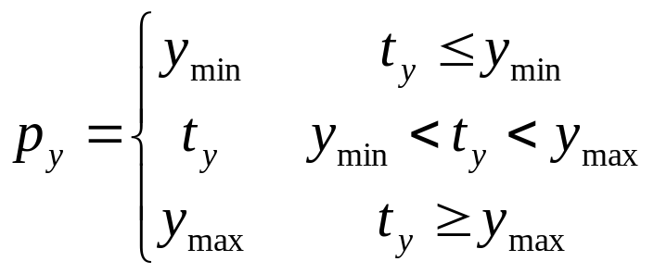
Kdtree vs. Target
Find closest point p in hr to target t
y_{m`ax}
t
p
y_{min}
x_{min}
x_{max}

Slide 18
Time Complexity
At least O(log N) inspections are necessary
No more than N nodes are searched: the algorithm visits each node at most once
Depends on the point distribution

Slide 19
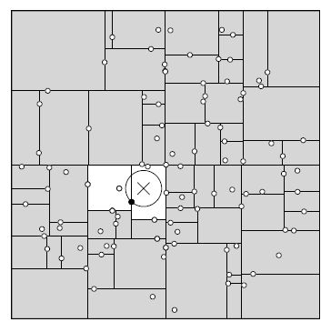
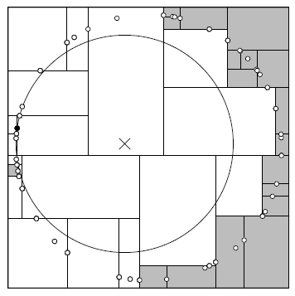
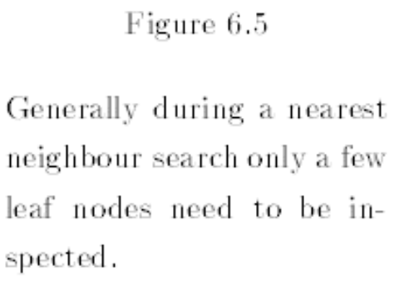
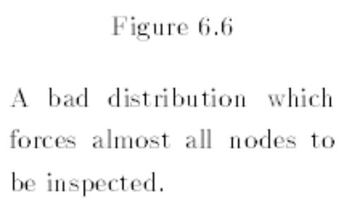

Slide 20
Pivoting Strategy
Properties of ideal Kd-tree
  Reasonably balanced
    O(logN) behavior
  Leaf nodes fairly equally proportioned
    Maximum cutoff opportunities for the nearest neighbor search
Possible Strategies
  “Splitting dimension as the maximum variance, pivot set at median” – pray for alternating and balancing splits
  Other strategies possible: “middle of the most spread dimension” (see next page)

Slide 21
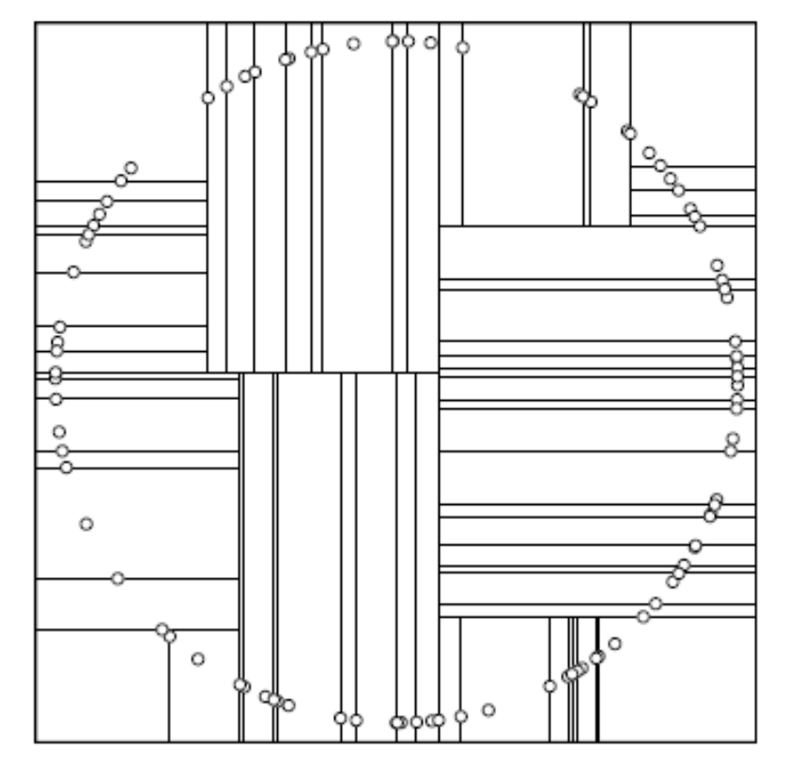
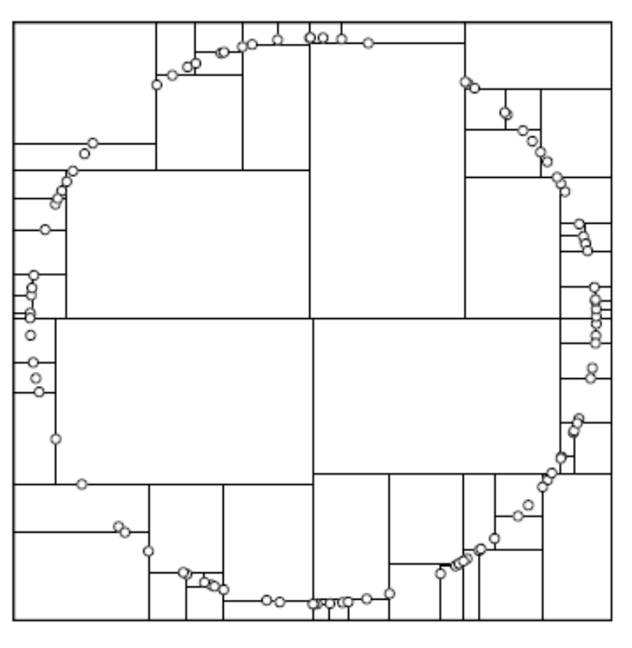
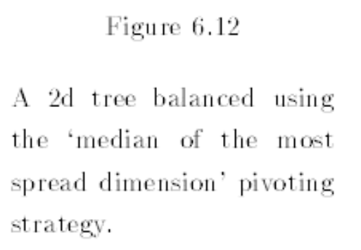
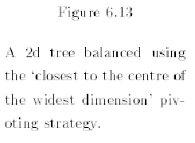

Slide 22
Exercise
a
nearest = ?
min-dist-sqd = ∞
NN(c, x)
b
c
f
e
b
c
d
g
a
f
e
g
d

