Slide 1
Distant reading of Sci-Fi using BookNLP: H.P. Lovecraft, Philip K. Dick, William Gibson
Canidate: Oprica D. Dan-Andrei
Supervisor: Lector Dr. Dinu Anca

Slide 2
Introduction
My dissertation’s aim is to analyze a sci-fi corpora through the lens of the machine.
Distant reading: […] allows you to focus on units that are much smaller or much larger than the context: devices, themes, tropes – or genres and systems.
[Moretti, Franco. Conjectures on World, 2000]

Slide 3
I employ several distant reading tools with aim of analyzing and comparing the works of established authors in the fci-fi genre. The selected corpora are run through BookNLP, a python-based text-mining pipeline, specialized for narrative fiction. The pipeline allows for large scale semantic and narratological analysis, the latter being achieved through character and “event” detection. Other Python libraries are then employed for combing and visualizing the obtained data (Pandas, JSON)

Slide 4
The authors
I selected for analysis the works of three widely influential authors of sci-fi (although the work of the first two were attached to different labels also, they remain under the sci-fi umbrella in broad sense): H.P. Lovecraft, Philip K. Dick, William Gibson. Their work spawned significant followings and fandoms, which arguably became subgenres of their own under the sci-fi umbrella.

Slide 5
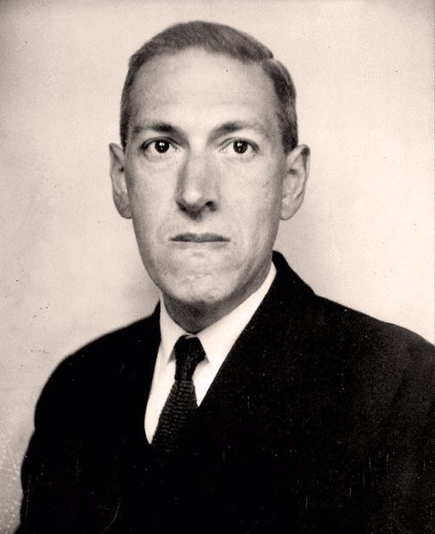
Howard Philips Lovecraft (1890-1937) developed a shared universe between his various short stories and novellas, governed by an impressive mythos of his own creation. He spawned a genre that is now known as cosmic horror, or even Lovecraftian horror, when his mythos is directly referenced by other authors. In his work, sci-fi elements blend with fantasy and horror.

Slide 6
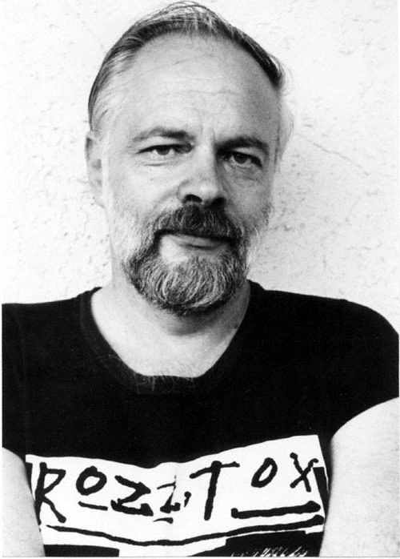
Philip Kindred Dick’s (1952-1982) fiction is centred on his characters’ struggle to comply with their given reality. His fears reflect the unstable political environment of his youth during the cold war, which mainly involved distrust in the government and the looming nuclear menace. His heavy use of substances, which eventually brought him to an early end, fueled a dystopic, convoluted imagery, where the reality is controlled by entities (governmental superstructures, aliens, artificial intelligence) beyond human understanding. Besides sci-fi, his work has been labelled as paranoid fiction or even philosophical fiction.

Slide 7
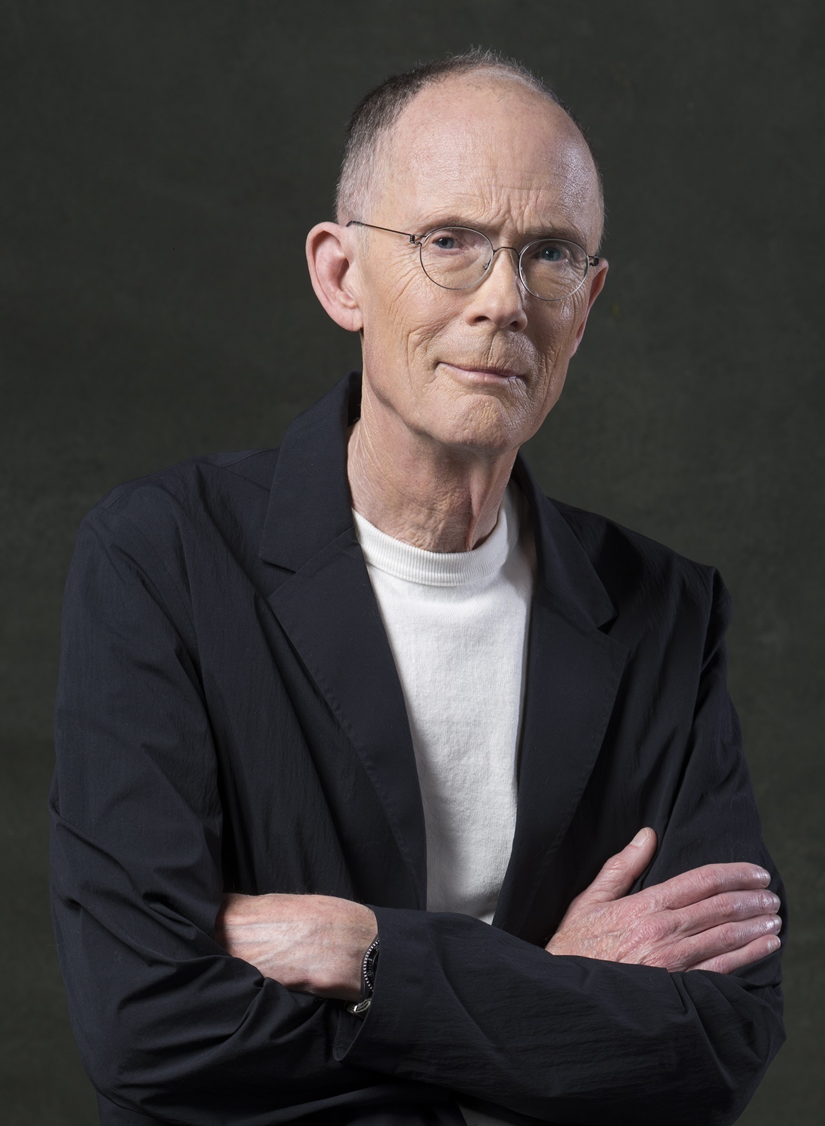
William Ford Gibson (1948)’s work is both visionary and foreboding, being developed across a shared universe that entails the definitive aesthetics and socio-politics of cyberpunk. This subgenre has been succinctly defined by the “high-tech, low-life” tenet. Gibson warns about a world where human life becomes increasingly expandable, crumbling under the pervasive and domineering technology that surpassed its creators. His characters deal with loss of identity, as their consciousness is being afflicted by oppressive digital systems.

Slide 8
My aim was to collect a balanced corpus across the authors. For each, I selected one longer work – a short novel, and 4 short stories/novellas, resulting in a corpus of ~100.000 words per author:
- H.P. Lovecraft: the novel At the mountains of madness (1931), and 4 short stories/novellas: Call of Cthulhu (1928), The Colour out of Space (1927), The shadow over Innsmouth (1931), The Whisperer in Darkness (1930).
- Philip K. Dick: the novel Do androids dream of electric sheep? (1968) and 4 short stories: Electric Ant (1969), Faith of our Fathers (1967), Impostor (1953), The minority report (1956).
- William Gibson: novel Neuromancer (1984) and the 4 short stories: Burning Chrome (1982), Hinterlands (1981), New Rose Hotel (1986), Johnny Mnemonic (1981)

Slide 9
BookNLP
The main tool that I am employing is a Python-based NLP pipeline suggestively named BookNLP. It was developed by David Bamman, associate professor in the School of Information at Berkeley, University of California. The GitHub documentation [4] page lays out the pipeline’s capacities:
BookNLP is a natural language processing pipeline that scales to books and other long documents (in English), including: part-of-speech tagging, entity recognition, character name clustering (e.g., "Tom", "Tom Sawyer", "Mr. Sawyer", "Thomas Sawyer" -> TOM_SAWYER), quotation speaker identification, supersense tagging, event tagging, referential gender inference.

Slide 10
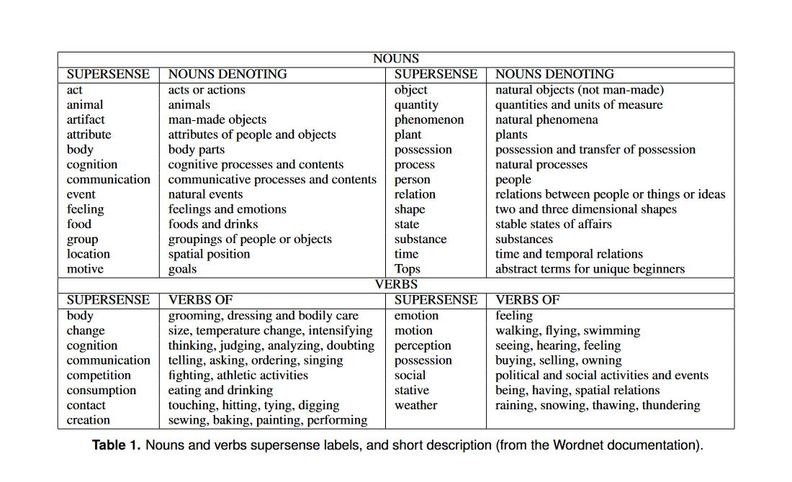
Semantic analysis
BookNLP’s supersense tagging functionality assigns to each verb and noun in the input text file a tag based on the WordNet taxonomy:

Slide 11
Such an exhaustive semantic taxonomy is well suited for sci-fi, a genre where authors generally employ specific terminologies for the purposes of world building. Beyond proper scientific terms of various domains, repurposed to fit their particular naratological aims (ex: in “Faith of our Fathers” by Philip K. Dick, pharmaceutical vocabulary is employed, with certain substances playing a major role in the narrative), sci-fi implies terms that designate speculative ideas and objects, products of the author’s imagination, that are more or less derived from actual science – hard sci-fi vs soft sci-fi (ex: William Gibson’s “cyberspace” vs. Lovecraft’s and Dick’s alien entities and their technologies).
For my purposes, I am going to use the results offered by BookNLP to compare semantic statistics between the three corpora by scanning for meaningful differences/contrasts.

Slide 12
General semantic diversity
The semantic diversity percentage means the proportion of unique words (words present in one corpus, but not in the other two) against all tagged words present in a corpus. The results for each author:
Author | Percentage
Dick | 27.91%
Lovecraft | 38.71%
Gibson | 40.93%
We observe that Lovecraft and Gibson’s values are quite close, at ~2% between the two, while Philip K. Dick ranks ~10% behind them in this metric. These results seem to indicate the different writing styles and narratological approaches. Dick’s value highlights his concise, more “narrative” style. Lexical innovation and diversity aren’t required for him, as he makes use of restrained set of key words to drive his narrative, his worldbuilding isn’t as detailed, what can be inferred about the worlds he envisions is based on the actions and thoughts of his characters.

Slide 13
Total supersense percentages (all words and unique words) Nouns

Slide 14
supersense_category | lovecraft | dick | gibson
noun.Tops | 0.80% | 0.30% | 0.17%
noun.act | 3.38% | 2.64% | 2.33%
noun.animal | 1.39% | 1.76% | 0.61%
noun.artifact | 9.26% | 9.65% | 14.82%
noun.attribute | 3.30% | 1.65% | 1.89%
noun.body | 1.54% | 2.91% | 5.54%
noun.cognition | 4.28% | 1.87% | 1.76%
noun.communication | 5.29% | 4.28% | 3.69%
noun.event | 1.45% | 0.74% | 0.73%
noun.feeling | 1.29% | 0.76% | 0.44%
noun.food | 0.20% | 0.35% | 0.41%
noun.group | 2.29% | 2.30% | 1.97%
noun.location | 6.53% | 2.03% | 4.39%
noun.motive | 0.08% | 0.07% | 0.03%
noun.object | 3.76% | 0.68% | 1.03%
noun.person | 6.91% | 13.09% | 12.19%
noun.phenomenon | 0.74% | 0.29% | 0.52%
noun.plant | 0.52% | 0.13% | 0.29%
noun.possession | 0.16% | 0.48% | 0.50%
noun.process | 0.22% | 0.06% | 0.10%
noun.quantity | 1.11% | 0.71% | 0.85%
noun.relation | 0.38% | 0.26% | 0.17%
noun.shape | 0.35% | 0.08% | 0.38%
noun.state | 2.36% | 1.70% | 1.24%
noun.substance | 2.08% | 0.98% | 3.24%
noun.time | 2.89% | 2.32% | 1.79%
supersense_category | lovecraft | dick | gibson
noun.Tops | 0.55% | 0.18% | 0.11%
noun.act | 4.95% | 4.04% | 3.46%
noun.animal | 2.16% | 0.62% | 1.20%
noun.artifact | 7.61% | 11.01% | 17.85%
noun.attribute | 4.14% | 2.00% | 2.15%
noun.body | 1.32% | 1.24% | 2.50%
noun.cognition | 3.21% | 2.04% | 1.45%
noun.communication | 6.42% | 6.48% | 5.15%
noun.event | 2.38% | 1.02% | 1.08%
noun.feeling | 1.59% | 0.93% | 0.61%
noun.food | 0.45% | 0.49% | 0.73%
noun.group | 2.24% | 4.31% | 3.51%
noun.location | 7.64% | 3.60% | 6.41%
noun.motive | 0.06% | 0.09% | 0.05%
noun.object | 3.04% | 0.40% | 1.26%
noun.person | 9.63% | 11.45% | 11.83%
noun.phenomenon | 0.65% | 0.31% | 0.63%
noun.plant | 1.06% | 0.22% | 0.58%
noun.possession | 0.26% | 0.80% | 0.74%
noun.process | 0.43% | 0.04% | 0.19%
noun.quantity | 0.45% | 0.93% | 0.89%
noun.relation | 0.45% | 0.18% | 0.15%
noun.shape | 0.56% | 0.36% | 0.61%
noun.state | 2.80% | 2.22% | 1.37%
noun.substance | 2.02% | 1.46% | 4.06%
noun.time | 1.38% | 1.07% | 0.80%
All words ->
Unique words ->

Slide 15
Artifacts = man-made objects. For all words, Gibson scores almost ~15%, a ~5 to 6 % increase when compared with the other two, who are very close in the 9% range. For unique words, the difference increases, with Gibson reaching ~17%, and a gap of ~3% appearing between Dick (~11%) and Lovecraft (~8%).
Gibson’s shared universe is hyper-technologized and industrialized, with a constant stream of tools, gadgets, vehicles, body augmentations, and vehicles finding their way into the market (mostly the black-market). All these various artifacts are central to the narrative and overall atmosphere, translating into the general themes: technology-inflected isolation, invasive tech, loss of boundaries between human and machine.
For Dick and Lovecraft, a significant difference appears only when comparing unique words, while in the all-words comparison, they score very close. It can be inferred that man-made objects populate their respective worlds similarly from a quantitative point of view, but in Dick’s fiction, they are more varied (there are more kinds of artifacts). This is indicative of each author’s historical context. Their respective speculative visions develop the technology that was known and available to them.

Slide 16
In sci-fi worlds, artifacts are frequent, as many of them are the result of the technological “progress” envisioned by the author. They serve as a worldbuilding tool, as well as plot devices. However, under the umbrella of this genre, “man-made” and “progress” are relative: in Lovecraft’s universe, adventurers come across vestiges left by extinct alien civilizations from time immemorial. Still, they fit into the artifacts category under the taxonomy, so for true accuracy when mining through sci-fi and fantasy texts, artifacts should be redefined as “sentient-being made objects”.

Slide 17
The noun.body category also highlights a significant difference when looking at the all words results, with ~1.5 % for Lovecraft, ~3% for Dick and 5.5% for Gibson. The differences fade out when looking at just unique words. This is natural, as body parts are an overall limited category of words. This stat infers information about the envisioned worlds, as well as the styles of the authors. Gibson’s cyberpunk universe is full of body augmentations and implants, highlighted by his cinematographical style (when new characters are introduced, it’s usually through close-ups of such glaring features, building into the theme of technological possession). In Dick’s work there are some similar instances, most notably in the beginning of The Electric Ant, when the main character wakes up in a hospital with a replaced hand, as he is an electric ant, an android whose body parts are replaceable.

Slide 18
In the noun.cognition category, Lovecraft is 2 percentages ahead of the other two, at ~4% percent in the all words statistic. The difference is dimmed when looking at the unique words, but still present, as he is still ahead by ~ 1.5%. This is indicative of Lovecraft’s overall style and focus on what the characters experience as they encounter the maddening supernatural. Also, it’s representative for the type of characters that he prefers, who are an extension of his own persona: scholars and intellectuals who possess vast amounts of knowledge and the lexicon to express it, trying in vain to make sense of absurd phenomena and beings. Example of nouns denoting cognition present only in Lovecraft’s texts: speculation, research, contradiction, puzzlement, realisation.

Slide 19
In the noun.location category, Lovecraft scores the highest (both for all words and unique words). His narratological approach involves various written reports, accounts and letters coming from many geo-locations. Gibson is the second highest, as his characters travel to various cities in their missions, there are also accounts of past events that happened around the globe for world-building purposes (especially in Neuromancer). Notable for Gibson is the cyberspace, a computer network where hackers transfer their consciousness. BookNLP correctly assigns the cyberpsace with the noun.location tag, as it is a plane of existence that characters travel to, but not in a physical sense. Philip K. Dick fiction is more focused and confined, especially the short stories, his characters don’t travel as much.

Slide 20
In the noun.object (natural objects, as opposed to artifacts) category, Lovecraft is also the highest (both for all words and unique words), as his characters interact more with the natural world. This ties with the noun.location category, as he is fond of exotic environments and biomes. Examples of unique object in Lovecraft: swamp, desert, ice barrier, valley, boulder.

Slide 21
Conclusions for semantic tagging
The semantic tags can provide insights about the overall semantic composition of narrative texts. They are plentiful in the current iteration of BookNLP, but I think that there is still room for more subspecialization within the vaster categories, such as nouns.artifact and nouns.object (for artifacts there could be subcategories such firearms, melee weapons, gadgets, clothes, household etc).
In today’s landscape of fiction, the modern reader is overwhelmed with options. Selection is often algorithm assisted. Such a semantic tagging tool could prove useful for automatic genre assignment, as well as for large scale analysis of a genre, akin to my endeavour here. I expect that for different genres, other markers will be relevant: for romance noun.feeling or verb.emotion, for crime thrillers verb.social or verb.perception, etc.

Slide 22
Event statistics
The event layer identifies events with asserted realis (depicted as actually taking place, with specific participants at a specific time) -- as opposed to events with other epistemic modalities (hypotheticals, future events, extradiegetic summaries by the narrator).
[BookNLP documentation]

Slide 23
Events remain a contested category across narrative theory, philosophy and linguistics, with definitions varying depending on discipline, application, and context. […] In our annotation approach, we include activities, achievements, accomplishments, and changes of state as being events.
[Sims, Matthew et. Park, Jong Ho et. Bamman, David, Literary event detection]

Slide 24
Novels and even most short stories tend to be much longer than news articles, and tend to have more complex narrative structures both locally (individual scenes) and globally (plot) than works of non-fiction. Furthermore, literature is a creative enterprise. Journalistic discourse typically reports what actually happened in the real world and depicts definite casual chains connecting events, this causality is not hard coded into literary event sequences.
[Ibidem]

Slide 25
Events/sentence by author corpus
Author | No. events | No. sentences | Events/sent
Lovecraft | 4419 | 4735 | 93.33%
Dick | 7485 | 9140 | 81.89%
Gibson | 7509 | 9202 | 81.60%
This statistic implies that Lovecraft’s fiction is overall filled with more events. However, he has by far the longest average sentence length, at 25.7 words/sentence, more than double when compared with the other two. Therefore, I decided to extract on sentences that contain at least one event (eventSents):

Slide 26
eventSents/sentences
Author | No. eventSents | No. sentences | Percentage
lovecraft | 2008 | 4735 | 42.41%
dick | 4581 | 9140 | 50.12%
gibson | 4380 | 9202 | 47.60%
This statistic reveal that Lovecraft is the lowest in eventSentences, while being the highest in overall events. Thus, he concentrates his events in fewer, longer sentences (event clusters). Beyond these corpora statistics, I’ve employed the event functionality on single text analysis, via plots. I’ve generated “event maps” for one short story of each author.

Slide 27
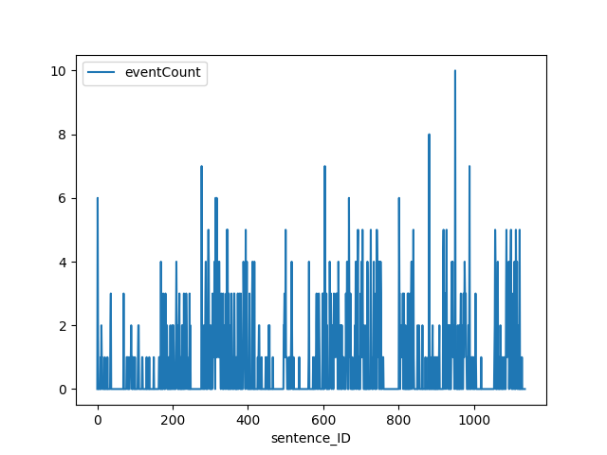
Lovecraft, The Whisperer in Darkness event map
In Lovecraft’s The Whisperer in Darkness, sentence with ID 950 out of 1136 peaks at 10 events:
If I tell you that I awaked at a certain time, and heard and saw certain things, you will merely answer that I did not wake then; and that everything was a dream until the moment when I rushed out of the house, stumbled to the shed where I had seen the old Ford, and seized that ancient vehicle for a mad, aimless race over the haunted hills which at last landed me—after hours of jolting and winding through forest-threatened labyrinths—in a village which turned out to be Townshend.
[Lovecraft, The whisperer in Darkness]

Slide 28
This sentence is typical for Lovecraft writing style. The short story is written in epistolary form, this segment being part of a report by the main character, Albert N. Willmarth, where he recounts how he escaped the house of his friend, who was taken away by the aliens. Narrative-wise, this event series occurs during the climax of the story and towards the end, showing how the main character manages to escape the major threat that he slowly uncovered up until this point.

Slide 29
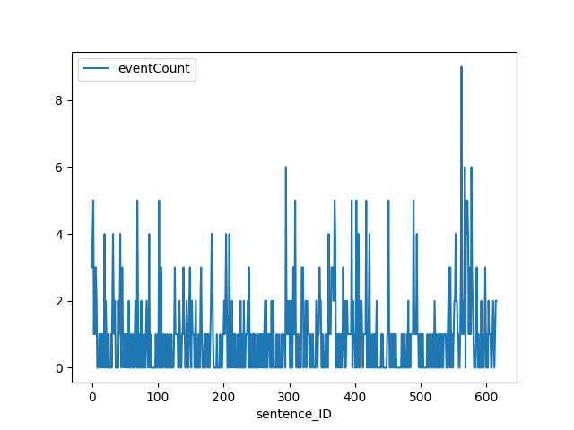
Dick, Electric Ant event map
In Philip K. Dick’s Electric Ant, sentence with ID 562 out of 615 peaks at 9 events:
Peering into the enlarging screen, he saw the beam from the photoelectric gleam upward, pointed directly into the scanner; at the same time he saw the end of the tape disappearing under the scanner... he saw this, understood it; I'm too late, he realized.
[Dick, Electric Ant]

Slide 30
The protagonist, Garson Poole, is an “electric ant”, an android designed to do tedious office work for the corporation that owns him. When he wakes up after a car accident, he has one of his arms replaced, thus his existential condition being revealed to him. This realization leads him into an identity crisis, so he decides to start altering the tape inside his body that ensures his cognition, thus modifying his perception of reality. Narrative-wise, this sentence is part of the high point of the story, when he starts modifying his tape beyond any safety guidelines. He triggers a delirium similar to a psychedelic trance, as his consciousness slowly fades away. The sentence depicts exactly this moment.

Slide 31
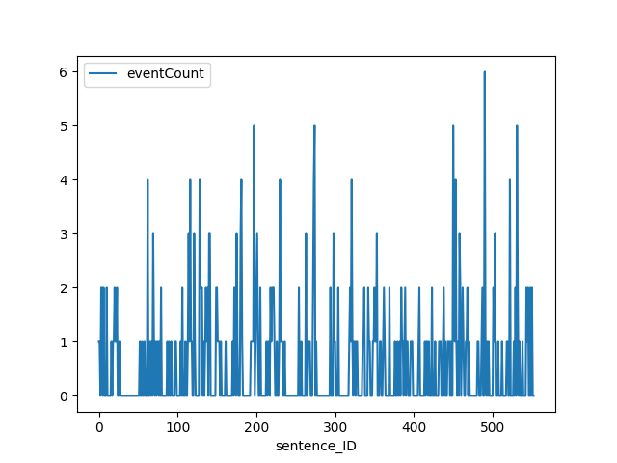
Gibson, Burning Chrome event map
In Burning Chrome by William Gibson, sentence with ID 490 out of 553 peaks at 6 events:
So I went out into the night and the neon and, let the crowd pull me along, walking blind, willing myself to be just a segment of that mass organism, just one more drifting chip of consciousness under the geodesics.

Slide 32
The events in the sentence depict the image of the main character, Automatic Jack, blending among the crowds in the city. In the narrative, this segment takes place after he accomplished his mission of hacking the system and eventually killing a powerful criminal leader named Chrome. The scene is similar to the sentence from Lovecraft’s Whisperer in the dark, both depicting and exit out of scene by the main characters that bridges to the ending.

Slide 33
Event detection is a potent narratological analysis tool. Beyond corpora statistics, it has use in visualized distant reading, with event peaks indicating high points within the narrative. For the short stories that I represented, all event peaks occur in high tension segments of the narratives, in the last quarter of text.

Slide 34
Conclusions
BookNLP, in its current iteration, possesses powerful distant reading tools. I’ve employed them in my analysis on a robust set of sci-fi corpora, with the aim of highlighting the overall diversity in themes, atmosphere and style.
The pipeline currently generates its results and inferences “in parallel”, without the possibility of correlation. I conclude that there lies great potential ahead, should the pipeline evolve into a combined approach between its components. For example, it would be very insightful to see what verbs, under the semantic taxonomy, trigger events, or what characters trigger particular events. Another insightful addon would be an integrated visualizing tool, like the one I’ve employed for event frequency per sentence.
Literary fiction, as stressed by researchers in the papers associated to BookNLP, presents inherent challenges for natural language processing, due to its inherent ambiguity and convolution. Therefore, NLP-based inferences should be targeted by specialists (critics, historians and literary theorists), with the aim of obtaining relevant machine-generated results.

