Slide 1
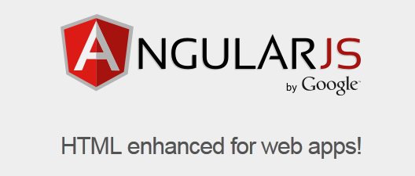
Dan Oprita

Slide 2
AngularJS
An open-source JavaScript framework, maintained by Google.

Slide 3
What it does
Lets you extend HTML vocabulary for your application
The resulting environment is extraordinarily expressive, readable, and quick to develop.

Slide 4
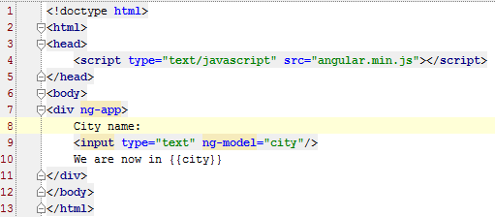
Example of a simple application

Slide 5
Data Binding
Data-binding is an automatic way of
updating the view whenever the model changes
as well as
updating the model whenever the view changes
(2-way data binding)
This is awesome because it eliminates DOM manipulation from the list of things you have to worry about.

Slide 6
Controllers
Controllers are the behavior behind the DOM elements.
AngularJS lets you express the behavior in a clean readable form without the usual boilerplate of updating the DOM, registering callbacks or watching model changes.
Controller has a scope object that is associated with a DOM element.

Slide 7
Imperative vs. Declarative
The old way was imperative
You need to follow the JavaScript code in order to understand what the application does (DOM changes, callbacks etc.)
AngularJS uses declarative programming right into HTML
It is easy to understand what the application does by looking into HTML

Slide 8
Directives
Directives is a unique and powerful feature that let you invent new HTML syntax, specific to your application.
You can use directives to create reusable components. A component allows you to hide complex DOM structure, CSS, and behavior. This lets you focus either on what the application does or how the application looks separately.

Slide 9
Important concepts
Model View Controller
Dependency Injection

Slide 10
Conclusion
AngularJS makes a step in the good direction with important changes in the way we work with the HTML
Reduces development time

Slide 11
Questions?

Slide 12
Thank you!

