Slide 1
Sugarcane Irrigation Methods Report

Slide 2
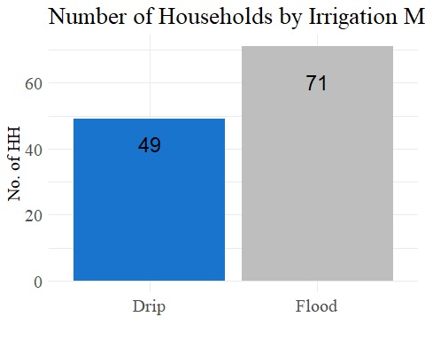
Summary statistics on irrigation practices and farmer characteristics related to sugarcane cultivation in Satara district, Maharashtra.
Irrigation Methods Plot

Slide 3
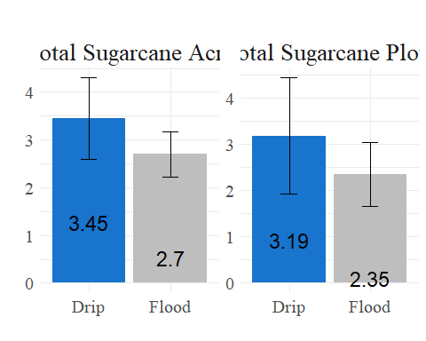

Slide 4
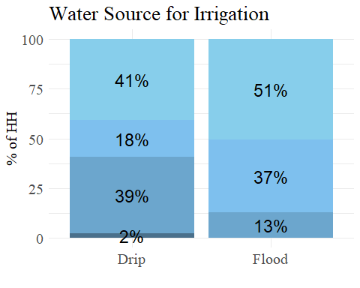
Water_source

Slide 5
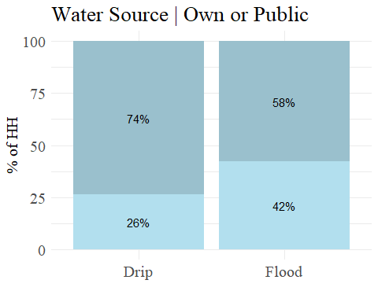

Slide 6
output: default
% a bit of vertical space
% slightly less space
% custom space
This is some text.
This is text after an empty line.

