Slide 1


Machine Learning Final Project
Dan Palmer & Jared Weber

Slide 2
Car Data Set
1,728 instances
Label
Evaluation Level (unacceptable, acceptable, good, very good)
Features
Buying Price
Maintenance Price
Number of Doors
Capacity of persons
Size of Trunk
Estimated Safey of Car

Slide 3
ML Task, Model/Software Choice
Multi-class Classification
Logistic Regression
Decision Tree using entropy
VS Code running Python 3.13 and collaboration/version control via Git

Slide 4
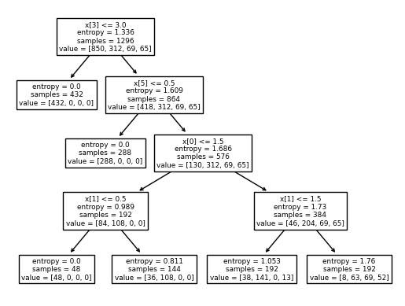
key:
x[0] = buying price
x[1] = maintenance price
x[2] = # of doors
x[3] = persons car can seat
x[4] = trunk size
x[5] = safety rating

Slide 5


Slide 6
Top 5 features
# of Doors
Maintenace Price
Buying Price
Size of Trunk
# of Persons

Slide 7
Overfitting and Cross-Validation
We randomized our data set by using cross validation in our selection of training/test split
Our models were performing well with the test data indicating a well fit model and avoidance of overfitting

Slide 8
Performance Metrics
Accuracy: 91%
ROC curve
Area Under ROC Curve

Slide 9
Ethical Issues
Bias in the Data

