Slide 1

Exam Presentation Simulation and Modelling of Communication Networks September 6, 2016
Nina Piontek
nina.piontek@tu-hamburg.de
Daniel Plöger
daniel.ploeger@tu-hamburg.de
Hamburg University of Technology
Notes:
1

Slide 2
Contents
2
Network overview
Assumptions and modeling
Simulation and evaluation
Conclusion
Notes:
2

Slide 3
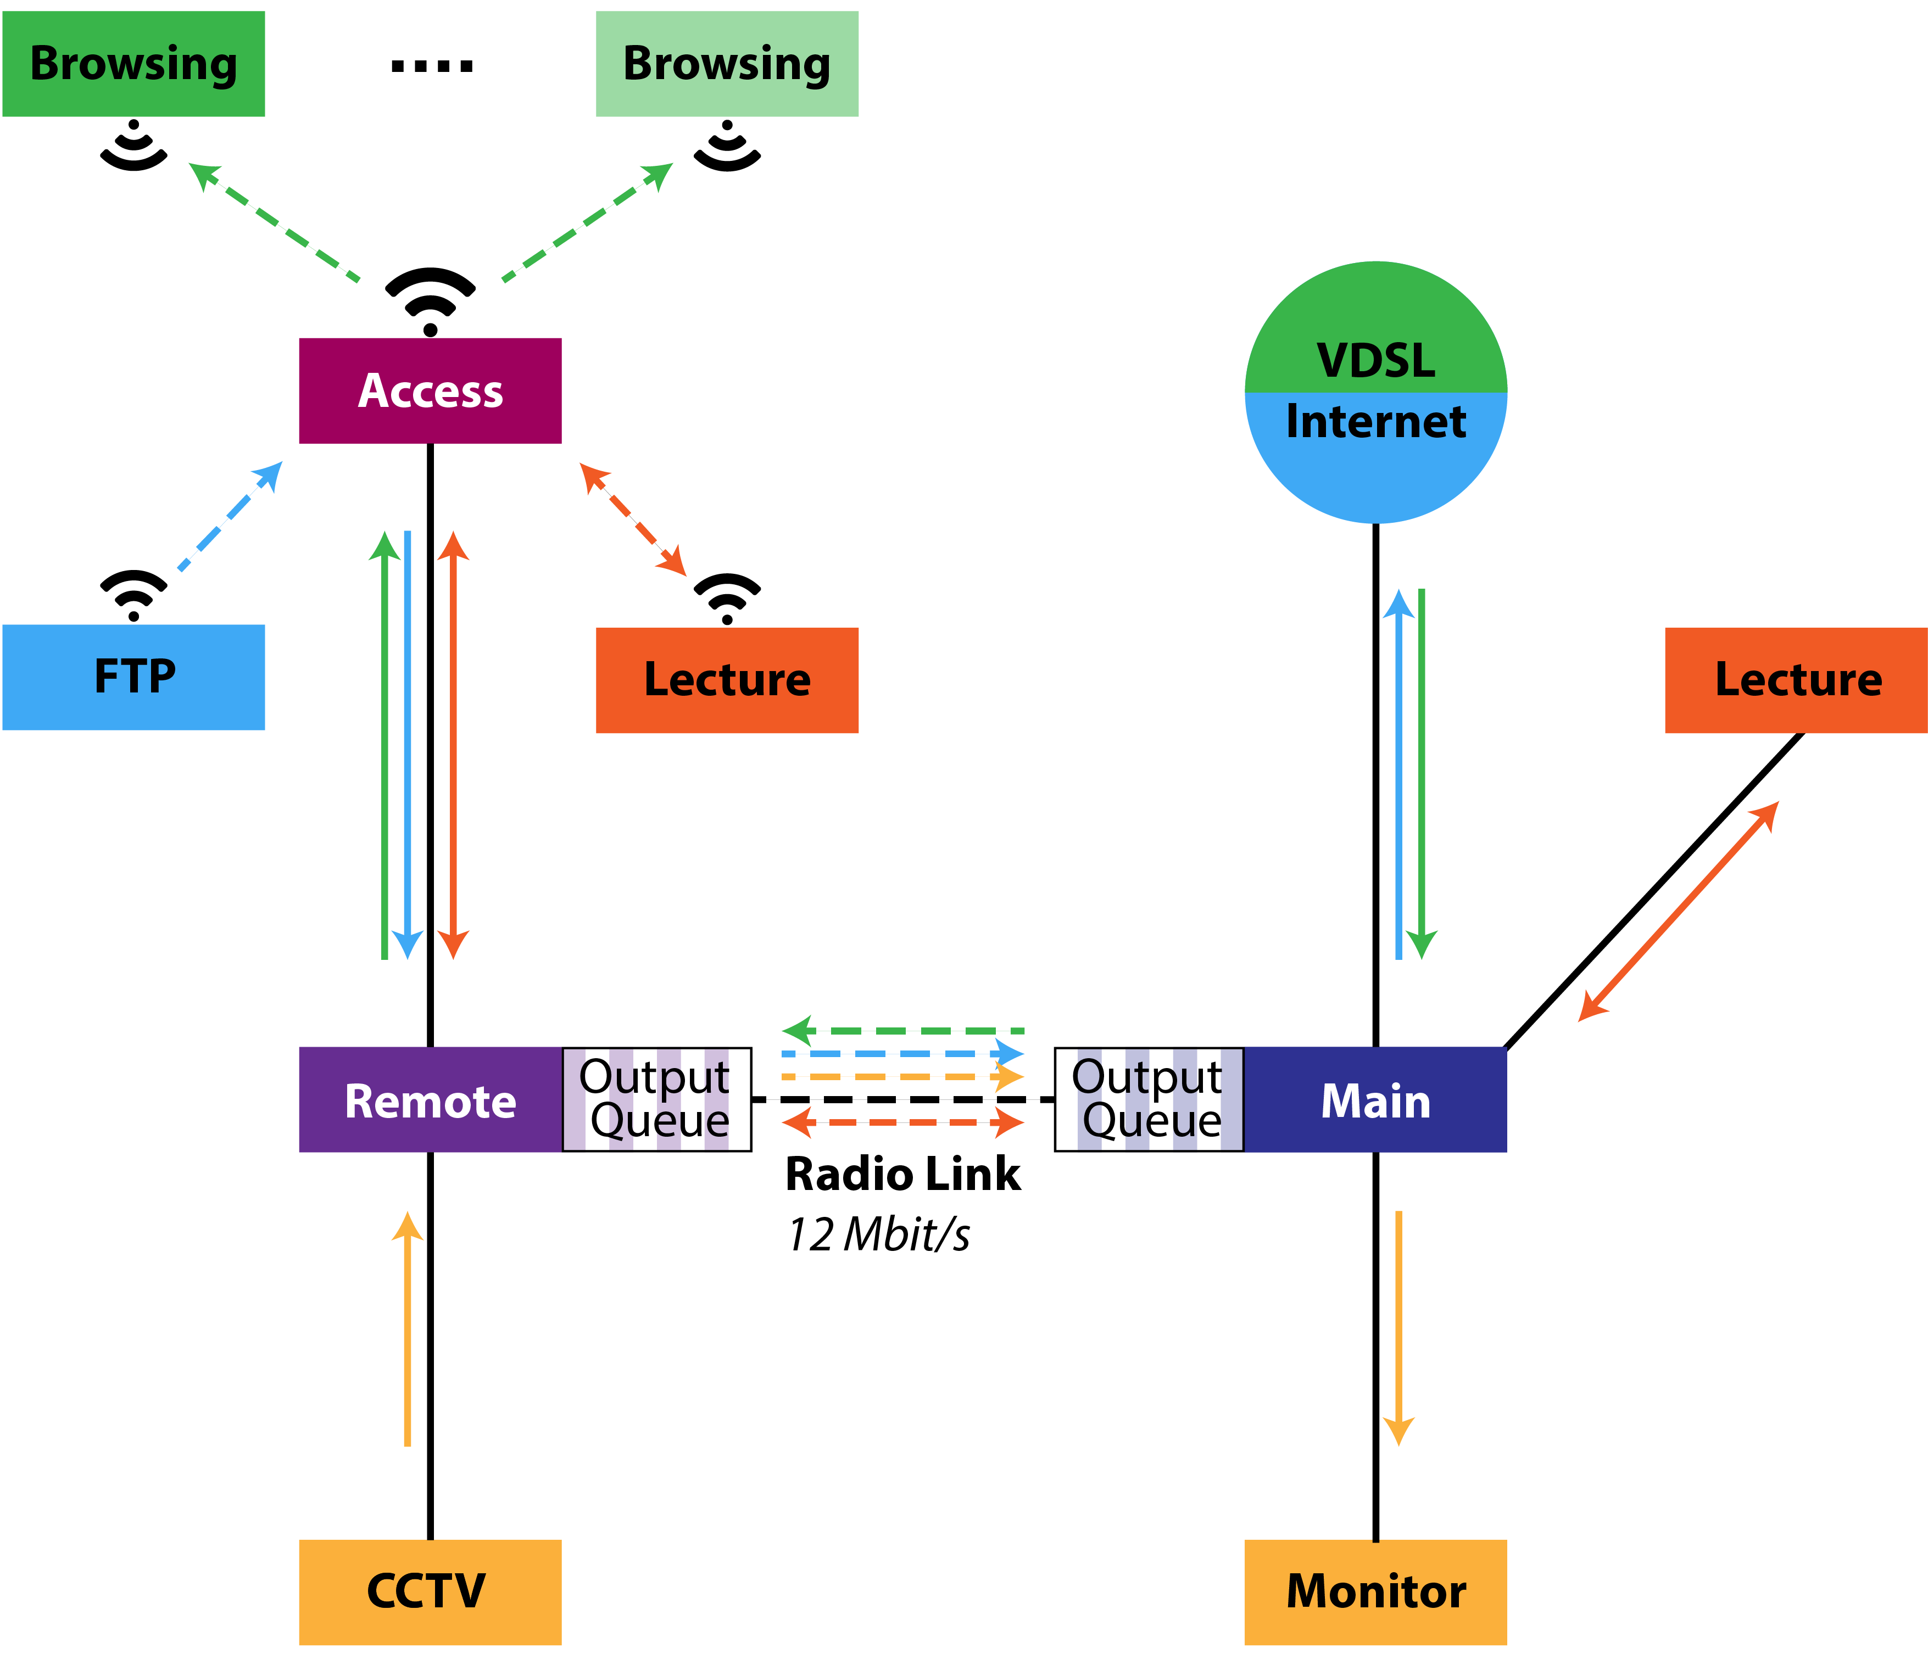
Network Overview
Notes:
3

Slide 4
Notes:
4

Slide 5
Assumptions and Modeling

Slide 6
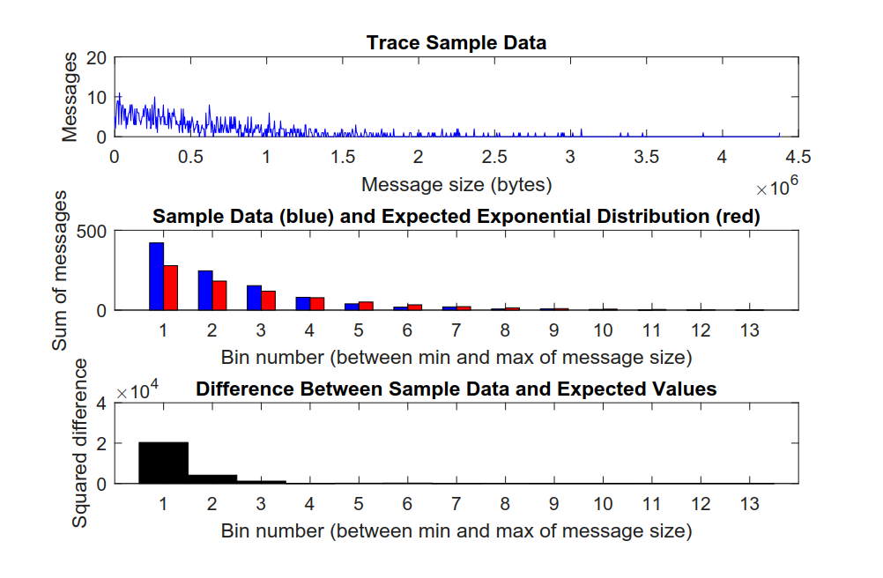
HTTP Traffic Analysis
Notes:
6

Slide 7
Notes:
7

Slide 8
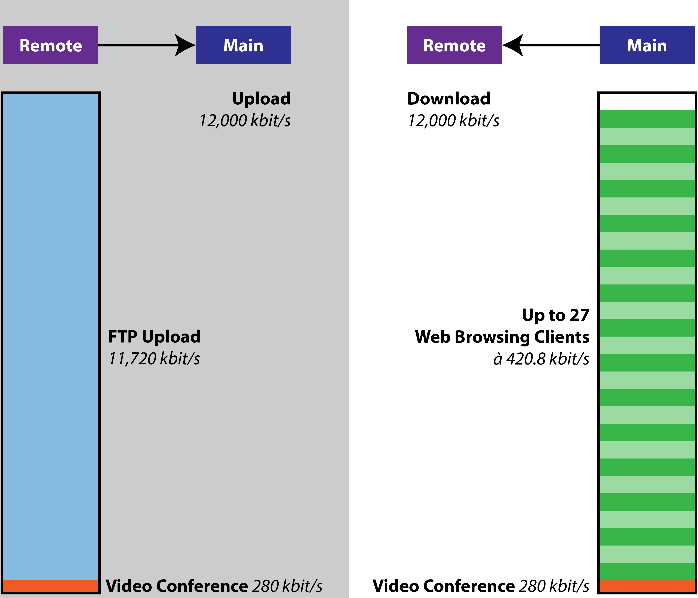
Behavior Expectations with CCTV Camera Turned OFF
Notes:
8

Slide 9
Notes:
9

Slide 10
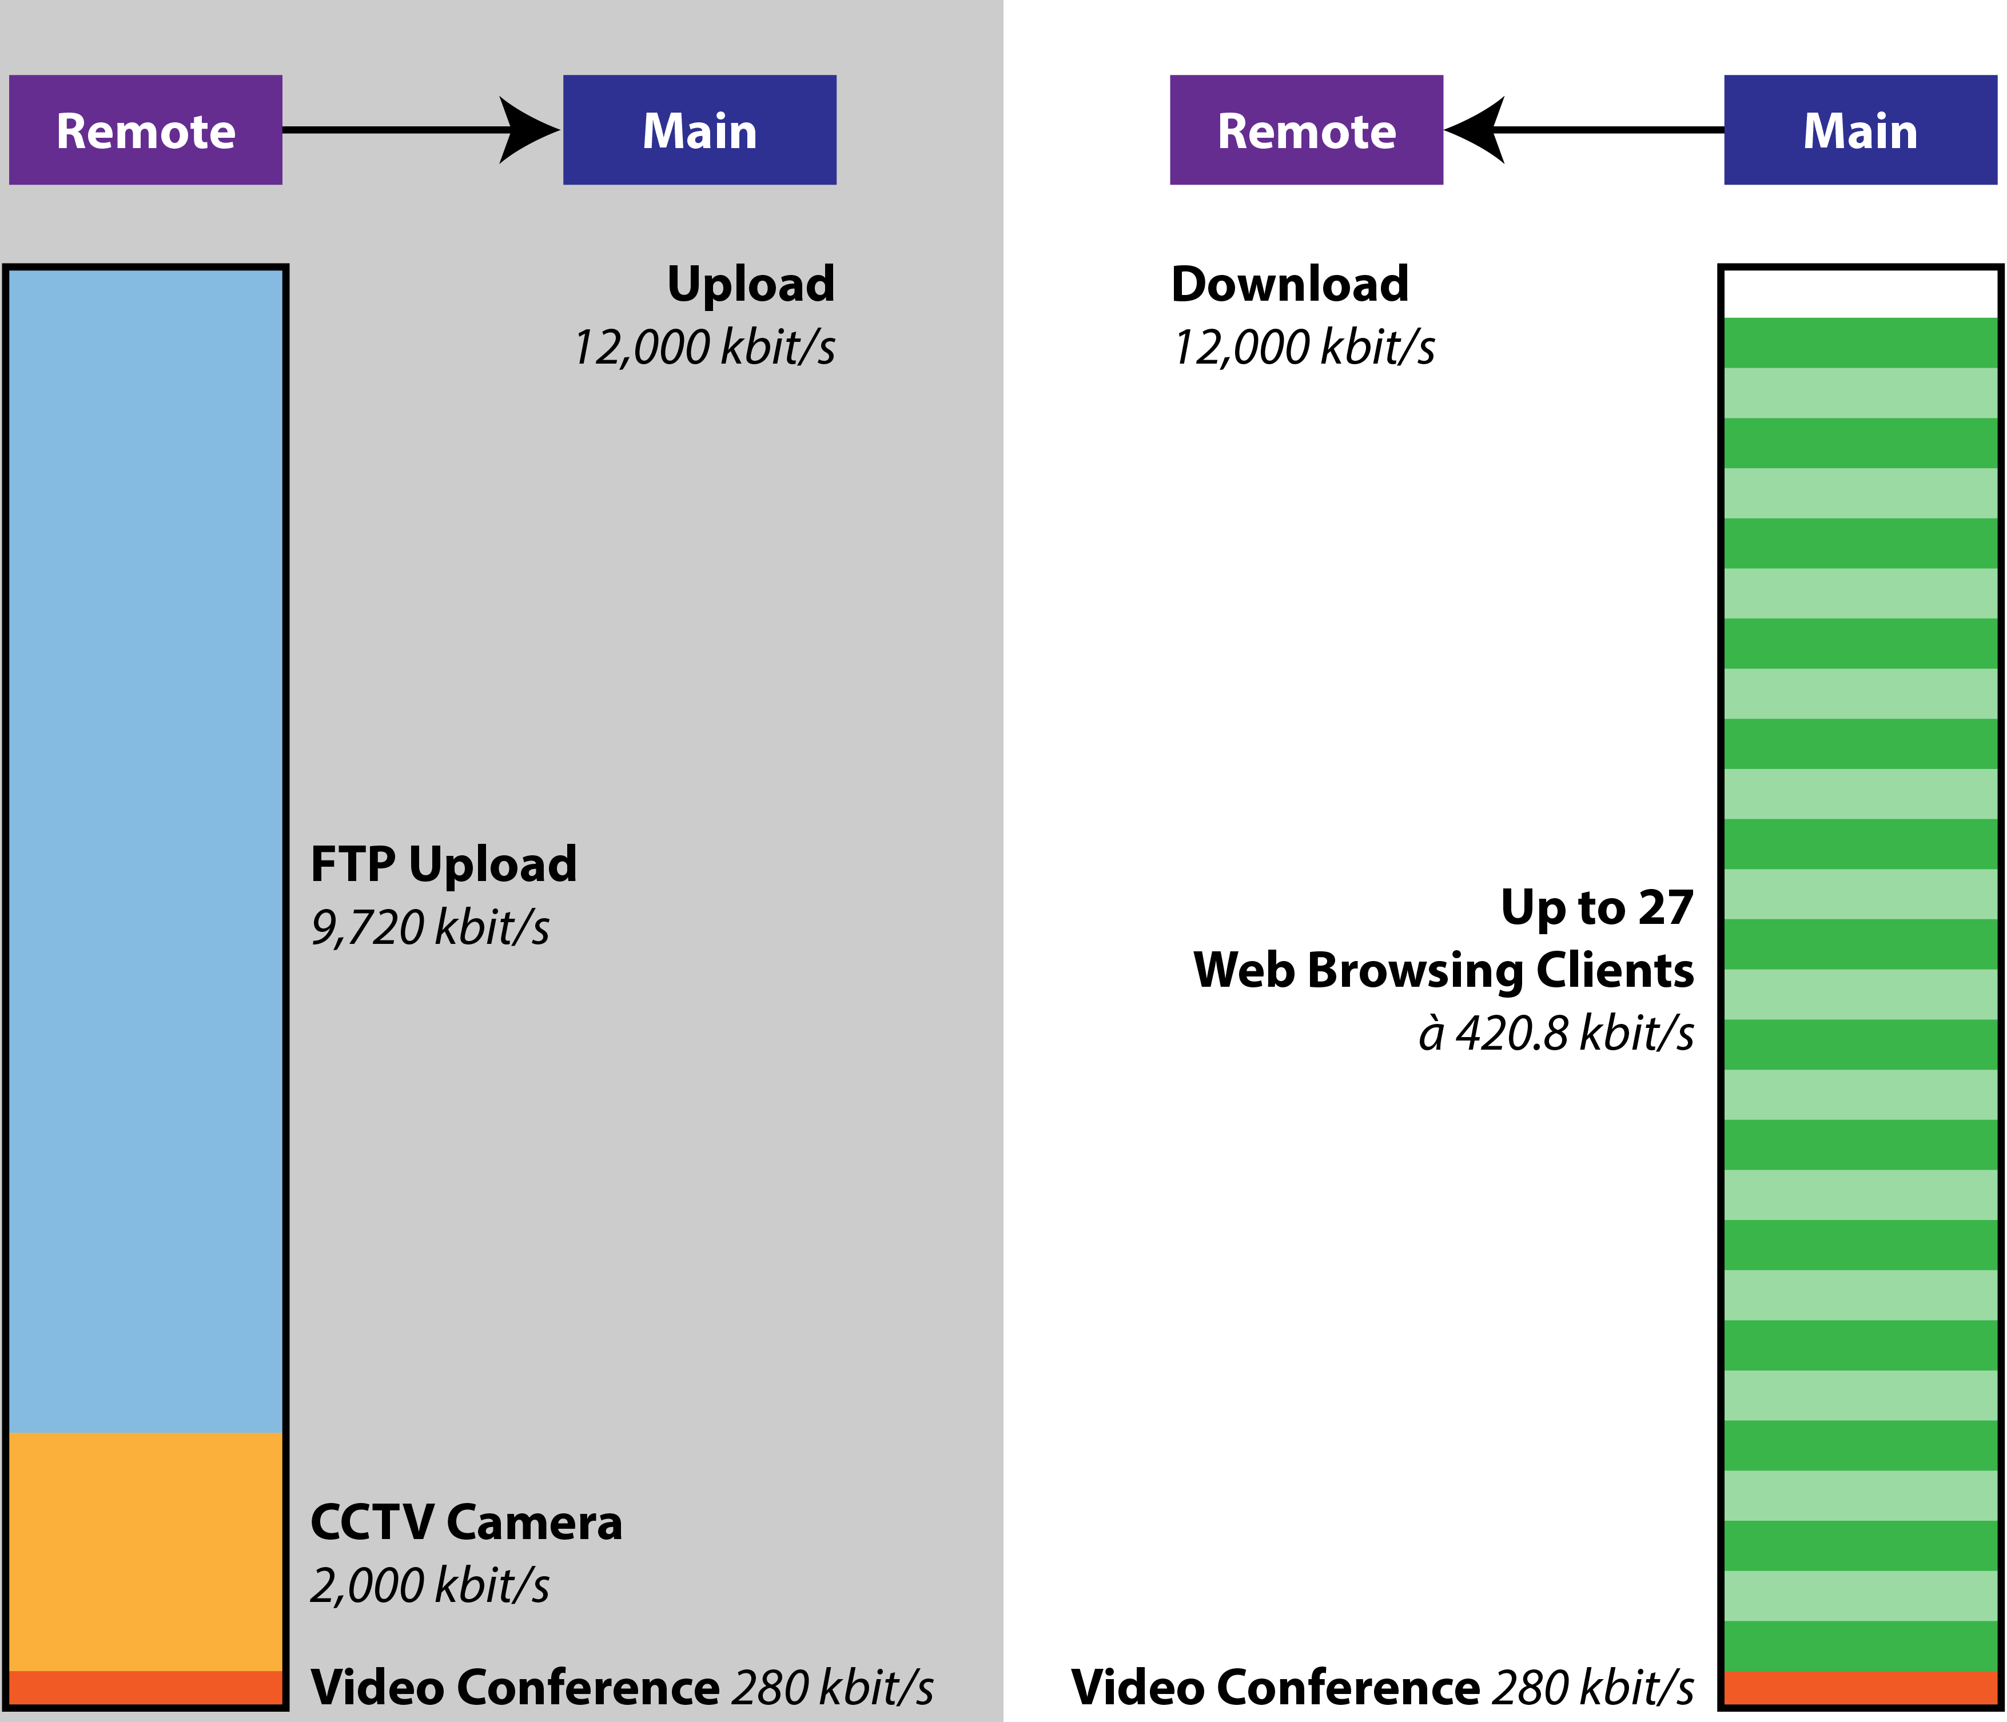
Behavior Expectations with CCTV Camera Turned ON
Notes:
10

Slide 11
Notes:
11

Slide 12
Simulation and Evaluation
CCTV turned off

Slide 13
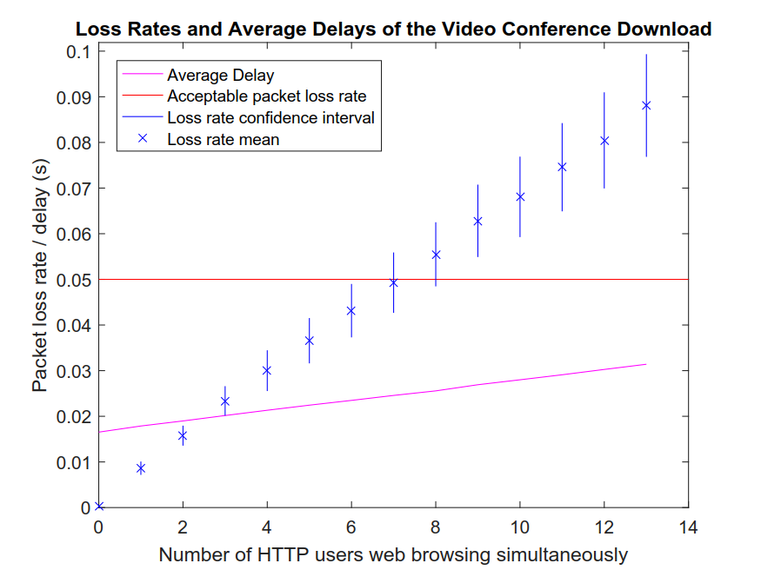
Notes:
13

Slide 14
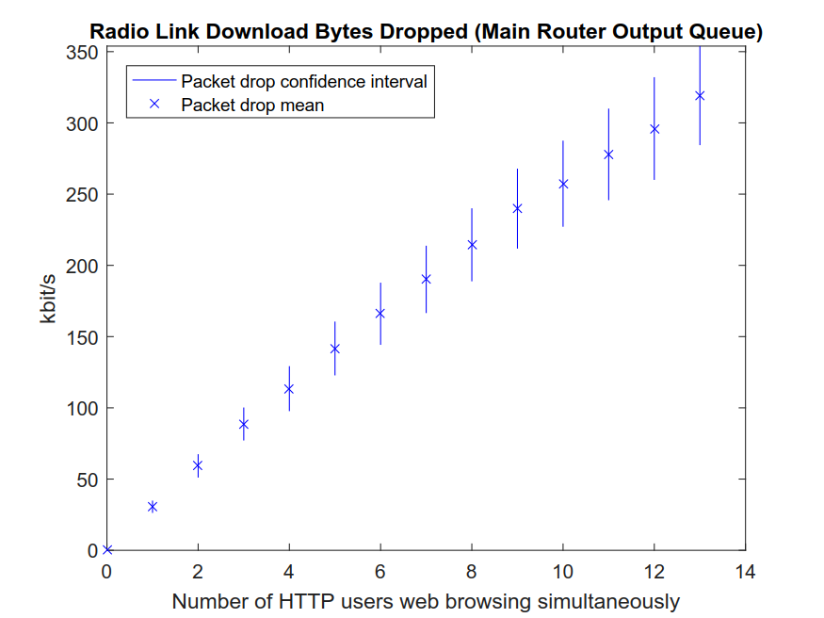
Notes:
14

Slide 15
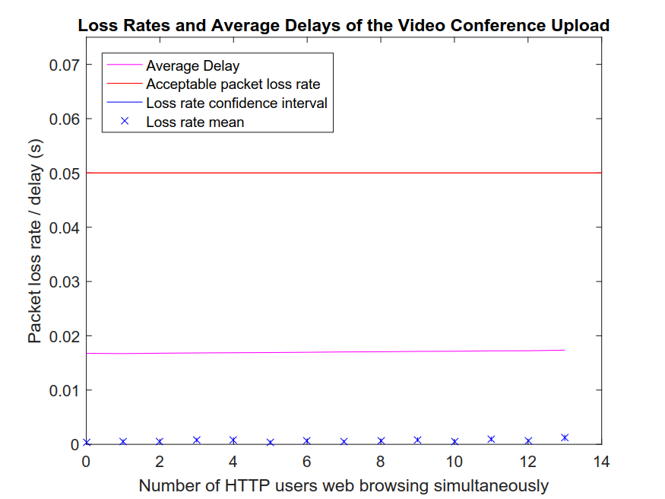
Notes:
15

Slide 16
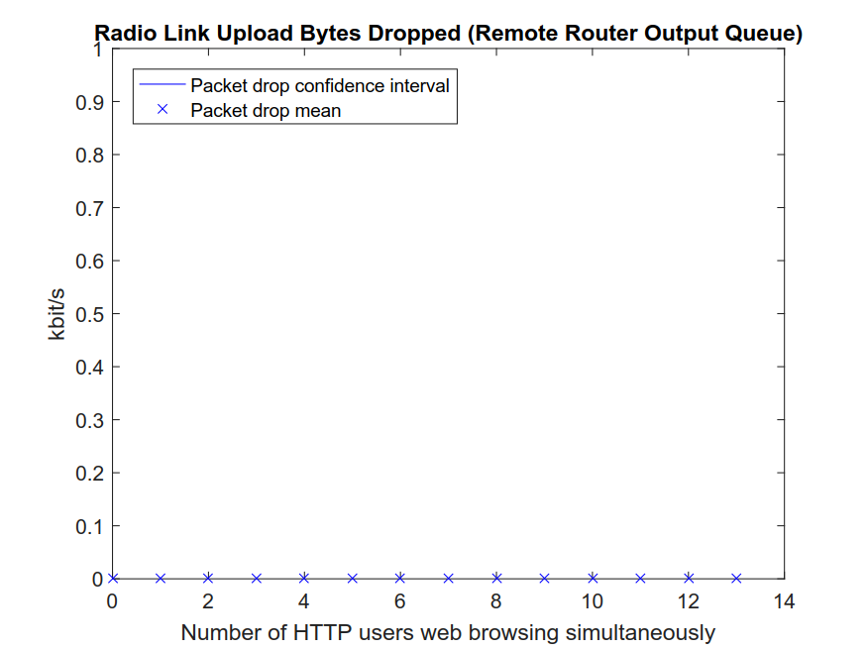
Notes:
16

Slide 17
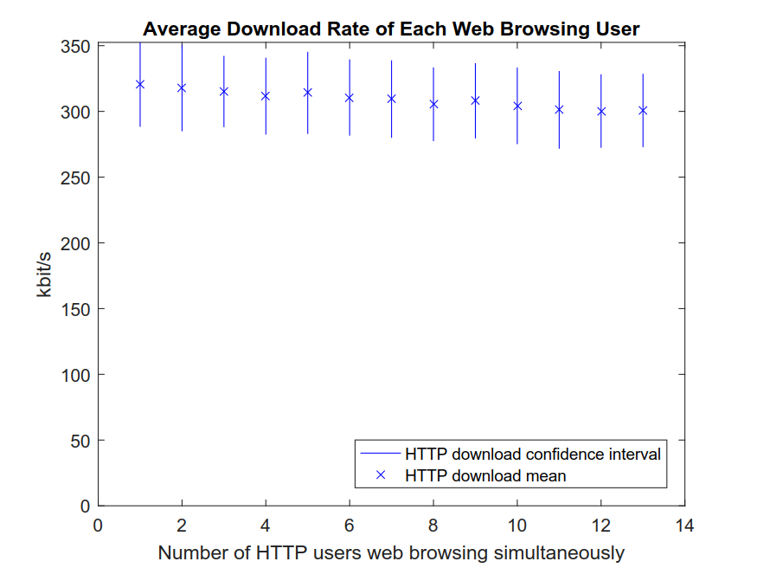
Notes:
17

Slide 18
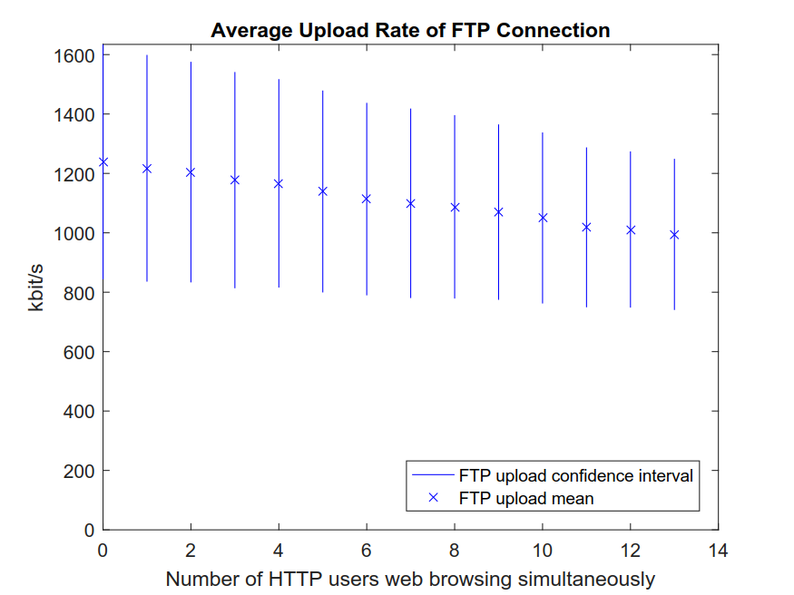
Notes:
18

Slide 19
Notes:
19

Slide 20
Notes:
20

Slide 21
Simulation and Evaluation
CCTV turned on

Slide 22
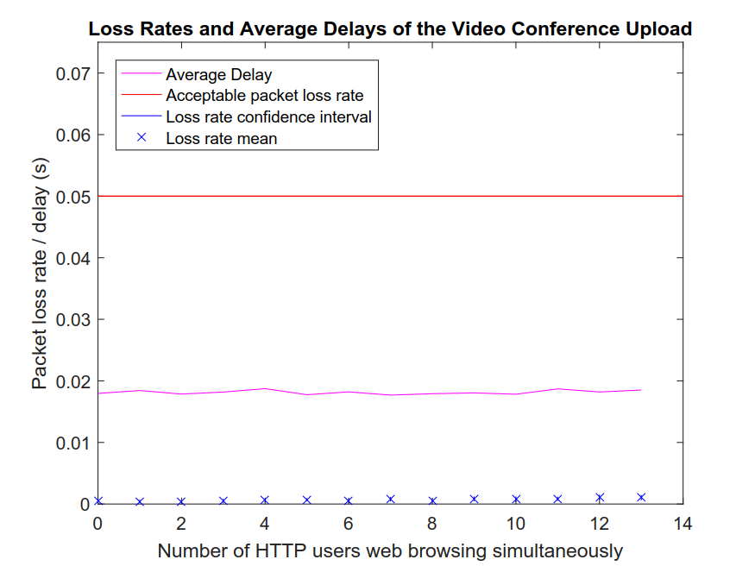
Notes:
22

Slide 23

Notes:
23

Slide 24
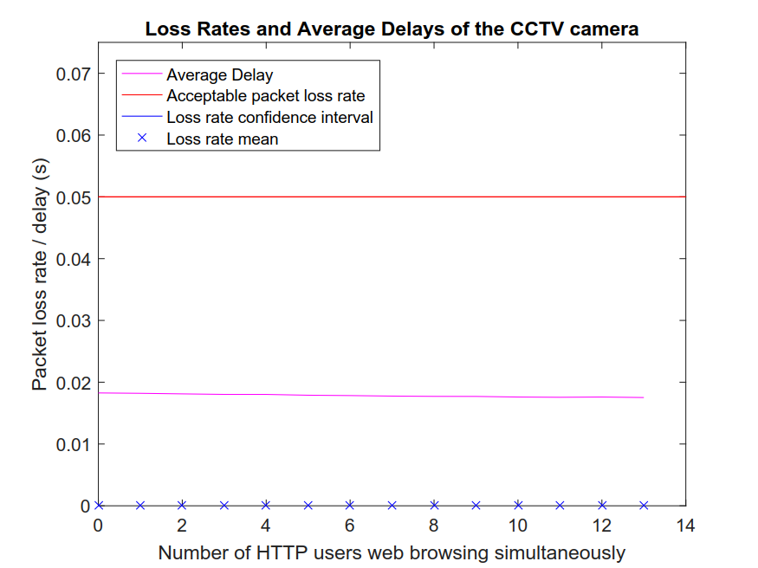
Notes:
24

Slide 25
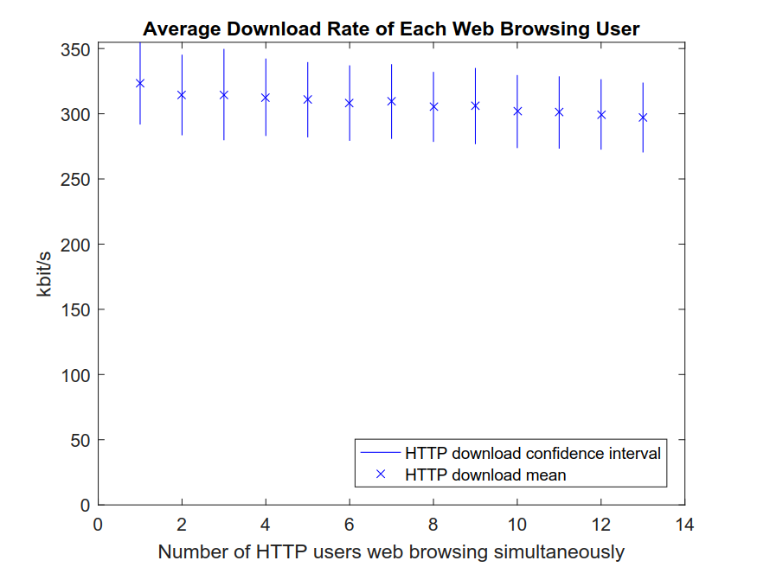
Notes:
25

Slide 26
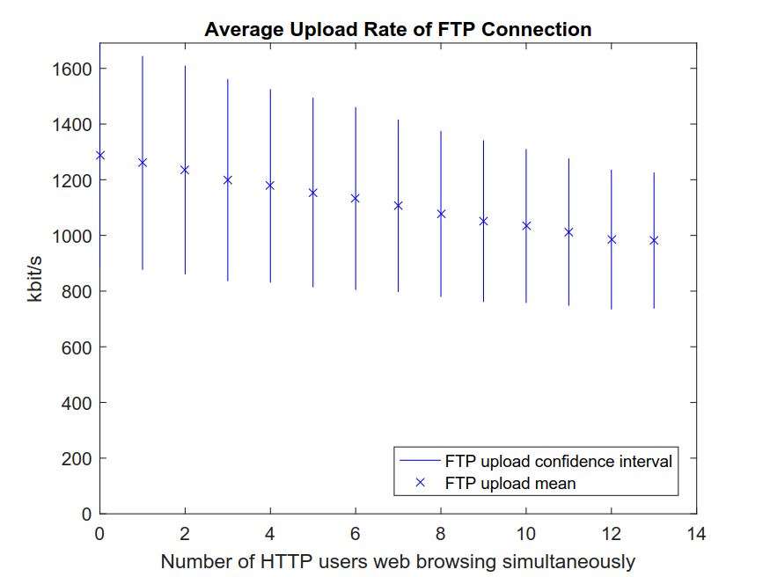
Notes:
26

Slide 27
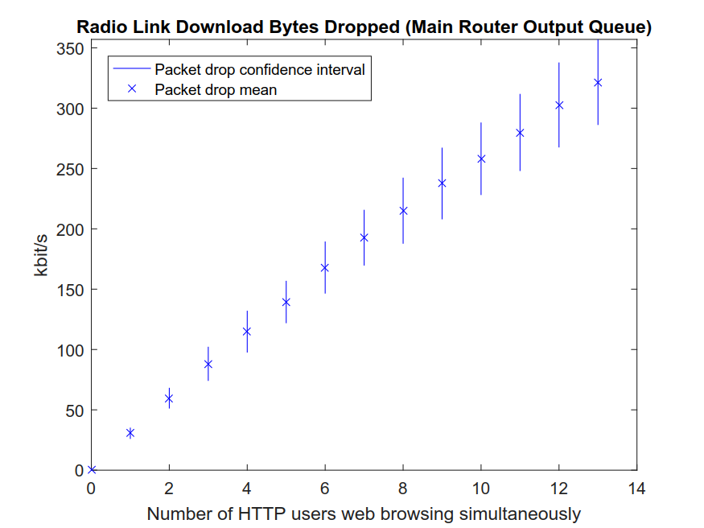
Notes:
27

Slide 28
Notes:
28

Slide 29
Notes:
29

Slide 30
Conclusion

Slide 31
Conclusion
31
Notes:
31

Slide 32
Thank you for listening!
32
Notes:
32

Slide 33
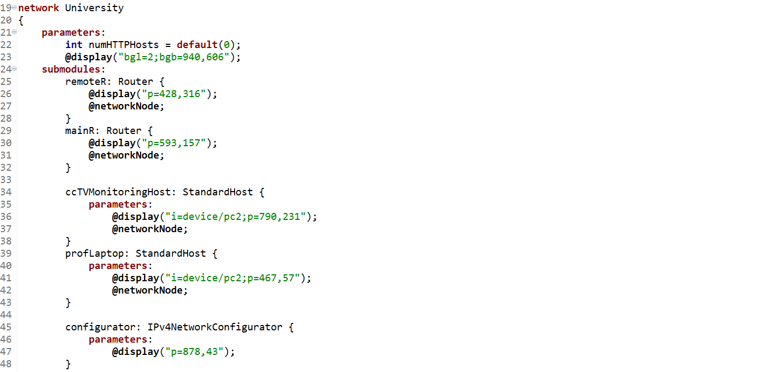
.ned Code Snippet (1)
33
Notes:
33

Slide 34
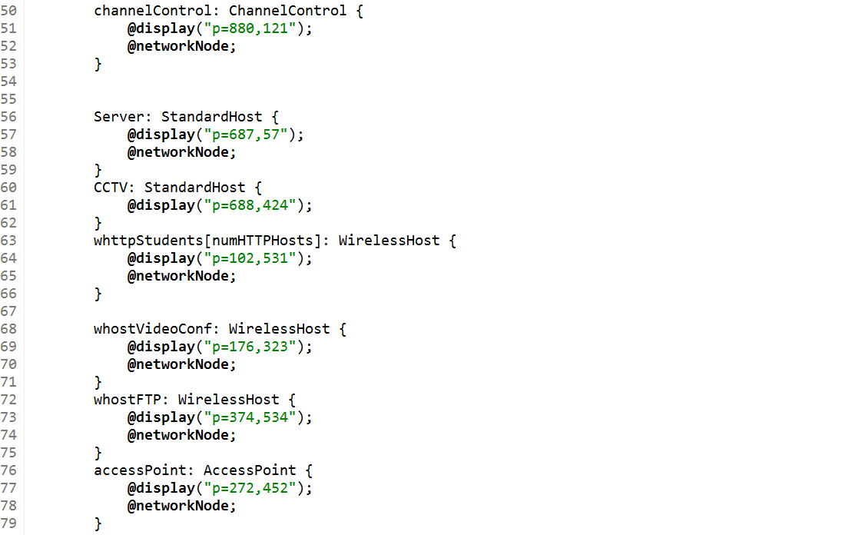
.ned Code Snippet (2)
34
Notes:
34

Slide 35
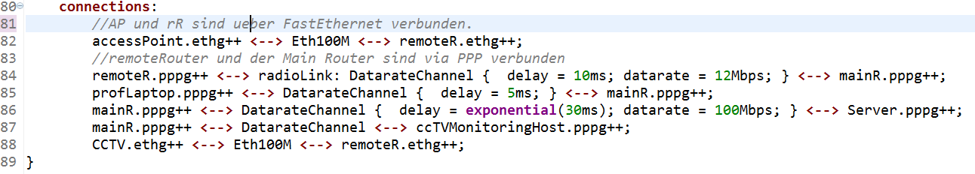
.ned Code Snippet (3)
35
Notes:
35

Slide 36
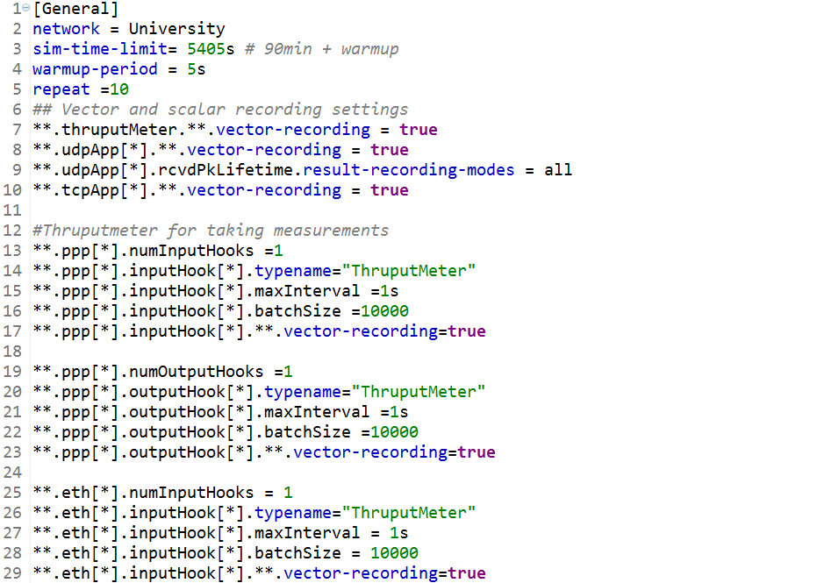
.ini Code Snippet (General + Recording)
36
Notes:
36

Slide 37
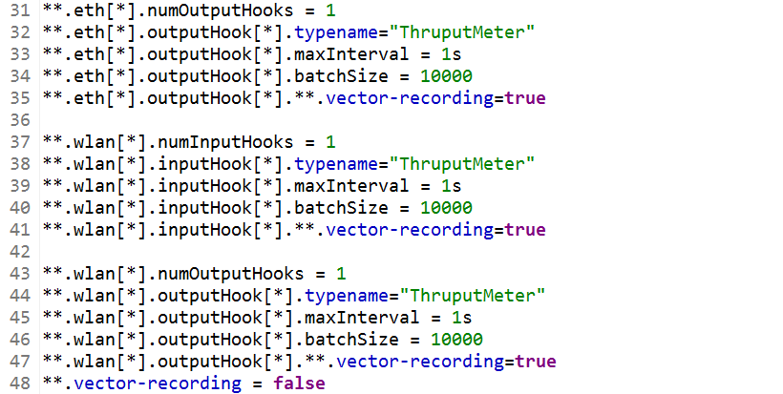
.ini Code Snippet (Recording cont.)
37
Notes:
37

Slide 38
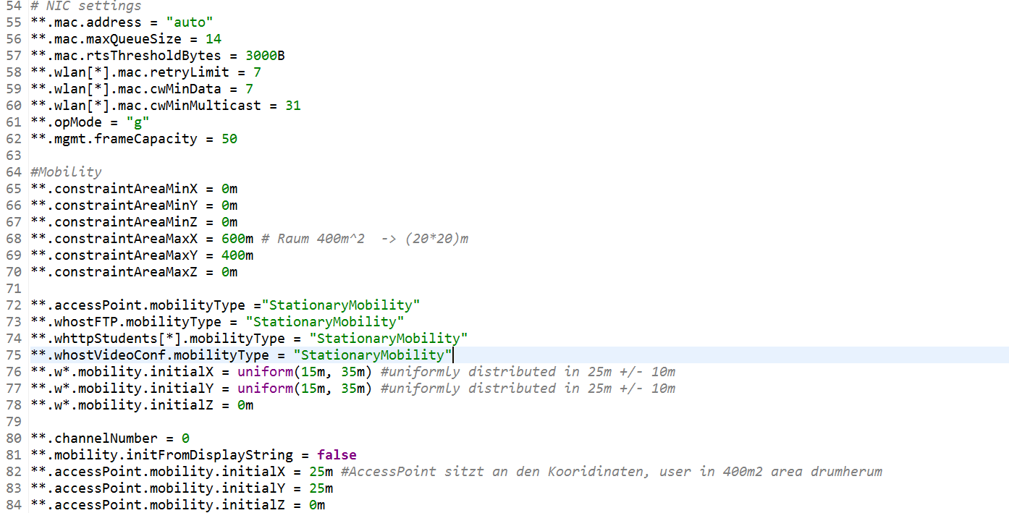
.ini Code Snippet (WLAN)
38
Notes:
38

Slide 39
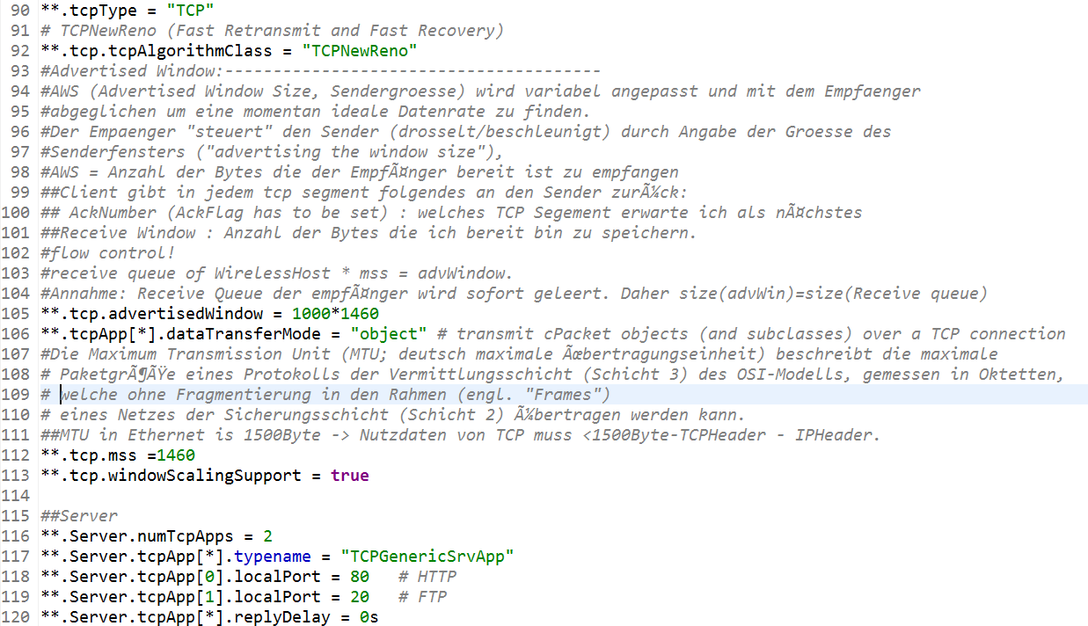
.ini Code Snippet (TCP General + Server)
39
Notes:
39

Slide 40
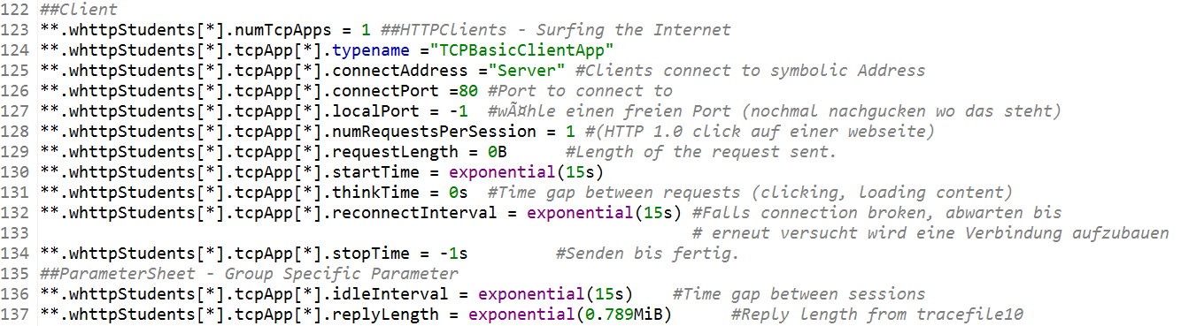
.ini Code Snippet (TCP HTTP Client)
40
Notes:
40

Slide 41
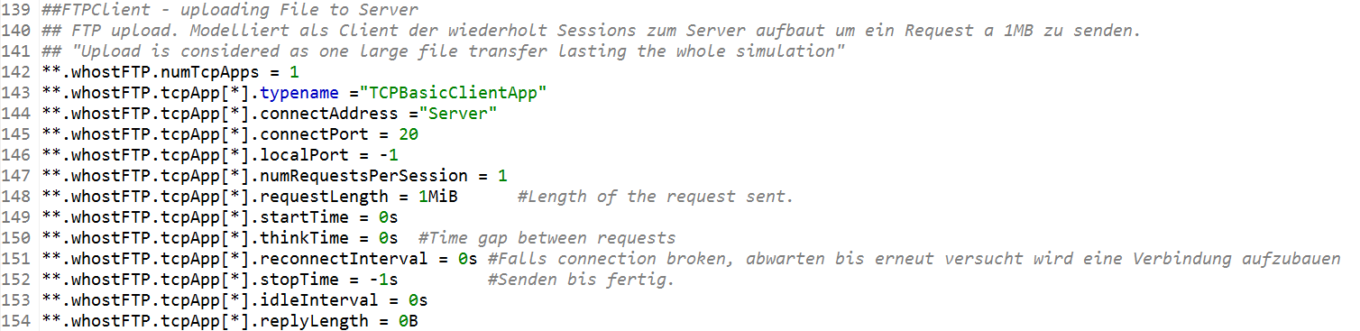
.ini Code Snippet (TCP FTP Upload)
41
Notes:
41

Slide 42
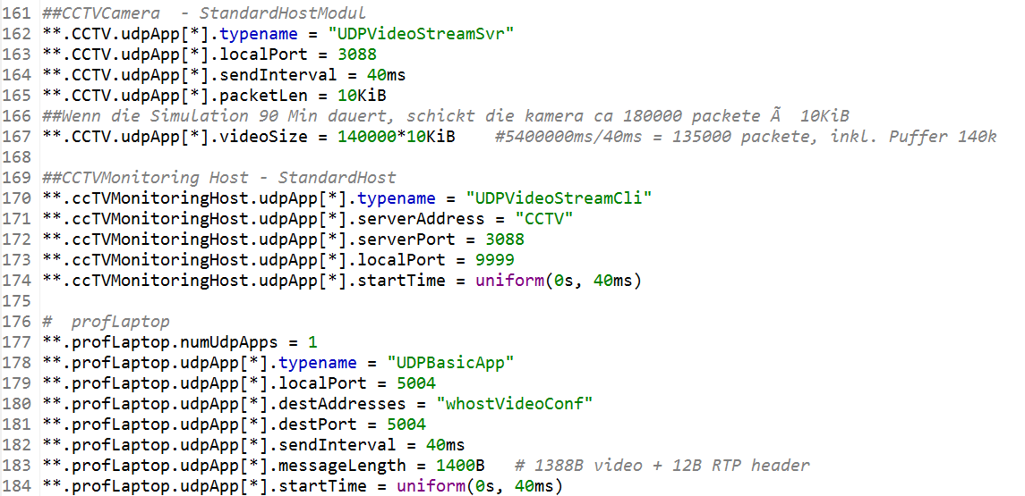
.ini Code Snippet (UDP CCTV + Professors Laptop)
42
Notes:
42

Slide 43
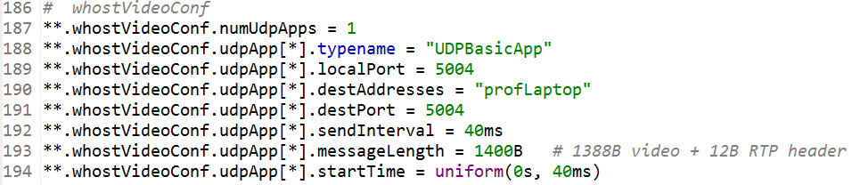
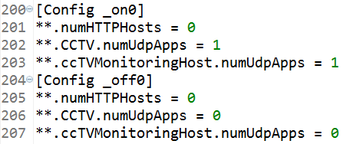
.ini Code Snippet (UDP Video Client + Run Config)
43
Notes:
43

