Slide 1

Exam Presentation Simulation and Modelling of Communication Networks September 6, 2016
Nina Piontek
nina.piontek@tu-hamburg.de
Daniel Plöger
daniel.ploeger@tu-hamburg.de
Hamburg University of Technology
Notes:
1

Slide 2
Contents
2
Network overview
Assumptions and modeling
Simulation and evaluation
Conclusion
Notes:
2

Slide 3
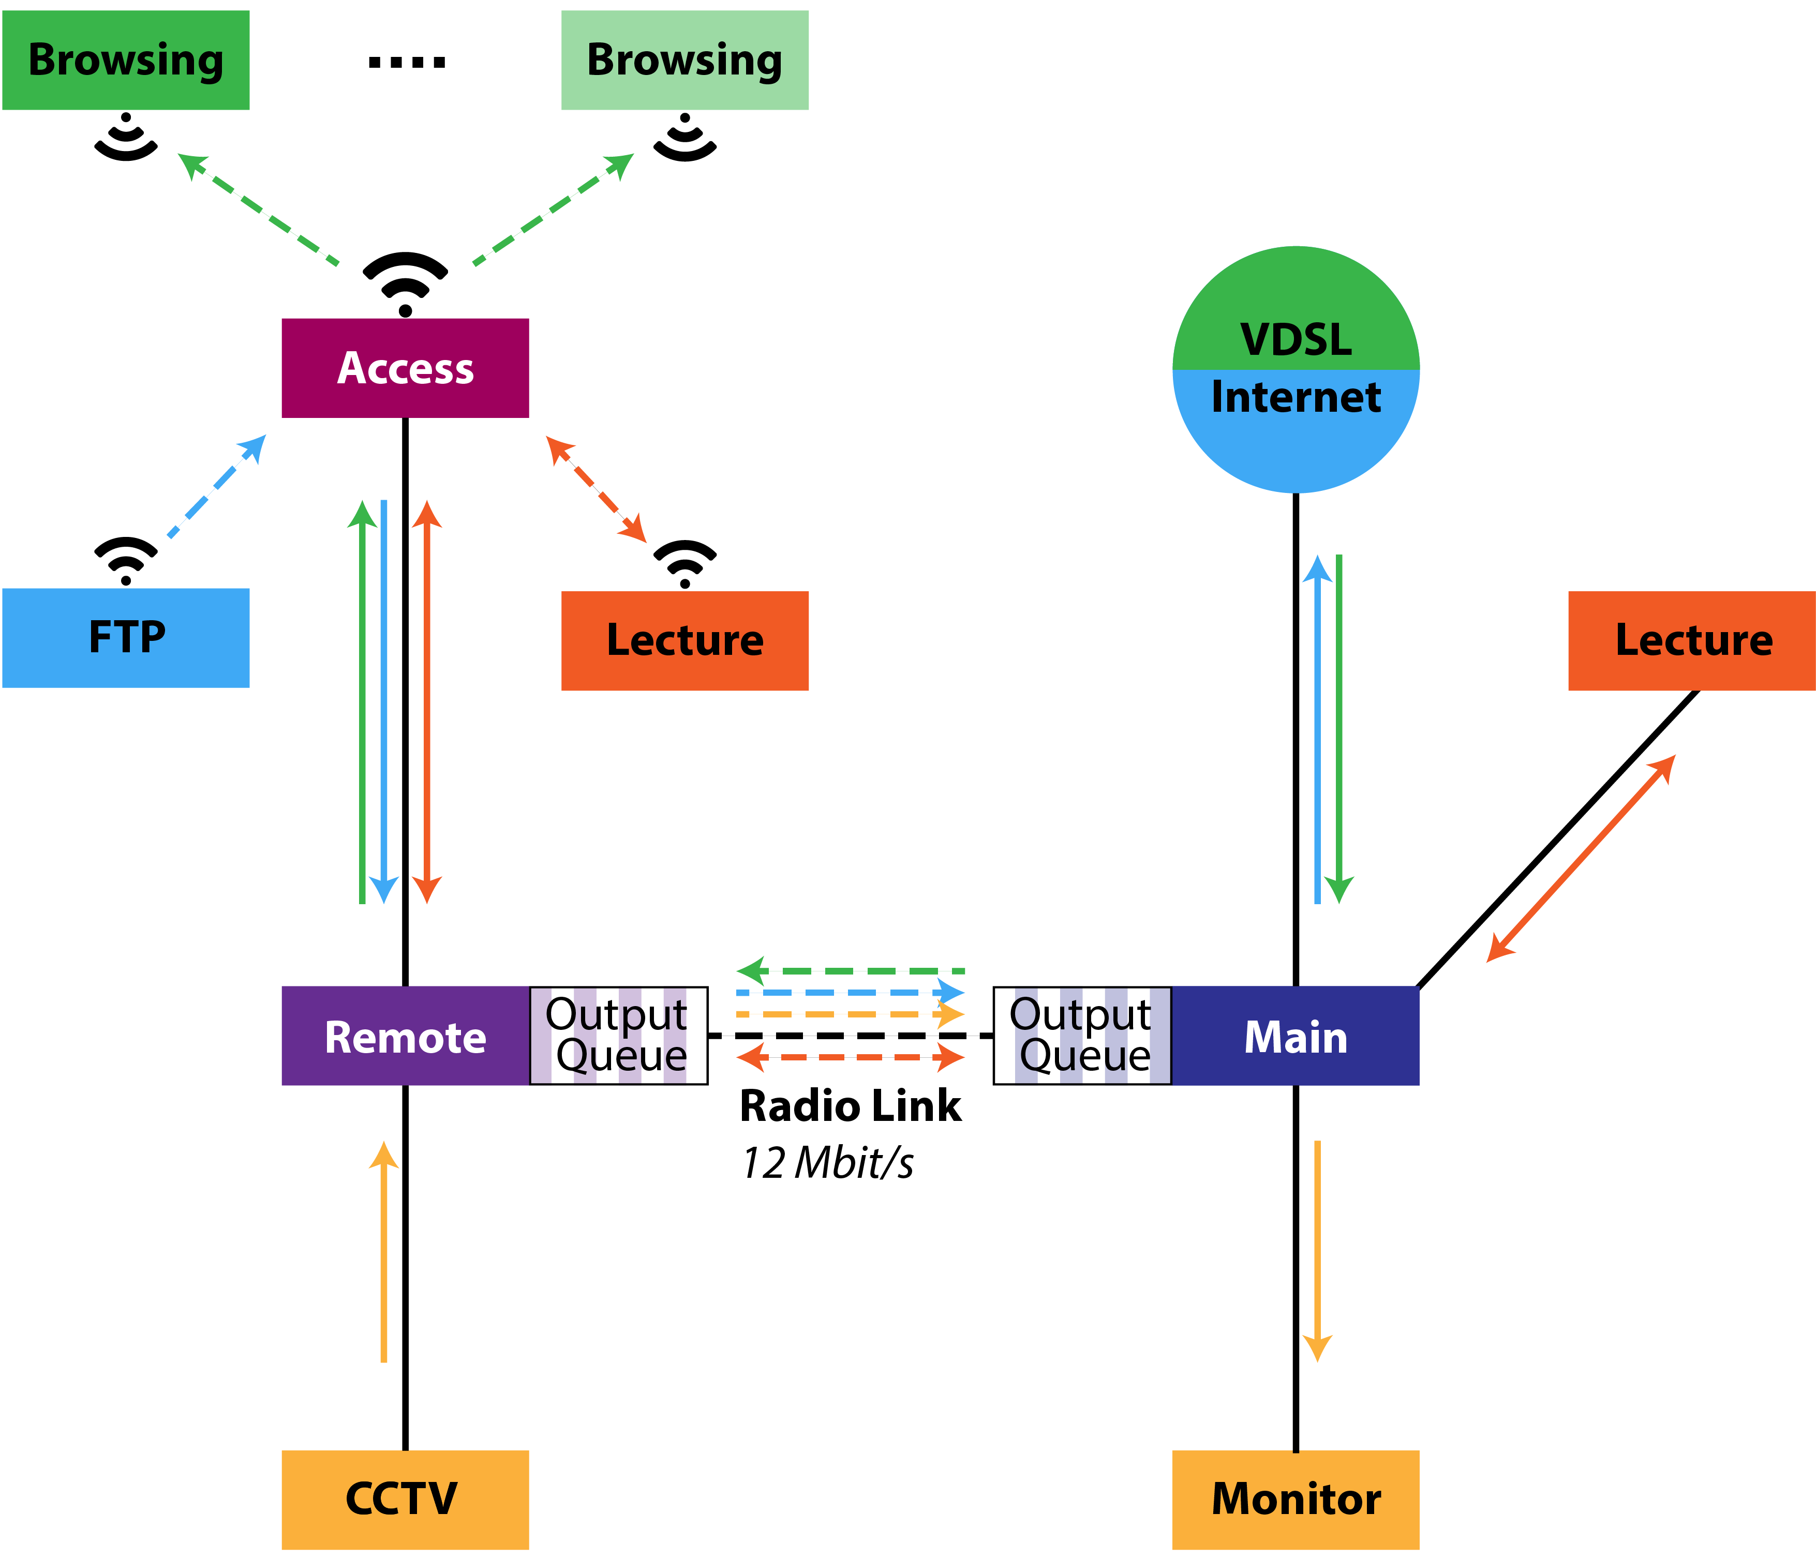
Network Overview
Web browsing (download)
FTP service for file upload
Video lecture in both directions
CCTV camera upload (optional)
Quality of service requirements
Video packet delay smaller than 100 ms
Exceeding delay plus packet drops less than 5 %
Notes:
3

Slide 4
Assumptions and Modeling

Slide 5
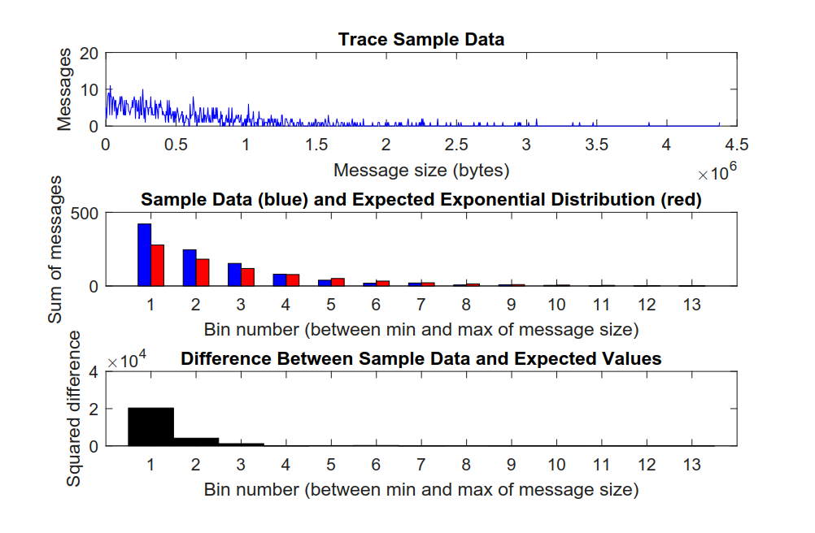
HTTP Traffic Analysis
Notes:
5

Slide 6
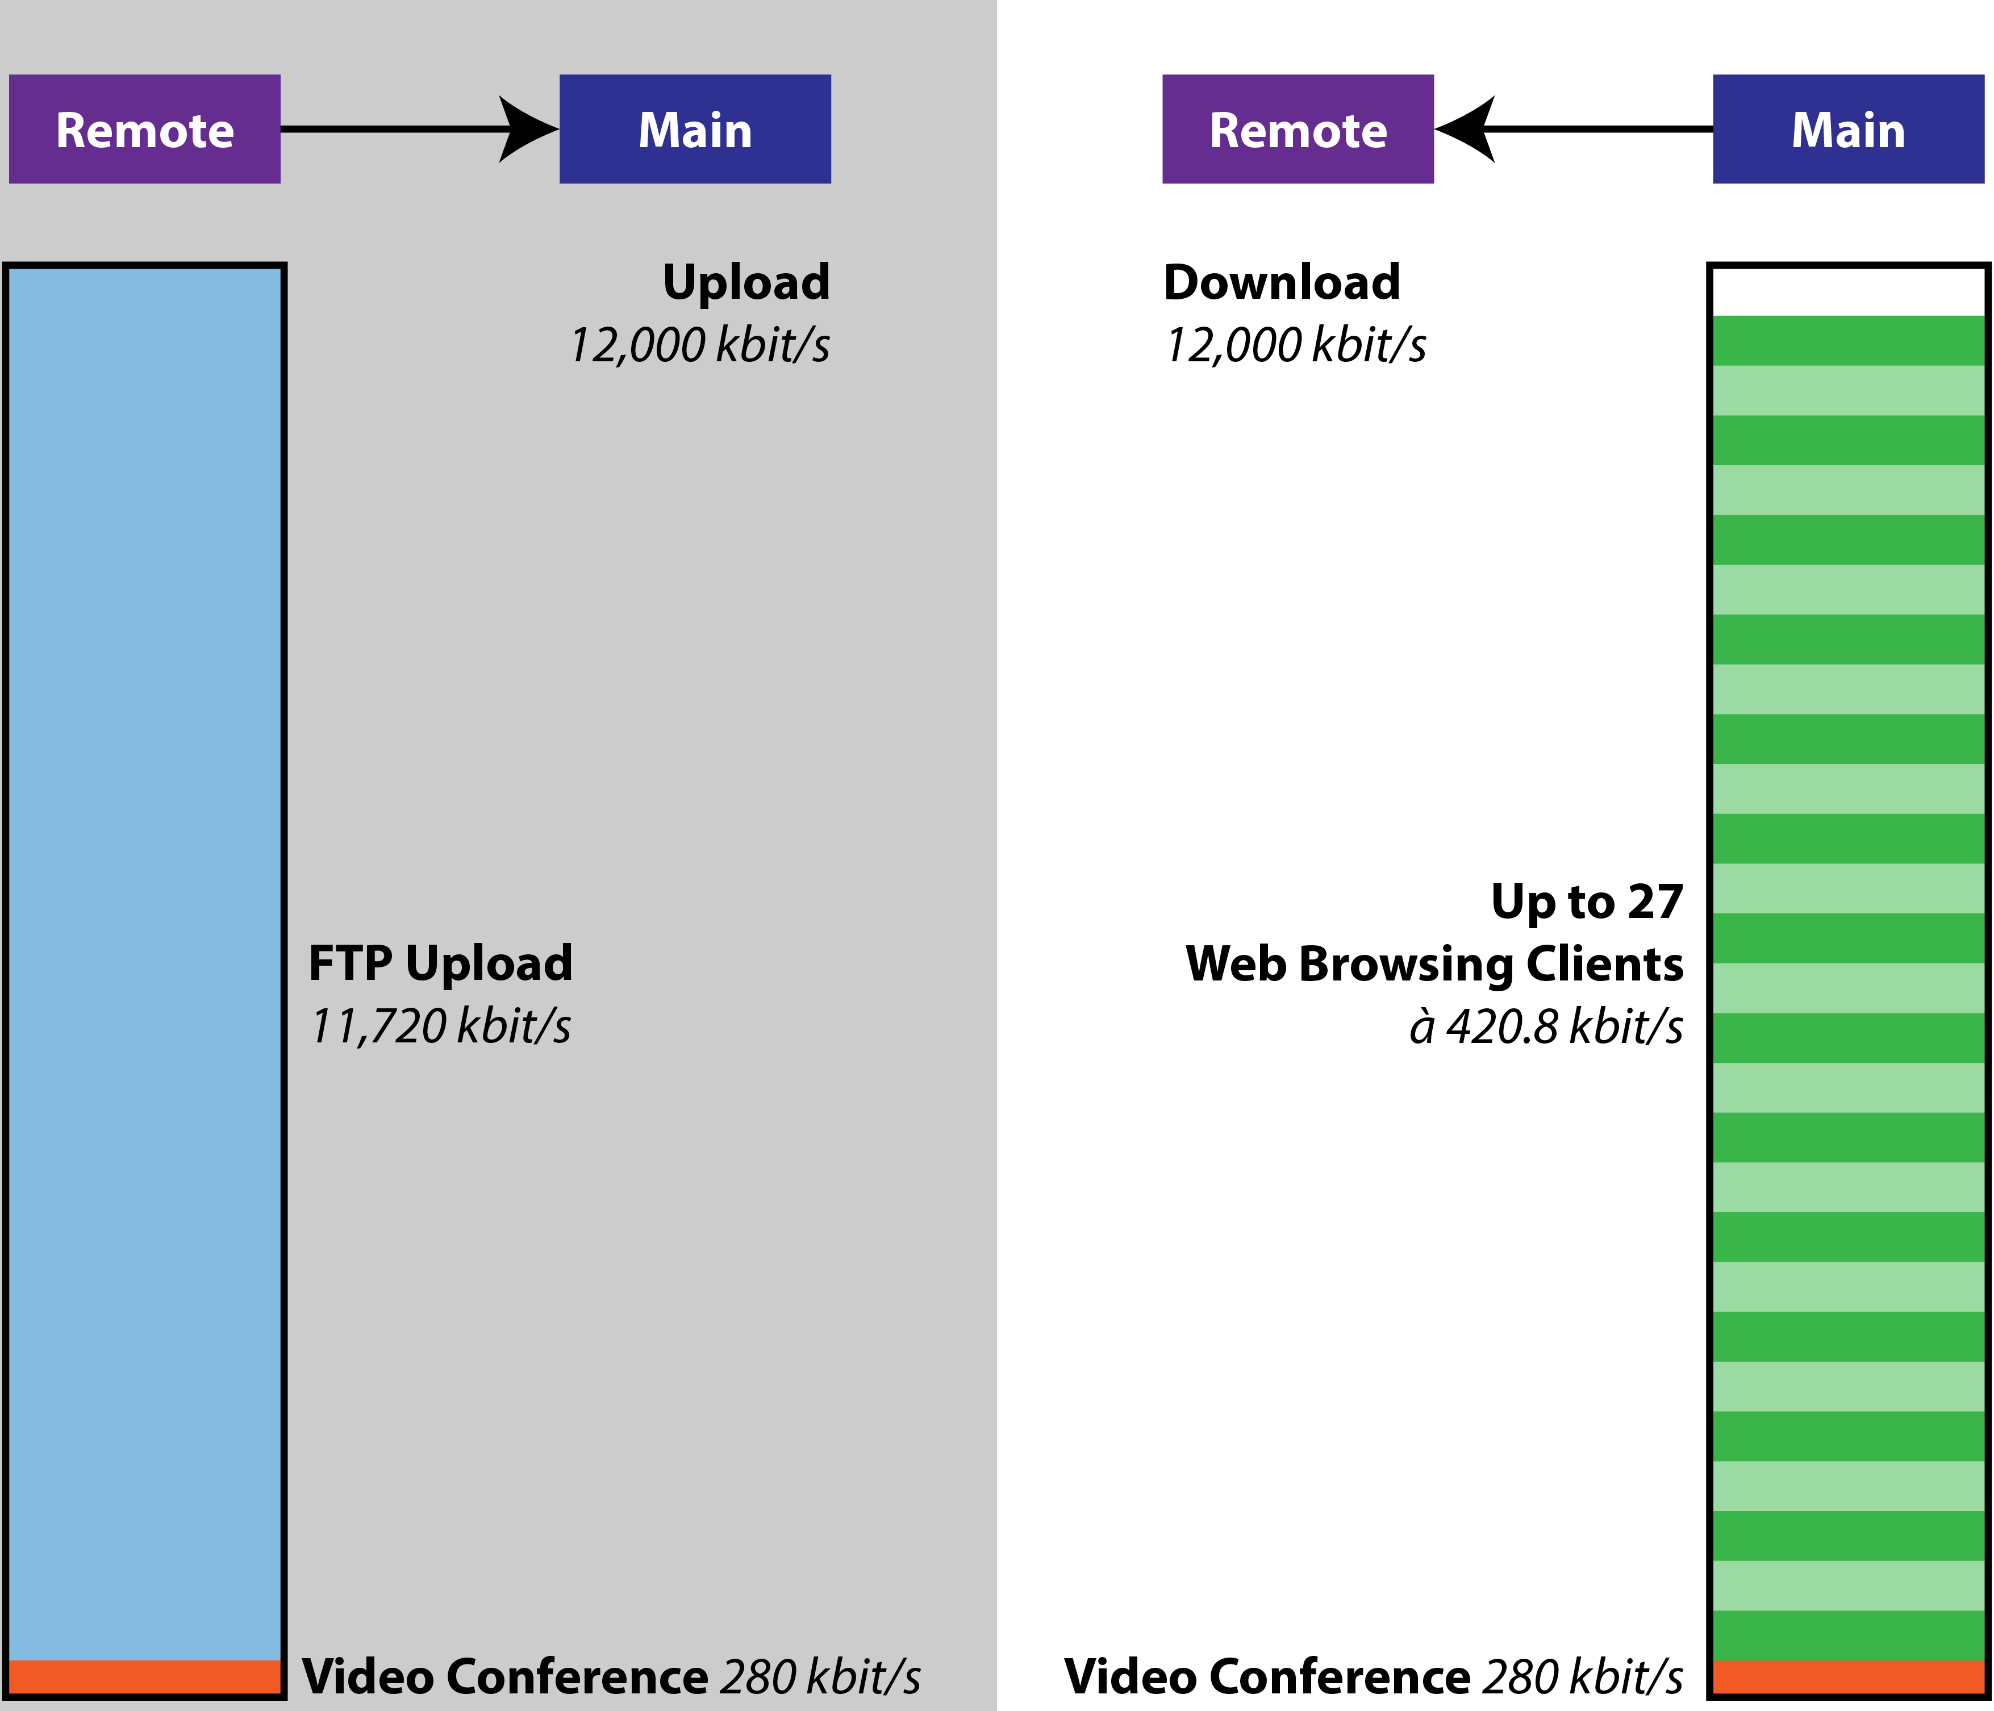
Behavior Expectations with CCTV Camera Turned OFF
Notes:
6

Slide 7
Notes:
7

Slide 8
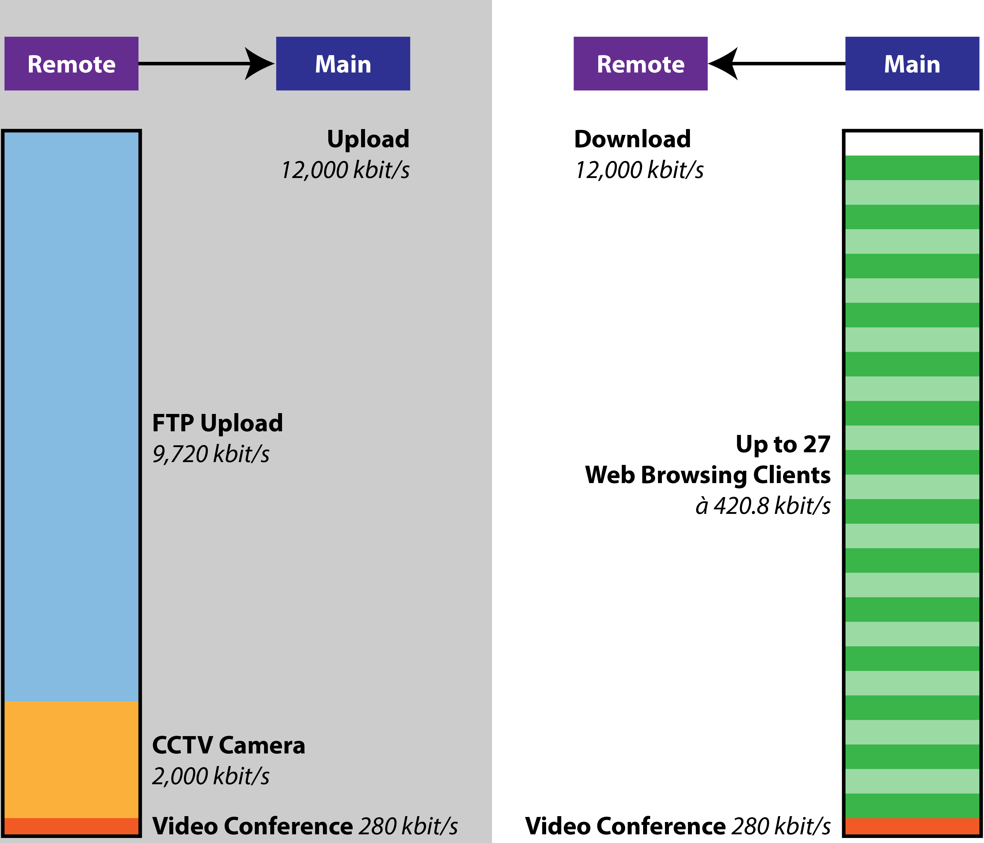
Behavior Expectations with CCTV Camera Turned ON
Point-to-point radio link is the weakest link
Maximum 27 uniformly distributed web browsing clients supported in theory
Even less clients in practice (high data peaks instead of uniform distribution)
Notes:
8
FTP upload: residual bandwidth
CCTV and FTP upload independent of number of clients

Slide 9
Simulation and Evaluation
CCTV turned off

Slide 10
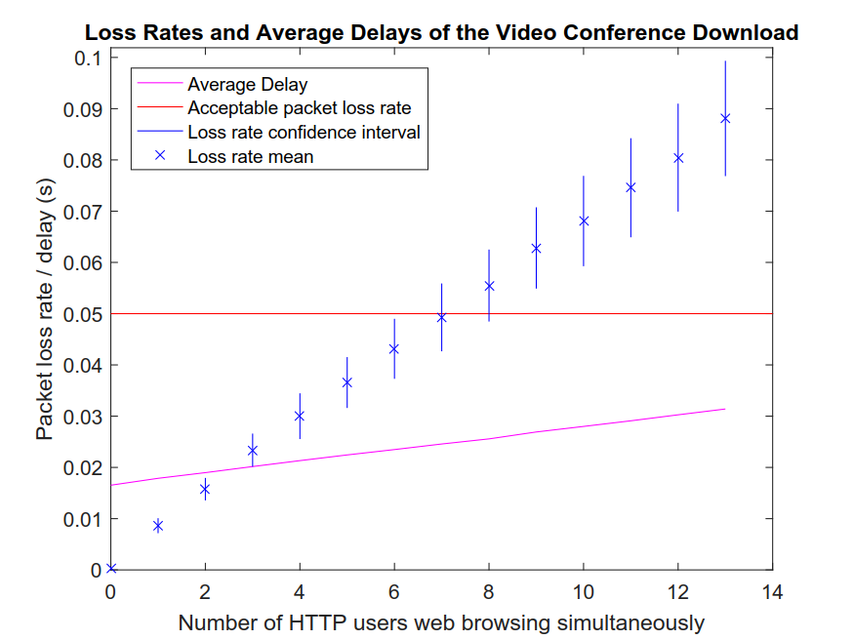
Notes:
10

Slide 11
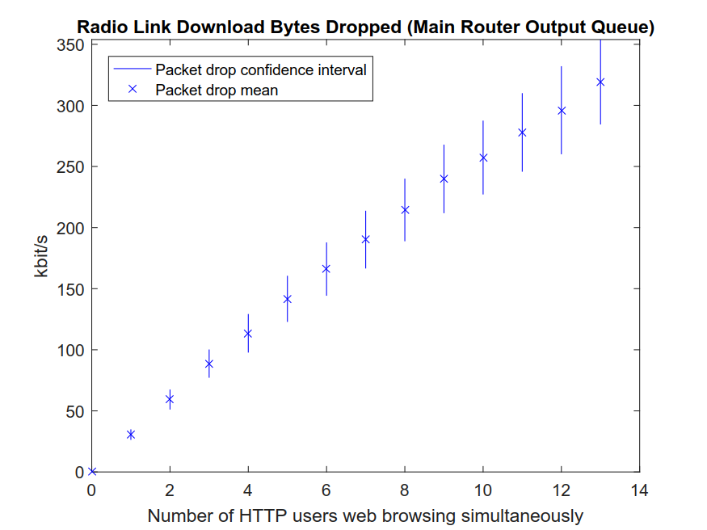
Notes:
11

Slide 12
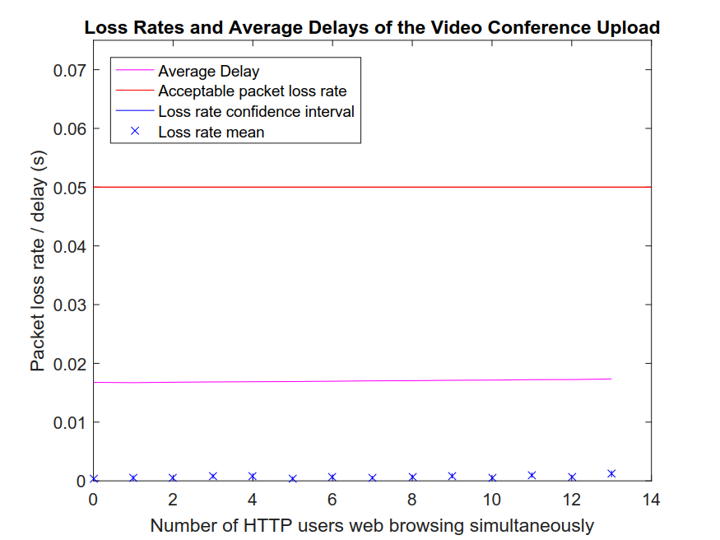
Notes:
12

Slide 13
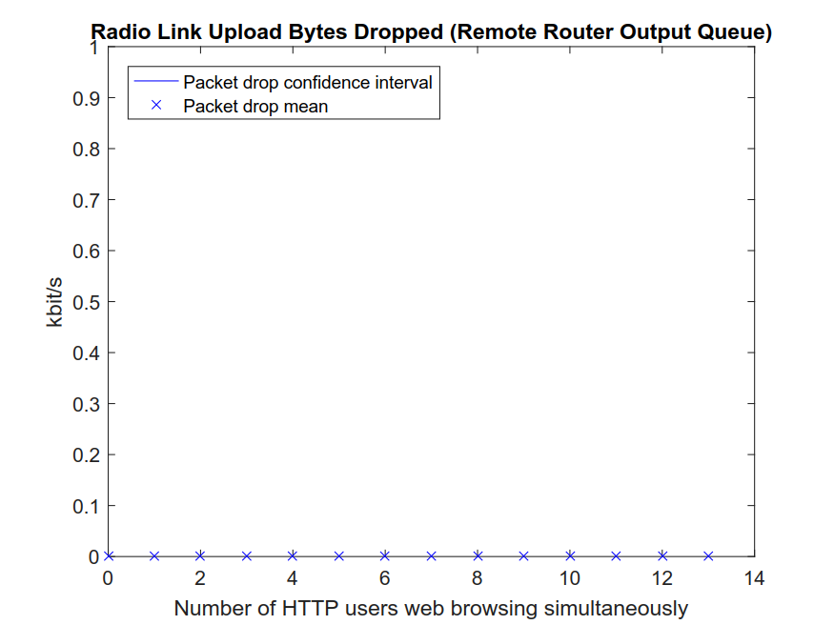
Notes:
13

Slide 14
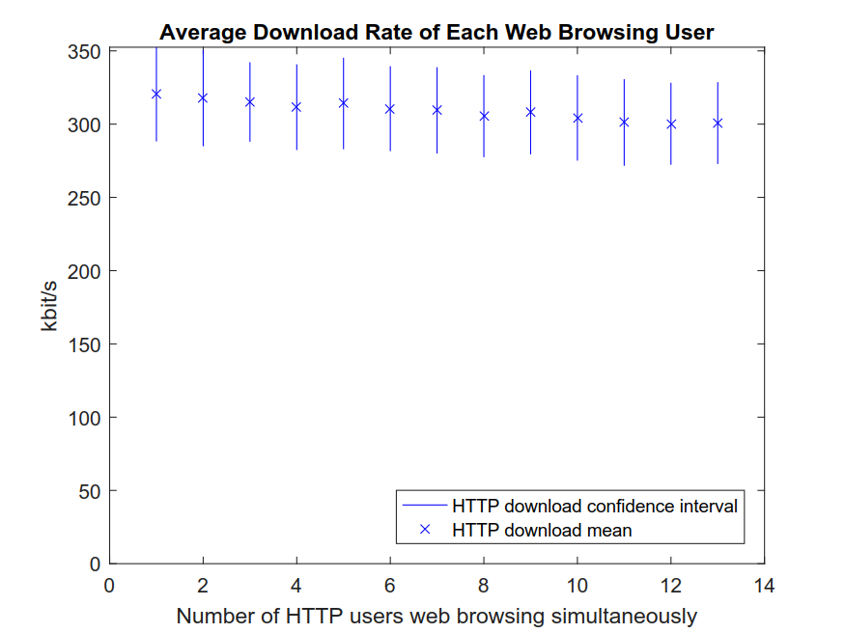
Notes:
14

Slide 15
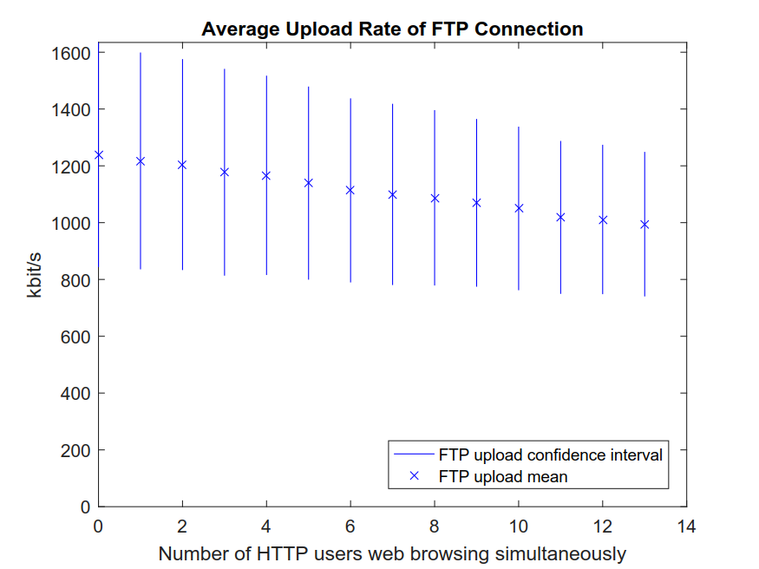
Notes:
15

Slide 16
Notes:
16

Slide 17
Notes:
17

Slide 18
Simulation and Evaluation
CCTV turned on

Slide 19
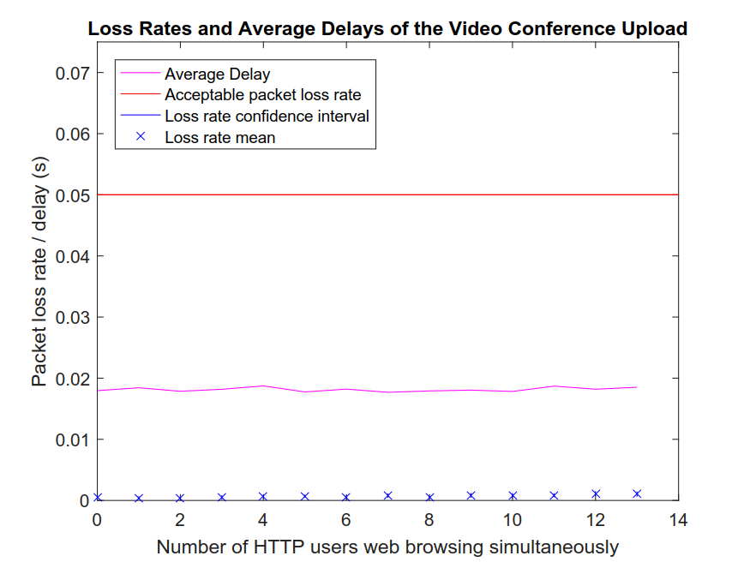
Notes:
19

Slide 20

Notes:
20

Slide 21
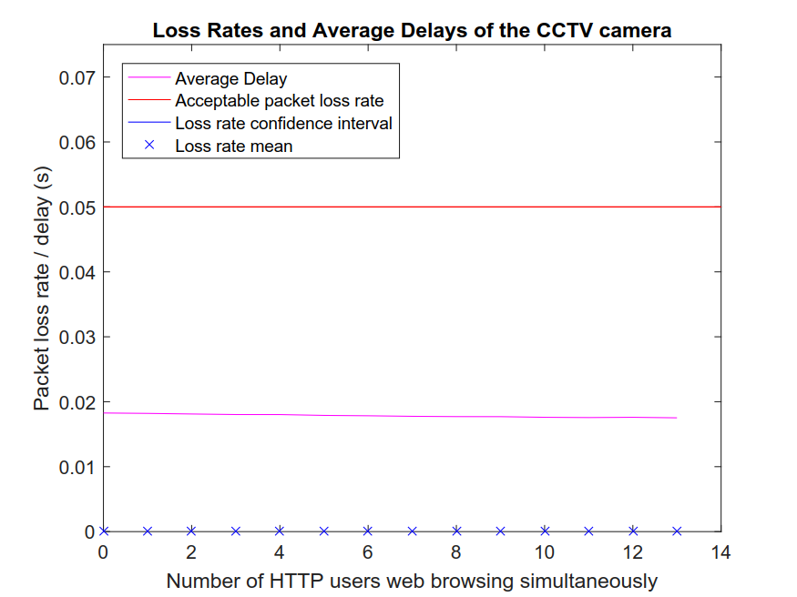
Notes:
21

Slide 22
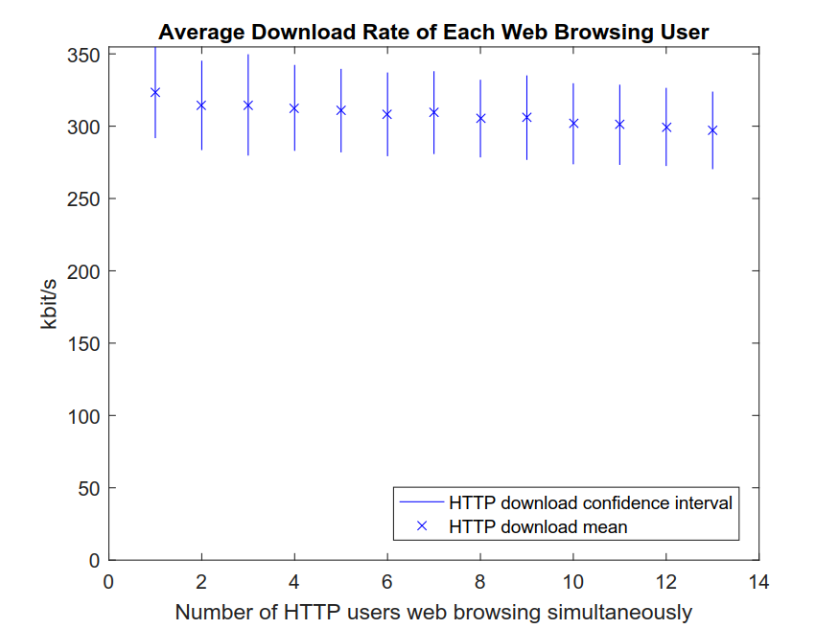
Notes:
22

Slide 23
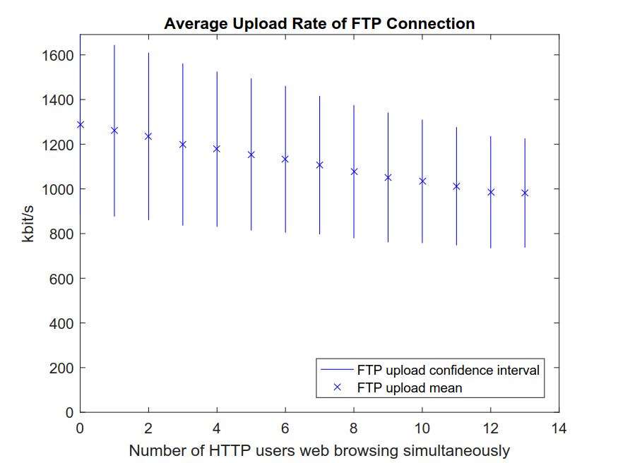
Notes:
23

Slide 24
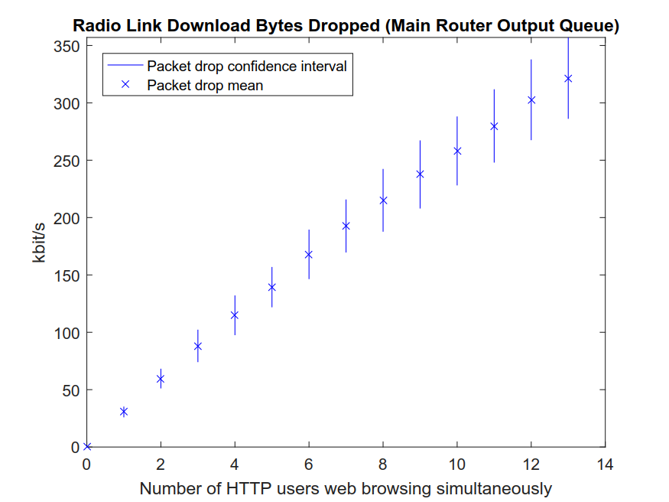
Notes:
24

Slide 25
Notes:
25

Slide 26
Notes:
26

Slide 27
Conclusion

Slide 28
Conclusion
28
Notes:
28

Slide 29
Thank you for listening!
29
Notes:
29

Slide 30
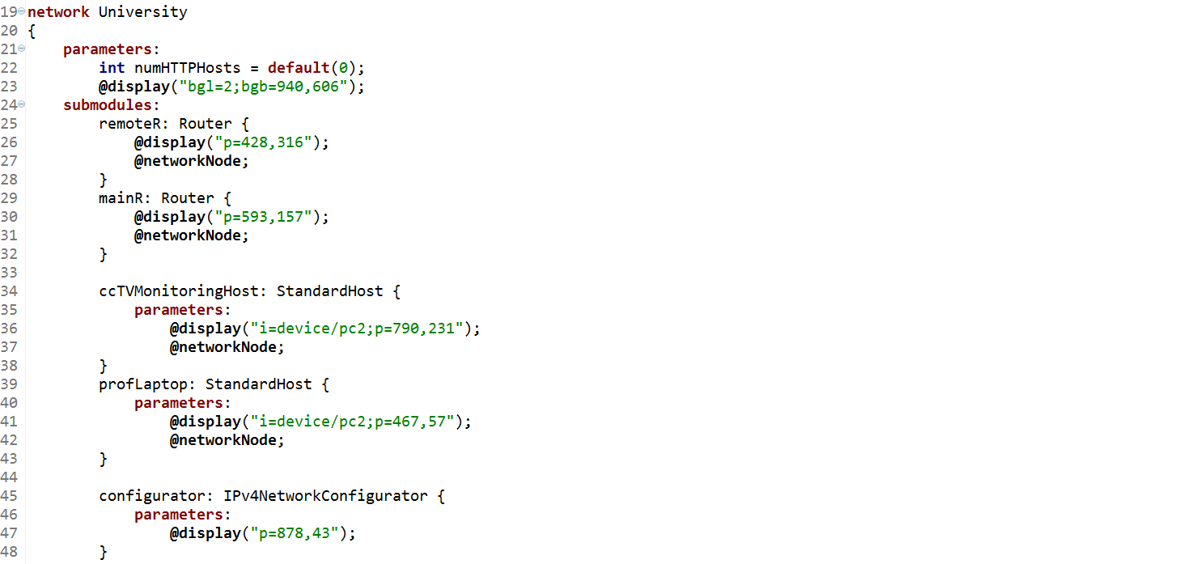
.ned Code Snippet (1)
30
Notes:
30

Slide 31
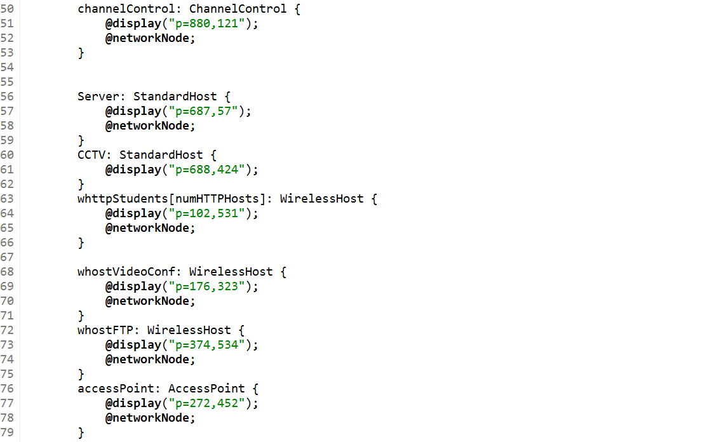
.ned Code Snippet (2)
31
Notes:
31

Slide 32
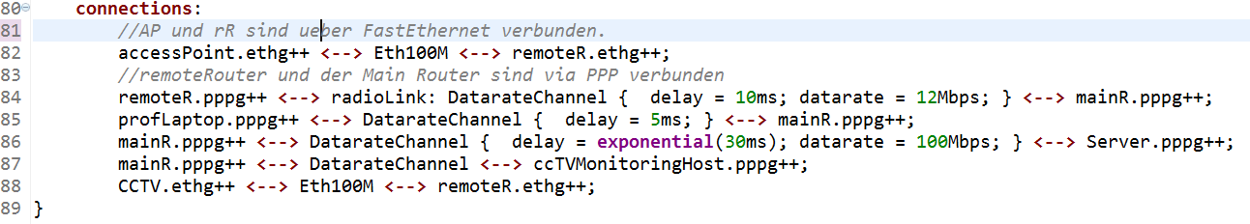
.ned Code Snippet (3)
32
Notes:
32

Slide 33
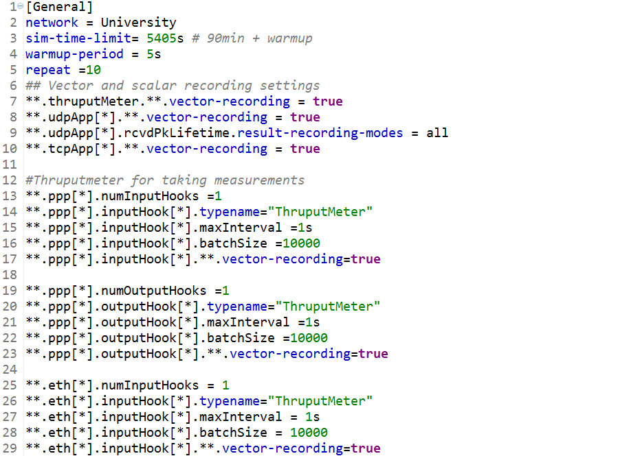
.ini Code Snippet (General + Recording)
33
Notes:
33

Slide 34
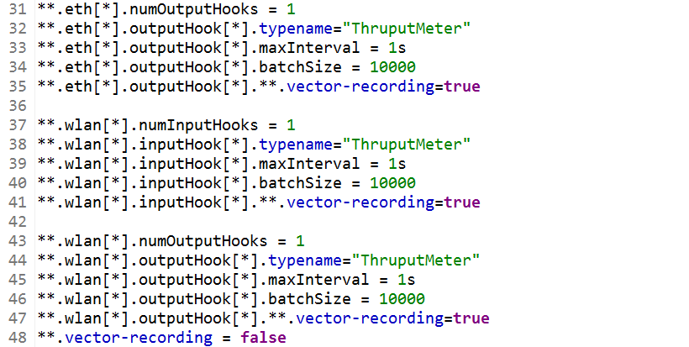
.ini Code Snippet (Recording cont.)
34
Notes:
34

Slide 35
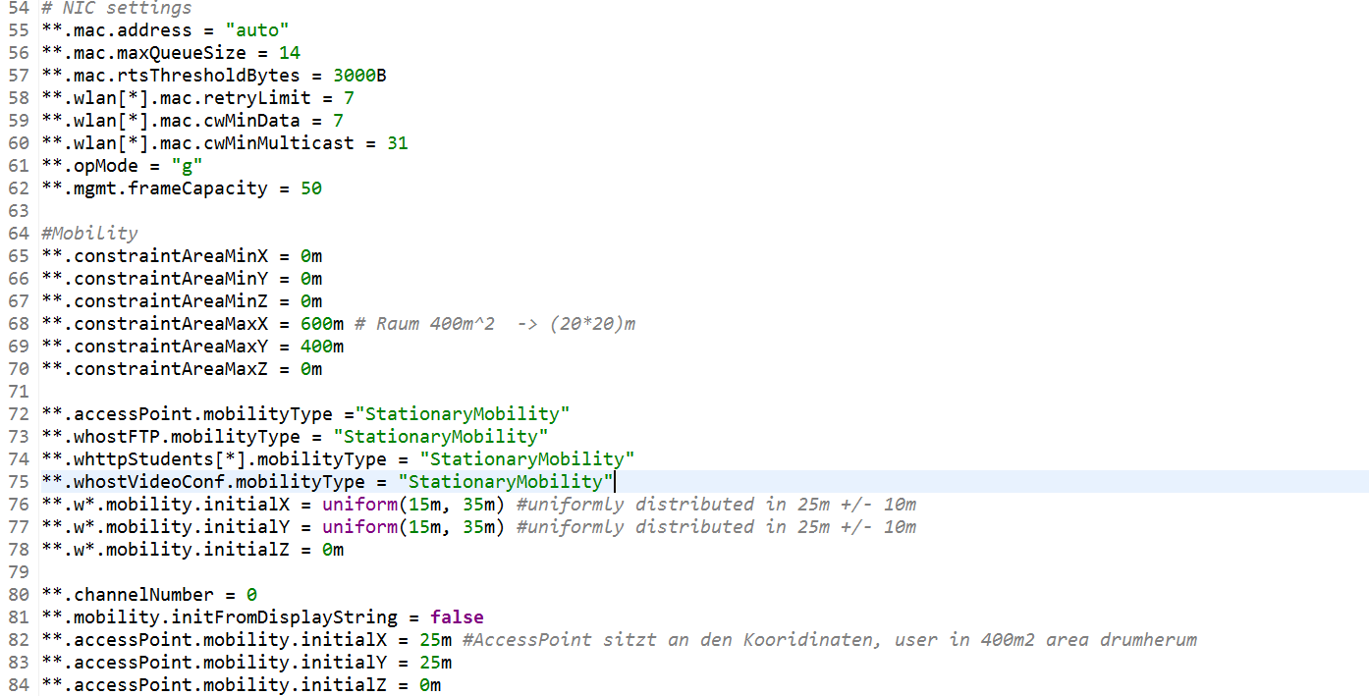
.ini Code Snippet (WLAN)
35
Notes:
35

Slide 36
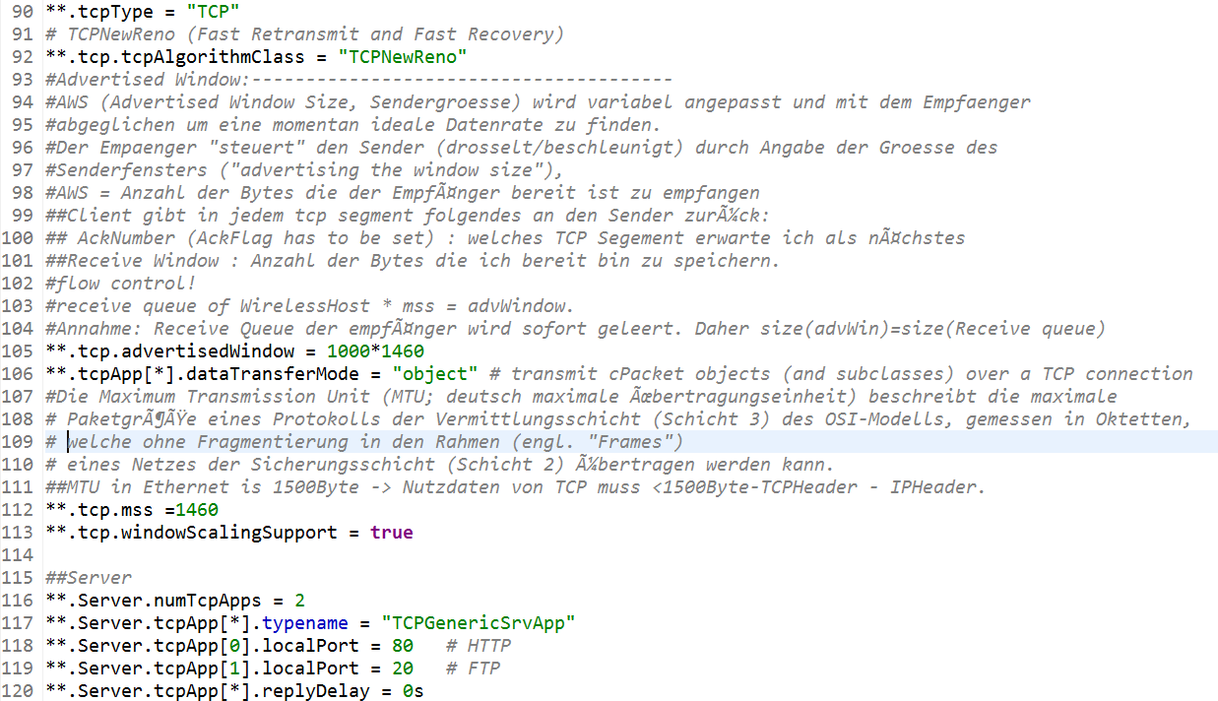
.ini Code Snippet (TCP General + Server)
36
Notes:
36

Slide 37
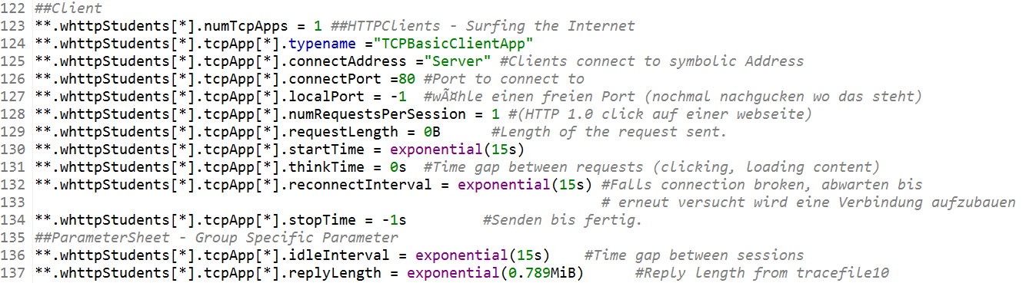
.ini Code Snippet (TCP HTTP Client)
37
Notes:
37

Slide 38
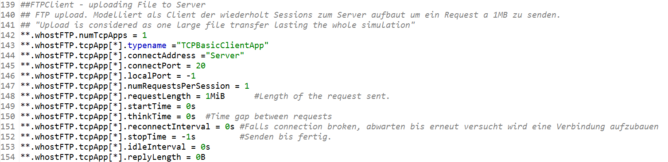
.ini Code Snippet (TCP FTP Upload)
38
Notes:
38

Slide 39
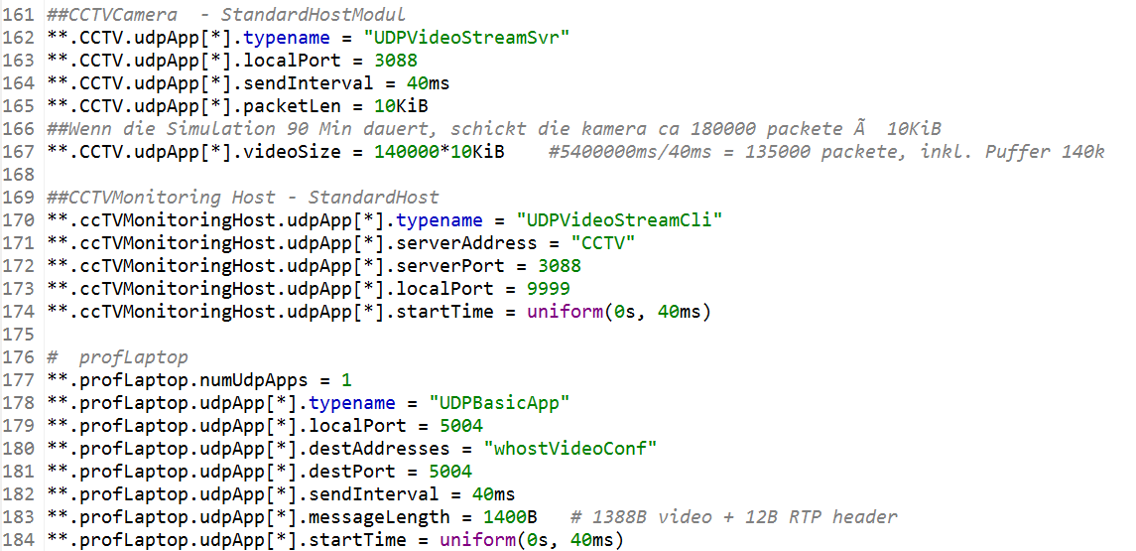
.ini Code Snippet (UDP CCTV + Professors Laptop)
39
Notes:
39

Slide 40
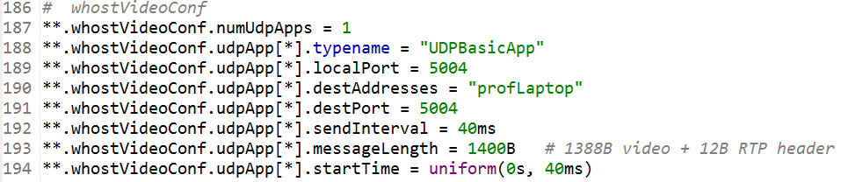
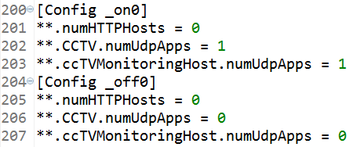
.ini Code Snippet (UDP Video Client + Run Config)
40
Notes:
40

