Slide 1

Exam Presentation
Simulation and Modelling of Communication Networks
September 6, 2016
Nina Piontek
nina.piontek@tu-hamburg.de
Daniel Plöger
daniel.ploeger@tu-hamburg.de
Hamburg University of Technology
1
Notes:
1

Slide 2
Contents
Network overview
Assumptions and modeling
Simulation and evaluation
Conclusion
2
2
September 6, 2016
Notes:
2

Slide 3
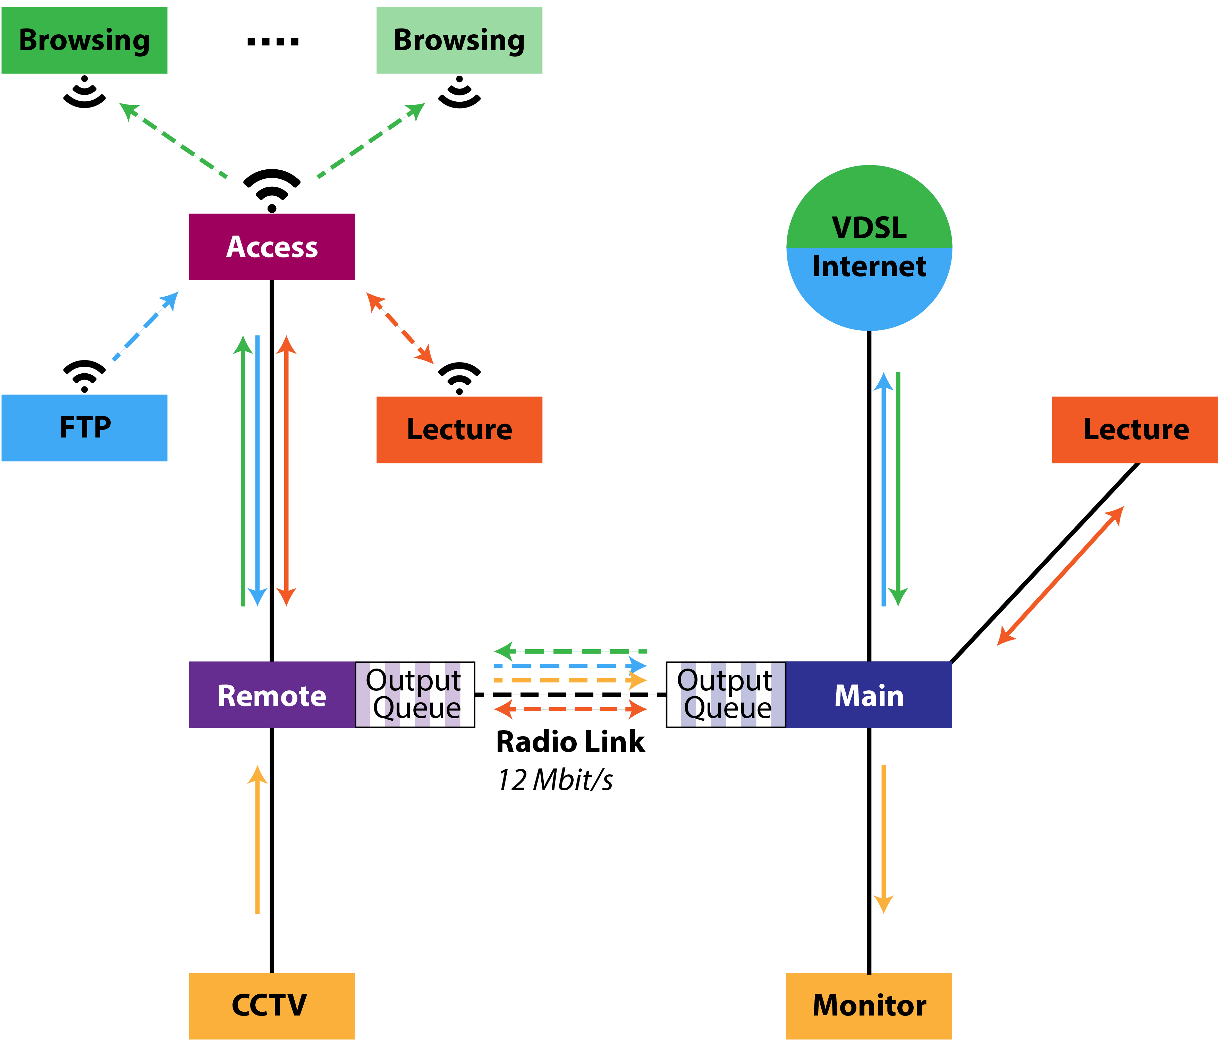
Network Overview
Web browsing (download)
FTP service for file upload
Video lecture in both directions
CCTV camera upload (optional)
Quality of service requirements
  Video packet delay smaller than 100 ms
  Exceeding delay plus packet drops less than 5 %
3
September 6, 2016
Notes:
3

Slide 4
Assumptions and Modeling
5
September 6, 2016

Slide 5
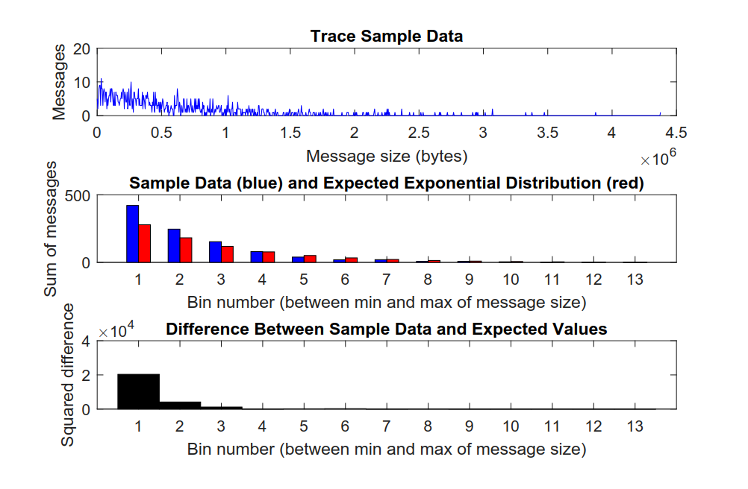
HTTP Traffic Analysis
6
September 6, 2016
Notes:
6

Slide 6
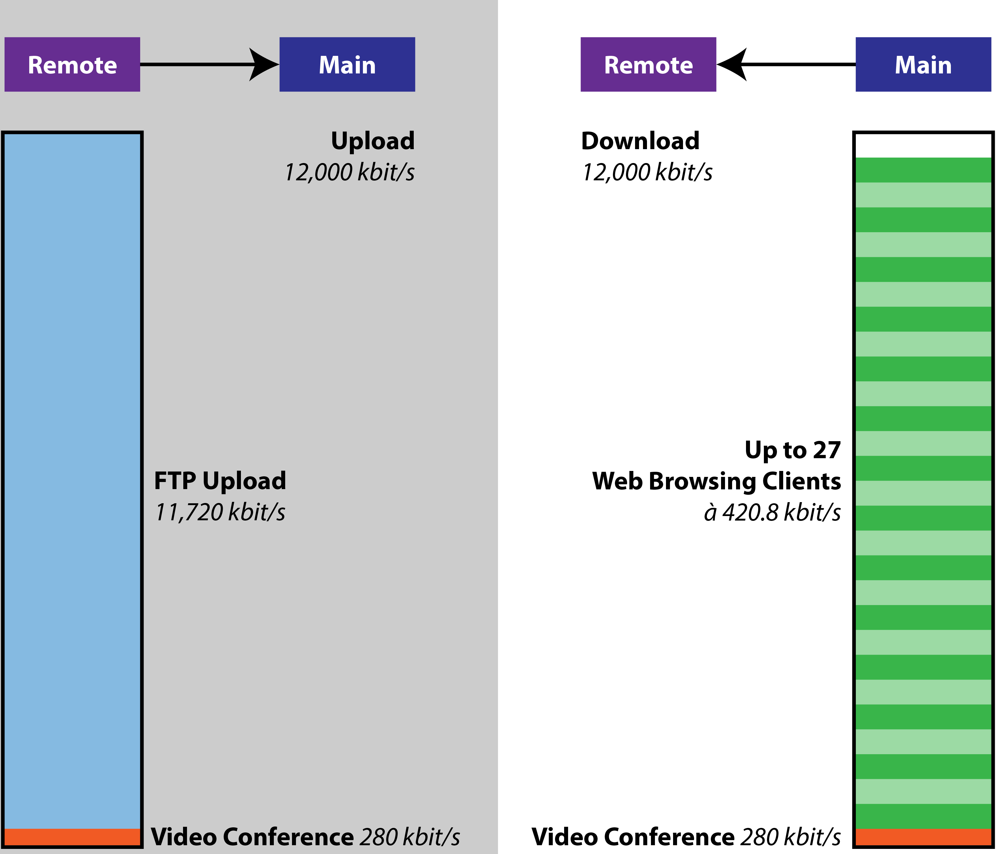
Behavior Expectations with CCTV Camera Turned OFF
8
September 6, 2016
Notes:
8

Slide 7
9
September 6, 2016
Notes:
9

Slide 8
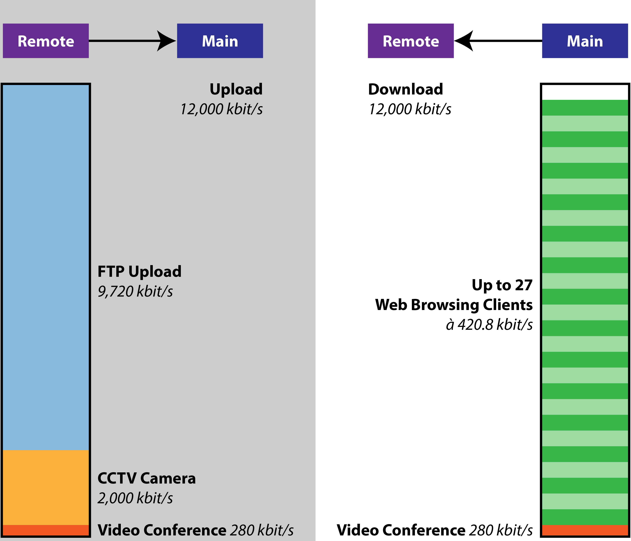
Behavior Expectations with CCTV Camera Turned ON
Point-to-point radio link is the weakest link
Maximum 27 uniformly distributed web browsing clients supported in theory
Even less clients in practice (high data peaks instead of uniformly distribution)
10
September 6, 2016
Notes:
10
FTP upload (residual bandwidth), 27 uniformly distributed web browsing clients

Slide 9
Simulation and Evaluation
CCTV turned off
12
September 6, 2016

Slide 10
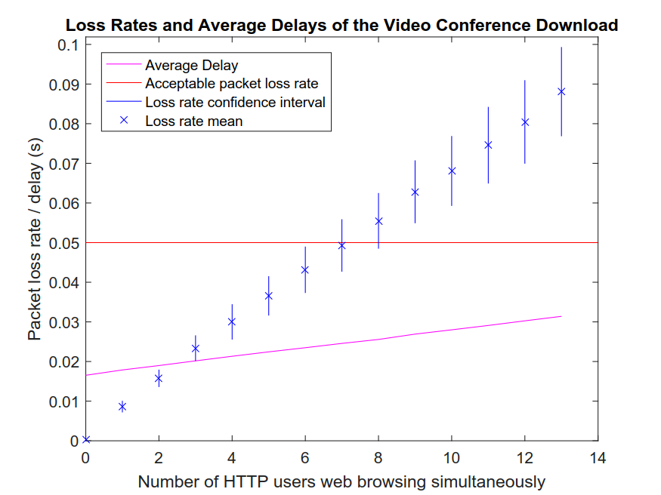
13
September 6, 2016
Notes:
13

Slide 11
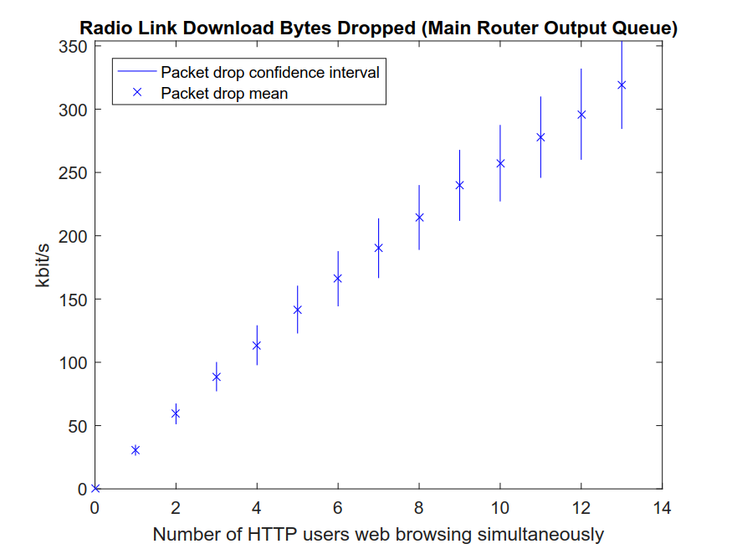
14
September 6, 2016
Notes:
14

Slide 12
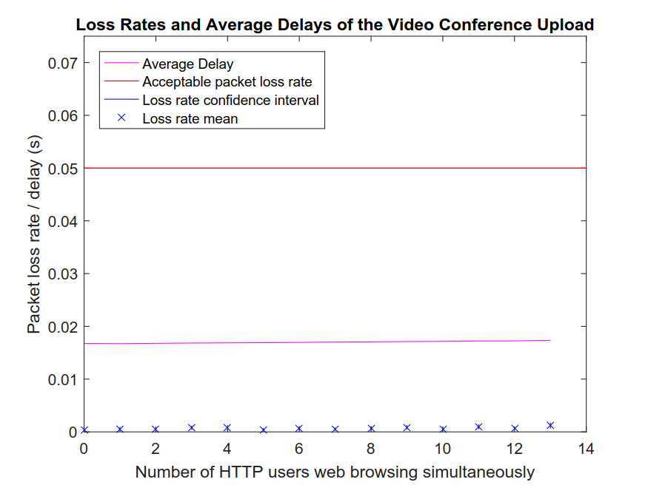
15
September 6, 2016
Notes:
15

Slide 13
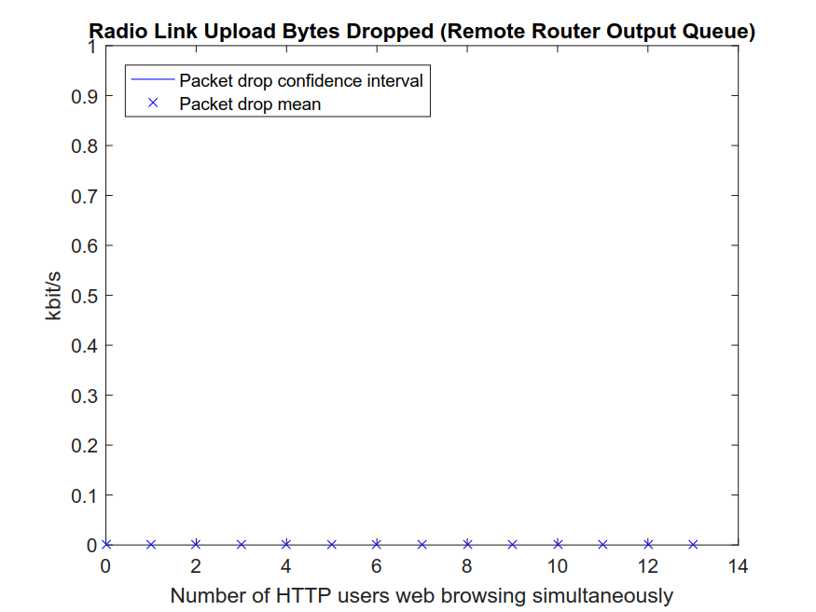
16
September 6, 2016
Notes:
16

Slide 14
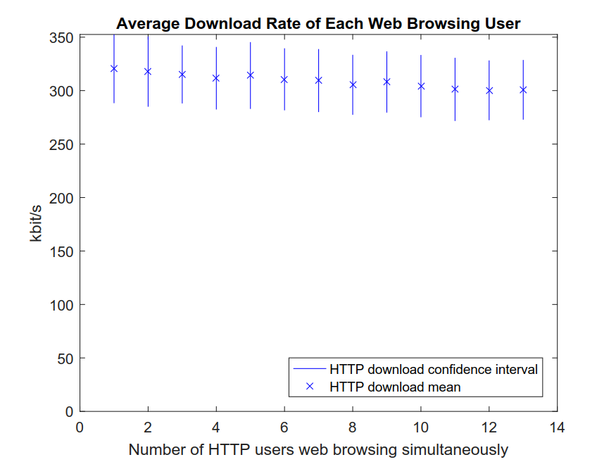
17
September 6, 2016
Notes:
17

Slide 15
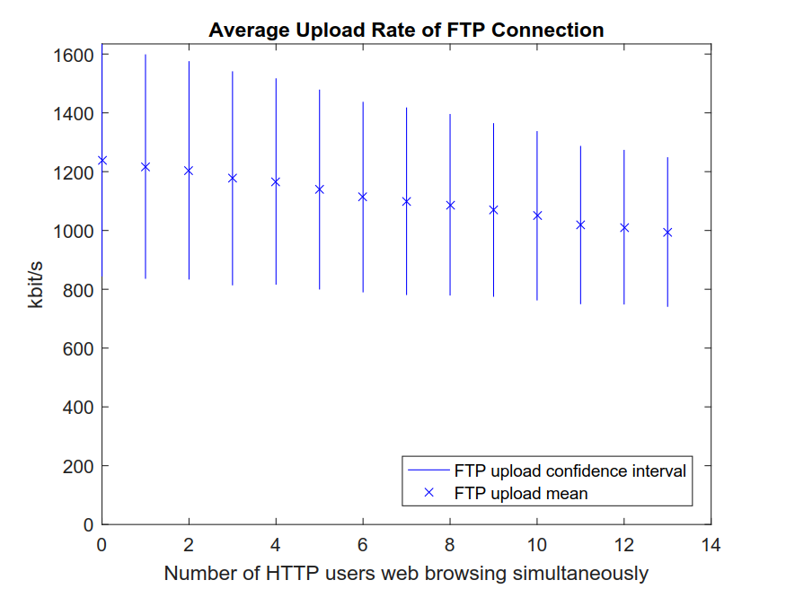
18
September 6, 2016
Notes:
18

Slide 16
19
September 6, 2016
Notes:
19

Slide 17
20
September 6, 2016
Notes:
20

Slide 18
Simulation and Evaluation
CCTV turned on
21
September 6, 2016

Slide 19
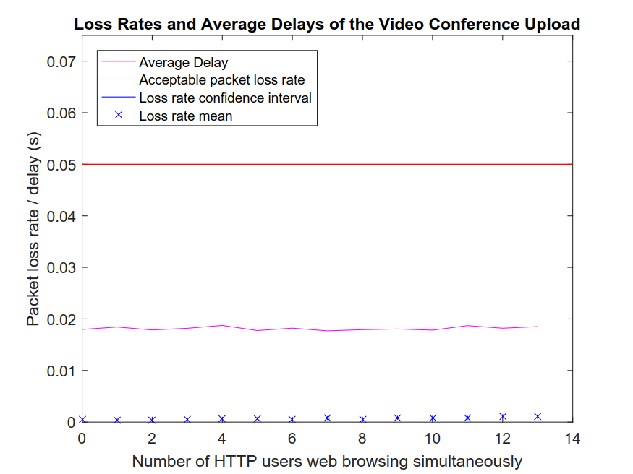
22
September 6, 2016
Notes:
22

Slide 20

23
September 6, 2016
Notes:
23

Slide 21
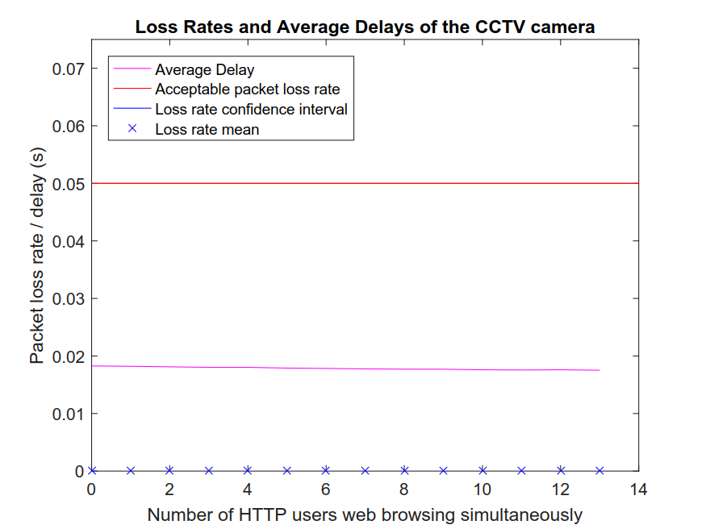
24
September 6, 2016
Notes:
24

Slide 22
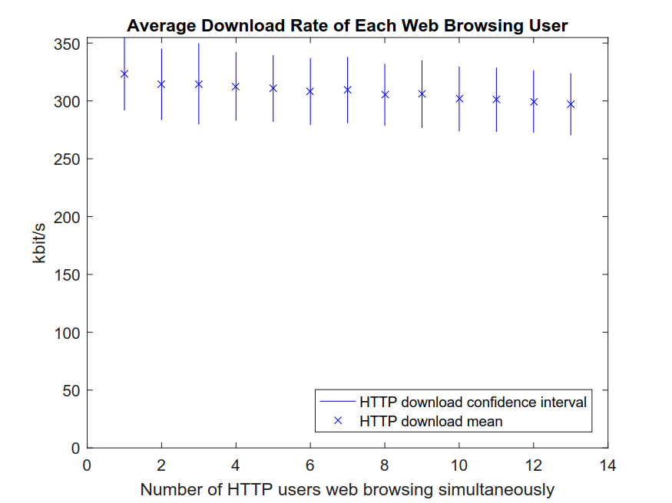
25
September 6, 2016
Notes:
25

Slide 23
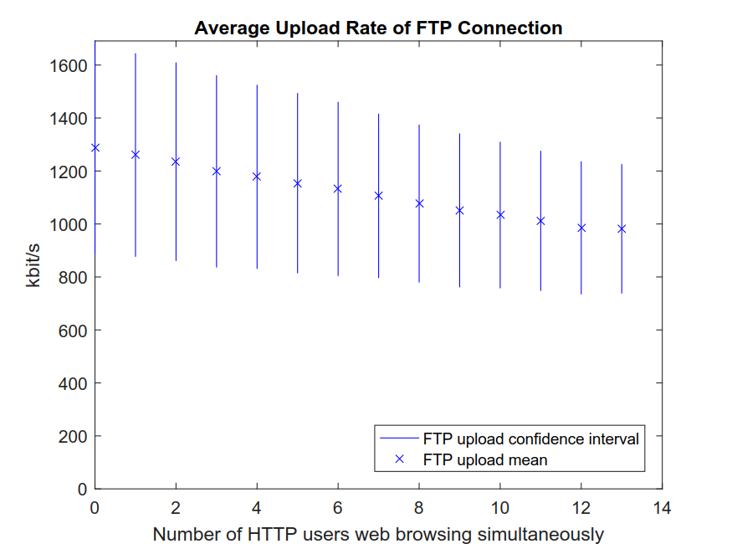
26
September 6, 2016
Notes:
26

Slide 24
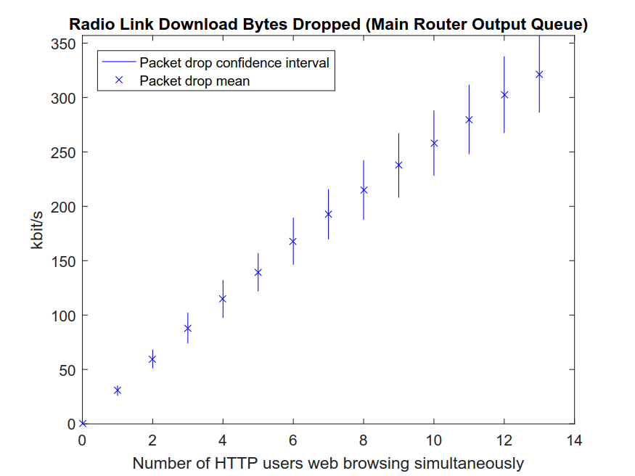
27
September 6, 2016
Notes:
27

Slide 25
28
September 6, 2016
Notes:
28

Slide 26
29
September 6, 2016
Notes:
29

Slide 27
Conclusion
30
September 6, 2016

Slide 28
Conclusion
31
31
September 6, 2016
Notes:
31

Slide 29
Thank you for listening!
32
32
September 6, 2016
Notes:
32

Slide 30
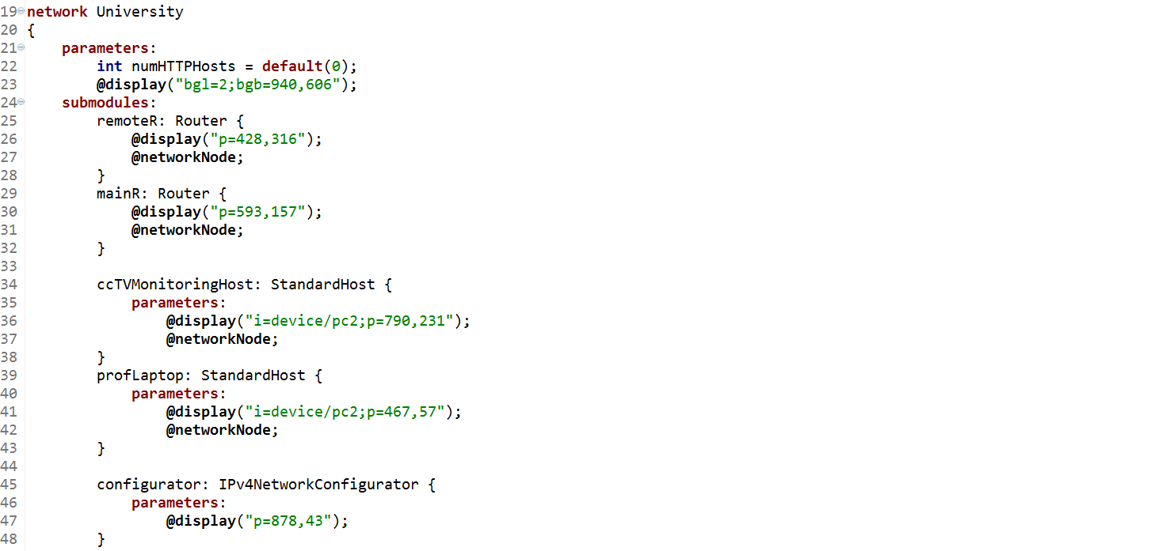
.ned Code Snippet (1)
33
33
September 6, 2016
Notes:
33

Slide 31
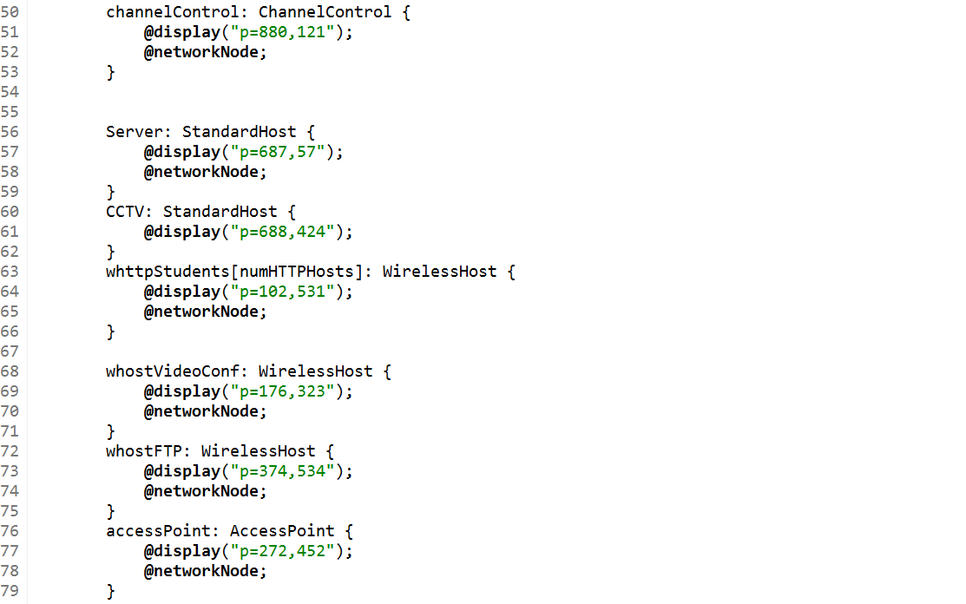
.ned Code Snippet (2)
34
34
September 6, 2016
Notes:
34

Slide 32
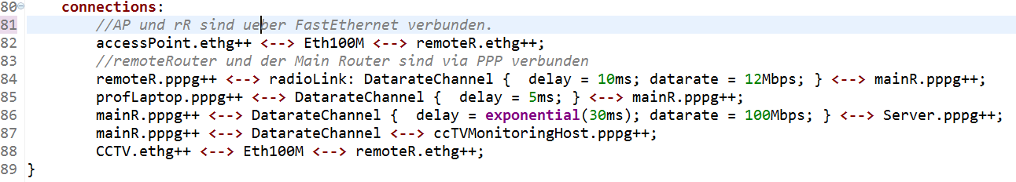
.ned Code Snippet (3)
35
35
September 6, 2016
Notes:
35

Slide 33
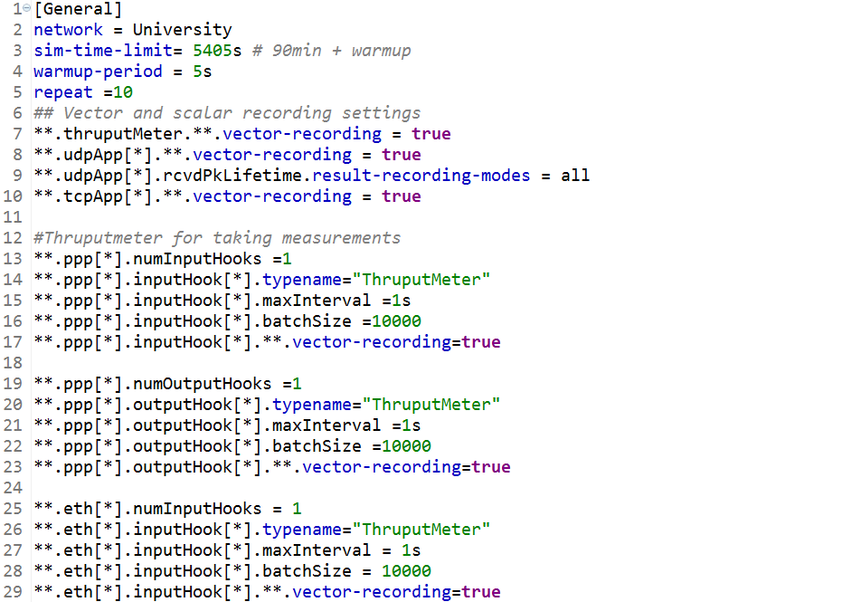
.ini Code Snippet (General + Recording)
36
36
September 6, 2016
Notes:
36

Slide 34
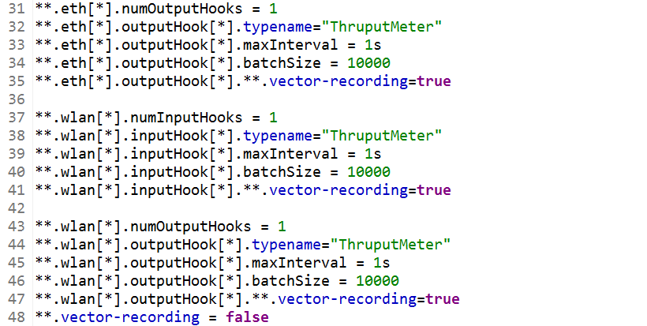
.ini Code Snippet (Recording cont.)
37
37
September 6, 2016
Notes:
37

Slide 35
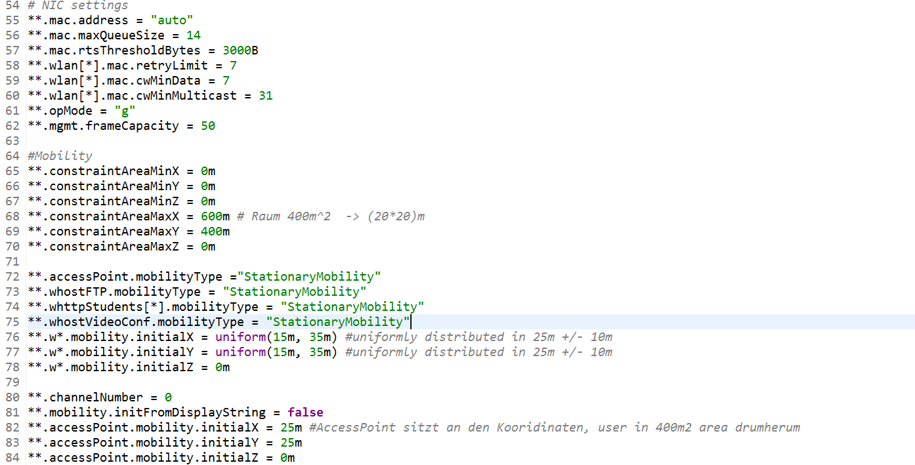
.ini Code Snippet (WLAN)
38
38
September 6, 2016
Notes:
38

Slide 36
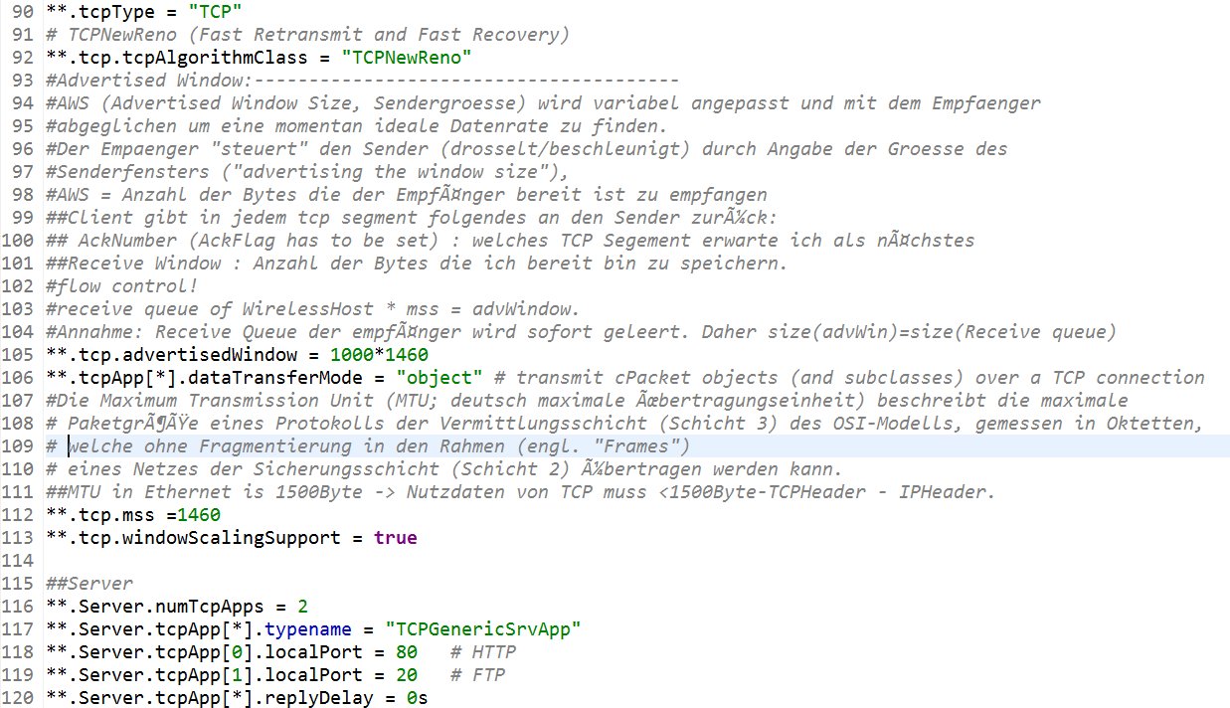
.ini Code Snippet (TCP General + Server)
39
39
September 6, 2016
Notes:
39

Slide 37
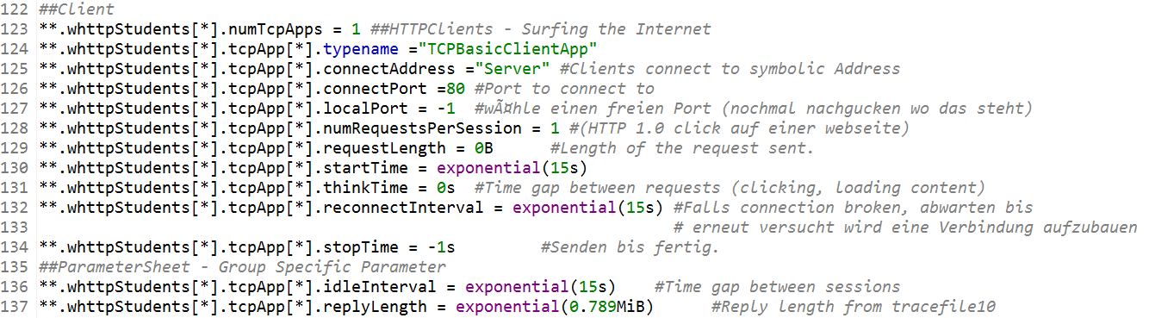
.ini Code Snippet (TCP HTTP Client)
40
40
September 6, 2016
Notes:
40

Slide 38
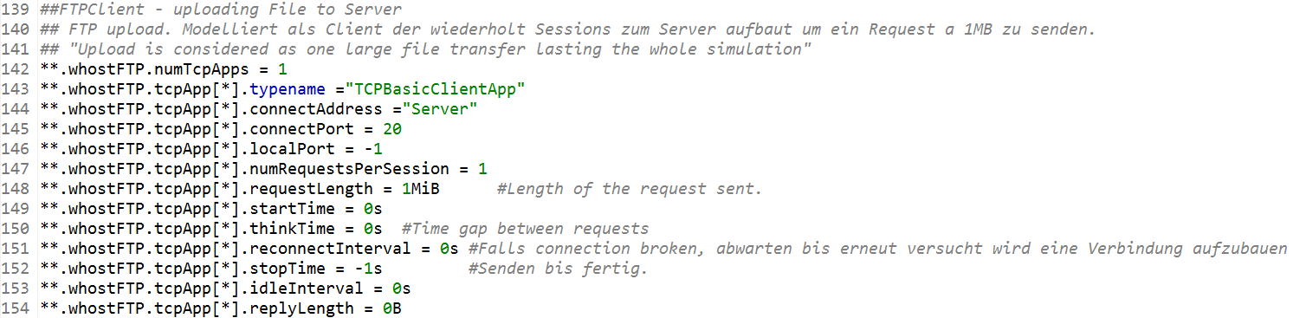
.ini Code Snippet (TCP FTP Upload)
41
41
September 6, 2016
Notes:
41

Slide 39
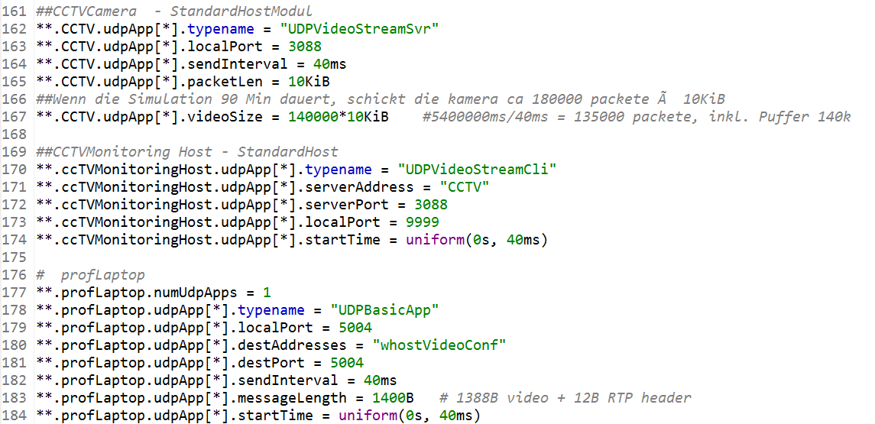
.ini Code Snippet (UDP CCTV + Professors Laptop)
42
42
September 6, 2016
Notes:
42

Slide 40
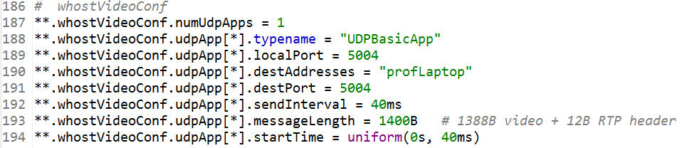
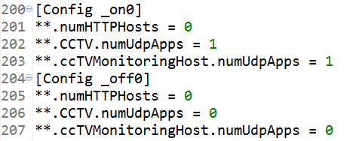
.ini Code Snippet (UDP Video Client + Run Config)
43
43
September 6, 2016
Notes:
43

