Slide 1
a framework for formalizing tensor computations

Slide 2
Background: matrix strides
A matrix stride may be familiar from libraries like CBLAS
In CBLAS matrices, each row is contiguous in memory, but the n’th row and the n+1’th row might not “touch”
The stride is the distance in memory elements between successive rows.
CBLAS requires it to be >= the number of columns.
The concept of stride makes it easier to operate on sub-parts of a matrix.
Vectors in BLAS may have strides too, in many contexts; this is the distance between successive elements of the vector. (Normally 1).

Slide 3
tensor strides
In frameworks like NumPy, PyTorch, Tensorflow, tensors have strides in the internal implementation
In most frameworks, a freshly allocated array of dim=[2,7,3] would have strides=[21,3,1].
This is “C-style” array, where first indexes have higher stride
The other way round, strides=[1,2,14], is “Fortran-style” array. (E.g. ArrayFire uses this)
Memory offset from data pointer is calculated as sum of (index times stride)
Operations like transposing a matrix, taking a submatrix, may be implemented by manipulating dims and strides rather than by allocating a new matrix

Slide 4
the problem
Documentation for frameworks like NumPy, PyTorch, and TensorFlow tends to be vague, especially when touching on tensor strides.
Most but not all operations on tensors treat the tensor as an abstract n-dimensional array, not requiring knowledge of the strides
Some operations (e.g. view()) and some things you might want to do (e.g. C++ extensions) require knowledge of the layout in memory
Documentation rarely makes clear which combinations of strides are allowed for which purpose
For example: where are negative strides allowed?
May strides be zero?
Under what circumstances would it be OK for successive rows of a matrix to “overlap”?

Slide 5
UNNECESSARY COPIEs
In PyTorch, many operations have requirements on the stride.
These operations usually just check whether the tensor is “contiguous” (meaning: it has C-style strides with no gaps between the elements), and if not, copy to a contiguous array.
This is wasteful because sometimes the array had the required properties even though it was not contiguous
I.e. it would be nice to have finer-trained distinctions than just “contiguous” vs. “not contiguous”
Certain operations (principally view()) require knowledge of the layout in memory
It’s not immediately obvious how to define the semantics of view() without reference to the memory layout
This can make it hard to define appropriate preconditions that interfaces must satisfy
Would usually just be “must be contiguous”, but there are many cases where a less-strict condition would be enough.

Slide 6
Is this OK?
Old-school programmers like myself are accustomed to documentation:
What requirements does a function have on its inputs?
What exactly is its behavior?
Precise documentation rarely seems to be a priority in Python programs.
Part of the issue may be that there is no language to compactly describe properties of Tensors relating to their strides.
Without such a language, it’s hard to do any complex reasoning about such things.

Slide 7
tensor patterns
In this talk, I will describe a particular formulation of a “tensor pattern” and show how it can be used to solve an example problem (finding the intersection in memory between two tensors)
Will develop a language for reasoning about these patterns
What this IS:
A framework for reasoning about memory layouts of tensors and describing the meaning of individual operations (multiplication, addition etc.)
What this IS NOT:
The only way to formulate this kind of thing
A framework for defining the meaning of tensor expressions (e.g. giving names to the axes; distinguishing ‘upper’ and ’lower’ indexes, as in physics/math). That’s a separate, orthognal issue.

Slide 8
a pattern
These definitions will stay quite close to the C++ implementation (rather than making it more mathematical-looking at the expense of ease of understanding).
We define the maximum possible number of axes in advance, as M. (E.g. M = 6).
struct Pattern {
int num_axes;
int dims[M];
int strides[M];
int offset;
};

Slide 9
basic interpretation
A pattern maps from a tuple of indexes to a single positive index into a memory region.
E.g. suppose we have
Pattern p; and
int indexes[N]; with p.num_axes <= N <= M, and
float* data (would have been allocated by malloc() or new)
Indexing would be done by accessing
data[m]
where
m = p.offset + sum(0<= i < N): p.strides[i] * indexes[i]]
Note on terminology: we call the index m into the data pointer a memory-index.
So far it’s pretty standard, e.g. quite similar to PyTorch.
We could include the offset in the data pointer, but there are various situations where it’s useful to separate the offset.

Slide 10
reversed axes
In frameworks like PyTorch, `broadcasting’ pads to the left with ones where num-axes differ
For instance, a basic operation on Tensors of dims [3,4] and [4] would be interpreted the same as an operation on dims [3,4] and [1,4].
This turns out to be extremely inconvenient to implement, as axis-indexes constantly shift.
Here, we swap everything around: broadcasting pads to the right with ones. Call our swapped numbering the ‘internal numbering’.
We intend to allocate with a “Fortran-style” layout (first stride equals 1, in the internal numbering)
To preserve the semantics that people are familiar with, we can use an outer layer / API that converts to the familiar layout (reversing axes). So the actual interface behavior would be the same as PyTorch, etc.
Note: for most purposes the num_axes is redundant (could view all patterns as having M axes)
num_axes only matters for the compatibility layer which preserves the semantics of PyTorch and similar.

Slide 11
Valid patterns
DEFINITION.
A valid Pattern is a pattern p that satisfies the following 7 properties:
Must have 0 <= p.num_axes <= M, where M is the maximum num-axes (e.g. M=6).
Must have p.dims[i] > 0 for all 0 <= i < M
For all axes i with num_axes <= i < M, we have p.dims[i] = 1 and p.strides[i] = 0
No memory-index reachable through the pattern may be negative, i.e.: p.offset + sum(0 <= i < p.num_axes): min(0, (p.dims[i]-1)*p.strides[i]) >= 0
For all axes i with p.dims[i] != 1, we have p.strides[i] != 0
The “axis-dominance” property. This property is satisfied if after sorting the axes by abs(stride), for 0 <= i < p.num_axes we would have p.dims[r] * abs(p.strides[r]) <= abs(p.strides[r+1]).
For all axes i with p.dims[i] = 1, we have p.strides[i] = 0

Slide 12
indexing a pattern
Index-tuple: a tuple of nonnegative integer indexes to be used to index a Pattern
We index a Pattern p by an index-tuple i and get an integer memory-index m, with the notation:
m = p[i]
Suppose i has elements i[0], i[1], .. i[size(i) - 1].
p[i] is defined if
p.num_axes <= size(i) <= M
for k in [0 .. size(i)-1], either p.dims[k] = 1 or 0 <= i[k] < p.dims[k]
Its value, if defined, is
p[i] = p.offset + sum(0 <= k < p.num_axes): p.strides[k] * i[k]

Slide 13
index-tuple-set of a pattern
Index-tuple-set: a set of tuples, representing a set of memory indexes
Index-tuple-set I(p) of a pattern p:
The set of n-tuples where n = p.num_axes, containing the Cartesian product
[0 .. p.dims[0] - 1] x [0 .. p.dims[1] - 1] x ... [0 .. p.dims[n-1] - 1]
The index-tuple-set of a pattern is in general smaller than the set of all tuples i for which p[i] is defined, because p[i] is defined even if i has nonzero values on axes where p.dims[k] = 1; and size(i) may exceed p.num_axes.

Slide 14
memory-index-set of a pattern
Memory-index-set: a set of nonnegative integers, representing a set of memory indexes
Reminder: a memory-index m is used to index a data-pointer, as in data[m]
Memory-index-set of a pattern:
The memory-index-set M(p) of a pattern p is the set { p[i]: i ∈ I(p) }
I.e. it’s what you get if you index p with all elements of its index-tuple-set.

Slide 15
uniqueness property
DEFINITION
A pattern p satisfies the uniqueness property if |M(p)| = |I(p)|, i.e. if the sizes of its memory-index-set and of its index-tuple-set are the same.
This is equivalent to saying that there are no two index-tuples in its index-tuple-set that map to the same memory-index.
Any pattern which is valid automatically satisfies the uniqueness property, because property vi (the axis-dominance property) implies the uniqueness property. The proof is quite straightforward.

Slide 16
broadcastability
DEFINITION
Patterns p and q are broadcastable if for 0 <= i < M, either p.dims[i] = q.dims[i], or p.dims[i] = 1, or q.dims[i] = 1.
I.e. they are broadcastable if all their dims are either the same, or one of them is 1.
Note: for patterns with different num_axes this is the opposite way around to the notion of broadcastability in PyTorch. I.e. we pad with dim=1 on the right, not the left.

Slide 17
pattern-tuples
DEFINITION
A pattern-tuple is a nonempty tuple of patterns where all pairs of elements of the tuple are broadcastable.
E.g. T = (p, q, r)
DEFINITION
The index-tuple-set I(T) of a pattern-tuple T is the same as the index-tuple-set of a pattern whose num_axes is the greatest of the num_axes of the elements of the tuple, and whose dimensions are the maximums of the corresponding dimensions of the elements of the tuple.
DEFINITION
The memory-index-tuple-set M(T) of a pattern-tuple T is the set of tuples of memory-indexes formed by indexing the elements of the pattern-tuple with the indexes in its index-tuple-set. E.g. if T = (p, q), then
M(T) = { (p[i], q[i]) for i in I(T) }

Slide 18
Shape of a pattern
The shape of a pattern p is the tuple (p.dims[0], p.dims[1],... ,p.dims[p.num_axes – 1])
The shape of a pattern-tuple, say, (p,q), is the tuple
(max(p.dims[0], q.dims[0]), ... , max(p.dims[n-1], q.dims[n-1])) where n is the maximum of the num_axes of p and q

Slide 19
tensors
A simplified version of a tensor is:
where data would have been allocated by malloc() / new.
We may form sub-tensors, so multiple tensor might share the same data pointer
Notation-wise, we let tensors behave the same way as patterns. If a is a tensor and i is an index-tuple, then a[i] is shorthand for a.data[a.pattern[i]].
When we use Tensors in contexts in which a pattern would be expected, such as forming a pattern-tuple, we let it be understood that we refer to those tensors’ patterns.
For example, we can talk about the memory-index-set of a tensor, meaning that of its pattern.
struct Tensor {
Pattern pattern;
float *data;
};

Slide 20
tensor operation semantics
Let a, b and c represent tensors with known, valid patterns that are all broadcastable w.r.t. each other
We define a += b to mean:
for i in the index-tuple-set of the pattern-tuple (a, b), do: a[i] += b[i]
The above encompasses broadcasting and summation.
We define “a = b” to mean “zero a, then do: a += b”. Again, this encompasses broadcasting and summation.
We define ”a += b c” to mean:
for i in the index-tuple-set of the pattern-tuple (a, b, c), do: a[i] += b[i] * c[i]
Note: the above definition assigns a meaning to the whole expression “a += b c” without assigning a meaning directly to the product b c.
It is equivalent to an expression-based interpretation where we let the product b c be the result of creating a tensor d whose shape is the same as the shape of the pattern-tuple (b,c), and executing d += be; we could then execute a += d. But the effect is the same.

Slide 21
defining tensor dimensions
Our approach is first define tensors’ patterns, and then do operations on them, set their values, etc.
This is a slightly different model than an expression-based model where a statement like a = b c creates a, defining its dimension.
The separation of these two things is mostly intended for internal implementation (inside the framework); it does not necessarily dictate user-interface decisions
Our model and a more expression-based model could easily coexist

Slide 22
matrix multiplication
Consider the expression: a += matmul(b, c), and assume a, b and c have the appropriate sizes.
Assume all the tensor dimensions are reversed w.r.t. what the user sees, so the column axis is axis 0, not the last axis.
The above can be written as: a.unsqueeze(1) += b.unsqueeze(0) * c.unsqueeze(2)
... where a.unsqueeze(k) returns a tensor sharing the same underlying data as a, and with the same pattern except we insert a trivial axis at position k.
We define a trivial axis as an axis with dim=1, stride=0.’

Slide 23
reducing pattern-tuples
In the implementation of an expression like a += b c, we want to view it in the simplest way possible
For example, suppose a, b and c are all matrices of the same size (and this is elementwise multiplication)
If a, b and c have the same layout and are contiguous in memory, we could do the above as a vector operation.
Reduction to the simplest possible form may lead to more efficient implementation.
Define two pattern-tuples as equivalent if they have the same memory-index-tuple-set
Reduction is the process of removing and combining axes while maintaining equivalence
Algorithm is fairly simple: keep looking for trivial axes to remove and pairs of axes that can be combined for all elements of the tuple, until there is no more change
Applied to a pattern-tuple with a single element, it produces a pattern with a reduced form
For single patterns, we can further convert this to canonical form by converting strides from negative to positive if needed (shifting the offset), and sorting axes by abs(stride).

Slide 24
choosing algorithms for linear operations
Linear operations can in general be expressed as things like a += b or a += b c, possibly after suitable reshaping
To ensure we are using the most appropriate algorithm, we can route these all through a function that chooses the right BLAS/CUBLAS operation(s) based on a code describing the shapes in the tuple
The code encodes things like: is the dim on this axis equal to 1? Is the stride on this axis equal to 1?

Slide 25
computing tensor intersection (intro)
Up to now we’ve introduced the key aspects of our notation and framework
It hasn’t accomplished much except make fairly standard tensor semantics more precise and explicit.
We now show how to use it to compute pattern intersection (in terms of memory locations / memory-index-set).
Useful in debugging (e.g. checking for invalidation of quantities needed in backprop)
Version tracking, like PyTorch does, is not very ideal as it doesn’t have finer granularity than the originally allocated memory region
The intersection between 2 patterns will be computed as a possibly-empty set of patterns (all of whose memory-index-sets are disjoint)
The algorithm is not completely general but applies to all the cases we expect to encounter when people are doing “normal” things with tensors.

Slide 26
additional definitions
These come in useful in the intersection algorithm
A pattern is valid-1 (valid minus one) if it satisfies all but the last property of a valid pattern
The last property is that axes with dim = 1 must have stride 0
A pattern is valid-2 (valid minus two) if it satisfies all but the last two properties of the valid pattern, and also has the uniqueness property
The last but one property is the axis dominance property
The uniqueness property is weaker than the axis dominance property

Slide 27
intersection algorithm overview
The intersection problem is: given patterns p and q, compute a list of disjoint patterns, the union of whose memory-index-sets is the intersection of those of p and q.
First convert p and q to canonical form (reduce, make sure axes positive, sort axes by stride).
Next convert the patterns to have common strides
This conversion produces lists of valid-1 patterns, possibly more than one for each of p and q, so: (p1,p2,..), (q1,q2,..)
Will provide more details below
Note: this conversion is not possible for all pairs of input patterns
For each pair of patterns (pn,qm), compute the intersection as a possibly-empty list of valid patterns; the output is all these lists appended together

Slide 28
conversion to common strides
Assume we have already converted p and q to canonical form so all strides are positive
Get a list of all strides present in p or q.
Convert p and q to valid-2 patterns with a common list of strides, by inserting axes with dim=1 with whichever strides were missing in p or q.
We then convert those valid-2 patterns into lists of valid-1 patterns.
Algorithm is iterative: ensure axis-dominance property holds for (axes 0,1); then for axes (0,1,2); and so on.
Example: suppose strides=(1,10), dims=(30,1). Can convert to dims=(10,3). If the dims were (31,1) we would have to split the pattern into two to cover the leftover part.
This algorithm may fail for some inputs.
It will always succeed if, when sorted, each stride divides the next (the exact requirement is weaker than this, but more complicated).

Slide 29
intersection given common strides
Consider the problem of computing the intersection between two valid-1 patterns p and q with common strides and with n axes.
Core part of the algorithm is to compute “list of offsets”.
An offset o is an n-tuple such that there exists an index-tuple i (also an n-tuple) with p[i+o] = q[i].
There could be more than one such offset
Each offset will correspond to one part of the intersection
Algorithm for finding all the possible offsets is recursive, starting from the highest-numbered axis (i.e. the one with largest stride)
At each point in the recursion we branch by up to 2
Given an offset, computing the piece of the intersection is quite straightforward

Slide 30
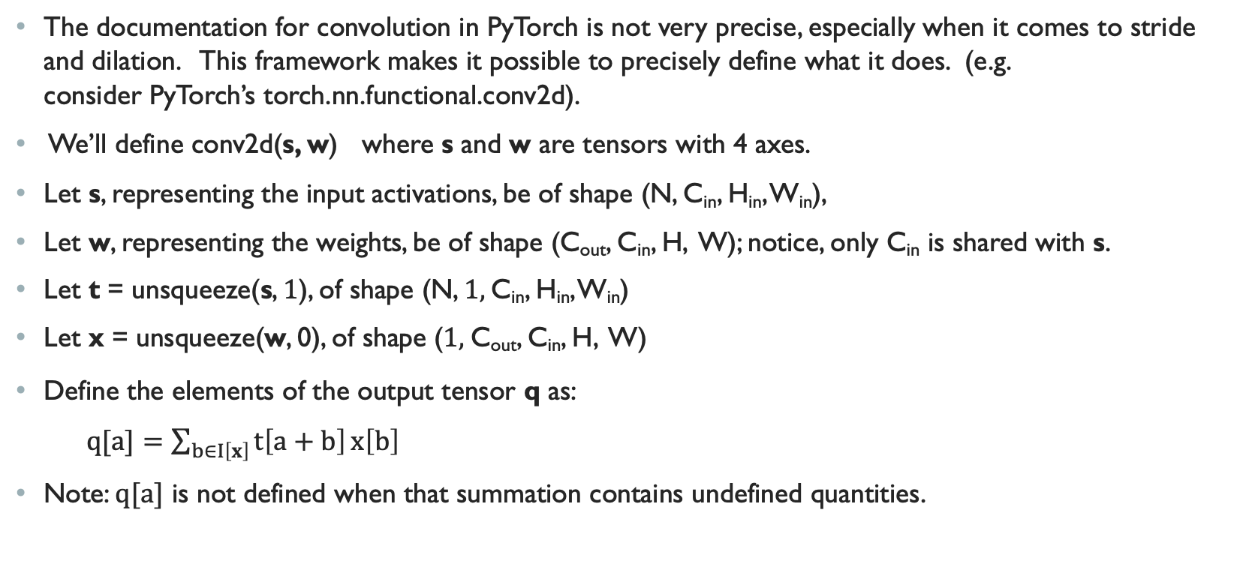
Clarifying documentation for convolution
The documentation for convolution in PyTorch is not very precise, especially when it comes to stride and dilation. This framework makes it possible to precisely define what it does. (e.g. consider PyTorch’s torch.nn.functional.conv2d).
We’ll define conv2d(s, w) where s and w are tensors with 4 axes.
Let s, representing the input activations, be of shape (N, C_{in}, H_{in}, W_{in}),
Let w, representing the weights, be of shape (C_{out}, C_{in}, H, W); notice, only C_{in} is shared with s.
Let t = unsqueeze(s, 1), of shape (N, 1, C_{in}, H_{in}, W_{in})
Let x = unsqueeze(w, 0), of shape (1, C_{out}, C_{in}, H, W)
Define the elements of the output tensor q as:
$q[a]=\sum_{b∈I\left[x\right]}{t\left[a+b\right]}x\left[b\right]$
Note: $q[a]$ is not defined when that summation contains undefined quantities.

Slide 31
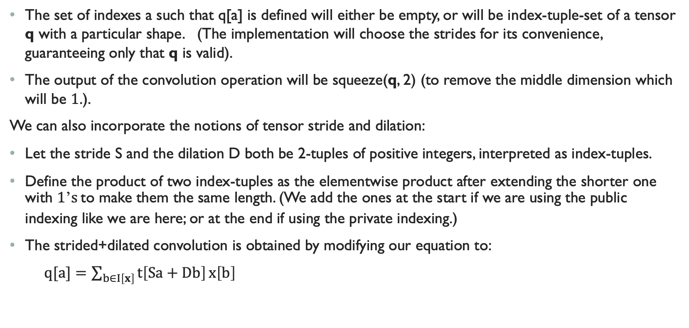
Clarifying documentation for convolution
The set of indexes a such that q[a] is defined will either be empty, or will be index-tuple-set of a tensor q with a particular shape. (The implementation will choose the strides for its convenience, guaranteeing only that q is valid).
The output of the convolution operation will be squeeze(q, 2) (to remove the middle dimension which will be 1.).
We can also incorporate the notions of tensor stride and dilation:
Let the stride S and the dilation D both be 2-tuples of positive integers, interpreted as index-tuples.
Define the product of two index-tuples as the elementwise product after extending the shorter one with 1’s to make them the same length. (We add the ones at the start if we are using the public indexing like we are here; or at the end if using the private indexing.)
The strided+dilated convolution is obtained by modifying our equation to:
$q[a]=\sum_{b∈I\left[x\right]}{t\left[Sa+Db\right]}x\left[b\right]$

Slide 32
conclusion
I believe tensor frameworks are widely-enough used that they deserve properly-defined semantics
I think this framework is a reasonable attempt to define those semantics in a precise way.
The tensor-intersection example shows that some issues relating to tensor patterns are complex enough that a well-defined mathematical language is essential if you want to get it right.
The convolution example shows how this framework makes it possible to precisely describe complex operations.
Advantages if we built a tensor framework on top of this:
More explicit documentation
Easier to write test code (since intended behavior would be clearly defined)
Software should be more robust
Avoid unnecessary copies, should improve efficiency

