Slide 1
Shortest Driving Distance Areas Around Points
Using Voronoi Polygons to Find the Area Around Michigan Community Colleges which Have the Shortest Travel Time to the College
Daniel P Vollrath
danpvollrath@gmail.com

Slide 2
Learning Goals
Creating random points (RP) within state bounds [QGIS]
Finding the closest (straight distance) colleges to RP [R]
Finding nearest travel time college to RP [R]
Creating zones around colleges within which all houses probably* have the shortest travel time to that college.
* You will see that the method we use involves random points and then expanding bounds until a random point with a different “closest college’ is reached. I believe this method is accurate enough to be useful but not accurate enough to conclude that all areas are perfect.

Slide 3
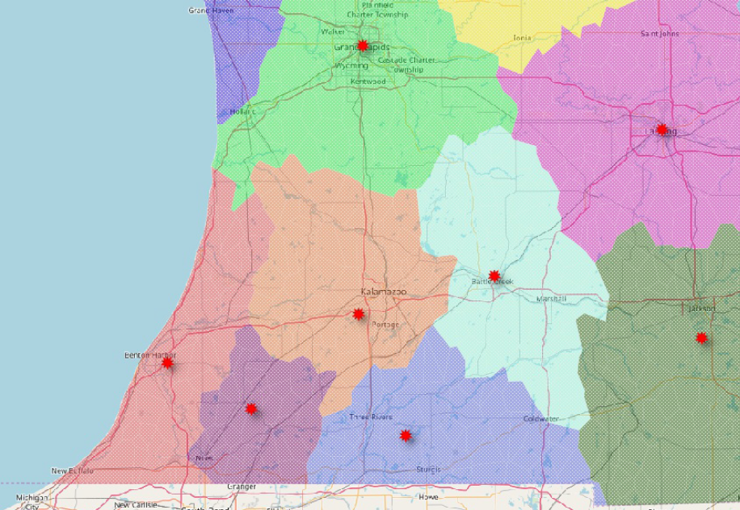
Example: Southwest Michigan CCs
School name labels weren’t added because the target audience is expected to know which point represents which school. Moving from left to right, Lake Michigan College, Southwestern Michigan College, Kalamazoo Valley CC, Grand Rapids CC, Glen Oaks CC, Kellogg CC, Lansing CC, Jackson College.

Slide 4
Background and Data Needed
R and QGIS
No background necessary, both open source and easily downloadable
States Shapefile
https://www.census.gov/geo/maps-data/data/cbf/cbf_state.html
500k should be fine. Higher resolution files are available
After download, extract zipped folder. We will use .shp file but be sure to NOT delete the other files in the folder. All files support the .shp file we use.
Creating Excel file with colleges and addresses
For Michigan, I could not find a file with schools and their addresses. IPEDS probably has something but I couldn’t get the information out cleanly.
https://ope.ed.gov/accreditation/getdownloadfile.aspx
Excel file of all colleges with addresses. For Michigan, I only had 28 schools to find and add on to a separate sheet of just Michigan CCs.

Slide 5
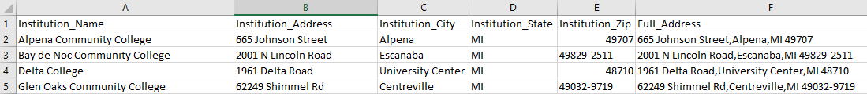
College Excel File
Whether using your own data source or the one I offered, follow these steps.
Eliminate extraneous data. Having some general information for each college may be useful but that depends on how you will be presenting this project.
Use concatenate in Excel to bring the different parts of an address into one variable.

Slide 6

R Code: Geocoding Institutions
# Dan Vollrath
# Find a way to map the area with closest drive time to school
# Example: https://www.caliper.com/featured-maps/maptitude-nba-arena-map.html
# Voronoi Polygons
# Feb 2018
install.packages("ggplot2")
install.packages("ggmap")
install.packages("geosphere")
install.packages("gmapsdistance")
Install.packages(“readr”)
library(ggmap)
library(ggplot2)
library(geosphere)
library(gmapsdistance)
library(readr)
It’s always important to comment your code. This helps future users of your code understand what is happening and helps them fix issues.
Installing packages and libraries used to geocode, calculate distance and travel time, read and save csv and excel files.

Slide 7

R Code: Geocoding Institutions
# Bring in Excel file of our colleges and their addresses
dat <- read_excel ("C:/Users/Dan/Dropbox/Work/Mapping/AllColleges_WithAddress.xlsx", sheet = "2-Yr MI")
# Geocoding Community Colleges
n <- length(dat)
dat[,(n+1)] <- NA ; colnames(dat)[(n+1)] <- "lon"
dat[,(n+2)] <- NA ; colnames(dat)[(n+2)] <- "lat"
View(dat)
m <- nrow(dat)
for(i in 1:m){
x <- geocode(as.character(dat[i,"Full_Address"]))
dat[i,"lon"] <- x[,"lon"]
dat[i,"lat"] <- x[,"lat"]
Sys.sleep(.1)
}
First Block of Code
All we’re doing here is bringing in an excel file named “AllColleges_WithAddress” and just the sheet named “2-Yr MI”. We’re then saving this sheet to an object called ‘dat’
Highlighted code will be different for each user.
Beginners may find useful. This button can be found in the top right window of R Studio.
Second Block of Code
First we’re adding columns calld ‘lon’ and ‘lat’ to our dat object.
Then we are going through and using geocode to get the coordinates of each school, and saving those coordinates to our dat object.

Slide 8
R Code: Geocoding Institutions
# Geocoding Community Colleges
# Check and see if there are errors
# If next line returns number >0, some addresses failed to geocode
sum(is.na(dat["lon"]))
# Going through and fixing errors
for(i in 1:m){
if(is.na(dat[i,"lon"])){
x <- geocode(as.character(dat[i,"Full_Address"]))
dat[i,"lon"] <- x[,"lon"]
dat[i,"lat"] <- x[,"lat"]
Sys.sleep(.5)
}
}
If some of the institutions failed to geocode, we need to go through and fix them.
Running this block of code may fix the problem. The geocode function has limitations because the Google API behind it only allows so many uses per second.
If a few institutions still fail to geocode, try replacing the highlighted piece of code with the variable containing institution name
Because our geocode function uses a Google API, it will recognize an institutions name and where it’s located.

Slide 9

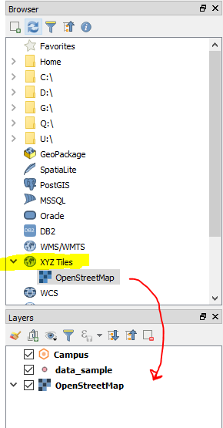
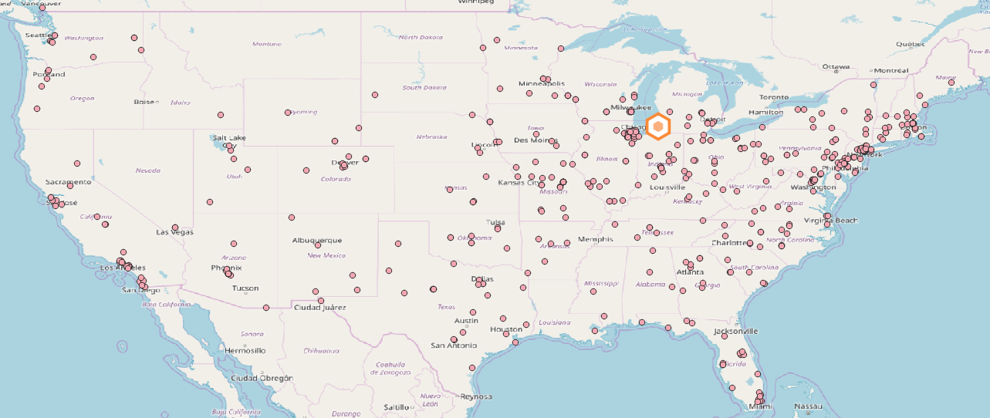
Add Basemap
On the left hand side, in the ‘Browser’ window, look for a tool that says “XYZ Tiles”.
Within that dropdown drag “OpenStreetMap” into our “Layers” box.
There are other basemaps in qgis if you don’t like this one. Here’s one blog about it (https://opengislab.com/blog/2018/4/15/add-basemaps-in-qgis-30).

Slide 10


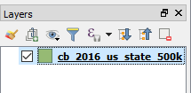

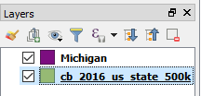
Generating Random Points Data in QGIS
I am currently using QGIS 3.0. In older or newer versions some of the visuals may be different
Creating a layer with just the state
Bringing in our states shapefile
In the top ribbon: Layer > Add Layer > Add Vector Layer
Find the states shapefile downloaded from before.
Select the file with the .shp extension.
Filtering down States Shapefile into one state
From the toolbar, select the ‘Select features by area or single click’ button
Select the state you wish to use for the project. It should light up yellow.
Right click the states layer in the ‘Layers’ panel (bottom left), select ‘Save As’
Next to ‘File Name’ click the ‘…’ button
Choose the file path and file name you wish
Find the ‘Save only selected features’ box and check it
Make sure the ‘Add saved file to map’ box is also checked
Click ‘OK’
Your ‘Layers’ panel should now have two layers

Slide 11
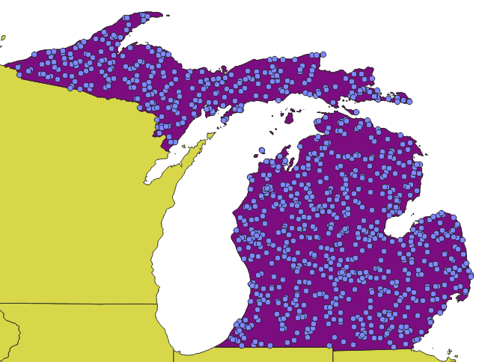
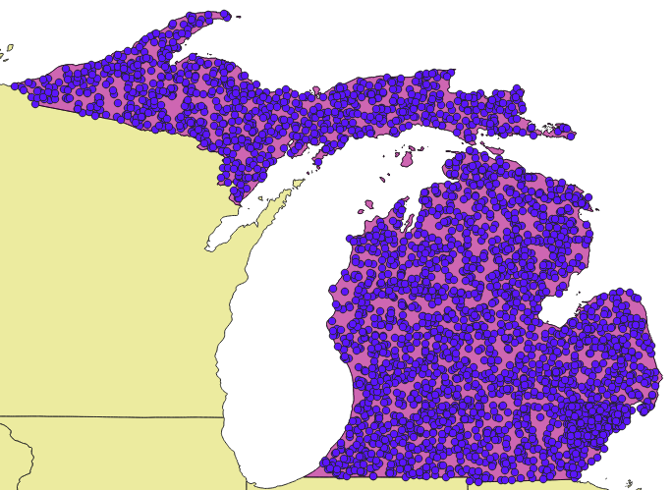
Generating Random Points Data in QGIS
Adding random points
In top ribbon: Vector > Research Tools > Random points in layer bounds
For ‘Input Layer’ select the layer created in previous slide with just the state of interest
Number of Points:`
The number of points is going to depend on the user’s project. For Michigan and the visuals used in this guide, I used about 3200. Once our random points are in R, each point will use the Google API twice, which has a daily limit of 2500 queries. More points will lead to a more accurate map but will also add time to the project. One of the nice things about this project is that it’s easy to start with a certain number of points and go back and add more.
Select ‘Run in background’
Map of Michigan with 1000 random points
Map of Michigan with 3200 random points

Slide 12
R Code: Bring in data sets
# These random points were created using QGIS
# Directions for this step are listed in project PowerPoint
RandomPoints_TwoThousand2 <- read_csv("C:/Users/Dan/Dropbox/Work/Mapping/RandomPoints_TwoThousand2.csv")
View(RandomPoints_TwoThousand2)
# Locations of our colleges
TwoYears_MI <- read_csv("C:/Users/Dan/Dropbox/Work/Mapping/TwoYears_MI.csv")
View(TwoYears_MI)
#Renaming dataframes
dat <- TwoYears_MI
RP <- RandomPoints_TwoThousand2
Installing packages and libraries in R.
Reading in our random point csv.
Reading in our institution csv.

Slide 13
R Code: Nearest Two Institutions
# Creating variables to store the closest and second closest college by distance
# Creating a variable to store the college name which has the fastest drive time to the random point
# Creating a variable with the time it takes to get to that closest college
n <- length(RP)
RP[,(n+1)] <- NA ; colnames(RP)[(n+1)] <- "Closest"
RP[,(n+2)] <- NA ; colnames(RP)[(n+2)] <- "Closest2"
RP[,(n+3)] <- NA ; colnames(RP)[(n+3)] <- "Fastest"
RP[,(n+4)] <- NA ; colnames(RP)[(n+4)] <- "Fastest_Time"
# Getting the closest and second closest colleges by distance
for(i in 1:nrow(RP)){
a=numeric()
for(j in 1:nrow(dat)){
x <- unlist(c(dat[j,"lon"],dat[j,"lat"]))
y <- unlist(c(RP[i,"xcoord"],RP[i,"ycoord"]))
a[j] <- distm(x,y)[1,1]
}
RP$Closest[i] <- dat$Institution_Name[(which.min(a))]
RP$Closest2[i] <-dat$Institution_Name[(which(a == sort(a,partial=2)[2]))]
}
First I am just setting up the variables I will eventually populate.
In the second block, I have two for loops.
The inner loop calculates the distance to each college in the state for one random point.
The outer loop takes the first and second closest colleges and stores their information in the random point data set (RP).

Slide 14
R Code: Fastest College
# Getting the fastest college between those 2 nearest colleges
for(i in 1:100){
a <- unlist(c(dat$lon[dat$Institution_Name==RP$Closest[i]],
dat$lat[dat$Institution_Name==RP$Closest[i]]))
b <- unlist(c(dat$lon[dat$Institution_Name==RP$Closest2[i]],
dat$lat[dat$Institution_Name==RP$Closest2[i]]))
c <- unlist(c(RP[i,"xcoord"],RP[i,"ycoord"]))
a2 <- gsub(" ","",paste(as.character(a[2]),"+",as.character(a[1])),fixed = T)
b2 <- gsub(" ","",paste(as.character(b[2]),"+",as.character(b[1])),fixed = T)
c2 <- gsub(" ","",paste(as.character(c[2]),"+",as.character(c[1])),fixed = T)
q <- gmapsdistance(c2,a2,mode="driving")
w <- gmapsdistance(c2,b2,mode="driving")
if( is.na(q$Time) | is.na(w$Time) ){
RP$Fastest[i] <- NA
RP$Fastest_Time[i] <- NA
}else if(min(q$Time,w$Time)==q$Time){
RP$Fastest[i] <- RP$Closest[i]
RP$Fastest_Time[i] <- q$Time/3600
}else{
RP$Fastest[i] <- RP$Closest2[i]
RP$Fastest_Time[i] <- w$Time/3600
}
}
First, getting the latitude and longitude of the closest institution and storing it as ‘a’. Same for the second closest stored as ‘b’. College coordinates stored as ‘c’.
Calculating the drive time to the closest college and storing that time as ‘q’. Same for the second closest and storing that time as ‘w’.
Using the minimum between q and w to store the fastest college’s name and the amount of time needed (comes out as seconds so dividing by 3600 to get it into hours).

Slide 15
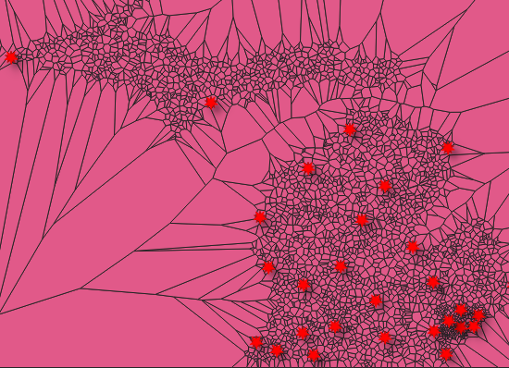
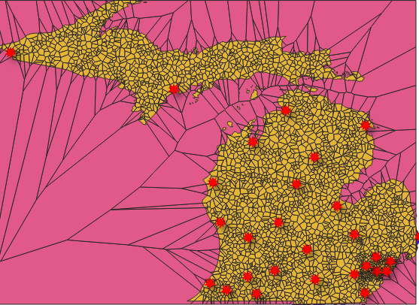
Creating Voronoi Polygons
Vector > Geometry Tools > Voronoi Polygons
Make sure the random point layer is listed as ‘Input Layer’
Vector > Geoprocessing Tools > Clip
Use our Voronoi polygons layer as the input layer and our state map as the clip layer.
First Step: Creating Voronoi Polygons
Second Step: Clipping with state map

Slide 16
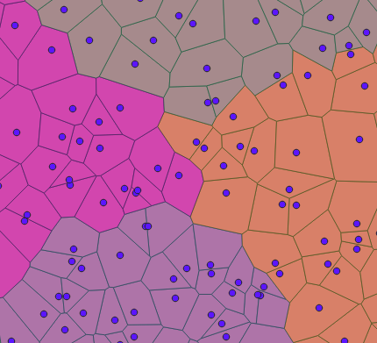
What is a Voronoi Polygon?
A Voronoi polygon creates a “region consisting of all points closer to that seed than to any other.” In this case, our ‘seeds’ are our random points.
https://en.wikipedia.org/wiki/Voronoi_diagram

Slide 17
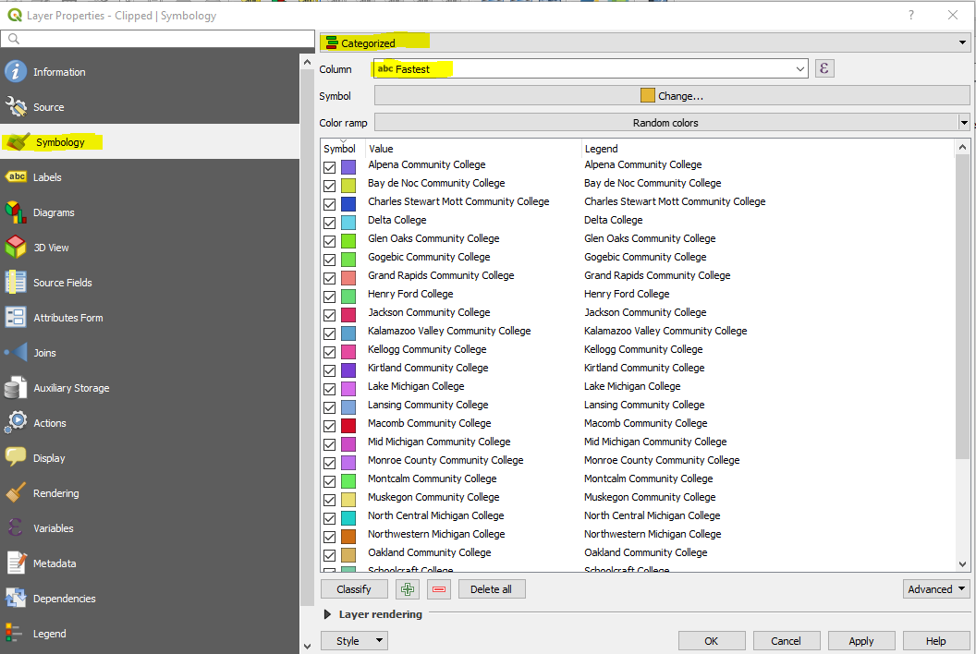
Visualizing Our Boundaries
Filling in our polygons
Right click the layer which should be named ‘Clipped’ from our previous step, select ‘Properties’
Go to the ‘Symbology’ tab. On the top dropdown, select ‘Categorized’
In the ‘Column’ dropdown, select our variable containing the closest institution (“Fastest” in this case).
You can play with the colors, this was my method:
Select “Change…” button next to ‘Symbol’
Set the ‘Opacity’ lower so we can see road map behind
Select the “Simple fill” subcategory
Make the ‘Stroke Color’ transparent
Select OK

Slide 18

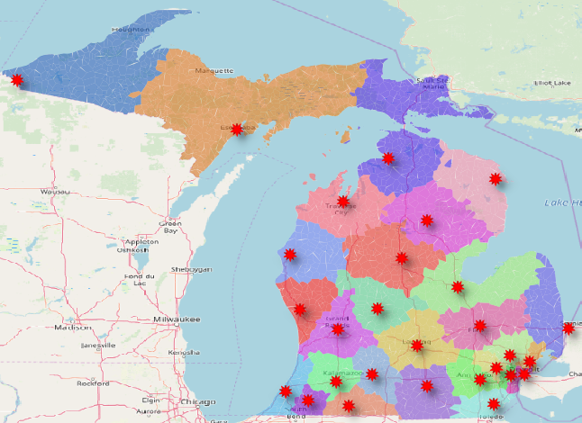
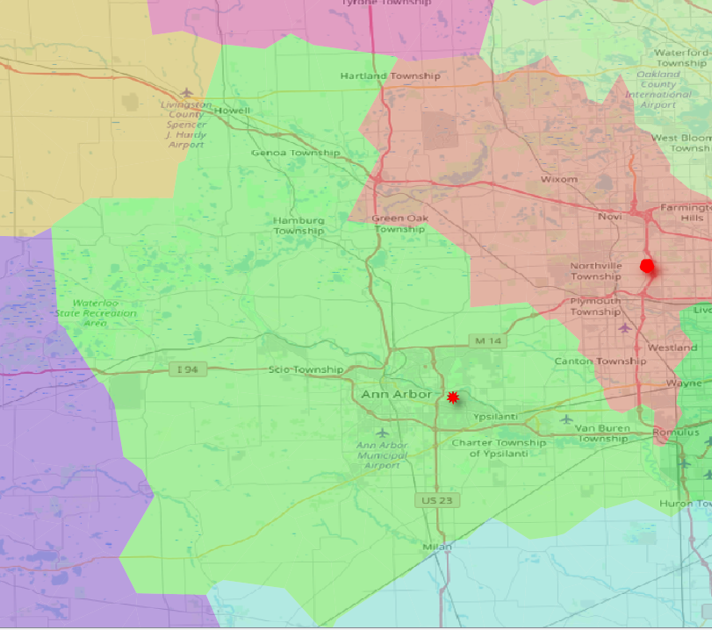
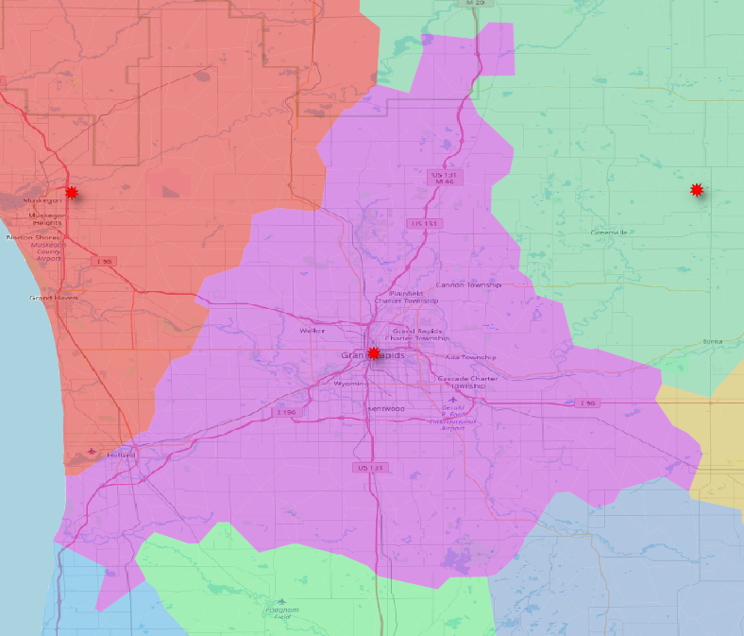
Final Result
Ann Arbor
Grand Rapids

Slide 19
Shortcomings
The more random points we generate, the more accurate these areas become along the edges.
We only test the two closest institutions by distance for their travel time. Areas that are near-equidistant to 3 or more colleges may be inaccurate because we didn’t test the travel time to those other colleges.
Wayne County CC’s multiple campuses were note addressed.

Slide 20
Thank You
Dan Vollrath
Elgin Community College
dvollrath@elgin.edu

