Slide 1
Creating Interactive Maps Using R and QGIS
Dan Vollrath
Institutional Research Data Specialist
Elgin Community College
dvollrath@elgin.edu
Notes:
How did they get there?

Slide 2
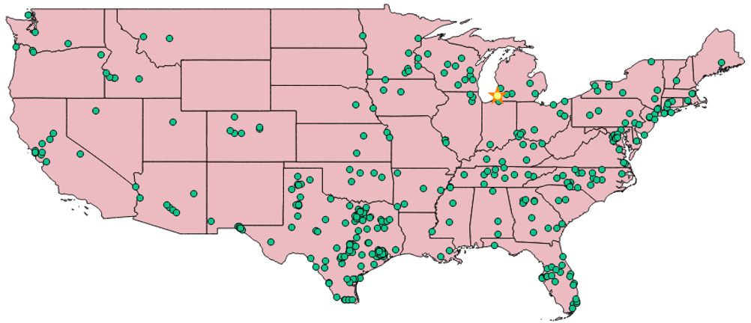
Learning Goals
Creating informative and interactive maps in QGIS
Saving maps for selective usage

Slide 3
Downloading R, Rstudio, and QGIS
R
http://cran.stat.ucla.edu/
RStudio
https://www.rstudio.com/products/rstudio/download/
QGIS
http://www.qgis.org/en/site/forusers/download.html
*I always download 64 bit

Slide 4


R is a language and environment for statistical computing
RStudio is an environment for using R.
Allows us to use R more intuitively.
CRAN
CRAN is the network of servers allowing us to use R. When you download R, it will ask you to choose your location, finding the nearest server.

Slide 5

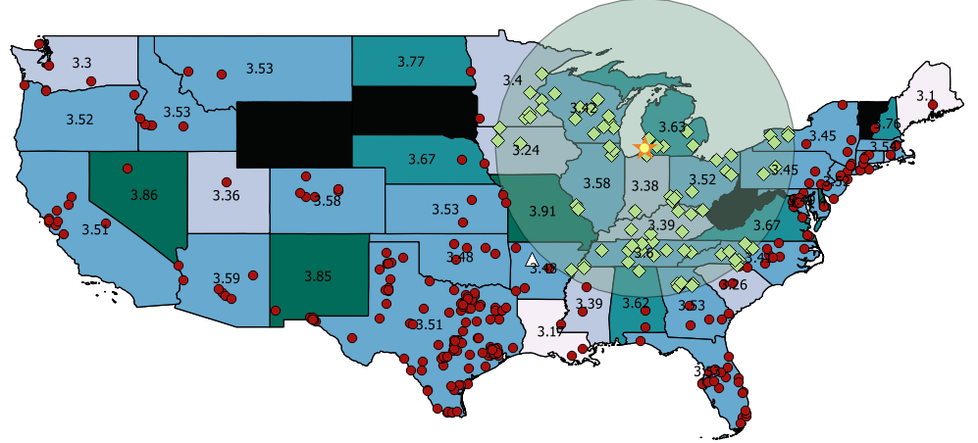
Quantum Geographic Information System
Tool to create, edit, visualize, analyze, and publish geospatial information
Created by Open Source Geospatial Foundation (OSGeo)

Slide 6
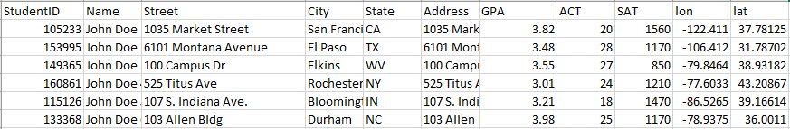

Our Data
Incoming Cohort
500 Students
High School GPA, ACT, SAT etc.
Latitude and Longitude from R
Student Data File Example
Campus Data File Example

Slide 7
Importing CSV files
# Usually I try to save Excel files as csv files before bringing them into R
# Excel is possible, I've just had much better luck with csv
# Use read.csv for csv
# file.choose opens the directory for you to select a file
# I like to at least add the filepath to the code, because I am always re-importing my original dataset
# "<-" is an assignment operator. It assigns our table to an object called mydata
# "=" can also be an assignment operator, but because of equality uses of "=", using "<-" is a good habit.
# Common mistakes by me: Using “\” instead of “/”, forgetting “.csv”, forgetting “header = T”
mydata <- read.csv("C:/Users/dvollrat/Desktop/addresses.csv",header = T)
mydata <- read.csv(file.choose(),header = T)

Slide 8
Viewing Data # Click on the object in the Environment window to view your dataframe # R is great because you can have multiple dataframes in your environment # Or use View(), View(mydata)

Slide 9
Geocoding (pt 1)
# First I'm creating empty columns for latitude and longitude in my dataframe
# The semicolon acts as a new line of code, since these two lines are so related, I find it more neat
# to code this way
# To access a part of a data frame, we use brackets. First position is row, second column
# To find what’s in row 1 column 1, we would write mydata[1,1] for example
# By not having a row in the first position of the [,], I'm accessing the entire 12th and 13 columns of mydata
length(mydata)
mydata[,12] <- NA ; colnames(mydata)[12] <- "lat"
mydata[,13] <- NA ; colnames(mydata)[13] <- "lon"
View(mydata)

Slide 10
Geocoding (pt 2)
Comments
Code
# Moving Step by step through this:
# We start by creating a for loop, we use i as our iterator,
# i gets set to 1, the colon is like saying "to", row 10
# Our geocode function returns a 1 row 2 column dataframe, so we save it to an object called x
# We make sure that each row of "Address" is in character format by using the function as.character
# We are then accessing row i, of column 'Address' in mydata
# We are then setting row i, column "lon" of mydata as the column of x which is longitude
# We are then setting row i, column "lat" of mydata as the column of x which is latitude
# We slightly stall the loop, for .03 seconds, with Sys.sleep because there's a limit to how many geocodes you can do in a second
# Our for loop then automatically does this again and again for however many rows we input.
# We're limited to 2500 geocodes per day by google. However, you can go onto other computers,
# open this R code, change the range of rows you want to geocode, and run it.
for(i in 1:10){
x <- geocode(as.character(mydata[i,"Address"]))
mydata[i,"lon"] <- x[,"lon"]
mydata[i,"lat"] <- x[,"lat"]
Sys.sleep(.03)
}

Slide 11
CSVT
Changing the type of a variable in QGIS can be difficult
A CSVT file works in conjunction with a CSV file
The CSVT file sets the data type for each column of a CSV file
CSVT files are one long string of types
Example: “String”, “String”, “Real”, “Integer”, “Date”…..
Only use one of the 4 types in the example above
String
Real
Integer
Date
The simplest way to do this is to just open notepad and write it out
When you save it, you must save it as the same name and same location as the csv going into QGIS
Then just add “.csvt” to force it into that file type

Slide 12
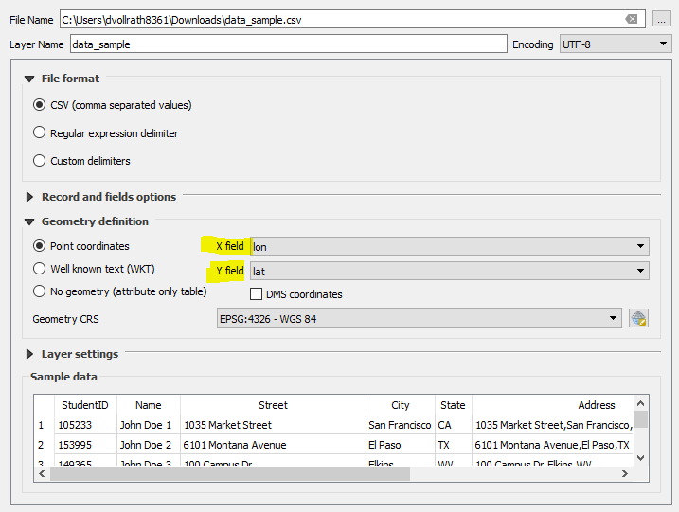
Adding Our CSVs to QGIS
Layer > Add Layer > Add Delimited Text Layer
‘…’ by ‘File Name’ and then find your file
Be sure to add X field and Y field as our ‘lon’ and ‘lat’
‘Add’

Slide 13
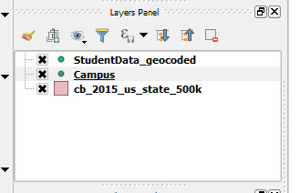
Add Campus and Change Symbol
Follow previous steps with our “campus” csv file.
Right click “Campus” in the Layers Panel
Go to Properties, on left hand side choose “Symbology”
At the top, Marker should be highlighted
You can choose different symbols
You can change the color
You can change the size
Etc.
To move the campus symbol in front of our student symbols:
In the Layers Panel, drag Campus above

Slide 14
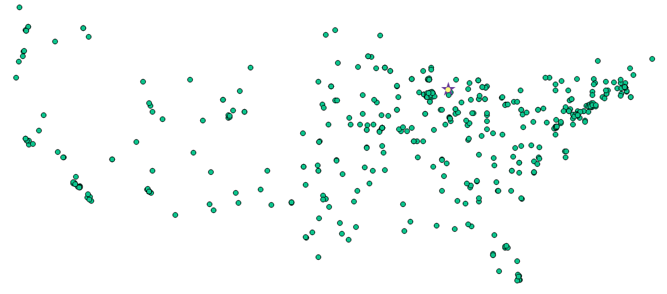
Where we’re at now

Slide 15

Cleanup our student data file
For this project, I don’t want all of the data popping up for each student. This can be dealt with in excel by eliminating information you don’t need for the map. However, data like a student’s geocoordinates are needed for QGIS but are unlikely to be useful to an end user of this map.
1: In our Layers Panel, right click the layer which holds our student data. Select “Properties.”
2: On the left hand side select the “Attributes Form” tab.
3: Find a variable that wouldn’t be useful to an end user under “Fields”. Select it.
4: Then look under “Widget Type” on the right. Click the drop down, and choose “Hidden”
5: For this project, I am going to hide everything but Name, GPA, ACT, and SAT
You may end up coming back to this once you’ve started working on our web map. The fewer variables that we use the cleaner and more understandable our end map will be.
These steps are the reason I suggest eliminating unneeded variables while in excel. I always try to bring in the most basic dataset I know I will need into QGIS.

Slide 16
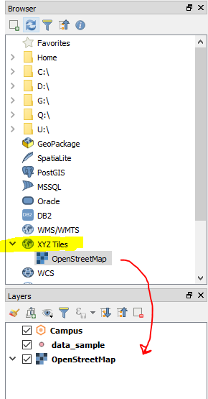
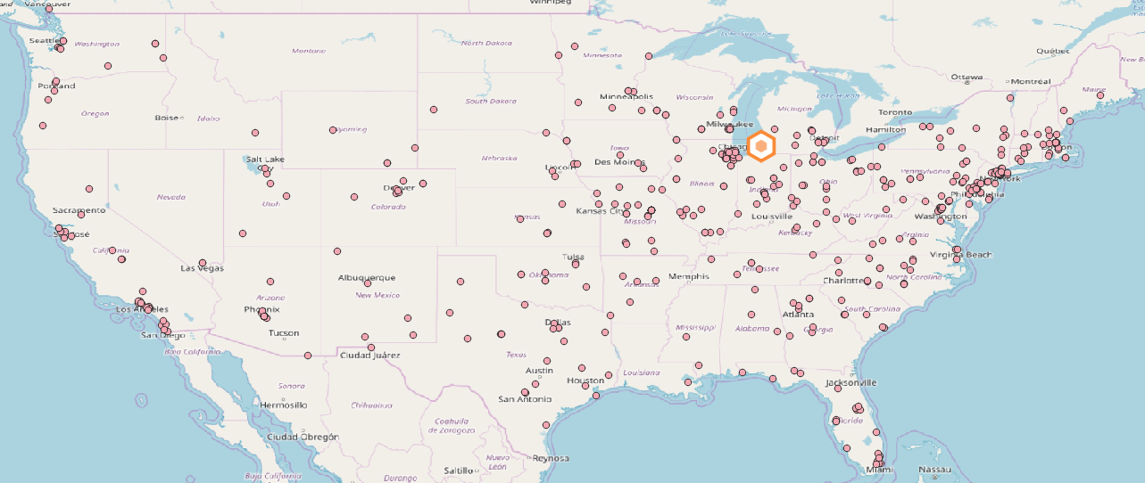
Add Basemap
On the left hand side, in the ‘Browser’ window, look for a tool that says “XYZ Tiles”.
Within that dropdown drag “OpenStreetMap” into our “Layers” box.
There are other basemaps in qgis if you don’t like this one. Here’s one blog about it (https://opengislab.com/blog/2018/4/15/add-basemaps-in-qgis-30).

Slide 17
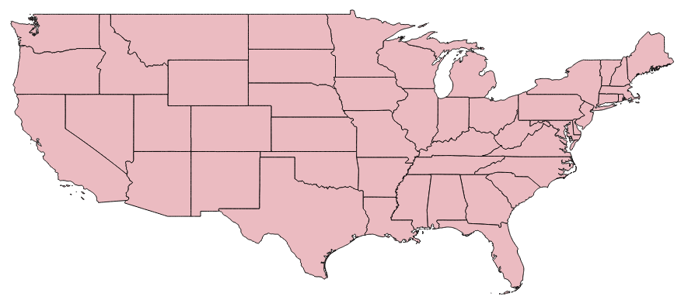
Downloading Shapefiles off the Internet
Shapefiles (.shp) are the maps we will be using in QGIS. There are many different sources for maps but a popular one comes from the U.S. Census called TIGER.
https://www.census.gov/geo/maps-data/data/tiger-cart-boundary.html
These will almost always download as .zip files.
Once you download the zip file and save it where you want, right click and select “Extract All”
IMPORTANT: Even though it only looks like we use the .shp file, all the files are being used. Do not delete the other files from the download just because it seems like you don’t use them.
Once you’ve extracted the folder, drag and drop the file with extension .shp and type SHP File into QGIS.

Slide 18
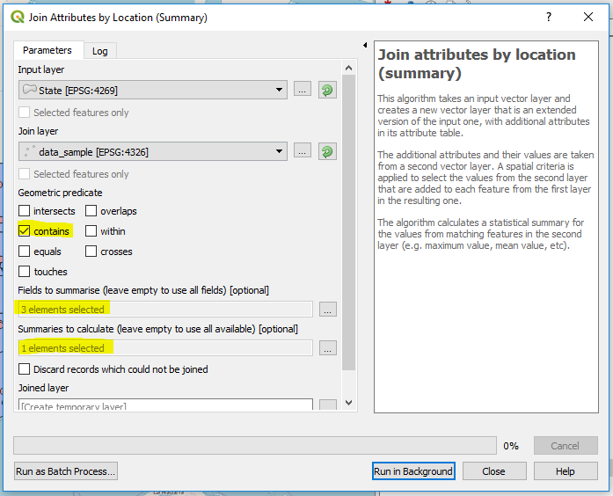
Aggregating by Geographic Boundary
(On our top ribbon) Processing > Toolbox > Vector General > Join attributes by location (summary)
Input layer should be the location shapefile you are aggregating up to.
Join layer should be the layer with your data
Geometric predicate will probably always be ‘contains’
“Fields to summarise” are the fields you’ll be calculating
“Summaries to calculate” are up to you.
Sometimes you may only want to keep the ‘places’ which contain your data (States/Counties that have students from them). In that case, choose “Discard records which could not be joined.”
This tool is helpful when we want to aggregate data by locations not typically found in an address line. You may want to aggregate by county. Community colleges in large metros may want to know where students live by census tract. All we would need are county and census tract maps, which are easy to find online.

Slide 19
Creating our shareable, interactive map
1: In the top ribbon, select “Plugins” > “Manage and Install Plugins”
2: Search “qgis2web” and Install
3: Zoom your QGIS map to the level you would like your interactive map to open to.
4: Your toolbar should display this symbol . You can click this symbol or also go to “Web” in the top ribbon, “qgis2web” > “Create web map.”
5: Play around by zooming in and scrolling in the map in our window. Click on a dot, notice the information related to that student pops up.
In the “Appearance” tab, select “Add Layers List” to be able to click our different layers on and off. This allows us to build multiple levels of aggregation into the same map. End users can look up point level data or ‘flip on’ an aggregation map like the one we created.
*** Be sure to click “Update Preview” button towards the bottom of this window to see changes you make while following these steps.

Slide 20
Creating our shareable, interactive map
7: I like when our student information pops up when you hover over their data point versus when clicking. In the bottom left window, find the “Appearance” expansion tab. Under Appearance, find “Show popups on hover” and check the box.
8: I also like the information which is displayed to have a label to make is easier on the end user. In the top left window, find the “Layers and Groups” expansion tab. Find the layer which holds our student data. You should notice the variables which are a part of our dataset. Click the dropdown next to the variables’ name and select “inline label” or “header label.”
Header Label Example Inline Label Example
Name:
John Doe 1
Name: John Doe 1
You can also choose to have no header, which may make sense if the content doesn’t need an explanation.
*** Be sure to click “Update Preview” button towards the bottom of this window to see changes you make while following these steps.

Slide 21
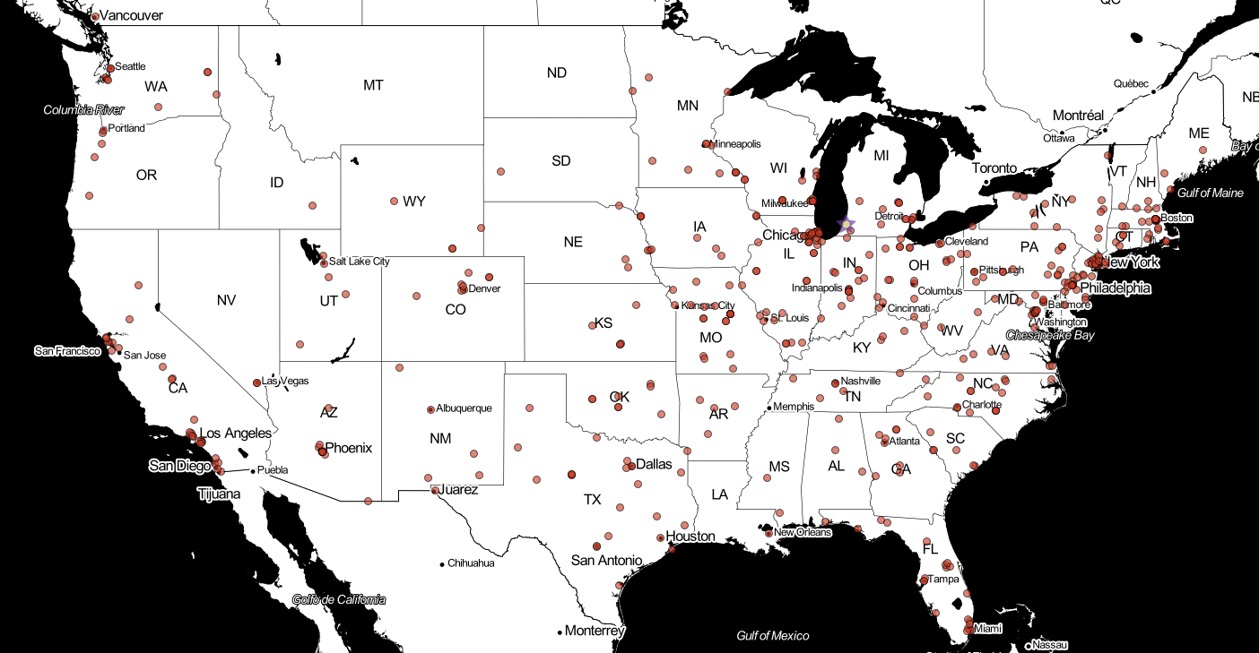
Creating our shareable, interactive map
The buttons “OpenLayers” and “Leaflet” at the bottom left are two plugins which qgis2web use to create the map. I haven’t noticed a difference in my experience, but there are strengths to each one. It’s possible that basic maps like the one we create here is not complex enough to show the differences.
9: Once the map in our preview window looks good. We are ready to export. Click the “Export” button at the bottom of our window.
Our map should open in a web browser.
10: At this point, our map only exists on our computer. Look at the URL bar of the browser that opened when you exported the map. This tells us where our folder with our map files sit on our computer. Mine is going to:
C:/Users/Dan/AppData/Local/Temp/qgis2web/….
11: This “qgis2web” folder has many folders in it for me. I’ve always used the most recent and deleted the rest. My guess is that QGIS may save every time we update preview.

Slide 22
Creating our shareable, interactive map
12: Once you’ve found the newest folder with a name that will look something like “qgis2web_2017_11_09-17_15_39_605000” you may want to rename it. You don’t want to rename anything within this folder however, so you may want to make sure the original folder name is descriptive enough to explain the entire map.
13: The last step is going to be different for every institution and for every project. In my experience, the best way to share the map is to save the folder somewhere on your institutions shared system and within a folder only IR and the concerned parties have access to. From there, just tell them to open the folder and open the HTML file called “index.”

Slide 23
Creating Interactive Maps Using R and QGIS
Dan Vollrath
Institutional Research Data Specialist
Elgin Community College
dvollrath@elgin.edu

Slide 24
Bonus Tools

Slide 25


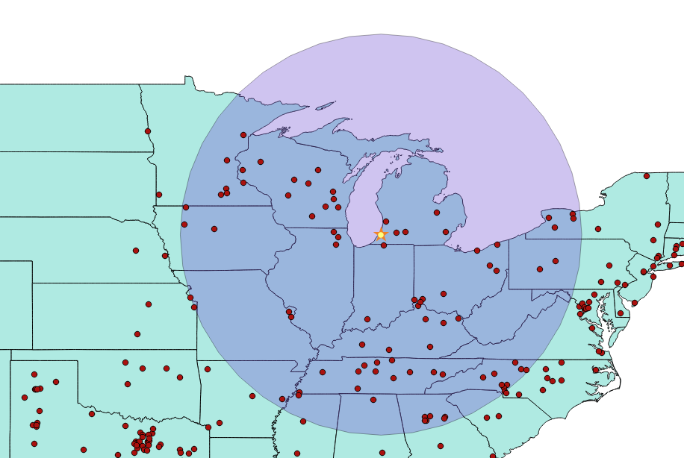
Finding who’s within 500 miles of campus
Information, Measurement, and Buffer tools
Make sure the student data layer is selected in the layers panel. Use the information icon pictured right. This icon lets us know the data behind any point/area on our map. The data shows up in the window on the right. Find a dot which has a distance from campus of ~500 miles. For our data, that was John Doe 65, right on the Kansas/Missouri border.
Use the measurement tool pictured right. Switch from meters to degrees. Using the crosshairs, click on our campus (as precisely as possible) and then click on John Doe 65 (or whichever student you’ve found).
You should have found something in the ballpark of 9.07 degrees.
Click the Campus layer in Layers Panel. Select Vector>Geoprocessing tools>Fixed distance buffer. Input layer should be Campus. Distance should be 9.07 (or whatever you’ve found), and I like to use about 10 segments. Run it.
Right click buffer, go to properties, set the transparency above 50%.
Your new buffer should end very close to the student you measured from.
Admittedly, I haven’t figured out the best way to do this yet. QGIS is using a CRS (Coordinate Reference System) and the buffer tool uses degrees. All we’re doing with the measurement tool is back of the envelope converting miles to degrees. This is more of a visual tool, if you say, want to know average GPA of everyone within 100 miles, just use the distances we calculated in R.

Slide 26
Label students within the buffer zone
Now we want to differently symbolize the students within the 500 mile buffer zone we just created.
Go to Vector > Geoprocessing Tools > Intersection. Use our student data as the Input layer and our Buffer layer as the Intersect layer.
I played around with the style to get what you see in the picture here.

Slide 27
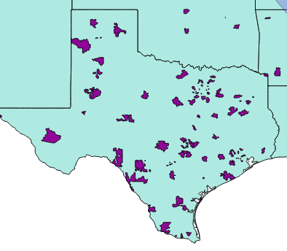
Joining Layers
Earlier, we joined by location because it’s the more generally useful method. You can also join layers in the properties menu. To demonstrate this, use a zipcode shapefile.
Add the zip code shapefile, right click it in the Layers Panel, select properties. Go to Joins on the left hand side. Hit the green plus sign button.
Set Join Layer to StudentData_geocoded, Join Field to ZIP and Target field to ZCTA5CE10.
I mostly use this method if I’ve already aggregated the Student Data using some other tool (Excel, R, etc) so that each row of data matches up with only one shape on the map. Notice in the example above there is no aggregation happening. QGIS is going to grab the information from the Student Data record it matches with first. It’s fine if you just want to show which areas have students in them (see example to right), but you won’t get something like ‘average GPA’, ‘sum of donation dollars from’, etc.

Slide 28
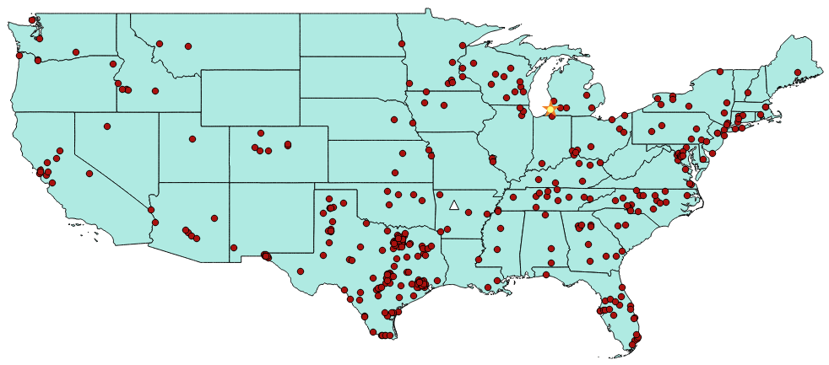
Finding the average location of your students
Using this tool you are able to find the mean location of your group of students. I’m not sure how useful this one statistic is on its own, but I believe it might be interesting to track over time.
Go to Vector>Analysis tools>mean coordinates. Enter your student level data for Input layer.

Slide 29
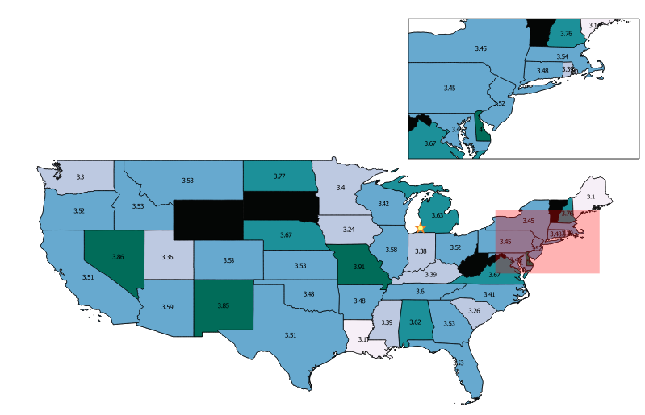
Creating a Location Zoom Insert
In our map, we lost out on the details about the states in the Northeast. So, to create a zoomed in insert onto our original map we follow these steps.
Start with our original map with the graduated color scheme in Print Composer (PC). Go back to the QGIS mapping window and find the zoom tool (magnifying glass with plus sign). Zoom into the Northeast.
Go back to PC and select ‘Add Map’ like before. Drag this map just like we did before, but in an open space, not covering our original map.
It doesn’t look very good without a border, so go to the Item Properties tab on the right hand side of PC. Scroll down and select the box next to “Frame”. Set your preferred dimensions.
Now we want to see where our little map came from on our big map. Under the “Items” grouping on the right hand side, make sure the big map is selected. Then go down to Item Properties again and find ‘Overview” (a couple spots above Frame). Green Plus sign > Map frame = [name of small map]. You can play with the formatting from there.

Slide 30
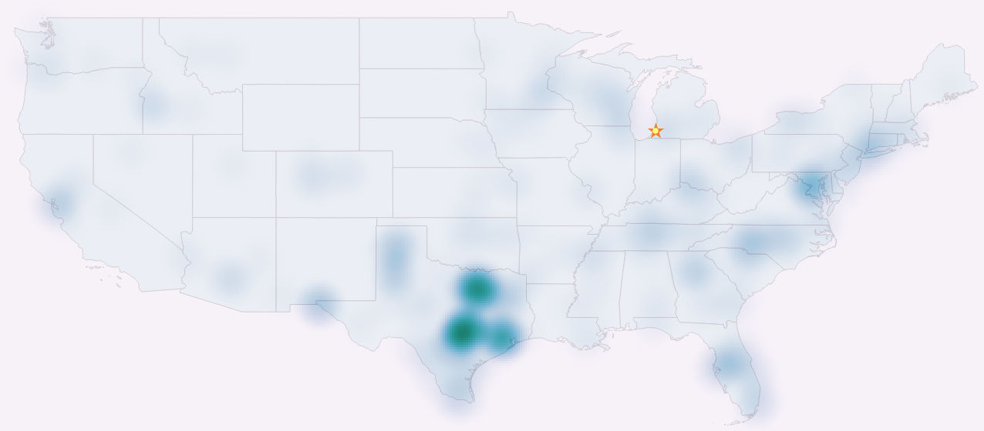
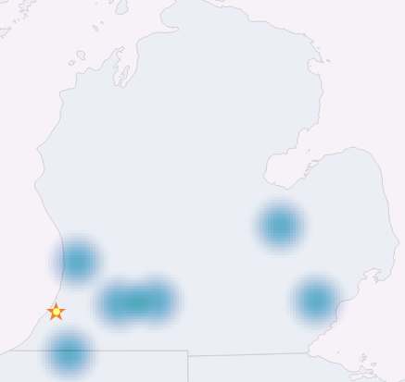
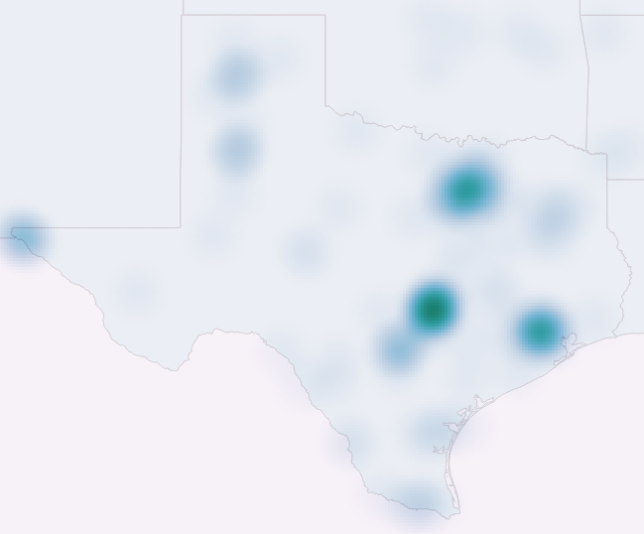
Creating a Heatmap
To create a heatmap of our students:
Right click on our StudentData_geocoded layer in our Layers Panel, then click properties.
Go to the Style tab on the left hand side, go to the drop down at the very top and select Heatmap.
To get the map in the background to show up, go down to the Layer rendering area and set the transparency above 0.
Note how the heatmap changes when we zoom in (right). In the country map Michigan doesn’t have much color because it has a low number of students compared to places like Texas. When we zoom in, Michigan is no longer being compared to places like Texas, so locations with students become darker. Also note how the color on the map centralizes around the cities when we zoom into Texas.

Slide 31

Creating a bootleg filter tool
At the time of writing, there’s no filter tool that you can add in the qgis2web plugin. You can filter within QGIS, but our goal is to make this map for people without QGIS. There’s one technique I’ve found that works well for variables that you can fit into ~5 or less bins.
1: In QGIS, go to our Layers Panel and find our layer with our student data. Right click the layer and select ‘Duplicate’. You want to create as many duplicate layers as you will have bins for a specific variable. For example: Two layers if you want to compare Male and Female. Rename the layers after what they will eventually represent.
2: Right click one of the duplicate layers and select “Filter.” Select the Field you are differentiating your students on and use the Operators to create your filter statement. (Note: It’s important your variables were imported as the right type in this step if you are looking at something like “GPA > 3.00”) Complete this for each new duplicate layer.
3: Follow the steps using the qgis2web plugin. In the “Export to web map” window, find the “Appearance” expansion tab and the “Add layers list” underneath. Click the dropdown and change it to “Expanded.”
4: Click “Update Preview”
Example on Next Page

Slide 32
