Slide 1
HALO: Haskell to Logic through Denotational Semantics
Dimitrios Vytiniotis, Simon Peyton Jones,
Koen Claessen, Dan Rosén
Submitted to POPL 2013
web.student.chalmers.se/~danr/halo-popl.pdf

Slide 2
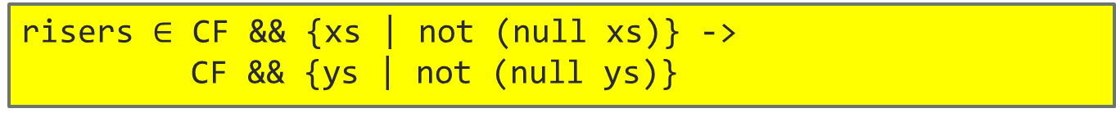
Static Contract Checking for Haskell
risers [] = []
risers [x] = [[x]]
risers (x:y:ys)
= case risers (y:ys) of
[] -> error “Crash”
(s:ss) -> if x <= y then (x:s):ss
else [x]:s:ss
CAN THIS CODE CRASH?
risers $∈$ CF && {xs | not (null xs)} ->
CF && {ys | not (null ys)}
Syntax of contracts
C ::= {x|p} | (x:C) -> C | C && C | CF
Just a Haskell expression of type Bool
“crash-free”

Slide 3




Check contracts using an FOL theorem prover
First Order Logic
Formulae
module Foo
f x y = …
HALO:
translation to First Order Logic
$$T_{definitions}$$
g $∈?$ CF -> CF -> CF
$${¬φ}_{contract}$$
-- Prelude
data [a] = [] | a : as
data Bool = True | False
… Functions over these…
$$T_{prelude}$$
Haskell
Source
Theorem prover
Z3/Equinox
Satisfiable ☹
Either contract doesn’t hold or too weak induction
Unsatisfiable ☺
Contract holds!
<loop>
Can’t tell anything

Slide 4
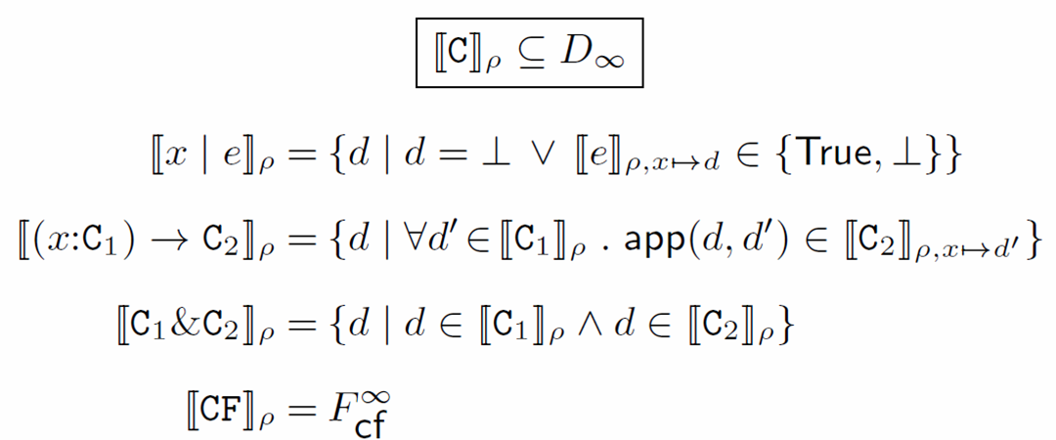

Satisfying a contract, denotationally
What does it really mean to satisfy a contract?
Define contract satisfication: f $∈$ C to be [f] $∈$ [C]

Slide 5
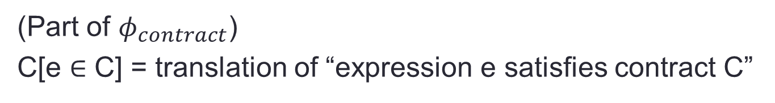
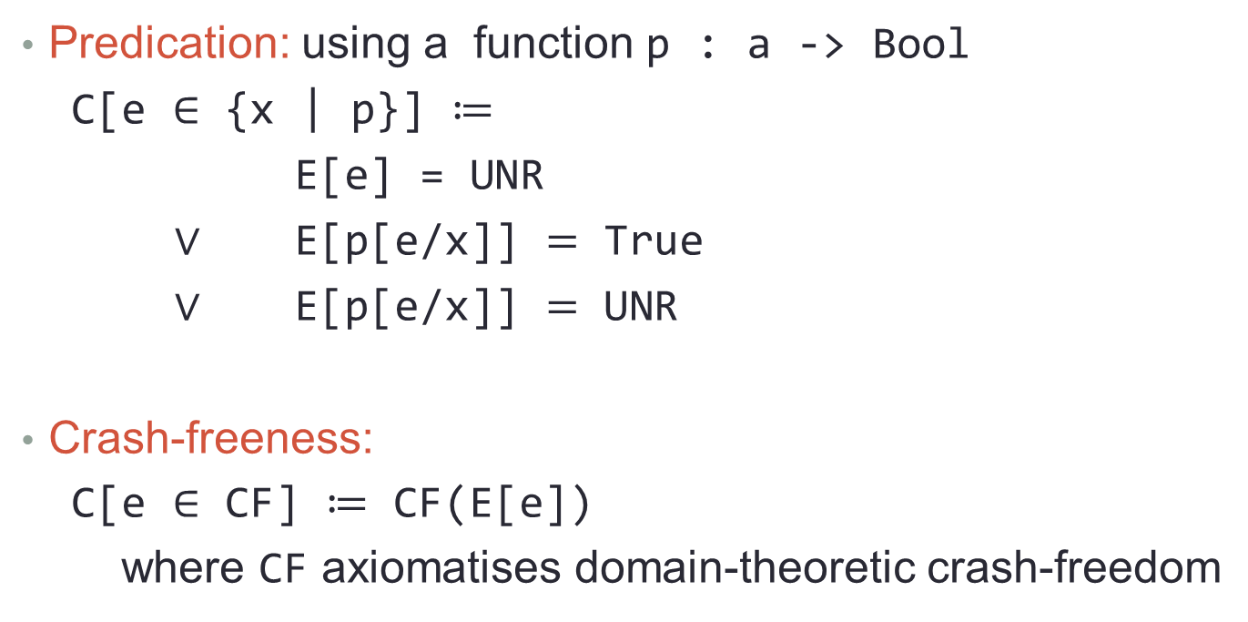
Example: Base contracts to FOL
(Part of $φ_{contract}$)
C[e $∈$ C] = translation of “expression e satisfies contract C”
Predication: using a function p : a -> Bool
C[e $∈$ {x | p}] $≔$
E[e] = UNR
$∨$ E[p[e/x]] $=$ True
$∨$ E[p[e/x]] $=$ UNR
Crash-freeness:
C[e $∈$ CF] $≔$ CF(E[e])
where CF axiomatises domain-theoretic crash-freedom

Slide 6
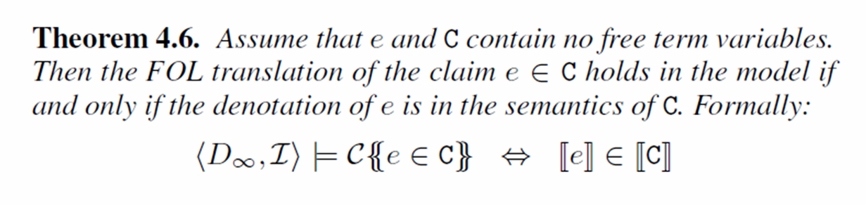
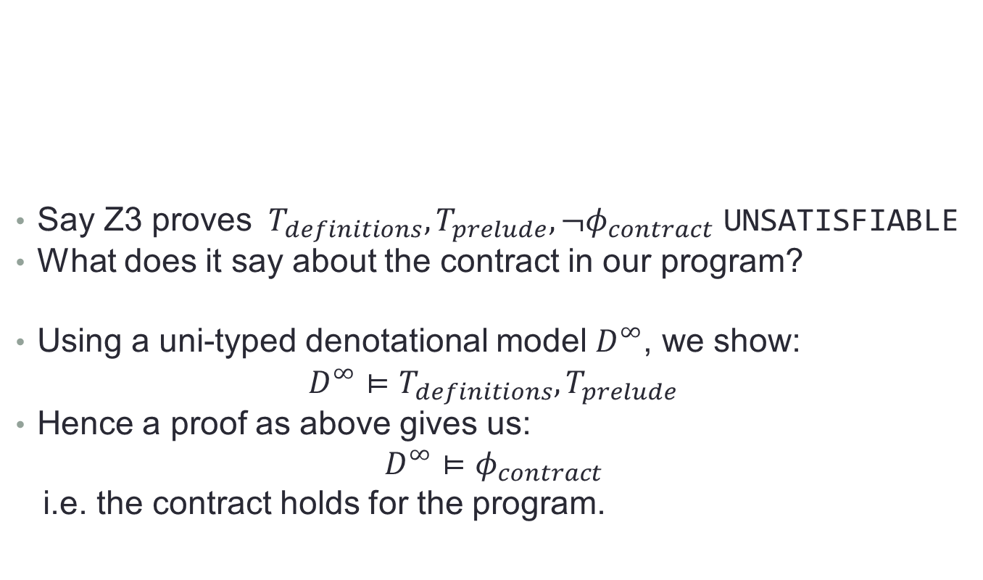
Justified by Denotational Semantics
Say Z3 proves $T_{definitions},T_{prelude},¬φ_{contract}$ UNSATISFIABLE
What does it say about the contract in our program?
Using a uni-typed denotational model $D^{∞}$, we show:
$D^{∞}⊨T_{definitions},T_{prelude}$
Hence a proof as above gives us:
$D^{∞}⊨φ_{contract}$
i.e. the contract holds for the program.

Slide 7
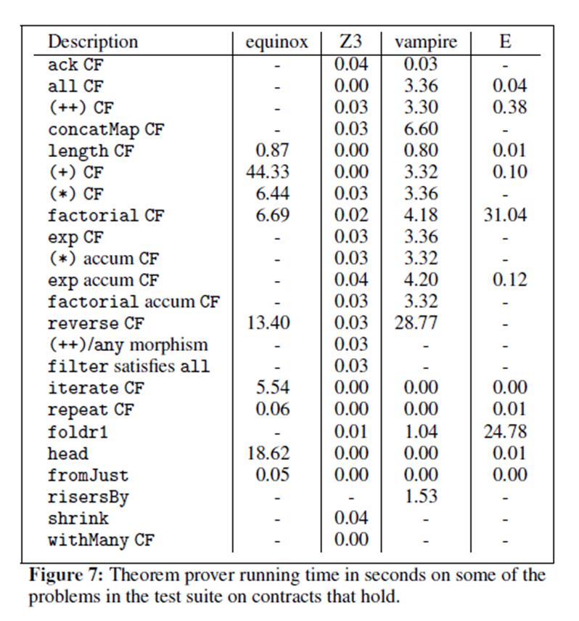
We have a tool that implements this!
BUT
if the contract doesn’t hold
all theorem provers diverge!

Slide 8
Backup slides
:)

Slide 9
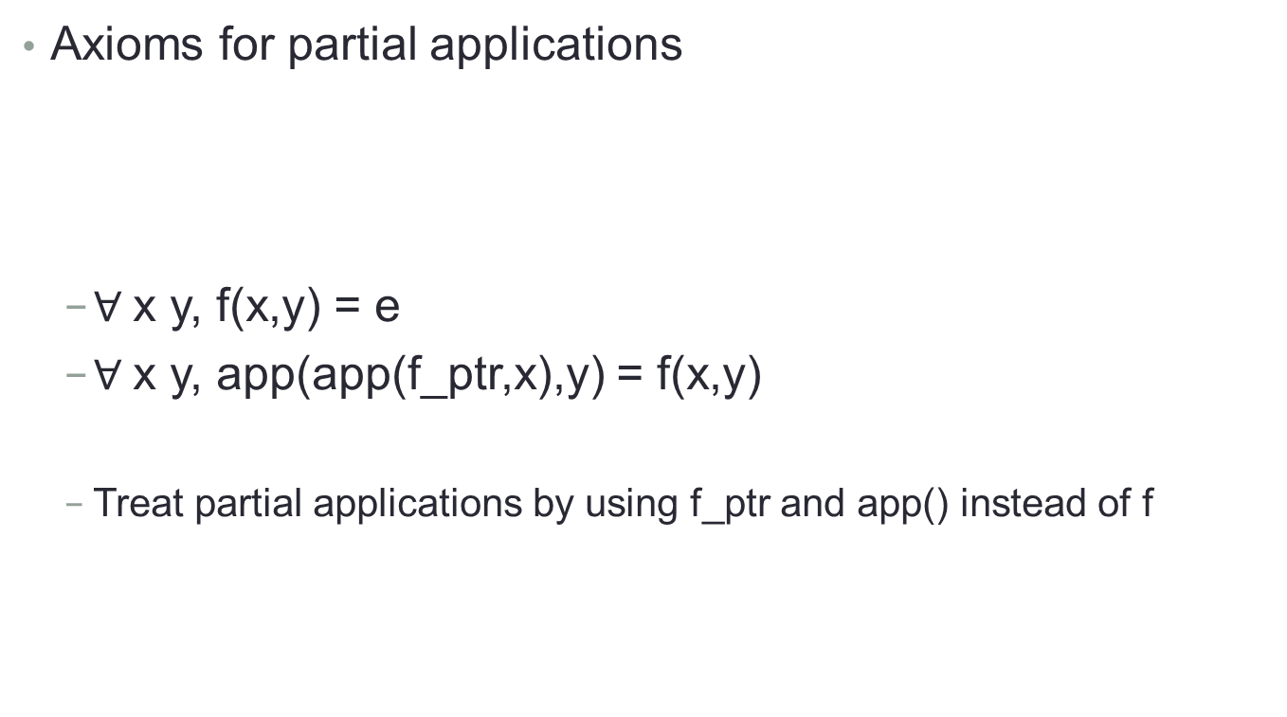
Partial applications
Axioms for partial applications
$∀$x y, f(x,y) = e
$∀$x y, app(app(f_ptr,x),y) = f(x,y)
Treat partial applications by using f_ptr and app() instead of f
f :: Int -> Int -> Bool
f x y = …

Slide 10
Moving forward to new territory
Enable finite counter models for contracts that don’t hold: users can then get counterexamples
Can we use our ideas using triggers in Z3?
These heuristics can guide theorem provers to faster successes
Richer contract constructs
parameterised, partially applied contracts, access to FOL equality
Wider Haskell coverage
Type classes, primitive theories for data types as Integer
web.student.chalmers.se/~danr/halo-popl.pdf

Slide 11
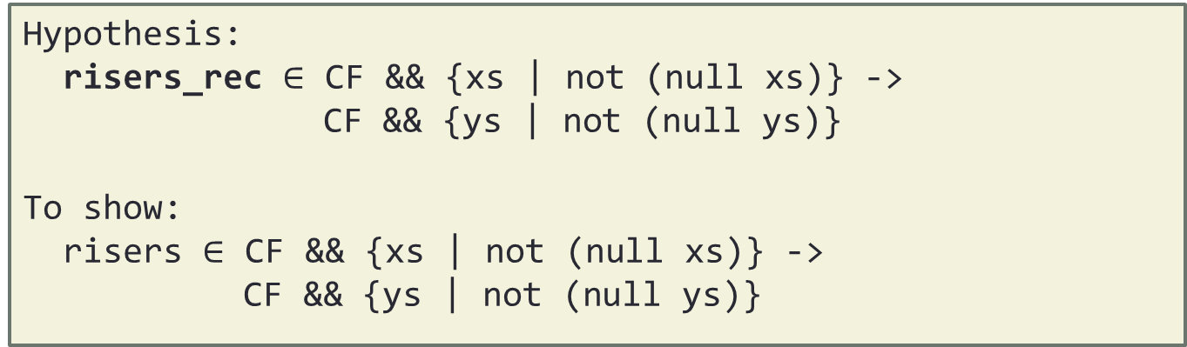
Fixed point induction
Replace recursive calls to a fresh function risers_rec:
Assume contract holds for the recursive call:
risers [] = []
risers [x] = [[x]]
risers (x:y:ys)
= if x <= y then (x:s):ss else [x]:s:ss
where (s:ss) = risers_rec (y:ys)
Hypothesis:
risers_rec $∈$ CF && {xs | not (null xs)} ->
CF && {ys | not (null ys)}
To show:
risers $∈$ CF && {xs | not (null xs)} ->
CF && {ys | not (null ys)}
Fixed point induction only applicable on admissible predicates!
Contracts are!

Slide 12
Static verification for functional programs
Liquid Types [Jhala et al]
Symbolic contracts
Predicate abstraction
Inference
Strict semantics
ESC/Haskell [Xu et al]
Contracts are programs
Symbolic execution/inlining
Lazy semantics
Zeno [Sonnex et al]
Automated equality proofs
Clever heuristics
Strict semantics
ACL2
Catch [Mitchell]
Detect pattern match failures
Via static analysis
For Haskell
Dafny & Boogie [Leino et al]
Leon [Suter et al]
Satisfiability mod CBV recursive programs
Integrated with Scala
Recursive predicates [Bjørner et al]
Recursive logic programs + SAT
2011
2012
F7/F* [Swamy et al]
Value-dependent types
Symbolic predicates
Active research on
verification of “pure” recursive programs
…

Slide 13
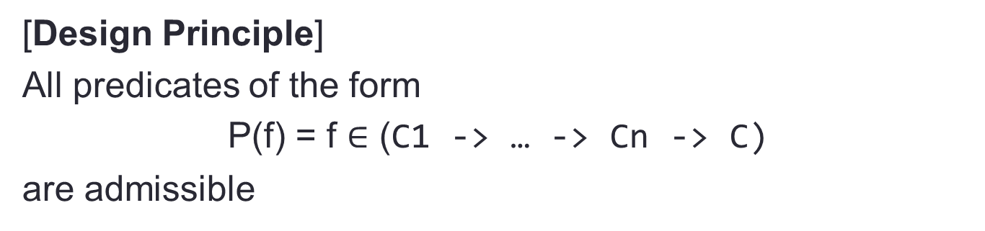
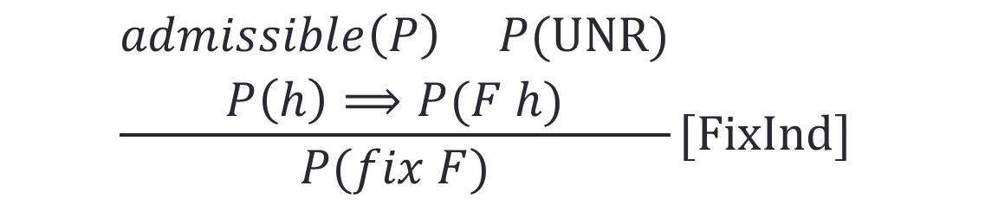
Admissibility and induction
If a predicate is true for all elements of a chain, then it is true for the limit. Not all predicates are admissible
Our language of contracts is admissible:
Informal argument: Haskell functions are continuous
$$\frac{\begin{aligned}admissible\left(P\right) P(UNR) \\ P\left(h\right)⟹P(F h)\end{aligned}}{P(fix F)}[FixInd]$$
[Design Principle]
All predicates of the form
P(f) = f $∈$ (C1 -> … -> Cn -> C)
are admissible

Slide 14
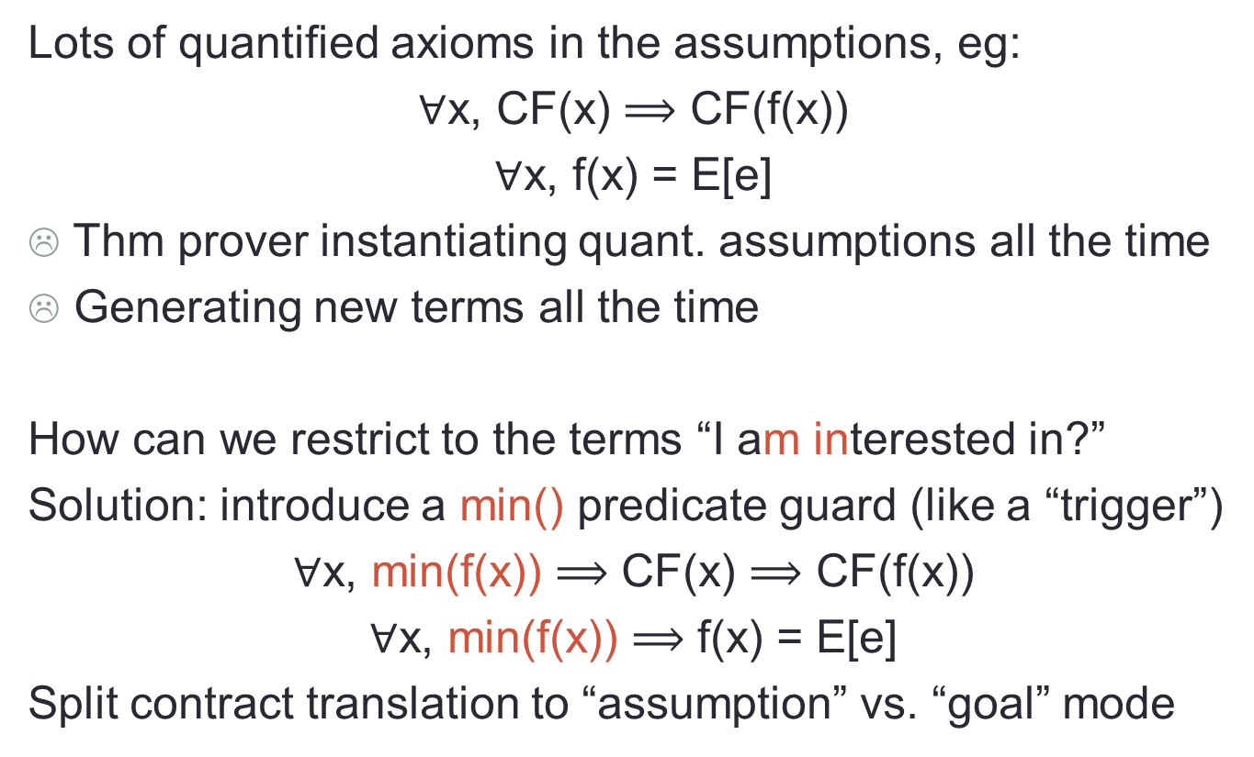
Minimize to the terms I’m interested in
Lots of quantified axioms in the assumptions, eg:
$∀$x, CF(x) $⟹$ CF(f(x))
$∀$x, f(x) = E[e]
Thm prover instantiating quant. assumptions all the time
Generating new terms all the time
How can we restrict to the terms “I am interested in?”
Solution: introduce a min() predicate guard (like a “trigger”)
$∀$x, min(f(x)) $⟹$ CF(x) $⟹$ CF(f(x))
$∀$x, min(f(x)) $⟹$ f(x) = E[e]
Split contract translation to “assumption” vs. “goal” mode

Slide 15
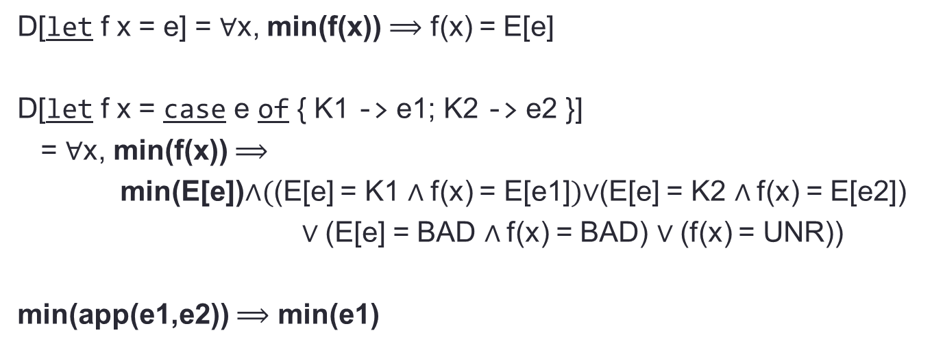
Minimize to the terms I’m interested in
min() predicate propagates along evaluation, contract translation splits to
assumption/goal modes
D[let f x = e] = $∀$x, min(f(x)) $⟹$ f(x) = E[e]
D[let f x = case e of { K1 -> e1; K2 -> e2 }]
= $∀$x, min(f(x)) $⟹$
min(E[e])∧((E[e] = K1 ∧ f(x) = E[e1])$∨$(E[e] = K2 ∧ f(x) = E[e2])
$∨$(E[e] = BAD ∧ f(x) = BAD) $∨$(f(x) = UNR))
min(app(e1,e2)) $⟹$ min(e1)

Slide 16
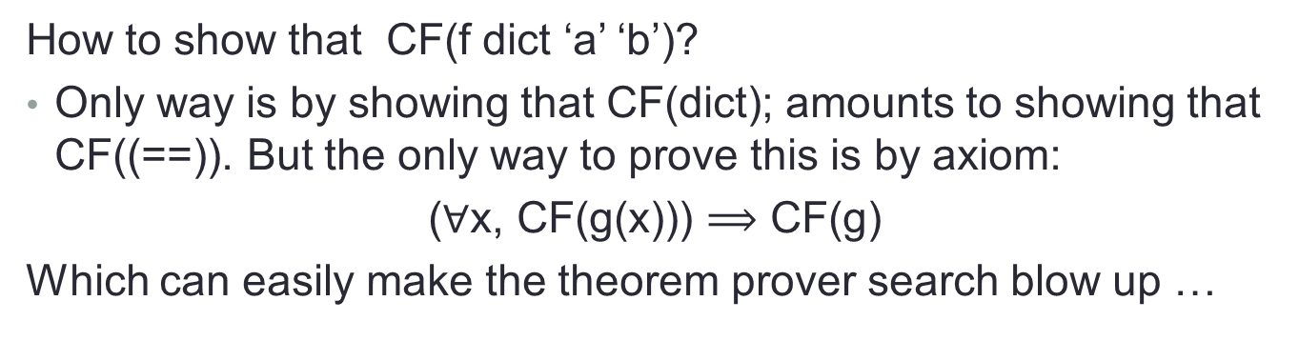
Type classes: the problem
Do not want to treat dictionaries as records of functions!
f :: Eq a => a -> a -> Bool -- In source
f x y = x == y
f :: forall a. Eq a => a -> a -> Bool -- In FC
f = /\a.\dEq x y. (==)@a dEq x y
How to show that CF(f dict ‘a’ ‘b’)?
Only way is by showing that CF(dict); amounts to showing that CF((==)). But the only way to prove this is by axiom:
($∀$x, CF(g(x))) $⟹$ CF(g)
Which can easily make the theorem prover search blow up …

Slide 17
Type classes: solution
Treat type classes as “open GADTs”
data Eq a where
TInt :: Eq Int -- there is an instance Eq Int
TBool :: Eq Bool -- there is an instance Eq Bool
TList :: Eq a -> Eq [a] -- there is an instance Eq a => Eq [a]
(==) :: Eq a => a -> a -> Bool
(==) TInt = ...
(==) TBool = ...
(==) TList [] [] = True
(==) (TList t) (x:xs) (y:ys)= (==) t x y && (==) (TList t) xs ys
(==) (TList t) _ _ = False
Each instance declaration introduces:
A new constructor with appropriate type
A new FOL clause that matches on the new constructor

Slide 18
Ideas for separate compilation
Foo.hs
Bar.hs
Haskell Contract Interface
Just a TPTP file
Foo.hi
Foo.hci
Bar.hi
Bar.hci
Flip.hci
Main.hci
Z3 / Equinox
Main.hs
+
Prelude theory

Slide 19
Int vs Int#
In Haskell Int is something like:
data Int where
Int# : Int# -> Int
This means we can treat it as any other datatype and treat the Int# argument as primitive integer, with operations as +# directly interpreted in the theory
Need FOL + theory of arithmetic

