Slide 1
Software Engineering Intern Task
program that simulates a basic health information system for managing clients
and health programs/services.

Slide 2
Assignment scoop analysis
I first started by analyzing the task and the requirements and are mentioned to be included which were:
Health program creation (e.g., TB, HIV)
Client registration
Client enrollment in programs
Client search
Client profile view (with enrolled programs)
Expose profile via API for other systems

Slide 3
Tools I will use to achieve my task
Still in planning face and this part was crucial to me as it will determine the time I will take to complete the program and also the feel of the program(the UI and speed of the application) so I needed to make a good decision on this. Am really confident with reactjs, nextjs, mongodb, firebase, reactNative, node and express, sql, php, supabase and many other tools related to software development. For this specific project with its time line i decided to use this tools:
React + vite, mongodb atlas, node and express, GitHub and render for deployments.

Slide 4
Development phase
So in development phase I started with the backend as usual because of the Api endpoints and database setup.
I setup the database on Atlas and then move on with the Api key to connect it with my express and node backend and after completing the server.js I use the command node server.js to start the service and good to me everything on the backend was working fine including the controller that will expose the Api to the frontend and the models that will define the structure of the data(health record) being saved on the database.

Slide 5
Frontend/client side
It was time to start working on the other side of the project(frontend) and see my work in real time. At first I needed to setup my project on a deferent folder so that everything will be organized. Then I initialized my project with react + vite and then tailwind followed. By the way I used tailwind on styling which is very commonly used by react devs, its first and lightweight which when used with vite makes the application super-fast. After setting up everything I created the components that I will be using and then in each use api call to fetch or save data to the database. At first the api were using local host but now after deployment its using both local and the url of the backend as vite api url on the environment.

Slide 6
Pushing to GitHub
The next thing was to push the project to github both backend and frontend before I do any deployment.
So I created a new repo CEMA assignment then initialized it with my local project and push the changes to github. So all the time I will be making any change I will just make sure both sides are up to date by pushing any change to remote area which is my github repo.

Slide 7
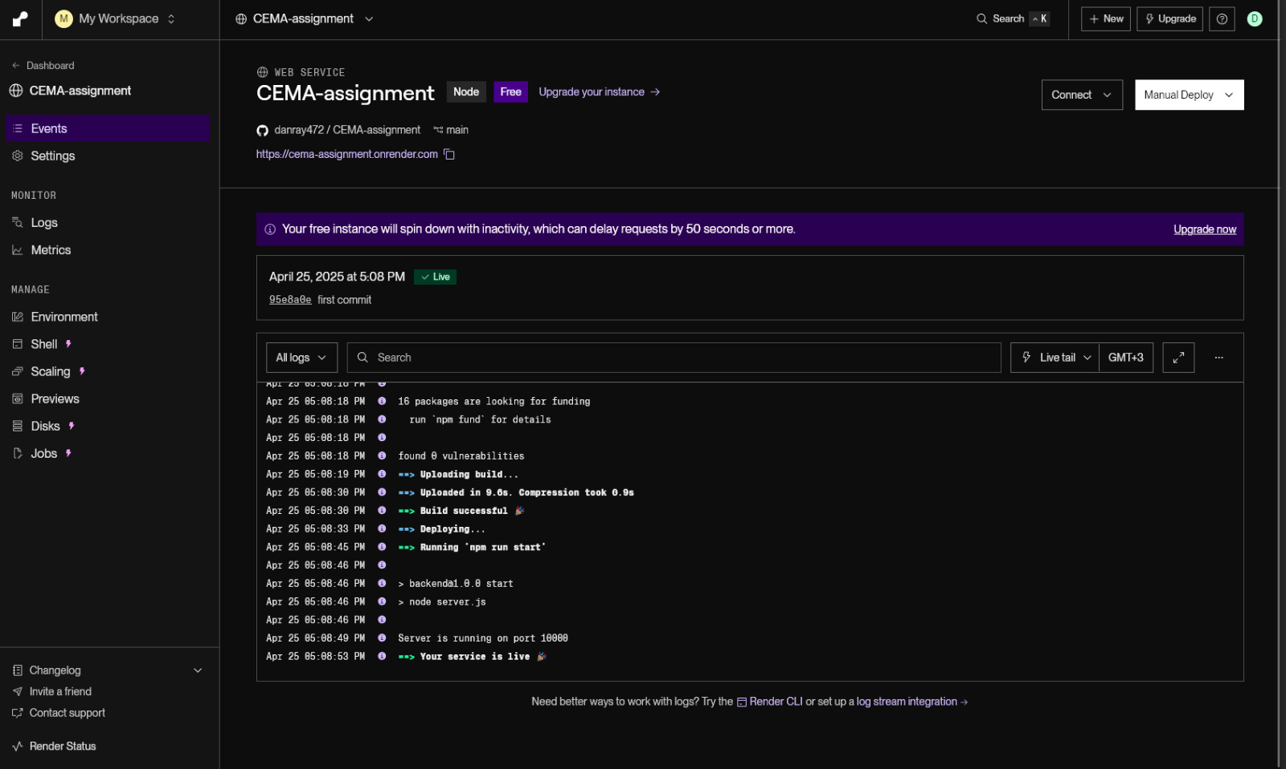
Backend Deployment

Slide 8
The above pic show my deployment of the backend. I had to start with the backend so that I will get the url to it while running and use it on the environment variable of vite on the frontend. After everything was working well I moved on to deploy the frontend and the following image it’s a successful deployment of frontend on render.

Slide 9
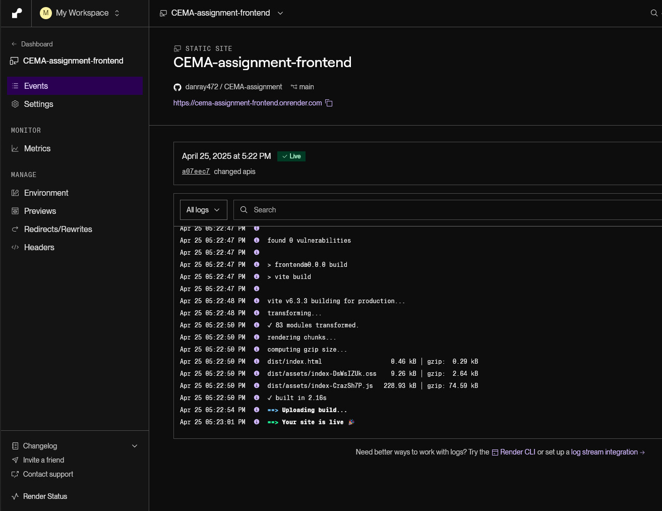
Frontend Deployment

Slide 10
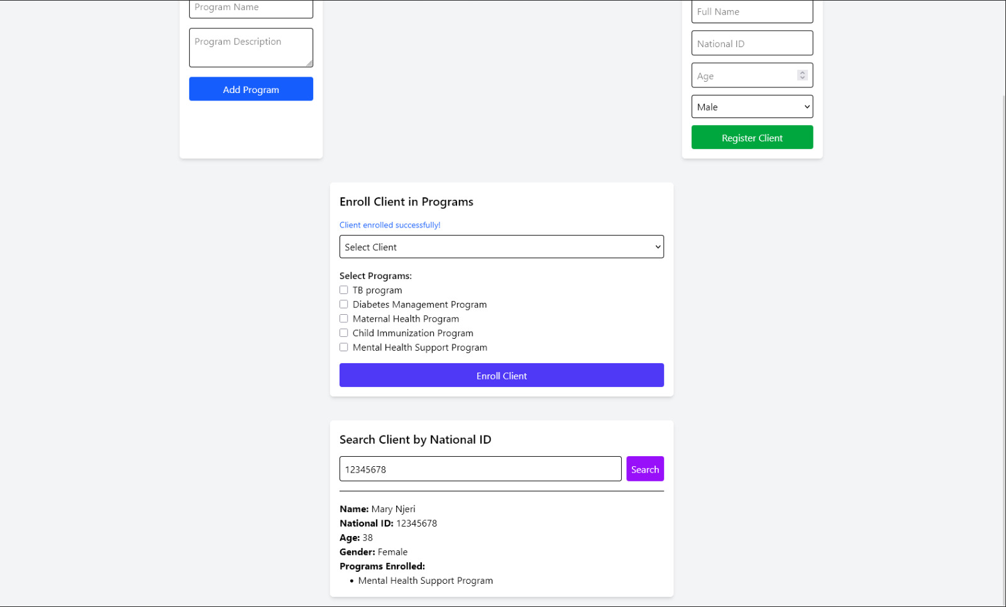
After deployment: frontend view

Slide 11
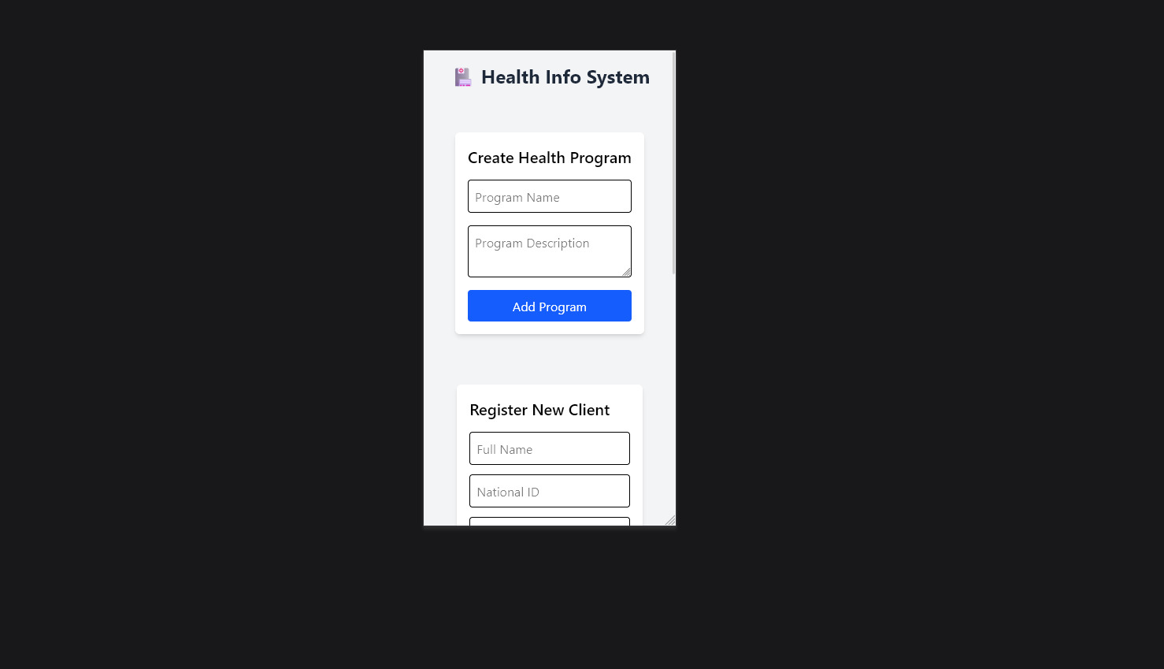
Responsiveness on mobile devices test using dev tools

Slide 12
Conclusion
After deploying both sides on render I did some testing of the Api endpoints and also security checks like data validation and sanitization of inputs also I review the frontend to make sure its user friendly on mobile devices.
This was the end my assignment and hope to hear from you soon below is the link to the site:
https://cema-assignment-frontend.onrender.com/

