Slide 1
Laboratory of advanced programming: MARS AUTOMATION PLATFORM
Dan Razin - 2065165
Beatrice Gambetti - 2063585
Matteo Ciula – 2065405
Andrea Piermartini - 2046607

Slide 2
GOAL: developing a robust, distributed infrastructure to manage life-support and environmental systems of a Martian habitat
Introduzione
CHALLENGE
Heterogeneous environment: sensors speak different languages (REST; WebSockets, SSE)
Partial destruction: there’s no automation, but manual monitoring is impossible for a 24/7 colony
High stakes: thermodynamic failure equals mission end
SOLUTION
A distributed microservices platform built on Python and Kafka
Real-time normalization of all the data into a single internal language
Dynamic Rule Engine to ensure the habitat react automatically to environmental threats

Slide 3
USER STORIES
1) As an operator , I want to select a sensor, an operator and a value to define an automation trigger.
2) As an operator , I want to link an actuator to a rule so that the system reacts automatically.
3) As a supervisor , I want to see all configured rules in a dedicated list.
4) As a system admin , I want the UI to prevent contradictory automation rules.
5) As an energy engineer , I want to view the Solar Array Power graph.
6) As a safety officer , I want to monitor Radiation Exposure trends.
7) As a user , I want LIVE indicators on charts to verify active streams.
8) As a botanist , I want sensor progress bars to change color when values become dangerous.
9) As a colonist , I want to see the greenhouse temperature in Celsius.
10) As a maintenance worker , I want to track entrance humidity levels.
11) As a life-support specialist , I want to monitor hall CO₂ concentration.
12) As an operator , I want to manually toggle actuators ON/OFF.
13) As a technician , I want to clearly see actuator states.
14) As a developer , I want newly discovered actuators to appear automatically in the UI.
15) As a crew member , I want to see the current SOL and Mars Local Time.
16) As a network admin , I want a broker connection indicator.
17) As a developer , I want a simulator health indicator.
18) As a supervisor , I want all system actions recorded in an event log.
19) As a user , I want color-coded log entries to quickly identify issues.
20) As a data analyst , I want each log entry to include a precise timestamp.

Slide 4
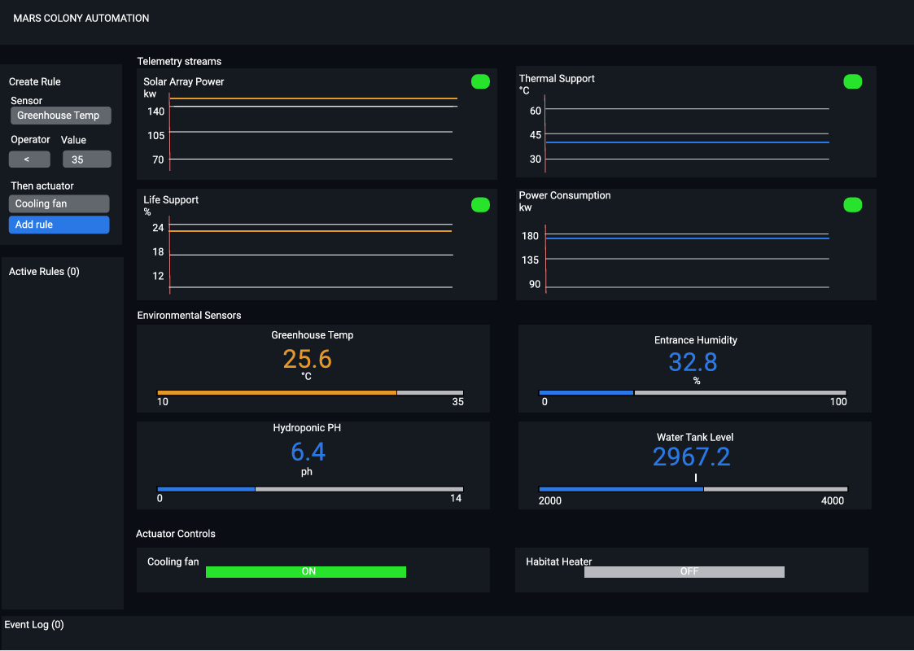
The operator: needs to define «IF-THEN» triggers and toggle actuators (Fans,Heaters)
The specialist (botanist/engineer): requires specific monitoring for Greenhouse temp, solar array and radiation
The system admin: Needs to monitor the «Health» of the infrastructure (broker status, simulator connectivity)
The crew member: needs high-level situational awareness (mars time, SOL, event logs)

Slide 5
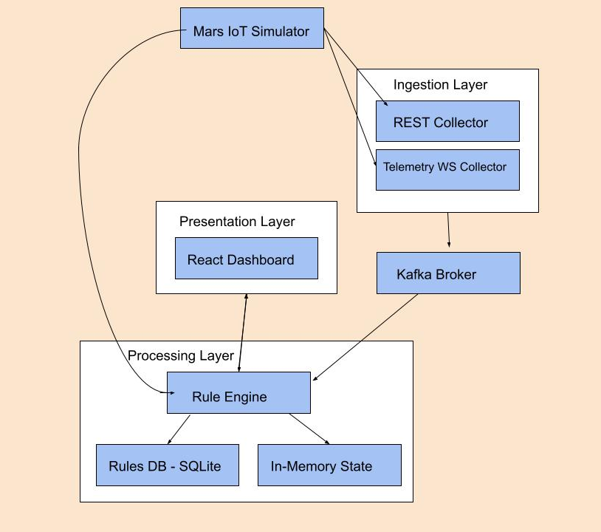
THE «DATA LIFE CYCLE»
Ingestion layer: (collectors) polling REST sensors and subscribing to Telemetry streams
Messaging layer: (Kafka broker) the central nervous system for asynchronous event distribution
Processing layer: (rules engine) evaluates incoming data against a persistent SQLite database
Presentation Layer: (react/Vite dashboard) real-time visualization and command interface

Slide 6
STANDARDIZING LANGUAGES
To decouple the sensors from the logic, we normalize every reading into a single JSON format:
JSON
{
"event_id": "d290f1ee-6c54-4b01-90e6-d701748f0851",
"ts": "2036-03-09T10:15:30Z",
"sensor_id": "hydroponic_ph_ph_level",
"value": 6.4,
"unit": "pH",
"metadata": {
"metric": "ph_level",
"status": "nominal"
}
}
This helps the Rules Engine that now doesn’t need to know if the data came from a REST poll or a WebSocket stream

Slide 7
UI MOCKUP & UX STRATEGY
Visual priority: progress bars change color (green->red) based on danger thresholds (US08)
Transparency: real-time «live» indicators verify that telemetry is active (US07)
Accountability: a timestamped, color-coded Event log tracks every system action (US19, US20)
Automatic discovery: the UI dynamically lists new actuators as they appear in the network (US14)

Slide 8
INGESTION STRATEGY – HETEROGENEOUS SOURCES
The system has to manage two very different data flows (implemented in the files collector_rest.py and collector_telemetry_ws.py)
REST polling (Pull): used for discrete sensors (for example greenhouse temp and water tank level). The system queries the simulator at regular intervals
WebSockets Telemetry (Push): this is used for high-frequency data (for example radiation levels, power bus and airload). The system is always listening and receives data as soon as they are generated
Decoupling: collectors’s only job is to fetch raw data and pass it to the Normalizer

Slide 9
THE NORMALIZER
Every sensor type has its own data schema. The normalizer.py file it fundamental to keep our data consistent:
Dispatcher Pattern: the normalize_event function receives a «schema_type» and routes the packer to a specific handler (for esample normalize_rest_scalar or topic_power)
UUID & timestamps: every event is assigned to a unique identifier (uuid4) and preserves the original capture timestamp
Standard output: it doesn’t matter the source of the data, the output is a standardized JSON object ready for the message bus

Slide 10
MESSAGING WITH APACHE KAFKA
We use Kafka in this part, which gives us
Asynchronicity: if the Rules Engine is busy or offline, the data doesn’t get lost. It stays in the mars_normalized_events topic
Scalability: we can add infinite collectors or consumers (for example a database for history or an AI module) without changing a single line of collector code
Reliability: there’s a built-in error handling (for example the while producer is None loop in collectors to wait for the broker to be ready)

Slide 11
DEEP DIVE: REST COLLECTOR CODE
The collector_rest.py file does the following:
Configuration: a REST_SENSORS list maps every endpoint to a specific normalization schema
Robustness: uses response.raise_for_status() and try-except blocks to handle Martian network failures
Ingestion Loop: a continuous while True cycle ensures constant monitoring without interruprions

Slide 12
DEEP DIVE: WEBSOCKET COLLECTOR CODE
The collector_telemetry_ws.py file does the following:
Concurrency with asyncio: manages multiple WebSocket streams together without blocking the execution flow
Auto-healing: if a connection drops, the system waits 3 seconds and attemps an automatic reconnection (await asyncio.sleep(3))
Efficiency: data is pushed to Kafka in real-time, ensuring the dashboard reflects radiation spikes instantly

Slide 13
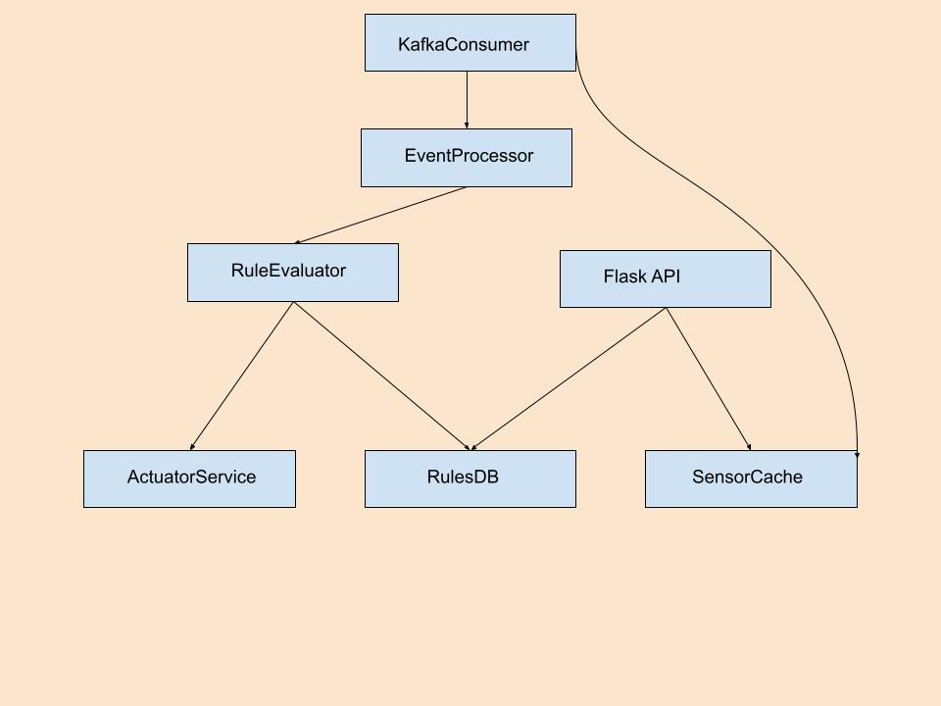
THE RULES ENGINE – THE «BRAIN» OF THE HABITAT
The Rules Engine (engine.py) is a multi-threaded service designed to process environmental data and execute safety protocols without human intervention:
Asynchronous processing: uses a dedicated thread to consume events from Kafka (run_kafka_consumer), ensuring the API remains responsive
State awareness: maintains a local memory (sensor_mem) of the latest sensor values to allow for complex evaluations
Trigger logic: when a new sensor value arrives, the engine queries the database for associated rules and evaluates them immediately

Slide 14
RULE EVALUATION LOGIC
The logic (implemented in evaluate_condition) supports a full range of comparison operators to handle different mission scenarios:
Operators: <, >, ==, >=, <=, !=
Dynamic Thresholds: rules are not hard-coded: they are fetched from the DB, allowing the Crew to change safety limits on the fly (for example lowering temperature thresholds during «Power save» mode)
Automatic reset: the engine includes logic to «invert» actions (for example turning a heater OFF if the temperature is safe) to maintain equilibrium

Slide 15
PERSISTENCE LAYER - SQLITE
We chose SQLite (database.py) for rule persistence. In a remote Martian colony, simplicity often means reliability:
Schema Design: stores rule descriptions, sensor Ids, operators, threshold values and target actuator states
CRUD operations: full support for adding, deleting and retrieving rules via a clean Python API
Independence: the database ensures that if the container restarts, all safety automation rules are reloaded instantly

Slide 16
ACTUATOR CONTROL SYSTEM
The actuators.py module acts as the bridge between the digital logic and the physical habitat hardware:
REST interface: sends POST requests to the Mars Simulator to toggle hardware like cooling_fan or habitat_heater
Error handling: implements timeouts and status code checks. If a hardware command fails, it’s logged but doesn’t crash the engine
State sync: provides a get_actuators_state function so the Frontend can verify if a command was actually executed by the hardware

Slide 17
MULTI-THREADING ARCHITECTURE
To satisfy the requirement of simultaneous monitoring and management, the engine runs two parallel loops:
Thread A (Flask API): Handles incoming requests from the Dashboard to create or delete rules.
Thread B (Kafka Consumer): Continuously listens for sensor data.
Why? This prevents a "flooding" of sensor data from making the user interface laggy or unresponsive.

Slide 18
FRONTEND ARCHITECTURE – REACT & VITE
The dashboard is built using React 18 and Vite, providing a lightning-fast, reactive interface for colony oversight.
Component-Based Design: The UI is split into specialized modules (SensorGauge, TelemetryChart, RuleManager) for better maintainability.
Real-time Synchronization: Uses useEffect and useCallback hooks to manage data flow from the backend API.
State Management: React useState tracks the live status of actuators and sensor readings, ensuring the UI always reflects the "Ground Truth" of the habitat.

Slide 19
VISUALIZING SURVIVAL DATA
We implemented custom components to ensure operators can make split-second decisions:
SensorGauge.jsx: Uses dynamic color scaling. If a value exceeds 80% of its safety range, the gauge turns Red automatically (US08).
TelemetryChart.jsx: Provides historical context for high-frequency data (like radiation), allowing users to spot trends before they become emergencies.
The "LIVE" Indicator: A visual heart-beat confirming that the WebSocket stream is active and the data is fresh.

Slide 20
COMMAND AND CONTROL COMPONENTS
The interface allows for both manual override and automated management:
ActuatorControl.jsx: Large, high-contrast buttons for toggling Fans, Heaters, and Ventilation. It shows a ● ACTIVE status only when the hardware confirms the state.
RuleManager.jsx: A dedicated panel to create "IF-THEN" logic. It translates user input into the structured JSON required by the Python Rules Engine.
NotificationBar.jsx: The mission log. It categorizes events (Info, Success, Warning) and scrolls automatically to the latest system action.

Slide 21
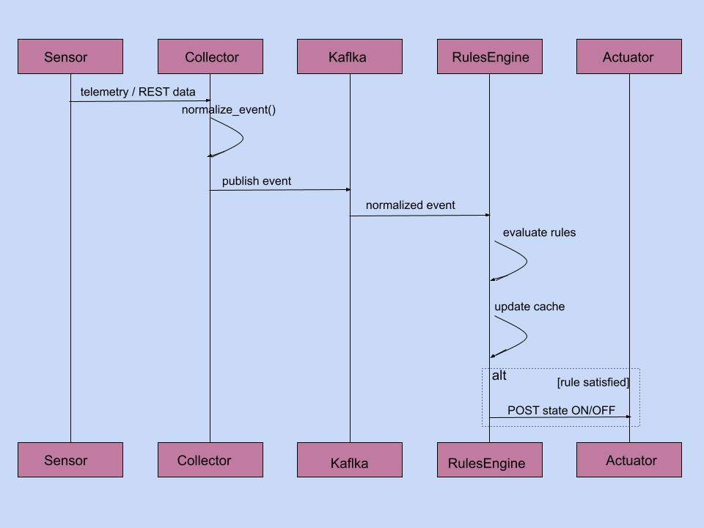
PROFESSIONAL UI FOUNDATION
To ensure a robust and accessible interface, we utilized a professional-grade component library (Shadcn/UI and Radix UI):
Atomic Design: Used modular files like button.tsx, card.tsx, and alert.tsx to keep the UI consistent.
Accessibility: Components like alert-dialog.tsx ensure that critical actions (like deleting a safety rule) require explicit confirmation.
Responsiveness: The layout uses Tailwind CSS to adapt the "Mars Command" view to different screen sizes (from tablets to wall-mounted monitors).

Slide 22
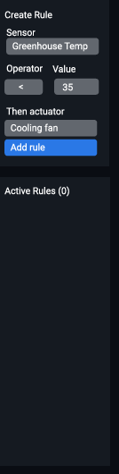
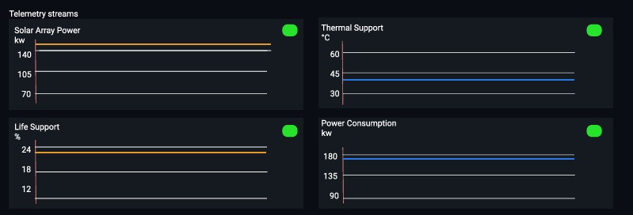
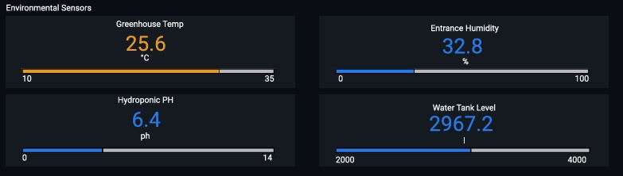
THE FINAL RESULT – USER STORY VALIDATION
US05, US06, US07
US01, US02, US03, US04
US08, US069, US10, US11

Slide 23

THE FINAL RESULT – USER STORY VALIDATION
US12, US13
US14, US15, US16, US17
US18, US19, US20

Slide 24
DEPLOYMENT AND CONTAINERIZATION
A Martian system must be portable and easy to redeploy. We used Docker and Docker Compose to manage the entire ecosystem.
Microservices Isolation: Each component (Rest Ingestion, WS Ingestion, Rules Engine, Kafka, UI) runs in its own isolated container.
Orchestration: The docker-compose.yml file manages network aliases (e.g., http://simulator:8080), ensuring services can find each other automatically.
Scalability: We can restart or update the Rules Engine without stopping the data ingestion from the sensors.
Environment Parity: "It works on my machine" means "It works on Mars.“

Slide 25
DEPLOYMENT AND CONTAINERIZATION
We have successfully built a fragmented automation stack into a unified, reactive safety system.
Unified Data: Heterogeneous sensors are now one single "Martian Language."
Reliability: Kafka ensures no life-critical data is lost during spikes.
Automation: The Rules Engine provides the 24/7 "Autopilot" the habitat needs.
Modern UX: A dashboard designed for rapid response and situational awareness.

Slide 26
THANKS FOR THE ATTENTION!

