Slide 1
A Very Brief Analysis of Public and Private Higher Education in the United States
Daniel r. doran
SEAS 8515 - Data Engineering for AI Project 1
April 20, 2024

Slide 2
Methodology and tools used
For this project I analyzed various characteristics of public and private institutions of higher education in the US, according to the Institution-level data file for 2013-14 of the US Department of Education College Scorecard, found at https://collegescorecard.ed.gov/data/.
I used PySpark locally in VS Code due to issues I was having with maintaining a working cluster in Databricks community edition. Recognizing the scalability limitations of a local setup, I would have to graduate to a distributed cluster if my data or processing needed to grow.
I utilized Python and Spark for data extraction and processing, SQL for data manipulation and transformation, and Python libraries like Matplotlib, Seaborn, and Plotly for data visualization.
With these tools I sought to understand some socio-economic nuances of public and private institutions and convey these nuances via insightful data visualizations, including a choropleth map, a heatmap, and various bar charts.

Slide 3
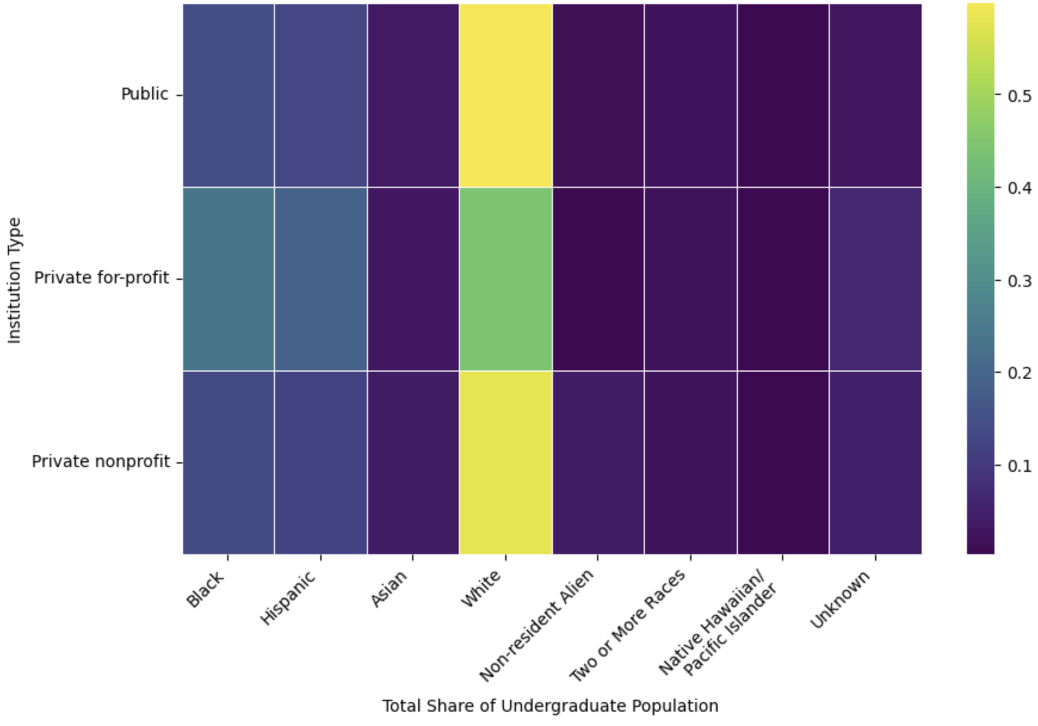
Distribution of Undergraduate Demographics by Institution Type
Key insights:
Whites are less represented in for-profit colleges compared to public and private nonprofit schools, while Blacks and Hispanics are more represented
The distributions of undergraduate demographics are approximately the same for public and private nonprofit schools

Slide 4
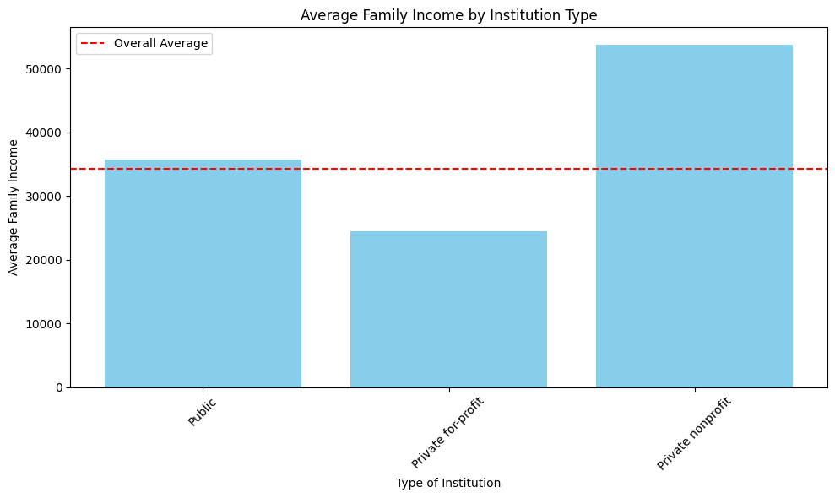
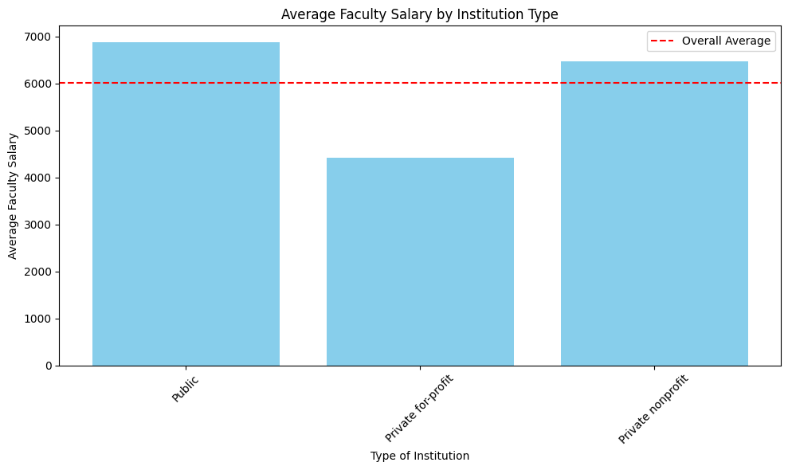
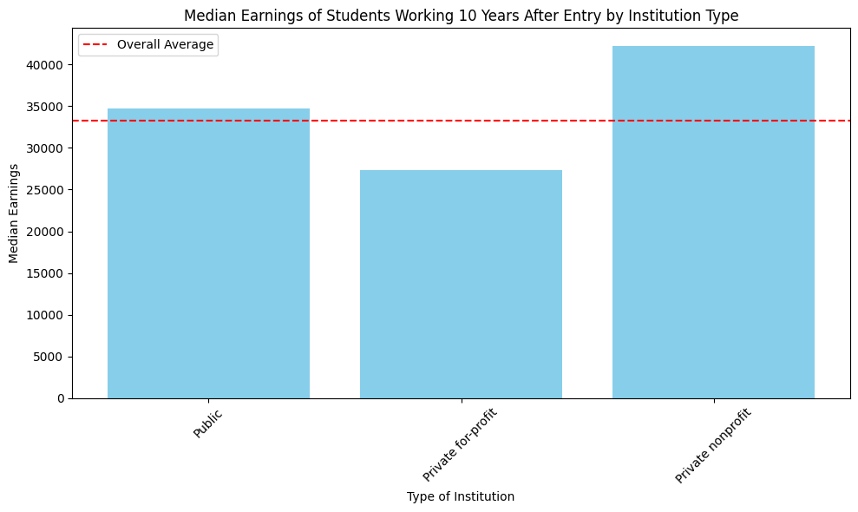
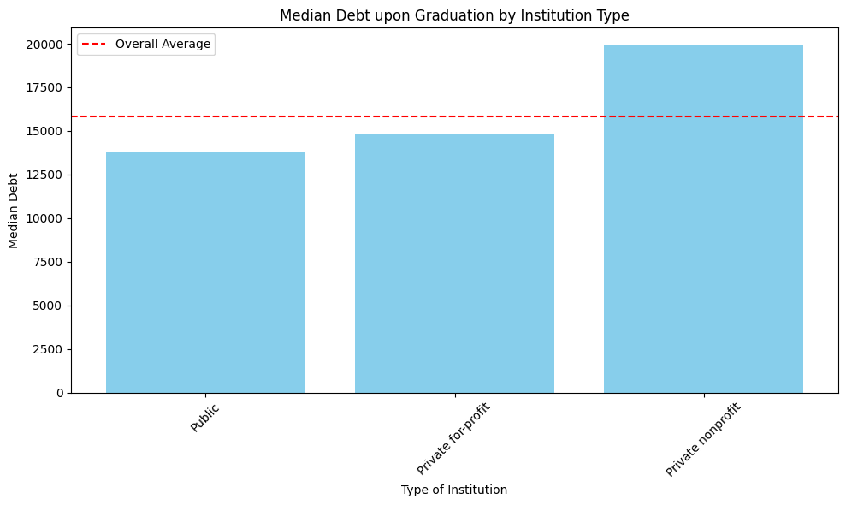
Bar Charts
Key insights:
Private nonprofit schools have the average highest family income, highest median earnings for graduates, and highest median debt upon graduation
For-profit schools have the lowest average family income, lowest median earnings for graduates, lowest average faculty salary, yet the second highest median debt upon graduation

Slide 5
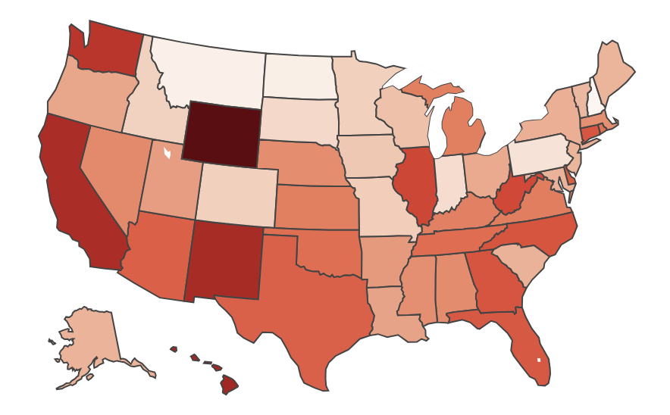
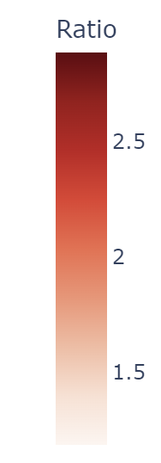
Ratio of Average Net Price Private to Public Institutions by State
Key Insight:
Private schools are most expensive compared to public schools in the following states: WY (2.88), HI (2.57), NM (2.52), CA (2.50), and WA (2.41)

Slide 6
Conclusions
My findings suggest Black and Hispanic students are overrepresented in for-profit colleges. Further analysis could be completed to examine the underlying causes of this, that might include an analysis of socio-economic barriers to accessing higher education, geographic availability of institutions, and targeted recruitment practices of for-profit schools.
Along with having a higher representation of these two minority groups in for-profit schools, these institutions tend to skew toward families with lower income and pay their faculty the least compared to other schools. Graduates of these schools comparatively earn the least on average, and they have higher levels of debt compared to public schools. This raises questions about the quality of education provided at for-profit schools and suggests that these institutions might not be providing the same return on investment as other schools.
Where private schools are least economically accessible compared to public schools are in Wyoming, Hawaii, New Mexico, California, and Washington, indicating that in these states families with a lower income may opt for public schools. The relative economic inaccessibility of private schools in certain states suggest that public institutions play a critical role in providing higher education to lower-income families.

