Slide 1
Different plot possibilities for cell counting data

Slide 2
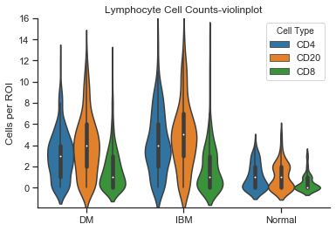
The violin plot does show estimated distributions of each category, but a drawback is that it uses a kernel density estimation with several tunable parameters (bandwith, scaling etc.) It can be scaled to use equal areas, equal widths and by total counts in each group. Additionally, the smoothed kernel can seem to show unphysical values (for instance cell count can obviously not be negative) due to kernel density estimation. From what I’ve read the pros of a violinplot are being able to see interesting distributions, such as multimodal peaks, heavy tails and other non-Gaussian type features, at the cost of the shape of the distribution depending on choice of bandwith in the KDE process.

Slide 3
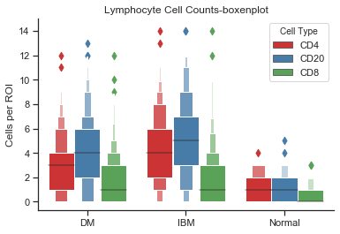
Another option is called a boxenplot, or letter-value plot. The main purpose from what I gather is to better represent outlier values in groups with large numbers of observations, where values outside of the IQR are to be expected based on chance alone. The middle fattest box is the usual box plot IQR with median indicated. Each box extends that to octiles, and so on, and then outliers are indicated that don’t pass a statistical test to be included in the last box.
I have a reference explaining this in more detail along with comparisons to violin and boxplots. The main advantage seems to be showing additional information over a boxplot without making assumptions on choosing a kernel or applying any smoothing as in the violinplot.

Slide 4
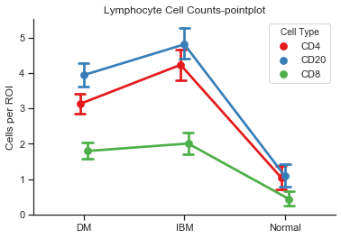
Finally, even though I think either the traditional box and whiskers plot with outliers, or one of the two above plots should be shown, this plot called pointplot, was suggested for easily comparing overall relationships among categories. It shows the mean (or any other estimator you choose) with a 95% confidence interval in the error bars calculated through bootstrapping, so it avoids any assumptions on the distribution of the underlying data to calculate the confidence interval.
From the source I read, it can be helpful to show such a graph in addition to more detailed graphs of distribution (like violin or boxenplot) since changes in slope indicating different responses of groups to changing conditions are easily interpreted by eye.

Slide 5
Of course I can also just do a traditional box and whiskers plot with outliers indicated as we had talked about before. I wanted to show some other options and get your thoughts on what you think portrays the data in the best way.
I did not include an overlay of all observations on the first two plots, because inherit in the construction of the plots, all data points are already included, with relative density of the data points indicated and any outliers in the case of the boxen plot shown. So I think it seems kind of redundant to overlay all data points when that will show basically the same information as already shown in the plot.
Let me know if you have any thoughts or suggestions for these ideas, or anything else.
Also, as an aside, I used two different color schemes, the standard default on in the violin plot, and a different preset color scheme in the last two. In case you prefer one or the other or not.

