Slide 1

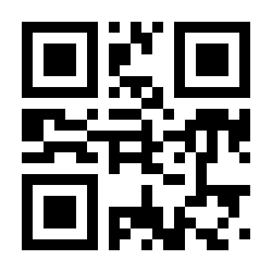

Congratulation!
You have won Microsoft Stores Gift Card
10%
Discount
Coupon
On Windows Phone 8
Powered by

