Slide 1
SmartFin - Implementing a Financial Domain-Specific Language for Smart Contracts
Daniel Dean DD2415
Notes:
Hi everyone, I’m going to tell you a little about my project: SmartFin - Implementing a Financial Domain-Specific Language for Smart Contracts. Let’s get right into it!

Slide 2


Introduction
$$$$$$$$$
0101010
0101010101010101
0101010101010101
0101010101010101
0101010101010101
0101010101010101
0101010101010101
0xfa1b..
0xc21a..
Financial Contract
Smart Contract
Notes:
In the world of financial engineering, it is becoming more and more common to represent financial contracts using smart contracts - programs which run on blockchain platforms and deal with cryptocurrencies.
This allows financial contracts to be carried out in an automated manner, and stored “immutably” on a blockchain for auditing purposes.
Unfortunately, using high-level languages like Solidity to implement these smart contracts is a lot of work and can often result in erroneous behaviour.
In fact, after an analysis of approximately 20k smart contracts on the main Ethereum blockchain - one of the many blockchains on which smart contracts can be deployed - over 45% of smart contracts analysed contained vulnerabilities.
Because of these issues, writing financial contracts in the form of smart contracts is inherently difficult and quite risky.
So what can we do to solve these issues?

Slide 3
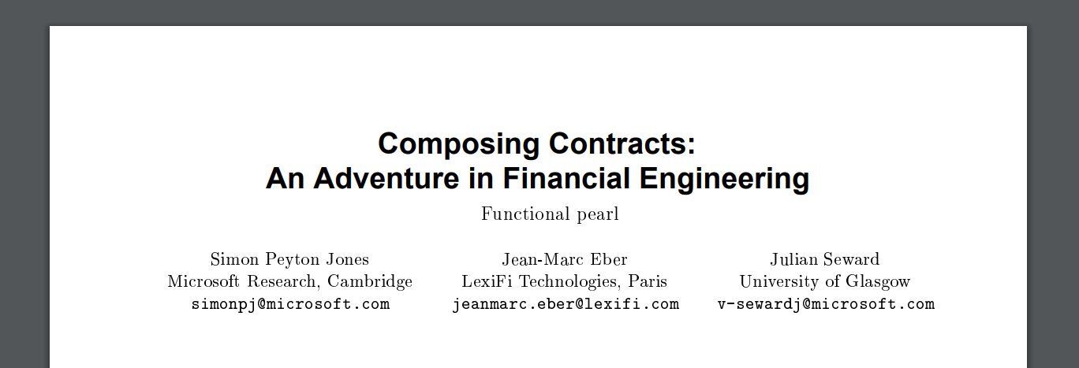
Introduction
Notes:
Looking back to the year 2000, a paper by Simon Peyton Jones and collaborators presented a functional domain-specific language (or DSL) for declaring financial contracts.
Traditional financial contracts in English are verbose and difficult to write.
After speaking with Dr Panos Parpas here at Imperial, who used to author financial contracts professionally, we found that even small financial contracts can often take weeks to write.
The aforementioned DSL contains 10 keywords, allowing a variety of financial contracts to be described in a concise and unambiguous manner - this makes writing financial contracts much easier and less error-prone.
How did we use the knowledge of this DSL to improve financial smart contracts?

Slide 4
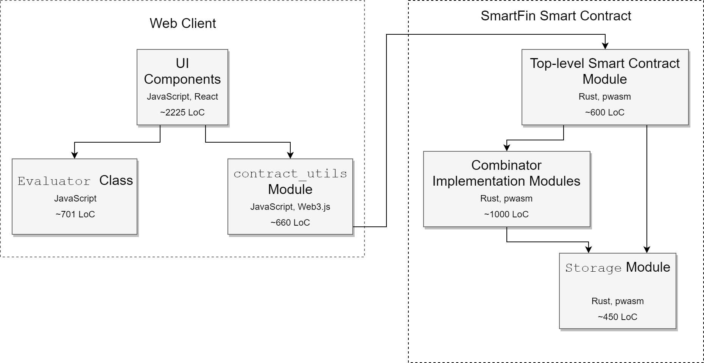
Introduction
Notes:
We present an implementation of a similar DSL for financial contracts, which we refer to as SmartFin, derived from the original DSL presented by SPJ and collaborators with some very minor modifications.
We have also implemented a single smart contract which can represent any SmartFin financial contract, passed through its constructor.
This allows financial engineers to focus on writing financial contracts in SmartFin, and our implemented smart contract will take care of the smart contract implementation - thus reducing the difficulty of implementation and the risk of erroneous behaviour.
We have also implemented a web client which provides the functionality required for these SmartFin financial contracts to be written and evaluated, and the resulting smart contract instances to be deployed and interacted with.
Let’s start things off by taking a look at SmartFin.

Slide 5
SmartFin Financial Contracts
payments
Counter-party
Holder
Notes:
What do we actually mean by “financial contract”, and how are these contracts represented in SmartFin?
SmartFin financial contracts are agreements between two parties, a holder and a counter-party, on a set of obligated payments between the two.
The counter-party typically refers to the author of the financial contract, and the holder is someone that can acquire the financial contract (which is like signing a traditional contract).
The main intuition behind SmartFin is that financial contracts can typically be described as a composition of smaller contracts.

Slide 6
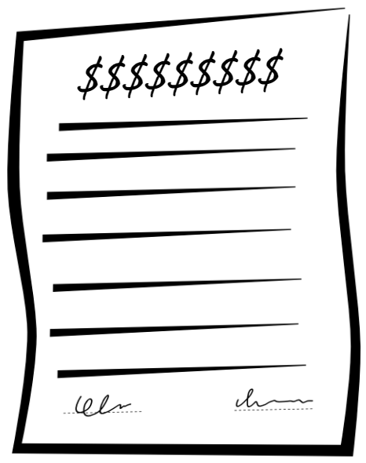
SmartFin Financial Contracts
payments
Counter-party
Holder
writes
acquires
Counter-party
Holder
Notes:
What do we actually mean by “financial contract”, and how are these contracts represented in SmartFin?
SmartFin financial contracts are agreements between two parties, a holder and a counter-party, on a set of obligated payments between the two.
The counter-party typically refers to the author of the financial contract, and the holder is someone that can acquire the financial contract (which is like signing a traditional contract).
The main intuition behind SmartFin is that financial contracts can typically be described as a composition of smaller contracts.

Slide 7
Example - European Option
On date t, the holder may choose whether or not to acquire contract c.
Notes:
For example, take a European option
This is a financial contract that declares that on a specific date t, the holder can choose whether or not to acquire some sub-contract c.
This is a composition of the sub-contract c with the top-level European option contract.
With SmartFin financial contracts, they are said to expire if they have no effect when acquired after a certain time - the latest time it can be acquired at is called its horizon.
In this European option example, the contract has no effect if acquired after time t, and so t is the horizon of the contract.

Slide 8
Example - European Option
On date t, the holder may choose whether or not to acquire contract c.
European option’s horizon is t.
Notes:
For example, take a European option
This is a financial contract that declares that on a specific date t, the holder can choose whether or not to acquire some sub-contract c.
This is a composition of the sub-contract c with the top-level European option contract.
With SmartFin financial contracts, they are said to expire if they have no effect when acquired after a certain time - the latest time it can be acquired at is called its horizon.
In this European option example, the contract has no effect if acquired after time t, and so t is the horizon of the contract.

Slide 9
SmartFin DSL
Notes:
But what does the SmartFin DSL actually look like?
A SmartFin financial contract is made up of several keywords, called “combinators” - a contract can consist of a single combinator, or a combination of combinators.
Let’s go through some simple combinators to get the idea.
The combinator “zero” represents a contract with no obligations, requiring nothing to be done when acquired.
The combinator “one” represents a contract requiring the counter-party to pay the holder 1 Wei upon acquisition - this is the smallest denomination of the Ethereum platform’s cryptocurrency.
An example of a combinator which takes an argument is “give”, which reverses the responsibilities in the given sub-contract. For example, the contract “give one” would require the holder to pay the counter-party 1 Wei.

Slide 10
SmartFin DSL
zero
Notes:
But what does the SmartFin DSL actually look like?
A SmartFin financial contract is made up of several keywords, called “combinators” - a contract can consist of a single combinator, or a combination of combinators.
Let’s go through some simple combinators to get the idea.
The combinator “zero” represents a contract with no obligations, requiring nothing to be done when acquired.
The combinator “one” represents a contract requiring the counter-party to pay the holder 1 Wei upon acquisition - this is the smallest denomination of the Ethereum platform’s cryptocurrency.
An example of a combinator which takes an argument is “give”, which reverses the responsibilities in the given sub-contract. For example, the contract “give one” would require the holder to pay the counter-party 1 Wei.

Slide 11
SmartFin DSL
zero
A contract with no obligations
Notes:
But what does the SmartFin DSL actually look like?
A SmartFin financial contract is made up of several keywords, called “combinators” - a contract can consist of a single combinator, or a combination of combinators.
Let’s go through some simple combinators to get the idea.
The combinator “zero” represents a contract with no obligations, requiring nothing to be done when acquired.
The combinator “one” represents a contract requiring the counter-party to pay the holder 1 Wei upon acquisition - this is the smallest denomination of the Ethereum platform’s cryptocurrency.
An example of a combinator which takes an argument is “give”, which reverses the responsibilities in the given sub-contract. For example, the contract “give one” would require the holder to pay the counter-party 1 Wei.

Slide 12
SmartFin DSL
zero
A contract with no obligations
one
Notes:
But what does the SmartFin DSL actually look like?
A SmartFin financial contract is made up of several keywords, called “combinators” - a contract can consist of a single combinator, or a combination of combinators.
Let’s go through some simple combinators to get the idea.
The combinator “zero” represents a contract with no obligations, requiring nothing to be done when acquired.
The combinator “one” represents a contract requiring the counter-party to pay the holder 1 Wei upon acquisition - this is the smallest denomination of the Ethereum platform’s cryptocurrency.
An example of a combinator which takes an argument is “give”, which reverses the responsibilities in the given sub-contract. For example, the contract “give one” would require the holder to pay the counter-party 1 Wei.

Slide 13
SmartFin DSL
zero
A contract with no obligations
one
Counter-party pays holder 1 Wei upon acquisition
Notes:
But what does the SmartFin DSL actually look like?
A SmartFin financial contract is made up of several keywords, called “combinators” - a contract can consist of a single combinator, or a combination of combinators.
Let’s go through some simple combinators to get the idea.
The combinator “zero” represents a contract with no obligations, requiring nothing to be done when acquired.
The combinator “one” represents a contract requiring the counter-party to pay the holder 1 Wei upon acquisition - this is the smallest denomination of the Ethereum platform’s cryptocurrency.
An example of a combinator which takes an argument is “give”, which reverses the responsibilities in the given sub-contract. For example, the contract “give one” would require the holder to pay the counter-party 1 Wei.

Slide 14
SmartFin DSL
zero
A contract with no obligations
one
Counter-party pays holder 1 Wei upon acquisition
give one
Notes:
But what does the SmartFin DSL actually look like?
A SmartFin financial contract is made up of several keywords, called “combinators” - a contract can consist of a single combinator, or a combination of combinators.
Let’s go through some simple combinators to get the idea.
The combinator “zero” represents a contract with no obligations, requiring nothing to be done when acquired.
The combinator “one” represents a contract requiring the counter-party to pay the holder 1 Wei upon acquisition - this is the smallest denomination of the Ethereum platform’s cryptocurrency.
An example of a combinator which takes an argument is “give”, which reverses the responsibilities in the given sub-contract. For example, the contract “give one” would require the holder to pay the counter-party 1 Wei.

Slide 15
SmartFin DSL
zero
A contract with no obligations
one
Counter-party pays holder 1 Wei upon acquisition
give one
Holder pays counter-party 1 Wei upon acquisition
Notes:
But what does the SmartFin DSL actually look like?
A SmartFin financial contract is made up of several keywords, called “combinators” - a contract can consist of a single combinator, or a combination of combinators.
Let’s go through some simple combinators to get the idea.
The combinator “zero” represents a contract with no obligations, requiring nothing to be done when acquired.
The combinator “one” represents a contract requiring the counter-party to pay the holder 1 Wei upon acquisition - this is the smallest denomination of the Ethereum platform’s cryptocurrency.
An example of a combinator which takes an argument is “give”, which reverses the responsibilities in the given sub-contract. For example, the contract “give one” would require the holder to pay the counter-party 1 Wei.

Slide 16
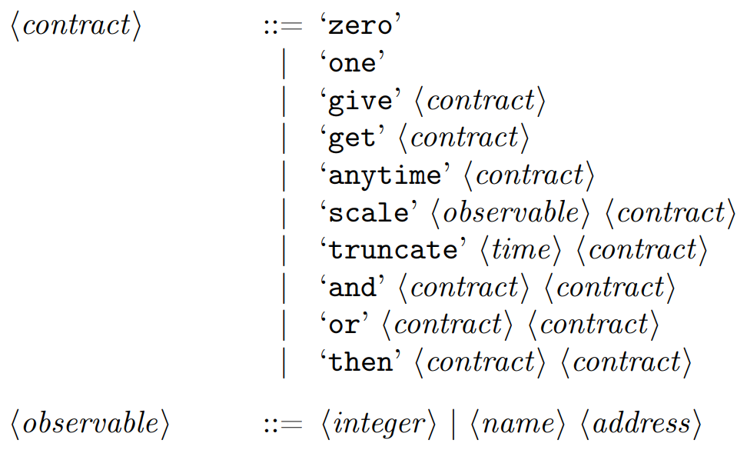
SmartFin DSL Syntax
Notes:
There are a few more combinators besides the simple examples we’ve looked at, as you can see here.
But there’s no need to memorise this, I’ll explain any relevant SmartFin combinators as we encounter them!

Slide 17
Demo
Composing (one, give one, European option)
Validation (just show briefly)
Evaluation
Monitoring (briefly) and acquisition
Notes:
Compose the contracts one, give one, get truncate <01/01/2020 00:00:00> or scale 100 one zero, and evaluate them.

Slide 18
Smart Contract Implementation
Notes:
So how does the implemented smart contract work?
The smart contract takes a SmartFin financial contract and the holder’s address through its constructor when it is deployed to a blockchain. The account that deploys the smart contract is taken as the counter-party.
Each combinator in the SmartFin financial contract is represented by an object (made up of a struct and a trait) that implements its semantics.
These combinators are stored as a tree, maintaining the compositional nature of the SmartFin DSL - here’s what the basic European option contract looks like as a combinator tree.
The deployed smart contract has methods to stake and withdraw funds in the contract, and for the holder to acquire it.
Unfortunately, it isn’t 100% straightforward to represent financial contracts in a smart contract...

Slide 19
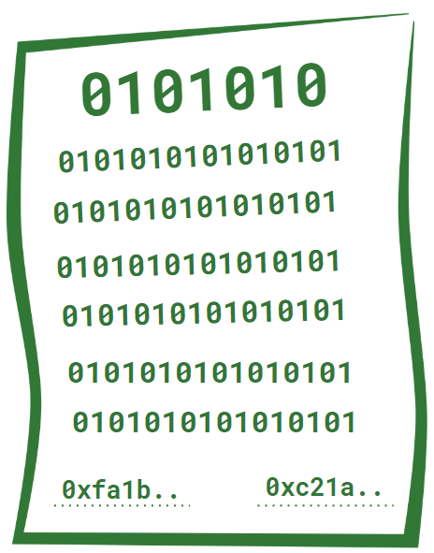
Smart Contract Implementation
SmartFin Financial Contract
deployed
Holder Address
Notes:
So how does the implemented smart contract work?
The smart contract takes a SmartFin financial contract and the holder’s address through its constructor when it is deployed to a blockchain. The account that deploys the smart contract is taken as the counter-party.
Each combinator in the SmartFin financial contract is represented by an object (made up of a struct and a trait) that implements its semantics.
These combinators are stored as a tree, maintaining the compositional nature of the SmartFin DSL - here’s what the basic European option contract looks like as a combinator tree.
The deployed smart contract has methods to stake and withdraw funds in the contract, and for the holder to acquire it.
Unfortunately, it isn’t 100% straightforward to represent financial contracts in a smart contract...

Slide 20
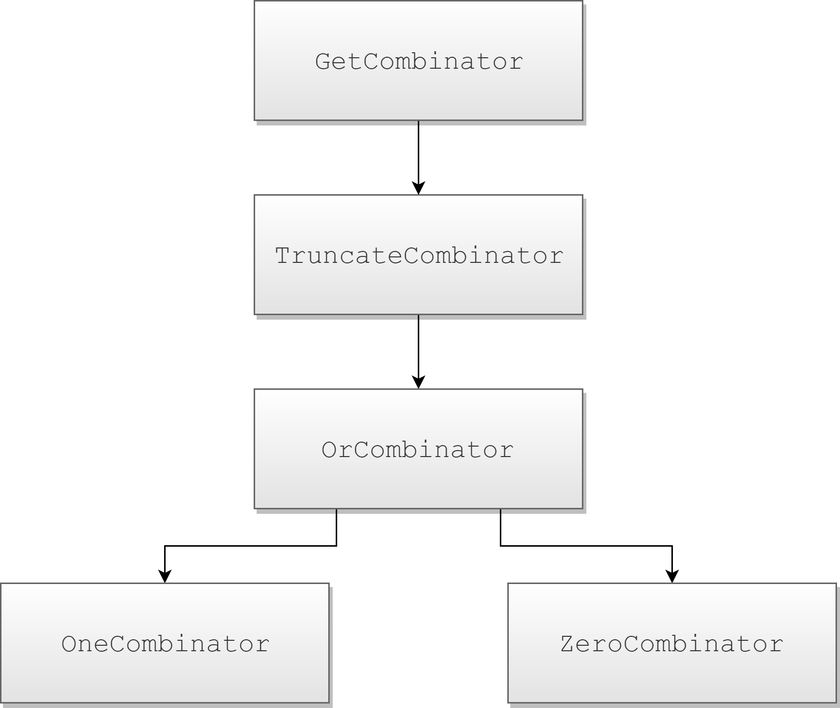
Smart Contract Implementation
get truncate t or one zero
European option contract at time t with
sub-contract one.
Notes:
So how does the implemented smart contract work?
The smart contract takes a SmartFin financial contract and the holder’s address through its constructor when it is deployed to a blockchain. The account that deploys the smart contract is taken as the counter-party.
Each combinator in the SmartFin financial contract is represented by an object (made up of a struct and a trait) that implements its semantics.
These combinators are stored as a tree, maintaining the compositional nature of the SmartFin DSL - here’s what the basic European option contract looks like as a combinator tree.
The deployed smart contract has methods to stake and withdraw funds in the contract, and for the holder to acquire it.
Unfortunately, it isn’t 100% straightforward to represent financial contracts in a smart contract...

Slide 21
Problems
get truncate t one
I have a financial contract with my client to pay them 1 Wei at time t
tomorrow, acquired by my client today.
Notes:
Let’s take a problematic example: a SmartFin financial contract requiring me to pay a client 1 Wei tomorrow at time t, which my client acquires sometime today.
Due to the nature of blockchain platforms, smart contract code is only executed when a function call transaction is sent, and so scheduled callbacks are not possible without external tools.
So how can we represent this financial contract requiring me to pay a client at time t?

Slide 22
Problems
get truncate t one
I have a financial contract with my client to pay them 1 Wei at time t
tomorrow, acquired by my client today.
No scheduled execution on the blockchain?
Notes:
Let’s take a problematic example: a SmartFin financial contract requiring me to pay a client 1 Wei tomorrow at time t, which my client acquires sometime today.
Due to the nature of blockchain platforms, smart contract code is only executed when a function call transaction is sent, and so scheduled callbacks are not possible without external tools.
So how can we represent this financial contract requiring me to pay a client at time t?

Slide 23
Retroactive Payment
get truncate t one
The counter-party pays the holder 1 Wei at
time t.
Initial Balance
0
Holder:
1
Counter-party:
Notes:
Instead of payments being handled in real-time, they are handled retroactively.
Each party has a balance in the smart contract, which can be increased or decreased by staking or withdrawing funds.
The smart contract also has an update method, which updates the balance based on required payments since the last call to update or acquire.
For our example, if my client calls update on the corresponding smart contract at or after time t tomorrow, their balance will be incremented and mine decremented, and they can withdraw their balance as payment.
Keeping track of this information requires the combinator objects to store some state, hence why they are not purely functional in the smart contract implementation as in the SmartFin DSL.
Unfortunately, this is not the only issue resulting from the nature of the Ethereum platform.

Slide 24
Retroactive Payment
get truncate t one
The counter-party pays the holder 1 Wei at
time t.
Initial Balance
0
Holder:
1
Counter-party:
update (at/after t)
1
Holder:
0
Counter-party:
Final Balance
Notes:
Instead of payments being handled in real-time, they are handled retroactively.
Each party has a balance in the smart contract, which can be increased or decreased by staking or withdrawing funds.
The smart contract also has an update method, which updates the balance based on required payments since the last call to update or acquire.
For our example, if my client calls update on the corresponding smart contract at or after time t tomorrow, their balance will be incremented and mine decremented, and they can withdraw their balance as payment.
Keeping track of this information requires the combinator objects to store some state, hence why they are not purely functional in the smart contract implementation as in the SmartFin DSL.
Unfortunately, this is not the only issue resulting from the nature of the Ethereum platform.

Slide 25
More Problems
scale <tempLondon> one
I have a financial contract with my client to pay them <average temperature in
London> Wei upon acquisition.
Notes:
Let’s look at another example: I have a financial contract with my client requiring me to pay them a number in Wei equal to the average temperature (Celsius) in London, at time t tomorrow.
The parameter tempLondon is called an “observable” in SmartFin; the scale combinator multiplies the values paid in the sub-contract one by the value of its observable, tempLondon, at its acquisition time, t.
Because smart contracts are run in a distributed manner, they are required to be deterministic no matter when they are executed.
As such, smart contracts cannot read information from off-chain sources, like servers over the internet, because these off-chain sources may not always return the same value and thus the execution would not be deterministic. This means that the value of an observable cannot be dynamically acquired.
So how will the smart contract ever know how much Wei should be paid?

Slide 26
More Problems
scale <tempLondon> one
I have a financial contract with my client to pay them <average temperature in
London> Wei upon acquisition.
Determinism? No off-chain data?
Notes:
Let’s look at another example: I have a financial contract with my client requiring me to pay them a number in Wei equal to the average temperature (Celsius) in London, at time t tomorrow.
The parameter tempLondon is called an “observable” in SmartFin; the scale combinator multiplies the values paid in the sub-contract one by the value of its observable, tempLondon, at its acquisition time, t.
Because smart contracts are run in a distributed manner, they are required to be deterministic no matter when they are executed.
As such, smart contracts cannot read information from off-chain sources, like servers over the internet, because these off-chain sources may not always return the same value and thus the execution would not be deterministic. This means that the value of an observable cannot be dynamically acquired.
So how will the smart contract ever know how much Wei should be paid?

Slide 27
Observable Arbiters
scale tempLondon <arbiter address> one
The counter-party pays the holder
tempLondon Wei.
Initial Balance
Holder:
0
Counter-party:
0
Notes:
When defining an observable in SmartFin we give it either a constant value, or a name and an address.
The address belongs to the Ethereum account of an arbiter - the arbiter (and no-one else) can provide the value of the observable.
This system is similar to an approach often used with traditional financial contracts, where both parties will agree on the source for a parameter’s value.
So let’s look back at our example:
We only know the average temperature in London once the contract is acquired.
So what do we do when the contract is acquired, but the value of the observable is not yet provided? How can payment still occur without a concrete value?
Yet again, retroactive payment is the answer!
In the smart contract, combinators involving observables are never updated until after their observable’s value is provided.
Once the observable is provided and the smart contract is updated, the balance will change accordingly.
As such, once the temperature in london is known and provided, the payment can be obtained.

Slide 28
Observable Arbiters
scale tempLondon <arbiter address> one
The counter-party pays the holder
tempLondon Wei.
Initial Balance
Holder:
0
Counter-party:
0
set observable value
update
Holder:
+tempLondon
Counter-party:
-tempLondon
Final Balance
Notes:
When defining an observable in SmartFin we give it either a constant value, or a name and an address.
The address belongs to the Ethereum account of an arbiter - the arbiter (and no-one else) can provide the value of the observable.
This system is similar to an approach often used with traditional financial contracts, where both parties will agree on the source for a parameter’s value.
So let’s look back at our example:
We only know the average temperature in London once the contract is acquired.
So what do we do when the contract is acquired, but the value of the observable is not yet provided? How can payment still occur without a concrete value?
Yet again, retroactive payment is the answer!
In the smart contract, combinators involving observables are never updated until after their observable’s value is provided.
Once the observable is provided and the smart contract is updated, the balance will change accordingly.
As such, once the temperature in london is known and provided, the payment can be obtained.

Slide 29
Demo
Contract interaction
Update/balance/retroactive payment demonstration with observables
Evaluation (with a less-simple contract, like euro option with observable)
Show providing user-input
Notes:
To make it easier to write SmartFin financial contracts and manage their smart contract representations, the web client was implemented.
A web client implementation was chosen mainly due to the comprehensive web3.js package for Ethereum interaction, but also due to past experience with React, and the need for MetaMask support - an extension which enables secure Ethereum account management.
Static functions for abstracting the smart contract interface were implemented, handling a lot of serialization/deserialization
Validation for SmartFin contracts with a simple stack trace was also implemented; due to smartfin’s simple syntax, this can simply be done by traversing the contract from left to right. There is also no need for semantic validation.
Besides the functionality for composing and interacting with SmartFin contracts and their corresponding smart contracts, the web client also provides functionality to evaluate a SmartFin contract.
The SmartFin contract evaluation in the web client allows a user to step through the combinators of a SmartFin contract and provide user input where necessary.
Once the step-through is complete, the client displays a human-readable string representing the value of the contract with the given input.
Observables are simply listed by name, allowing the user to estimate their values. Acquisition times for payments and observables can also be displayed to make this estimation easier.

Slide 30
SmartFin Financial Contract Evaluation
Notes:
How did we implement SmartFin financial contract evaluation?
The evaluation is handled by an Evaluator class in the web client
This class first pre-processes the given SmartFin financial contract. This is because the same contract may be re-used multiple times, across both the composition and monitoring views.
The contract is then stepped-through, and the evaluator class returns a list of options whenever a combinator requires user input (like the or combinator we saw earlier).
The evaluator keeps a stack of inputs from the user, containing acquisition time periods and or-choices. These are used to evaluate the contract once the contract traversal has terminated and no more input is required.
After this, the contract is then recursively traversed to evaluate its value.
Data regarding visited combinators which affect the value of the contract are stored in another stack (along with acquisition times).
For example, once we reach a one combinator we know the value starts at one and we push this to the stack. If the parent combinator is scale, we can push the observable to the stack, and so on.
This stack is then consumed to produce a human-readable string once the recursive traversal is complete.

Slide 31
SmartFin Financial Contract Evaluation
Pre-processing
Notes:
How did we implement SmartFin financial contract evaluation?
The evaluation is handled by an Evaluator class in the web client
This class first pre-processes the given SmartFin financial contract. This is because the same contract may be re-used multiple times, across both the composition and monitoring views.
The contract is then stepped-through, and the evaluator class returns a list of options whenever a combinator requires user input (like the or combinator we saw earlier).
The evaluator keeps a stack of inputs from the user, containing acquisition time periods and or-choices. These are used to evaluate the contract once the contract traversal has terminated and no more input is required.
After this, the contract is then recursively traversed to evaluate its value.
Data regarding visited combinators which affect the value of the contract are stored in another stack (along with acquisition times).
For example, once we reach a one combinator we know the value starts at one and we push this to the stack. If the parent combinator is scale, we can push the observable to the stack, and so on.
This stack is then consumed to produce a human-readable string once the recursive traversal is complete.

Slide 32
SmartFin Financial Contract Evaluation
Pre-processing
Add user input to stack exhaustively
Notes:
How did we implement SmartFin financial contract evaluation?
The evaluation is handled by an Evaluator class in the web client
This class first pre-processes the given SmartFin financial contract. This is because the same contract may be re-used multiple times, across both the composition and monitoring views.
The contract is then stepped-through, and the evaluator class returns a list of options whenever a combinator requires user input (like the or combinator we saw earlier).
The evaluator keeps a stack of inputs from the user, containing acquisition time periods and or-choices. These are used to evaluate the contract once the contract traversal has terminated and no more input is required.
After this, the contract is then recursively traversed to evaluate its value.
Data regarding visited combinators which affect the value of the contract are stored in another stack (along with acquisition times).
For example, once we reach a one combinator we know the value starts at one and we push this to the stack. If the parent combinator is scale, we can push the observable to the stack, and so on.
This stack is then consumed to produce a human-readable string once the recursive traversal is complete.

Slide 33
SmartFin Financial Contract Evaluation
Pre-processing
Add user input to stack exhaustively
Evaluate SmartFin financial contract recursively
Notes:
How did we implement SmartFin financial contract evaluation?
The evaluation is handled by an Evaluator class in the web client
This class first pre-processes the given SmartFin financial contract. This is because the same contract may be re-used multiple times, across both the composition and monitoring views.
The contract is then stepped-through, and the evaluator class returns a list of options whenever a combinator requires user input (like the or combinator we saw earlier).
The evaluator keeps a stack of inputs from the user, containing acquisition time periods and or-choices. These are used to evaluate the contract once the contract traversal has terminated and no more input is required.
After this, the contract is then recursively traversed to evaluate its value.
Data regarding visited combinators which affect the value of the contract are stored in another stack (along with acquisition times).
For example, once we reach a one combinator we know the value starts at one and we push this to the stack. If the parent combinator is scale, we can push the observable to the stack, and so on.
This stack is then consumed to produce a human-readable string once the recursive traversal is complete.

Slide 34
SmartFin Financial Contract Evaluation
Pre-processing
Add user input to stack exhaustively
Evaluate SmartFin financial contract recursively
Construct human-readable value string
Notes:
How did we implement SmartFin financial contract evaluation?
The evaluation is handled by an Evaluator class in the web client
This class first pre-processes the given SmartFin financial contract. This is because the same contract may be re-used multiple times, across both the composition and monitoring views.
The contract is then stepped-through, and the evaluator class returns a list of options whenever a combinator requires user input (like the or combinator we saw earlier).
The evaluator keeps a stack of inputs from the user, containing acquisition time periods and or-choices. These are used to evaluate the contract once the contract traversal has terminated and no more input is required.
After this, the contract is then recursively traversed to evaluate its value.
Data regarding visited combinators which affect the value of the contract are stored in another stack (along with acquisition times).
For example, once we reach a one combinator we know the value starts at one and we push this to the stack. If the parent combinator is scale, we can push the observable to the stack, and so on.
This stack is then consumed to produce a human-readable string once the recursive traversal is complete.

Slide 35
Evaluating our Contributions
Notes:
So overall, how useful is our SmartFin smart contract implementation for representing financial contracts as smart contracts?
In order to evaluate our contributions, besides self-reflection we have also carried out interviews with several of my peers who are knowledgeable about smart contracts, and Dr Panos Parpas as mentioned earlier. Overall, there is agreement that despite the compromises of the SmartFin smart contract implementation, it is still sufficiently accurate in its representation of traditional financial contracts.
It was also agreed that implementing financial contracts in SmartFin is much easier than implementing them in a traditional high-level smart contract language, and less error-prone because of this.
In terms of the correctness of our implementation, the smart contract alone has approximately 225 automated tests (consisting of both unit and integration tests), testing the different use cases of each combinator as well as the smart contract as a whole. The web client’s core functionality also has around 150 automated tests. This helps to assert the correctness of our implementation.

Slide 36

Evaluating our Contributions
Sufficiently accurate representation
Notes:
So overall, how useful is our SmartFin smart contract implementation for representing financial contracts as smart contracts?
In order to evaluate our contributions, besides self-reflection we have also carried out interviews with several of my peers who are knowledgeable about smart contracts, and Dr Panos Parpas as mentioned earlier. Overall, there is agreement that despite the compromises of the SmartFin smart contract implementation, it is still sufficiently accurate in its representation of traditional financial contracts.
It was also agreed that implementing financial contracts in SmartFin is much easier than implementing them in a traditional high-level smart contract language, and less error-prone because of this.
In terms of the correctness of our implementation, the smart contract alone has approximately 225 automated tests (consisting of both unit and integration tests), testing the different use cases of each combinator as well as the smart contract as a whole. The web client’s core functionality also has around 150 automated tests. This helps to assert the correctness of our implementation.

Slide 37
Evaluating our Contributions
Sufficiently accurate representation
Much easier implementation
Notes:
So overall, how useful is our SmartFin smart contract implementation for representing financial contracts as smart contracts?
In order to evaluate our contributions, besides self-reflection we have also carried out interviews with several of my peers who are knowledgeable about smart contracts, and Dr Panos Parpas as mentioned earlier. Overall, there is agreement that despite the compromises of the SmartFin smart contract implementation, it is still sufficiently accurate in its representation of traditional financial contracts.
It was also agreed that implementing financial contracts in SmartFin is much easier than implementing them in a traditional high-level smart contract language, and less error-prone because of this.
In terms of the correctness of our implementation, the smart contract alone has approximately 225 automated tests (consisting of both unit and integration tests), testing the different use cases of each combinator as well as the smart contract as a whole. The web client’s core functionality also has around 150 automated tests. This helps to assert the correctness of our implementation.

Slide 38
Evaluating our Contributions
Sufficiently accurate representation
Much easier implementation
Lower risk of error
Notes:
So overall, how useful is our SmartFin smart contract implementation for representing financial contracts as smart contracts?
In order to evaluate our contributions, besides self-reflection we have also carried out interviews with several of my peers who are knowledgeable about smart contracts, and Dr Panos Parpas as mentioned earlier. Overall, there is agreement that despite the compromises of the SmartFin smart contract implementation, it is still sufficiently accurate in its representation of traditional financial contracts.
It was also agreed that implementing financial contracts in SmartFin is much easier than implementing them in a traditional high-level smart contract language, and less error-prone because of this.
In terms of the correctness of our implementation, the smart contract alone has approximately 225 automated tests (consisting of both unit and integration tests), testing the different use cases of each combinator as well as the smart contract as a whole. The web client’s core functionality also has around 150 automated tests. This helps to assert the correctness of our implementation.

Slide 39
Evaluating our Contributions
Sufficiently accurate representation
Much easier implementation
Lower risk of error
~375 automated tests
Notes:
So overall, how useful is our SmartFin smart contract implementation for representing financial contracts as smart contracts?
In order to evaluate our contributions, besides self-reflection we have also carried out interviews with several of my peers who are knowledgeable about smart contracts, and Dr Panos Parpas as mentioned earlier. Overall, there is agreement that despite the compromises of the SmartFin smart contract implementation, it is still sufficiently accurate in its representation of traditional financial contracts.
It was also agreed that implementing financial contracts in SmartFin is much easier than implementing them in a traditional high-level smart contract language, and less error-prone because of this.
In terms of the correctness of our implementation, the smart contract alone has approximately 225 automated tests (consisting of both unit and integration tests), testing the different use cases of each combinator as well as the smart contract as a whole. The web client’s core functionality also has around 150 automated tests. This helps to assert the correctness of our implementation.

Slide 40
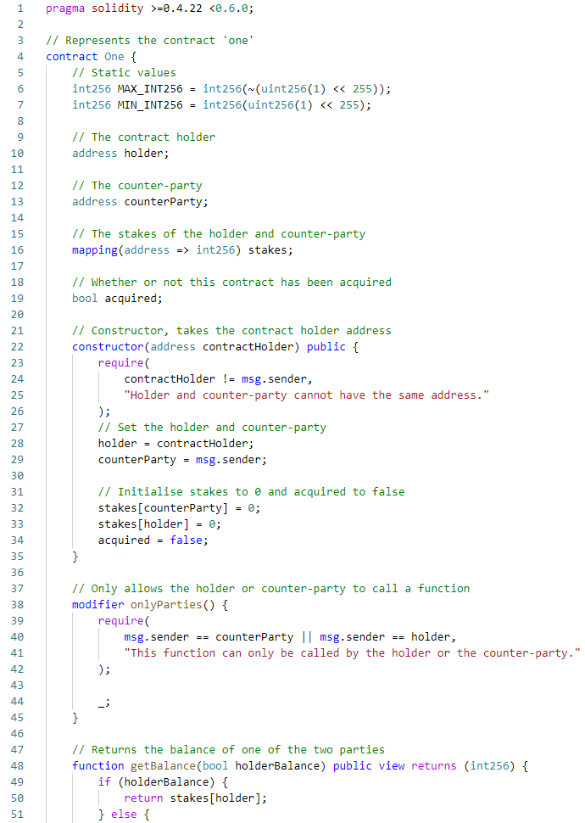
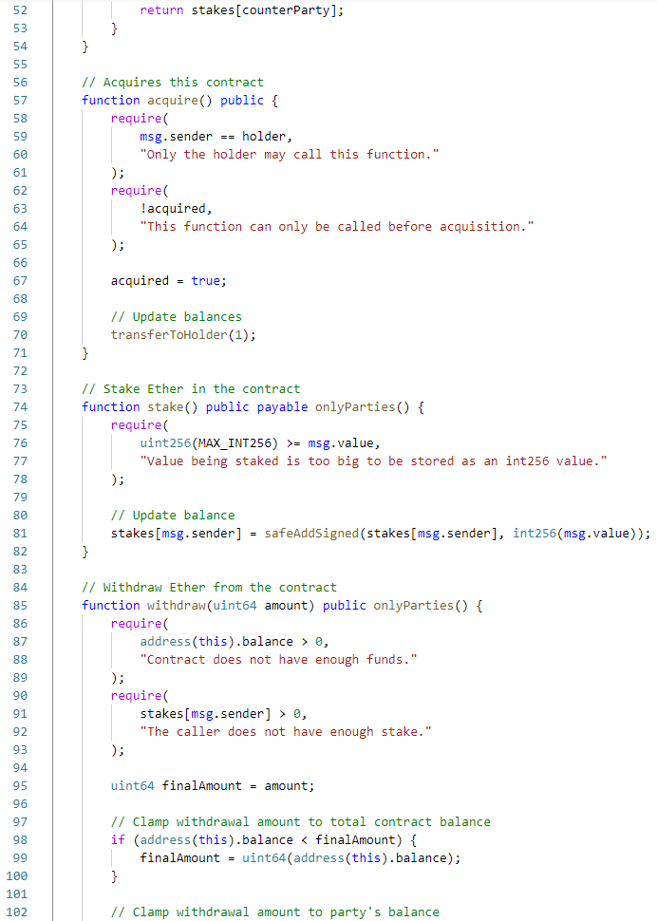
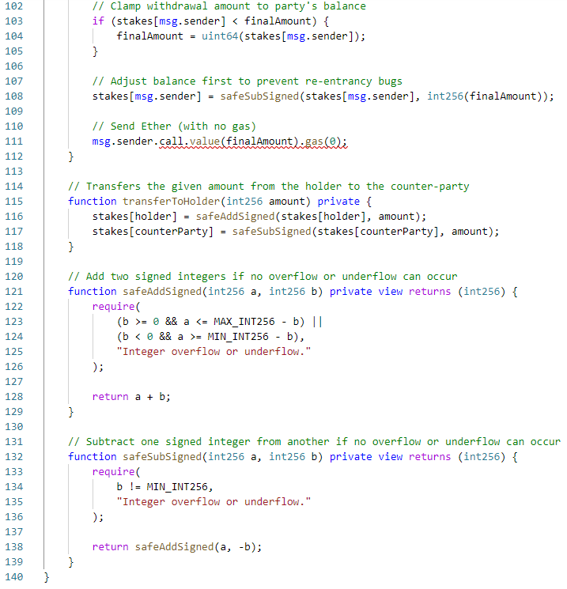
Evaluation - Case Studies
SmartFin: one
Solidity:
Notes:
In order to compare the SmartFin smart contract implementation with existing technologies, some bespoke implementations of specific SmartFin financial contracts have been written in Solidity, a popular high-level smart contract language.
Even for the simplest non-zero contract, “one”, the corresponding Solidity smart contract implementation was over 100 lines long, not including comments. You can see here just how stark the difference is.
Additionally, special care was required to avoid both the reentrancy and overflow/underflow vulnerabilities present in many Solidity smart contracts. This is not required when writing a financial contract in SmartFin, as the smart contract code is all pre-implemented by us and heavily tested.
With regards to accuracy of representation, the limitations of the Ethereum platform apply to both our SmartFin implementation and the bespoke Solidity contracts, and as such it was not possible to represent these SmartFin contracts more accurately in a bespoke smart contract, at least when viewing them as a black-box implementation.
The bespoke Solidity contracts did win in one area, however; efficiency.

Slide 41
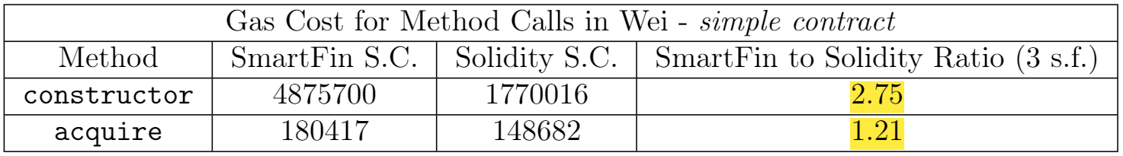
Evaluation - Case Studies
Notes:
When a smart contract is run on the Ethereum platform, the user that executes the code is typically paid paid by the caller in “gas fees”, a small amount of Ether paid based on the amount of work done.
A method call on the generic implementation of SmartFin that we provide was 1.2 times more expensive than the corresponding Solidity smart contract’s method call at best, but closer to 5-10 times worse in the majority of tests, as you can see on this slide.
While this is obviously not an upside, it may not be as much of a downside as it may seem. Gas fees are typically applied on public blockchains, whereas financial institutions would be more likely to deploy these contracts to a private blockchain. As such, gas fees will typically be handled differently or not applied at all, as the nodes running the network need no reward for their computation.
As such, keeping low gas fees is not essential for our intended use case.
To add to this, the order of magnitude of the gas fees for the contracts we compared was very low overall, around 10^9 times smaller than $1 USD.

Slide 42
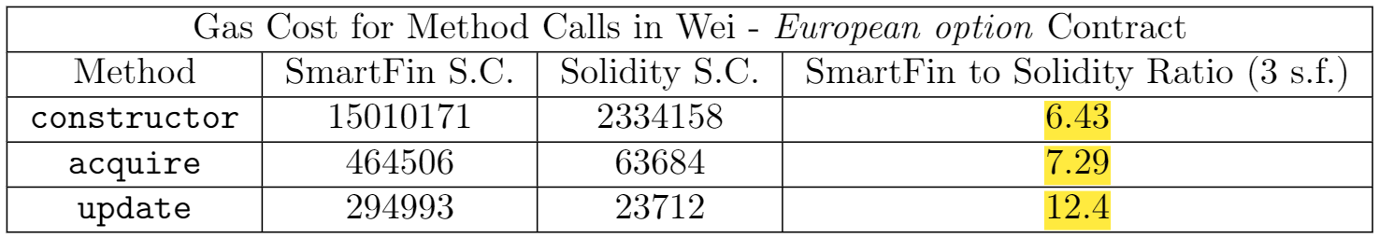
Evaluation - Case Studies
Notes:
When a smart contract is run on the Ethereum platform, the user that executes the code is typically paid paid by the caller in “gas fees”, a small amount of Ether paid based on the amount of work done.
A method call on the generic implementation of SmartFin that we provide was 1.2 times more expensive than the corresponding Solidity smart contract’s method call at best, but closer to 5-10 times worse in the majority of tests, as you can see on this slide.
While this is obviously not an upside, it may not be as much of a downside as it may seem. Gas fees are typically applied on public blockchains, whereas financial institutions would be more likely to deploy these contracts to a private blockchain. As such, gas fees will typically be handled differently or not applied at all, as the nodes running the network need no reward for their computation.
As such, keeping low gas fees is not essential for our intended use case.
To add to this, the order of magnitude of the gas fees for the contracts we compared was very low overall, around 10^9 times smaller than $1 USD.

Slide 43
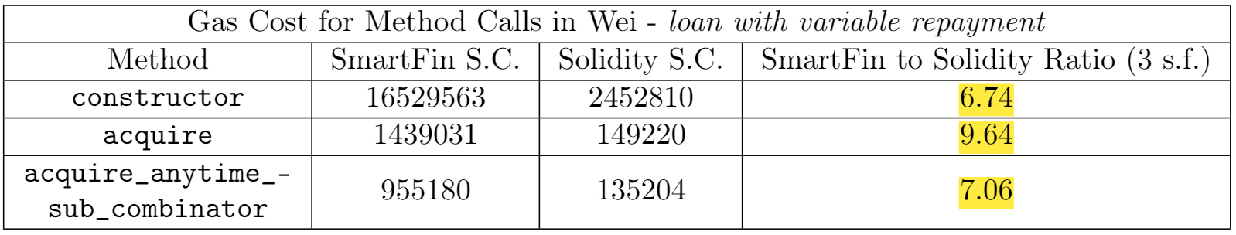
Evaluation - Case Studies
Notes:
When a smart contract is run on the Ethereum platform, the user that executes the code is typically paid paid by the caller in “gas fees”, a small amount of Ether paid based on the amount of work done.
A method call on the generic implementation of SmartFin that we provide was 1.2 times more expensive than the corresponding Solidity smart contract’s method call at best, but closer to 5-10 times worse in the majority of tests, as you can see on this slide.
While this is obviously not an upside, it may not be as much of a downside as it may seem. Gas fees are typically applied on public blockchains, whereas financial institutions would be more likely to deploy these contracts to a private blockchain. As such, gas fees will typically be handled differently or not applied at all, as the nodes running the network need no reward for their computation.
As such, keeping low gas fees is not essential for our intended use case.
To add to this, the order of magnitude of the gas fees for the contracts we compared was very low overall, around 10^9 times smaller than $1 USD.

Slide 44
Thanks for listening!
Questions are welcome!
Notes:
In conclusion, we have presented a smart contract implementation of SmartFin, and a web client to manage SmartFin contracts and their corresponding smart contracts.
The implementation of SmartFin for financial smart contracts is sufficient for the representation of financial contracts, and it brings great benefits with regards to ease of implementation and risk of erroneous behaviour, although the efficiency could be improved.
With regards to wider-ranging insights, we’ve found that implementing a single generic smart contract for a DSL can be significantly easier than implementing several bespoke smart contracts in the long term, and can lower the risk of erroneous behaviour.
This idea can be applied to a wide range of fields, not just financial contracts.
And that covers just about everything! Thank you very much for listening, and if you have any questions I’d be happy to answer them now!

Slide 45
Future Work
Maximal SmartFin financial contract evaluation
Numerical modelling of observables
Extension of SmartFin DSL, comparison-based combinators
Optimisation of storage

Slide 46
SmartFin DSL
zero
A contract with no obligations
one
Counter-party pays holder 1 Wei upon acquisition
give c
Acquiring give c acquires c with all payments reversed.
scale o c
Acquiring scale o c acquires c with all payments multiplied by the value of the
observable o at the time of acquisition.

Slide 47
SmartFin DSL
get c
Acquiring get c acquires c at the time of its horizon.
truncate t c
Acquiring truncate c acquires c until time t, after which it does nothing.
anytime c
After acquiring anytime c, the holder can acquire c at any point before its
horizon, at which point it must be acquired.
and c d
Acquiring and c d acquires both c and d.

Slide 48
SmartFin DSL
or c d
Acquiring or c d allows the holder to choose between acquiring c and d.
then c d
Acquiring then c d acquires c if it has not expired, or d if c has expired.

Slide 49
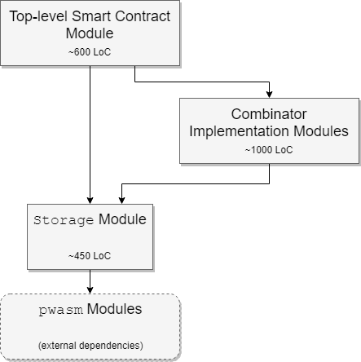
Smart Contract Architecture

Slide 50
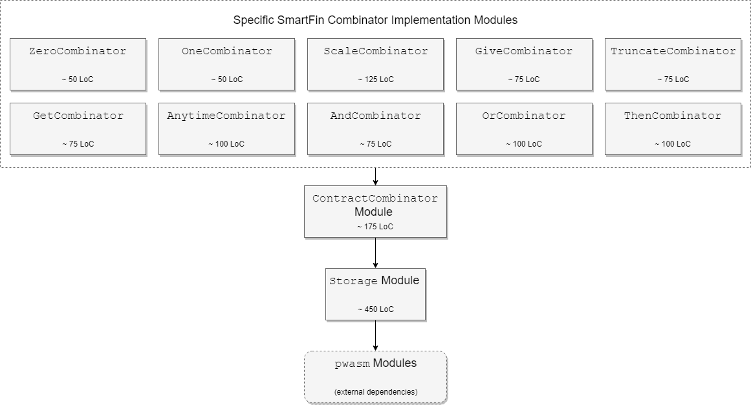
Combinator Implementation Architecture

Slide 51
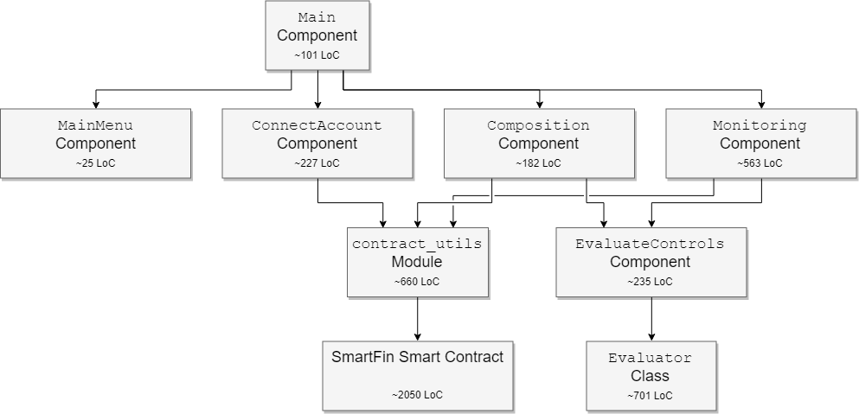
Web Client Architecture

Slide 52
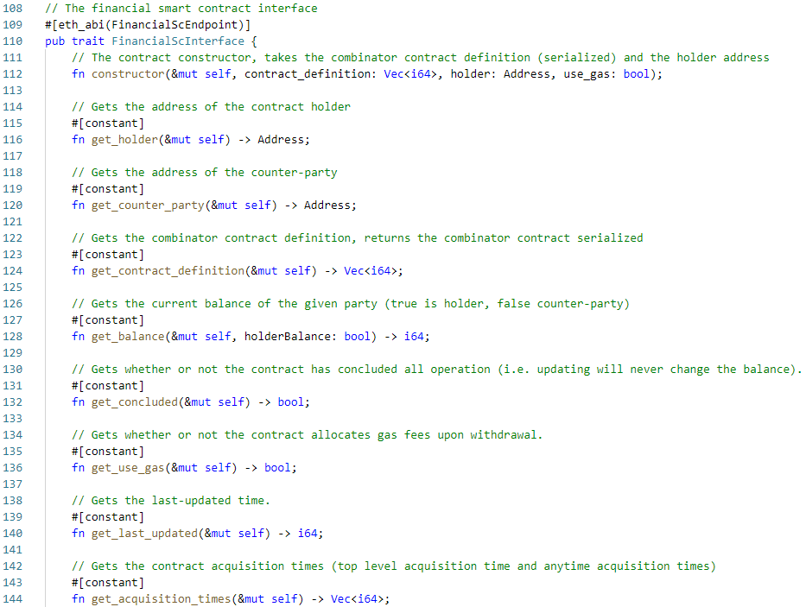
Smart Contract ABI Part 1

Slide 53
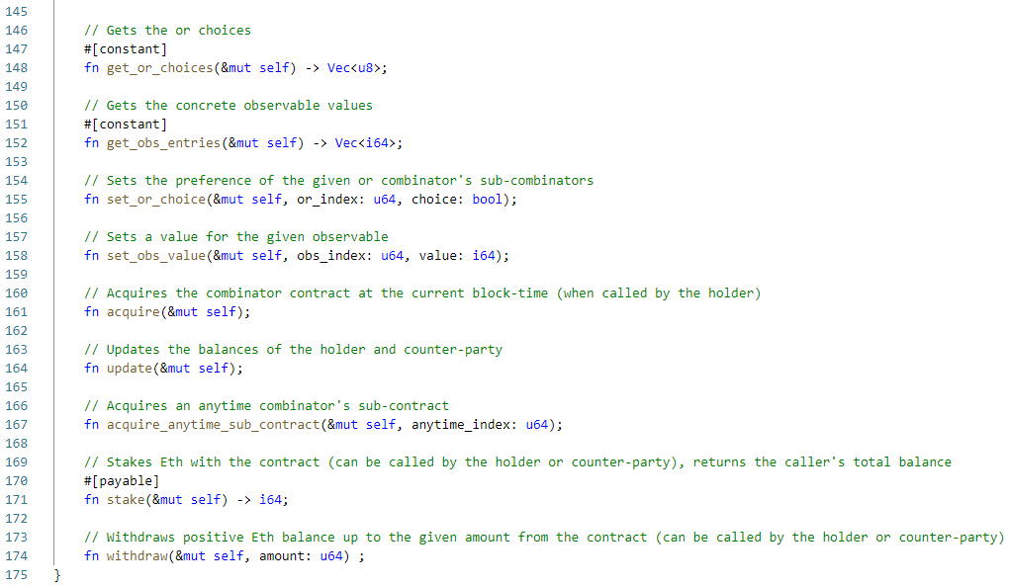
Smart Contract ABI Part 2

Slide 54
SmartFin Financial Contract Evaluation
Pre-processing
Sub-contract horizons
Sub-contract termination indexes
Top-level and anytime sub-contract acquisition time slices
User-input obtained exhaustively
Get execution path through SmartFin financial contract
Recursively traverse SmartFin financial contract
Create stack of value-altering combinators - one, scale, and
Consume value-altering combinator stack to produce value string

Slide 55
Smart Contract Storage
StoresFixed<T>
Stores a value of type T with a fixed size in storage.
StoresFixedVec<T> where StoresFixed<T>
Stores a vector of values of type T, where each has a fixed size in storage.
StoresVariable<T>
Stores a value of type T with variable size in storage.

Slide 56
Ethereum Vulnerabilities Statistic Source
A survey of attacks on Ethereum smart contracts
Nicola Atzei, Massimo Bartoletti, and Tiziana Cimoli
ACM CCS 2016, pages 254–269, 2016.
https://eprint.iacr.org/2016/1007.pdf

Slide 57
Extra Slides
Full syntax of SmartFin
Full semantics of SmartFin
How is SmartFin different from original DSL
Full Solidity code for case study implementations and comparison tables for gas fees
ABI
ContractCombinator trait declaration?
Architecture diagrams/equiv., for explanatory purposes
Citation for 45% of smart contracts being vulnerable maybe
Time slices/Next map?

