Slide 1


Evaluation of Estimation Models Using the Minimum Interval of Equivalence
Javier Dolado, Daniel Rodríguez, Bill Langdon, Mark Harman
Universidad del País Vasco/Euskal Herriko Unibertsitatea
Universidad de Alcalá
University College London

Slide 2
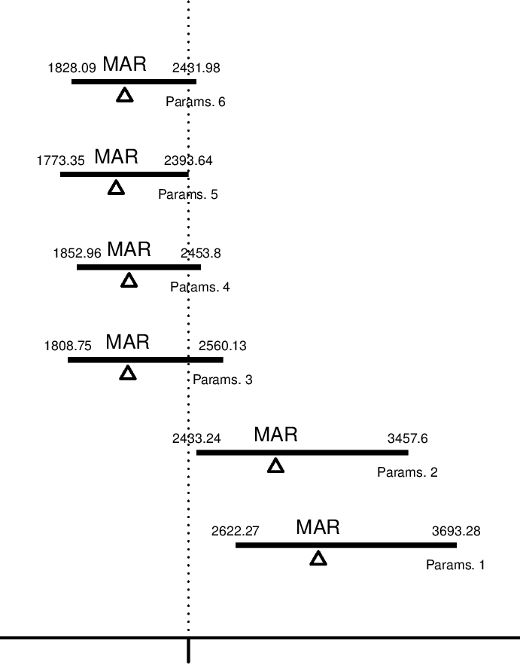
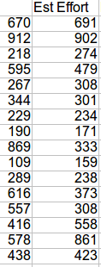
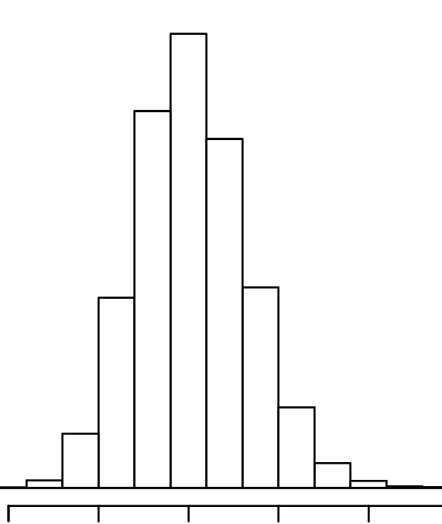
One dataset and One method
Dataset 1
Bootstrap CIs
ESTIMATION METHOD 1
Parameters 1
Parameters 2
…
Parameters n
Compute MARP0
Select interval
Compute MIEratio
Process followed for one dataset and one estimation method:
1. Select a set of parameters for the estimation method (“Parameters 1”)
2. Bootstrap a Confidence Interval for the Mean Absolute Error (“MAR”)
3. Repeat the process for “n” sets of parameters
4. Select the best interval, i.e. , that one with the upper limit closest to 0
5. Compute the MARP0
6. Compute the MIEratio

Slide 3

N datasets and M methods
Create k Folds in N datasets
Apply M Estimation Methods
with different sets of parameters
Select intervals
DATASET 1
T
GP
t-f1
LR
Bootstrap CIs
seed1
T
T
MLP
T
t-f2
RTree
t-f3
T
T
…..
Compute the k·N·M MIEratios
MARP0s
DATASET N
Compute the Credible Intervals
of the MIEratios for the M methods

Slide 4
Estimation Errors
The distribution of the absolute errors of the estimations is non-normal
Therefore, many of the usual measures based on the arithmetic mean are not valid
We use geometric means and bootstrap (non-parametric method)

Slide 5
Selection of the intervals
We compute the 1-2α confidence intervals by resampling methods (with bootstrap)
We select the closest intervals to the origin 0

Slide 6
MARP0s: random estimation
In order to compare the estimations with “something” we resort to the concept of random estimation (Hyndman, Shepperd, MacDonell)
Random estimation is the “worst estimation” that could be performed in a dataset

Slide 7
Selection of the intervals of equivalence

Slide 8
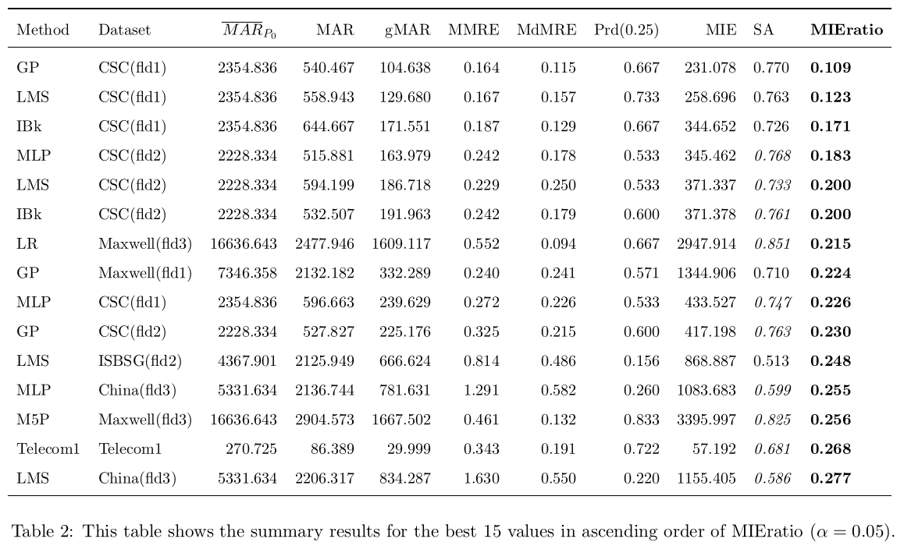
Ordered Table of the MIEratios
After all computations we get something like the table below
Usual measures used MMRE, Pred(0.25) are not correlated with our current values

Slide 9
Arranging the results by
Estimation Method
Confidence intervals (frequentist interpretation)

Slide 10
Bayesian Credible Intervals
We compare the distributions

Slide 15
Several Bayesian Credible Intervals

Slide 16
Conclusions
The use of the EHT approach allows us to select some specific intervals and to derive a new measure
The final figures show that Genetic Programming, M5P and Linear Regression with least mean squares are well positioned, but there is no clear “best” method.
There is still room for improvement in the comparisons

Slide 17
Equivalence Hypothesis Testing
It is an extension and variation of the concept of the classic Null Hypothesis Statistical Test
It “differentiates” between “null” and “nil” hypothesis
Null hypothesis refers to what we are trying to nullify, so that we accept the alternative hypothesis
Nil hypothesis refers to the null hypothesis of no difference. This is the common and usual Null Hypothesis Significance Test
But we could set as null hypothesis other situation other than the nil hypothesis

Slide 18
Equivalence (also known as bioequivalence in pharmacological studies) is a statistical approach that answers the question ‘‘is product T equivalent to some other reference product R within some range Δ?
These statistical tools are used in the pharmacological and food industries:
  Substitution of brand-name drugs by their generic counterparts
  Identify food products with similar properties (sensorial or others)
  Attempt to introduce a new product into a competitor's market

Slide 19
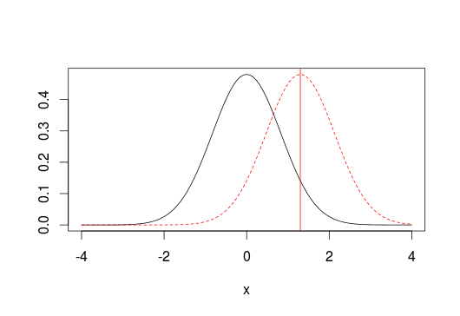
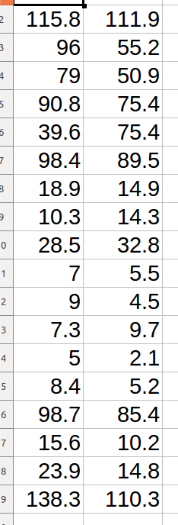

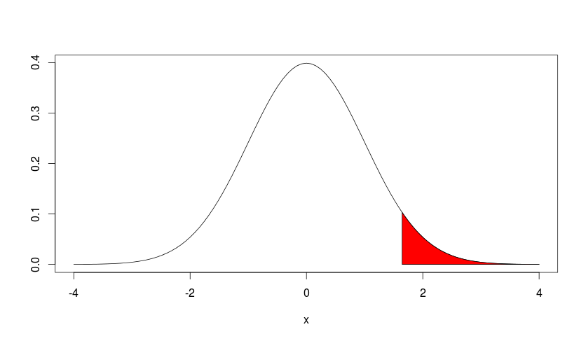
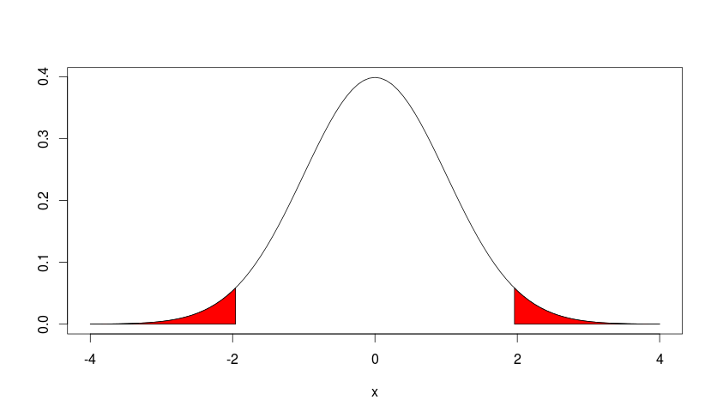
NHST: Null hypothesis significance test
Compare two things
T
R
Null hypothesis that is a Nil hypothesis: the means are equal
The statistical tests try to disprove the Null hypothesis

Slide 20
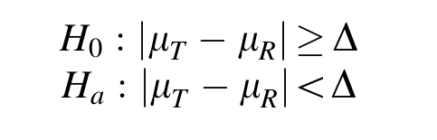
EHT reverses the Nil Hypothesis
The Null hypothesis is not that the things that we are comparing are equal anymore, but that they are different by a range (-Δ, +Δ)
Therefore we will try to disprove that the things are different for concluding that they are equivalent in the range (-Δ, +Δ)
The null hypothesis H0 and the alternative hypothesis Ha are “reversed”
NHST
EHT

Slide 21
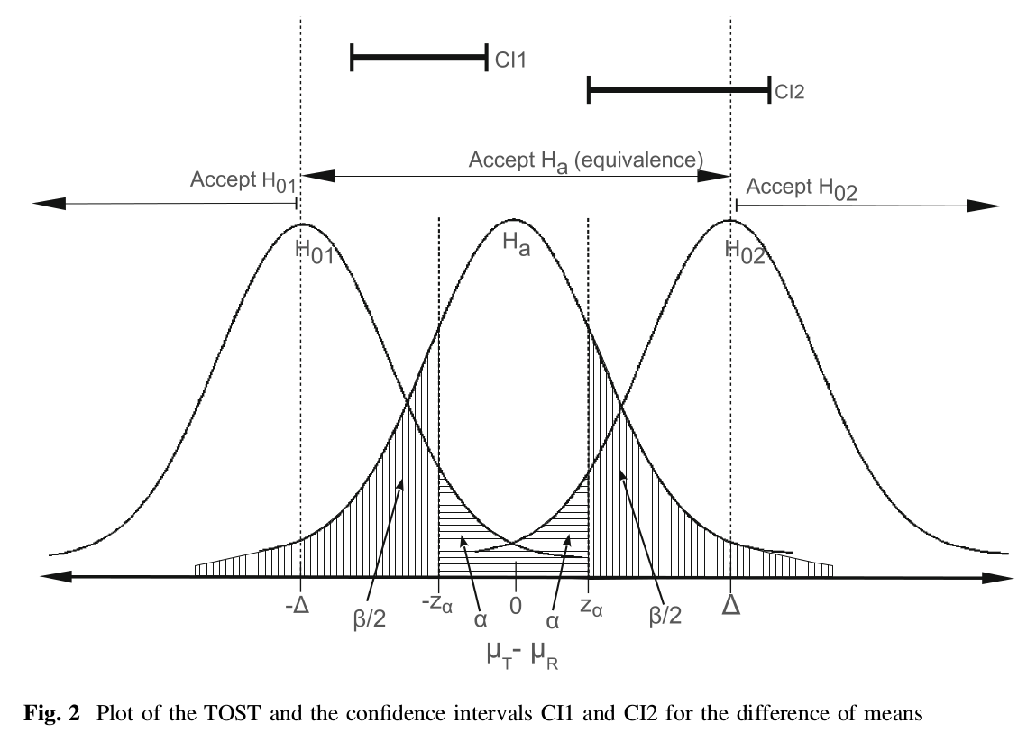
This is the range of values that consider “acceptable”
Null hypothesis
Null hypothesis
Alternative hypothesis

Slide 22
In EHT the null hypothesis involves two one-sided t-tests
If both t-tests are rejected we may conclude “equivalence”
This value does not reject H02
This value rejects H01
We perform a one-sided t-test at -Δ
We perform a one-sided t-test at Δ

Slide 23
There is an easier way to understand “equivalence” through Confidence Intervals
Equivalence can be declared if the classic or shortest 1-2α CI is inside the limits (-Δ, Δ)
This CI is inside the limits
These CIs are outside the limits

Slide 24
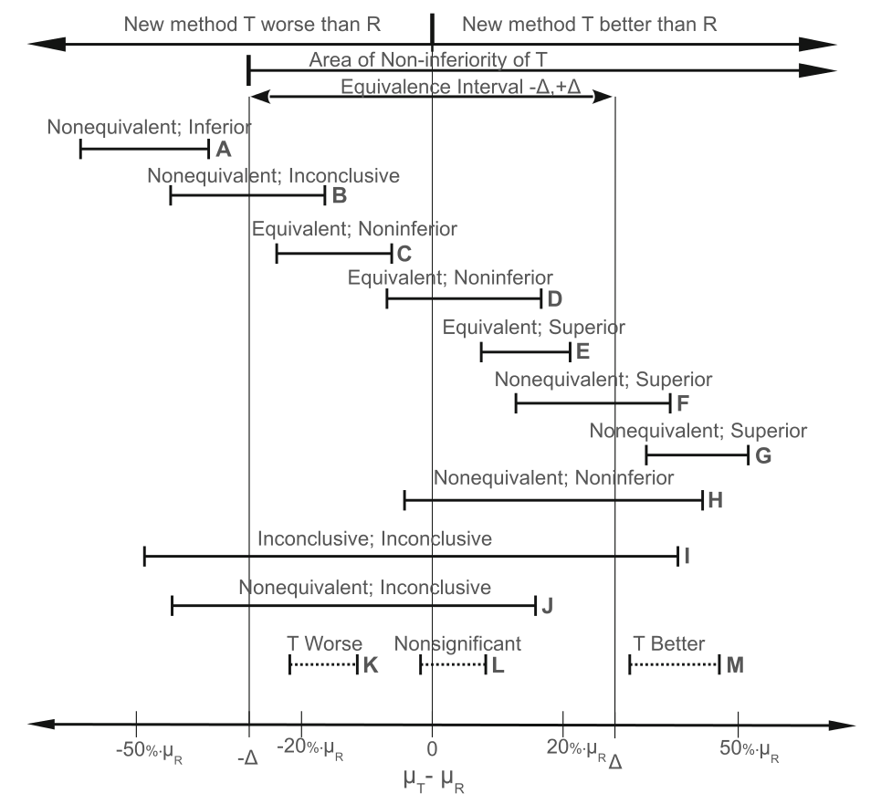
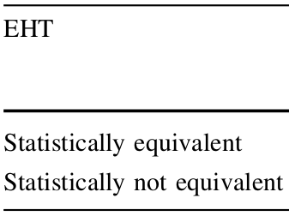
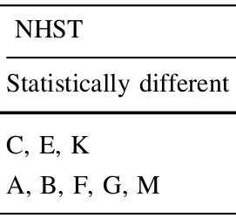
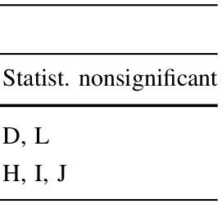
Different locations of the CI respect to the limits of equivalence
Equivalence
Established
In C D E
This is NHST

Slide 25
Steps to check for equivalence
Set the limits (-Δ, Δ) that the analyst consider reasonable in his/her field of experimentation.
Perform the experiment and compute the Two one-sided t-tests or the Confidence Intervals
Check whether the CIs are within the limits of equivalence

