Slide 1
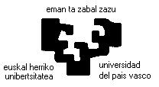
Evaluation using the Minimum Interval of Equivalence
Bayesian Networks in Software Testing
Javier Dolado
U. País Vasco/Euskal Herriko Unibertsitatea
Daniel Rodríguez
Universidad de Alcalá
PRESI TIN2013-46928-C3-1-R, TIN2013-46928-C3-2-R

Slide 2
Two problems we are researching
How to compare estimation methods?
  Article finished in collaboration with Harman's group
The use of Bayesian concepts and Bayesian Networks in Software Testing
  Article in progress with several collaborators

Slide 3
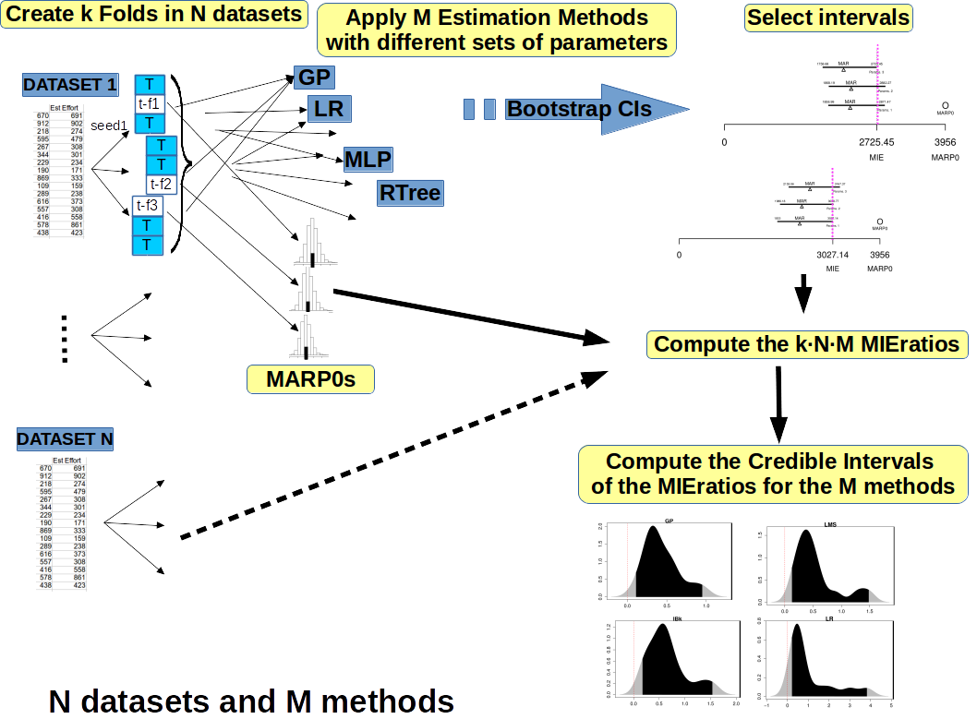

Slide 4
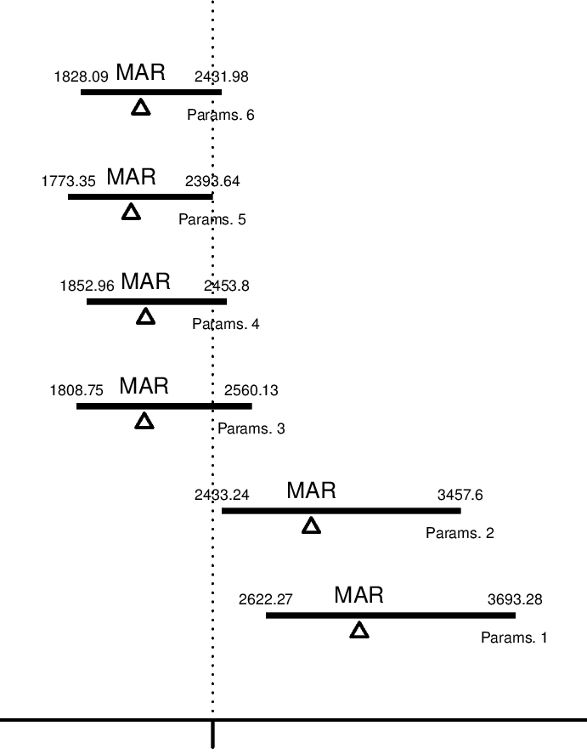
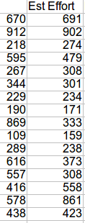
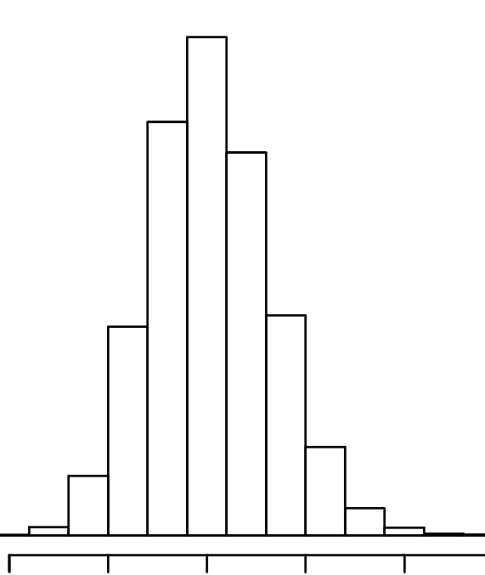
One dataset and One method
Dataset 1
Bootstrap CIs
ESTIMATION METHOD 1
Parameters 1
Parameters 2
…
Parameters n
Compute MARP0
Select interval
Compute MIEratio
Process followed for one dataset and one estimation method:
1. Select a set of parameters for the estimation method (“Parameters 1”)
2. Bootstrap a Confidence Interval for the Mean Absolute Error (“MAR”)
3. Repeat the process for “n” sets of parameters
4. Select the best interval, i.e. , that one with the upper limit closest to 0
5. Compute the MARP0
6. Compute the MIEratio

Slide 5
Estimation Errors
The distribution of the absolute errors of the estimations is non-normal
Therefore, many of the usual measures based on the arithmetic mean are not valid
We use geometric means and bootstrap (non-parametric method)

Slide 6
Selection of the intervals
We compute the 1-2α confidence intervals by resampling methods (with bootstrap)
We select the closest intervals to the origin 0

Slide 7
MARP0s: random estimation
In order to compare the estimations with “something” we resort to the concept of random estimation (Hyndman, Shepperd, MacDonell)
Random estimation is the “worst estimation” that could be performed in a dataset

Slide 8
Selection of the intervals of equivalence

Slide 9
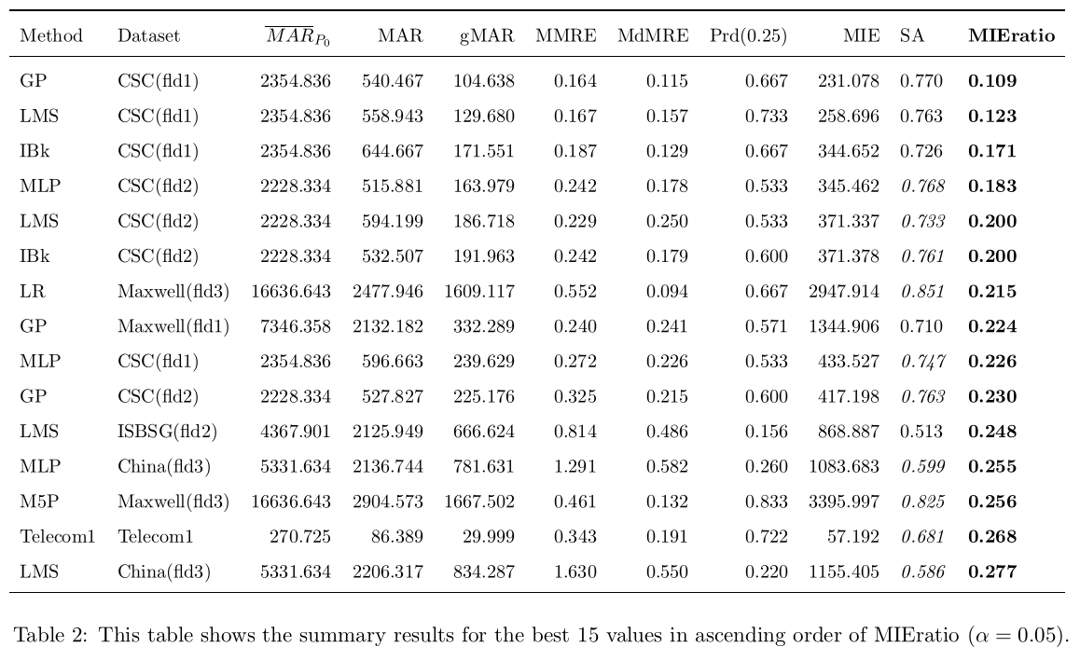
Ordered Table of the MIEratios
After all computations we get something like the table below
Usual measures used MMRE, Pred(0.25) are not correlated with our current values

Slide 10
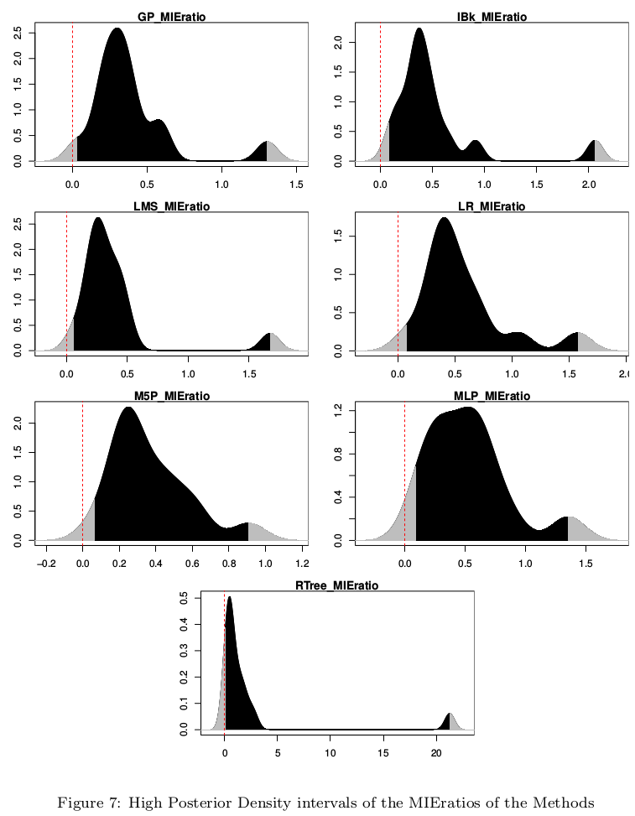

Slide 11
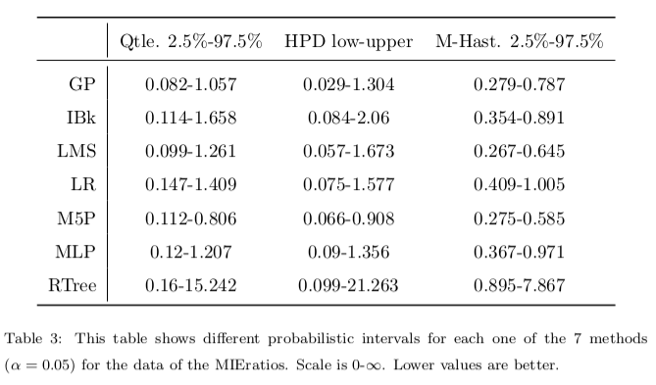
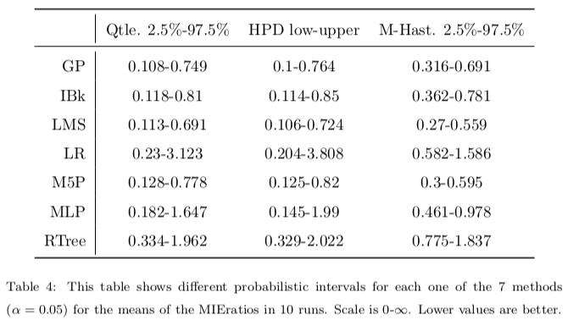

Slide 12
The use of Bayesian concepts and Bayesian Networks in Software Testing
  Article in progress with several collaborators
  Conference in Bergamo 2015
    Bayesian Concepts in Software Testing: An Initial Review
    Now, we focus on Bayesian Networks.
    Still, doing the review

