Slide 1


Data Carving
Daniel Rodríguez, University of Alcalá

Slide 2
Outline
Data transformation
Sampling
Feature Subset Selection (FSS)
Feature Ranking
Instance Selection

Slide 3
Data transformation
Many algorithms require data to be symmetrical, i.e., following the normal (Gaussian) distribution.
Typical transformations include:
log tranformations, power, etc.

Slide 4
Sampling techniques
When dealing with imbalanced datasets, there are two alternatives, either (i) sampling or balancing techniques, cost or robust algorithms.
Over-sampling algorithms aimed at balancing the class distribution increasing the minority class
    Res-ampling: Duplication of random instances of the minority class(es)
    SMOTE: Generación por interpolación de instancias minoritarias
Under-sampling algorithms that balance the class removing instances from the majority classes:
    Random Undersampling
    Wilson Editing aka Edited Nearest Neighbor (ENN)
    Tomek Links

Slide 5
SMOTE
Example:
Class A (mayority class)
Class B (Minority class)
Synthetic samples

Slide 6
Sampling should not be preformed over the test set

Slide 7

Discretisation
Data discretization transforms continuous attributes into discrete (nominal) attributes. : first using equal-width intervals (orange.EquiDistDiscretization), second using equal-frequency intervals (orange.EquiNDiscretization)
Unsupervised
  Equal size intervals
  Equal width intervals
Unsupervised
  Fayyad & Irani (AAAI92) based on MDL and entropy to find the best cut-off points considering the class attribute

Slide 8
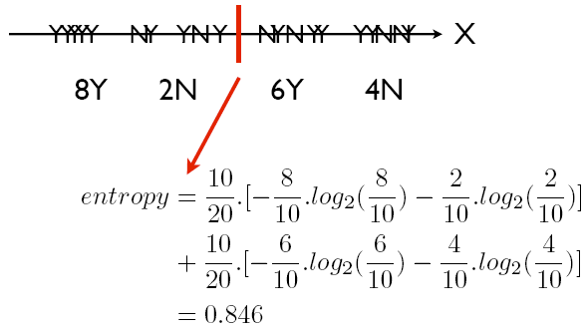
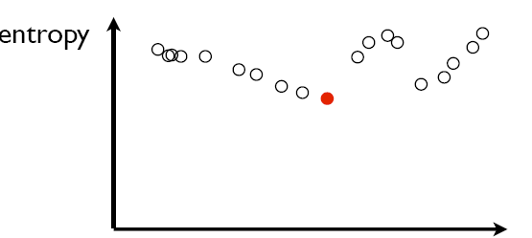
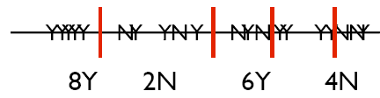
Supervised Discretisation
Finds the best cut-off points

Slide 9
Attribute Selection
Feature selection is important in different ways:
  A reduced volume of data allows different data mining or searching techniques to be applied.
  Irrelevant and redundant attributes can generate less accurate and more complex models. Furthermore, data mining algorithms can be executed faster.
  We can avoid the collection of data for those irrelevant and redundant attributes in the future.
There exist two major approach in feature selection from the method's output point of view depending on the way that features are evaluated:
  Feature ranking, a.k.a. feature weighting, assesses individual features and assigns them weights according to their degrees of relevance
  Feature subset selection (FSS) evaluate the goodness of each found feature subset (Unusually, some search strategies in combination with subset evaluation can provide a ranked list).

Slide 10
Feature Ranking
Feature ranking algorithms category, one can expect a ranked list of features which are ordered according to evaluation measures
Each attribute correlation with the class is evaluated independenly of other attributes according to a statistical test (e.g.: χ-squared, Infogain, etc.)
A subset of features is often selected from the top of a ranking list. A feature is good and thus will be selected if its weight of relevance is greater than a user-specified threshold value,
or we can simply select the first k features from the ranked list.
This approach is efficient for high-dimensional data due to its linear time complexity in terms of dimensionality
Very fast method.
However, it cannot detect redundant attributes

Slide 11
Feature Subset Selection (FSS)
In the FSS category, candidate subsets are generated based on a certain search strategy:
Exhaustive, heuristic and random search
Each candidate subset is evaluated by a certain evaluation measure. If a new subset turns out to be better, it replaces the previous best subset. The process of subset generation and evaluation is repeated until a given stopping criterion is satisfied. Existing evaluation measures include:
  Consistency measure attempts to find a minimum number of features that separate classes as consistently as the full set of features can. An inconsistency is defined as to instances having the same feature values but different class labels.
  Correlation measure evaluates the goodness of feature subsets based on the hypothesis that good feature subsets contain features highly correlated to the class, yet uncorrelated to each other.
  Accuracy of a learning algorithm (Wrapper-based attribute selection) uses the target learning algorithm to estimate the worth of attribute subsets. The feature subset selection algorithm conducts a search for a good subset using the induction algorithm itself as part of the evaluation function.
The time complexity in terms of data dimensionality is, exponential for exhaustive search, quadratic for heuristic search and linear to the number of iterations in a random search

Slide 12
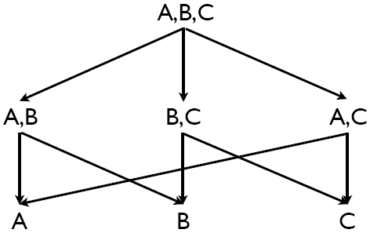
FSS – CFS (Correlation Based FS)
Correlation measure is applied in an algorithm called CFS that exploit heuristic search (best first) to search for candidate feature subsets.
One of the most frequently used search techniques is hill-climbing (greedy). It starts with an empty set and evaluates each attribute individually to find the best single attribute.
It then tries each of the remaining attributes in conjunction with the best to find the most suited pair of attributes. In the next iteration, each of the remaining attributes are tried in conjunction with the best pair to find the most suited group of three attributes.
This process continues until no single attribute addition improves the evaluation of the subset; i.e., subset evaluator is run M times to choose the best single attribute, M-1 times to find the best pair of attributes, M-2 times the best group of three, and so on.
E.g., if we have chosen 5 attributes through this method,
the subset evaluator has been run
M+(M-1)+(M-2)+(M-3)+(M-4) times.

Slide 13
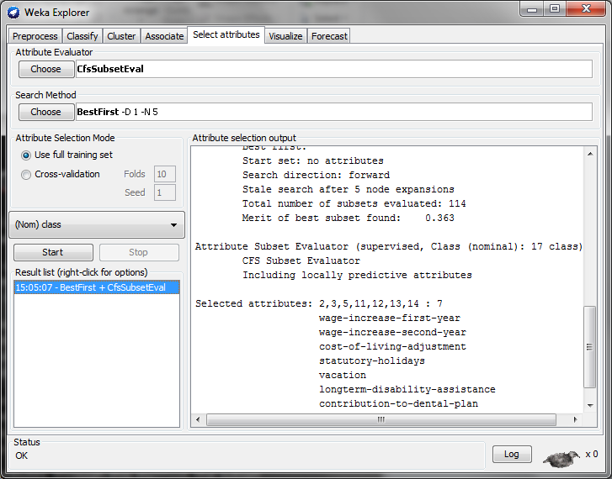
CFS Example

Slide 14
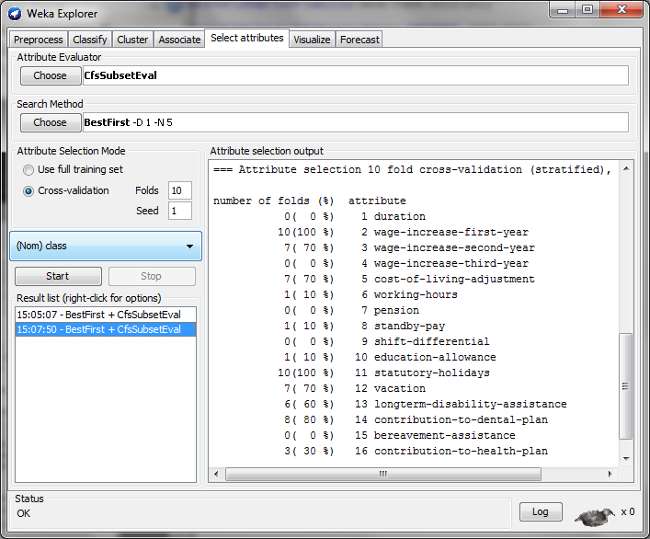
CFS – 10 CV

Slide 15
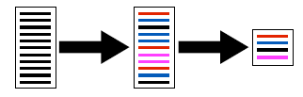
Instance Selection
We can also reduce the number of instances to deal with smaller datasets

Slide 16
Class Overlapping and separability
The problem of overlapping occurs when regions of the data space contains different values of the class.
Separability – a class is linearly separable if there a linear function (straight line, plane or hyper-plane) that is capable of differentiate between the values of a class.
    Linearly separable problems can easy be solved by any kind of classifier even if data is imbalanced (class distribution)
Geometric separability [thornton, 97]
Radial separability
Notes:
This lead to develop an inference with almost the same a priori probabilities in this overlapping area, which makes very hard or even impossible the distinction between classes.

