Slide 1


Introduction to Data Mining
Daniel Rodríguez, University of Alcalá

Slide 2
Outline
Knowledge Discovery in Datasets
Model Representation
  Types of models
    Supervised
    Unsupervised
Evaluation
(Acknowledgement: Jesús Aguilar-Ruiz for some slides)

Slide 3
Knowledge Discovery in Datasets
KDD is the automatic extraction of non-obvious,
hidden knowledge from large volumes of data.
Large amount
of data
Data mining
algorithms?
What knowledge?
How to represent
and use it?

Slide 4
Knowledge Discovery in Datasets
The non-trivial process of identifying valid, novel, potentially useful, and ultimately understandable patterns in data - Fayyad, Piatetsky-Shapiro, Smyth (1996)
multiple process
non-trivial process
valid
Justified patterns/models
novel
Previously unknown
useful
Can be used
understandable
by human and machine

Slide 5
Knowledge Discovery in Datasets
Impractical manual data analysis
INFORMATION
Expert
PROCESS
KNOWLEDGE
Knowledge
Engineer
Knowledge
Base
External resources
Data Mining

Slide 6
KDD: Potential Applications
Manufacturing information
Business information
- Marketing and sales
data analysis
- Investment analysis
- Loan approval
- Fraud detection
- etc.
- Controlling and scheduling
- Network management
- Experiment result analysis
- etc.
Scientific information
Personal information
- Sky survey cataloging
- Biosequence Databases
- Geosciences: Quakefinder
- etc.

Slide 7
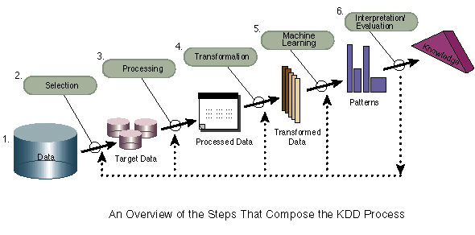
KDD Process

Slide 8
KDD Process
Data integration and recopilation
Selection, cleaning and transformation
  Data
Machine Learning (data mining)
  Patterns (e.g., classifiers, rules, etc.)
Evaluation and interpretation
  Knowledge
Decision making

Slide 9
KDD Process: Integration & Recopilation
Data warehousing, databases, data repositories from different and heterogeneous sources.
We usually deal with a plain and flat matrix of data
Data source
in London
INFORMATION
Data
warehouse
Data source
in Toronto
Query tool
Data source
in Seville
Flat File
customer
Cust-ID name address age income credit-info .
C1 Smith, Sandy 5463 E Hasting, Burnaby 21 $27000 1 …
BC V5A 459, Canada
… … … … … … …

Slide 10
KDD Process: Selection, cleaning and transformation
Removing Outliers
Data Sampling (if there are too much data)
Missing Values
Removing redundant and irrelevant attributes (feature selection)
Derive new attributes from existing ones
  E.g., Population density from population and area
Discretisation, normalisation, etc.

Slide 11
KDD Model Classification
DM algorithms are traditionally divided into
  Supervised learning which aims to discover knowledge for classification or prediction (predictive)
  Unsupervised learning which refers to the induction to extract interesting knowledge from data (descriptive)
New approaches also consider semisupervised learning: goal is classification but the input contains both unlabeled and labeled data.
  Subgroup Discovery approaches generate descriptive rules are also half way between descriptive and predictive techniques.

Slide 12
Supervised learning - classifiers
A classifier resembles a function in the sense that it attaches a value (or a range or a description) to a set of attribute values.
Induce a classification model, given a database with
  m instances (samples) characterized by
  n predicted attributes, A₁, …, A_{n},
  and the class variable, C (it is possible to have more than one class).
A₁ | … | A_{n} | C
a_{1,1} | … | a_{1,n} | c₁
… | … | … | …
a_{m,1} |  | a_{m,1} | c_{m}

Slide 13
Supervised Techniques
Decision trees are trees where each leaf indicates a class and internal nodes specifies some test to be carried out.
  There are many tree-building algorithms such as C4.5 (Quilan) or ID3.
Rule induction
  If condition then class_{label}
  If … then … else if … (hierarchical)
Lazy techniques store previous instances and search similar ones when performing classification with new instances
  k-nearest neighbour (k-NN) is a method for classifying objects based on closest training examples in the feature space.
Numeric prediction
  Regression Techniques
Neural Networks are composed by a set of nodes (units, neurons, processing elements) where each node has input and output and performs a simple computation by its node function.
Statistical Techniques
  Bayesian networks classifiers assign a set of attributes A₁, A₂,..., A_{n} to a class C_{j} such that P(C_{j} | A₁, A₂,..., A_{n}) is maximal.
Meta-techniques

Slide 14
Unsupervised Techniques
Association
  Association Rules, APRIORI
    E.g., rules among supermarket items
Clustering
  Tree clustering: join together objects (e.g., animals) into successively larger clusters, using some measure of similarity or distance.
  Algorithms: K-Means, EM (Expectation Maximization)
There is no ‘class’ attribute or class considered as another attribute
A₁ | … | A_{n}
a_{1,1} | … | a_{1,n}
… | … | …
a_{m,1} |  | a_{m,1}

Slide 15

KDD Representation (Models)
Dataset: Cancerous and Healthy Cells
colour #nuclei #tails class
H1 light 1 1 healthy
H2 dark 1 1 healthy
H3 light 1 2 healthy
H4 light 2 1 healthy
C1 dark 1 2 cancerous
C2 dark 2 1 cancerous
C3 light 2 2 cancerous
C4 dark 2 2 cancerous
H1
H2
H3
H4
C1
C2
C3
C4

Slide 16
Decision Rules
Mining with Decision Rules
If colour = light and # nuclei = 1
Then cell = healthy
If #nuclei = 2 and colour = dark
Then cell = cancerours
(and 4 rules more)
H1
H2
H3
H4
C1
C2
C3
C4

Slide 17
Decision Trees
Mining with Decision Trees
#nuclei?
H1
H2
1
2
colour?
colour?
H3
H4
light
dark
light
dark
H
#tails?
#tails?
C
C1
C2
1
2
1
2
H
C
H
C
C3
C4

Slide 18
Hierarchical Decision Rules
Mining with Hierarchical Decision Rules
If colour = light and # nuclei = 1
Then cell = healthy
Else
If #nuclei = 2 and colour = dark
Then cell = cancerous
Else
If #tails = 1
Then cell = healthy
Else cell = cancerous
H1
H2
H3
H4
C1
C2
C3
C4

Slide 19
Association Rules
Mining with Association Rules
association among A and B means that the presence of A in a record implies the presence of B in the same record
If colour = light
and # nuclei = 1
Then # tails = 1
(support = 25%;
confidence = 50%)
If # nuclei = 2
and cell = cancerous
Then # tails = 2
(support = 3/8%;
confidence = 2/3%)
H1
H2
H3
H4
  Support: the proportion of times that the rule applies. Confidence: the proportion of times that the rule is correct
C1
C2
C3
C4
Apriori algorithm, Agrawal 1993

Slide 20
Neural Networks
Mining with Neural Networks
H1
H2
color = dark
# nuclei = 1
# tails = 2
Healthy
H3
H4
Cancerous
C1
C2
C3
C4

Slide 21
Evaluation
Once we obtain the model with the training data, we need to evaluate it with some new data (testing data)
  We cannnot use the the same data for training and testing
    E.g., Evaluating a student with the exercises previouly solved
      Student ‘s marks will be “optimistic” and we don’t know about student capability to generalise the learned concepts.
Holdout approach consist of dividing the dataset into training (approx. 2/3 of the data) and testing (approx 1/3 of the data).
  Problems: Data can be skewed, missing classes, etc. if randomly divided
Stratification ensures that each class is represented with approximately equal proportions
  E.g., if data contains aprox 45% of positive cases, the training and testing datasets should mantain similar proportion of positive cases.
Holdout estimate can be made more reliable by repeating the process with different subsamples (repeated holdout method)
  The error rates on the different iterations are averaged (overall error rate)

Slide 22
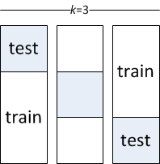
Cross-Validation
Cross-validation (CV) avoids overlapping test sets
  First step: split dataset (D) into k subsets of equal size C₁…,C_{k}
  Second step: we construct a dataset D_{i} = D-C_{i} used for training and test the accuracy of the classifier f_{Di} on C_{i} subset for testing
    Having done this for all k we estimate the accuracy of the method by averaging the accuracy over the k cross-validation trials
Called k-fold cross-validation
  Usually k=10
  Subsets are generally stratified before
  the CV is performed
  The error estimates are averaged
  to yield an overall error estimate

Slide 23
Evaluation Measures
From the confusion matrix, we can obtain multiple measures about the goodness of a classifier.
E.g. for a binary problem:
 |  | Predicted
 |  | Positive | Negative
Actual | Positive | TP True Positive | FN False Negative (Type II error) | TPrate=TP/(TP+FN) (Sensitivity, Recall)
 | Negative | FP False Positive (Type I error) | TN True Negative | TNrate=TN/(FP+TN) (Specificity)
 |  | PPV=TP/(TP+FP) Positive Predictive Value (Confidence, Precision) | NPV=TN/(FN+TN) Negative Predicted Value | Accuracy= TP+FP/(TP+TN+FP+FN)

Slide 24
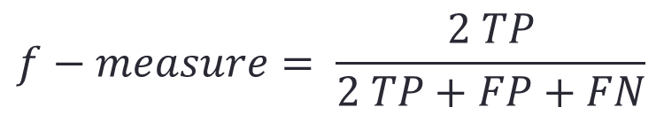
Evaluation Measures
Many times we need to combine the TP and FP to estimate the goodness of a classifier
  For example, with imbalance data, the accuracy of a classifer needs to improve the percentage of the mayority class. In a binay problem and 50/50 distribution, we need improve accuracy over 50%. However if the distribution is 90/10, accuracy needs to be over 90%
f −measure is an harmonic median of these proportions:
AUC (Area under the ROC)
$$f−measure= \frac{2 TP}{2 TP+FP+FN}$$

Slide 25
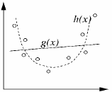
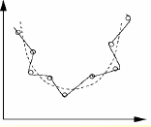
Evaluation: Underfitting vs. Overfitting
Underfitting
Overfitting
Too simple model
Too complex model

Slide 26
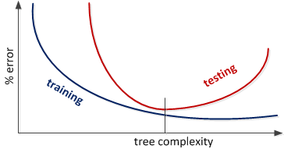
Overfitting – Decision trees example
Increasing the tree size, decreases the training and testing errors. However, at some point after (tree complexity), training error keeps decreasing but testing error increases
  Many algorithms have parameters to determine the model complexity (e.g., in decision trees is the prunning parameter)

Slide 27
Evaluation: Cost
In many cases to fail in one way is not the same as failing in the other one (Type I error vs. Type II error).
Cost can be considered when inducing the model from the data using the cost data.
  Cost sensitive classifiers
  Metacost (Dominos, 1999)
Ej. Cost matrices
  by default –left- and considering cost –right-:
 |  | Predicted
 |  | Positive | Negative
Actual | Positive | 0 | 1
 | Negative | 1 | 0
 |  | Predicted
 |  | Positive | Negative
Actual | Positive | 0 | 15
 | Negative | 1 | 0

Slide 28
Thanks!
Questions?

