Slide 1


Introduction to Weka
Daniel Rodríguez, University of Alcalá

Slide 2
Weka
Weka Toolkit
  http://www.cs.waikato.ac.nz/ml/weka/
Developed in Java and Open source
GNU Licence
Well supported by the community through mailing lists and Wiki:
http://weka.wikispaces.com/
Also, supported commercially by Pentaho
http://weka.pentaho.com/
Acknowledgement: J Hernandez & C Ferri (UPV) for some some examples

Slide 3

Weka Tookit
Composed of several tools
  GUI Chooser
    Package manager,
    Visualisation and Viewers
  Explorer (the one to use most of the time)
  Experimenter
  KnowlegeFlow
  SimpleCLI
    (Command Line Interface) - Obsolete

Slide 4
ARFF, XRFF, and sparse formats
ARFF (Attribute-Relation File Format) is Weka’s native file format
  Composed of Header and Data
    Header of the ARFF file contains the name of the relation, a list of the attributes (the columns in the data), and their types (numeric, nominal, date).
    Data is compsed of comma separated values after @data
  XRFF (eXtensible attribute-Relation File Format) is an XML-based extension of the ARFF format. It has the advantage of the following additional capabilities:
  class attribute specification
  attribute weights (So far, only Naïve Bayes can handle attribute weights)
  and instance weights are also supported in ARFF de
  It can be compressed using the xrff.gz extension
  Both ARFF and XRFF formats support sparse data when most data values are zeros
  (e.g. supermarket dataset)

Slide 5
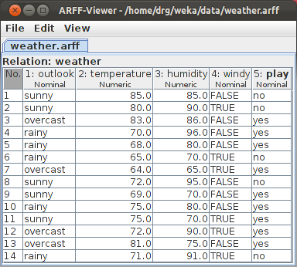
ARFF Example
@relation weather % Comment
@attribute outlook {sunny, overcast, rainy}
@attribute temperature real
@attribute humidity real
@attribute windy {TRUE, FALSE}
@attribute play {yes, no}
@data
sunny,85,85,FALSE,no
sunny,80,90,TRUE,no
overcast,83,86,FALSE,yes
rainy,70,96,FALSE,yes
rainy,68,80,FALSE,yes
rainy,65,70,TRUE,no
overcast,64,65,TRUE,yes
sunny,72,95,FALSE,no
sunny,69,70,FALSE,yes
rainy,75,80,FALSE,yes
sunny,75,70,TRUE,yes
overcast,72,90,TRUE,yes
overcast,81,75,FALSE,yes
rainy,71,91,TRUE,no

Slide 6
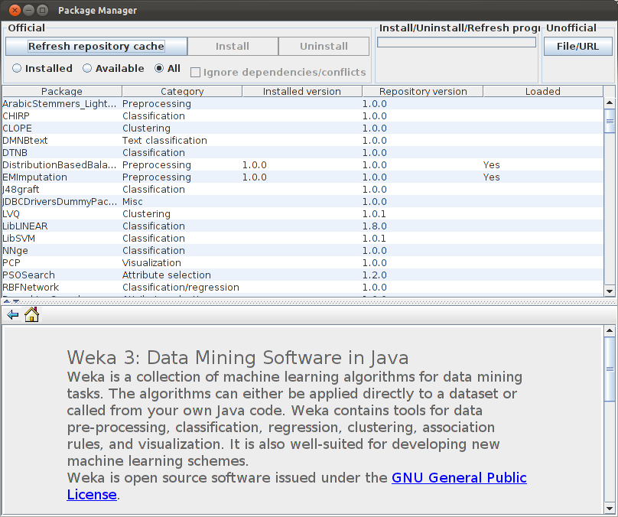
Package Manager (version > 3.7.2)
Just the most common algorithms are included with the download but others can be installed via the Package Manager.

Slide 7
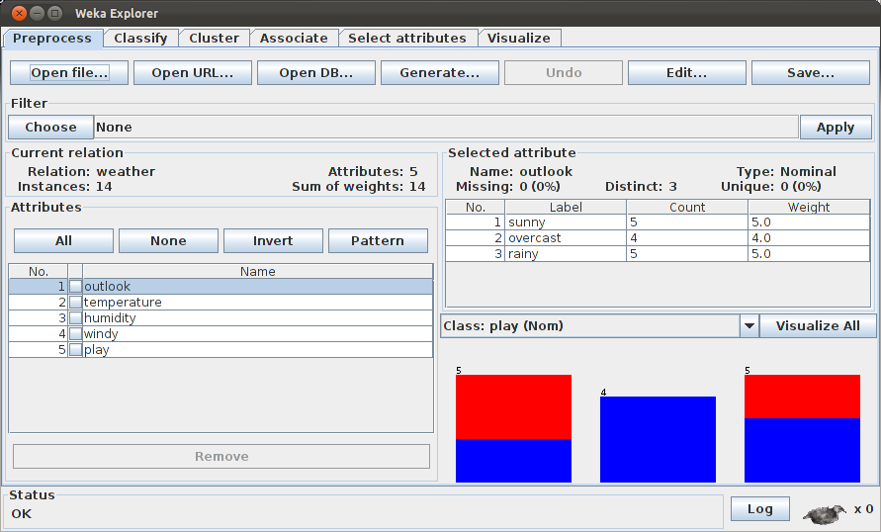
Explorer
The one to use most of the time. It can be used to find the most appropriate algorithm and parameters for a given dataset (usually trial & error approach)

Slide 8
Explorer’s panels
Explorer has 6 panels to analyse and prepare data:
  Preprocess: Tools and filters for data manipulation
  Classification: Classification and regresión techniques
  Cluster: Clustering techniques
  Associate: Association techniques
  Select Attributes: Permite aplicar diversas técnicas para la reducción del número de atributos
  Visualize: Visualisation techniques
  Other panels can be added (e.g., Time series analysis)

Slide 9
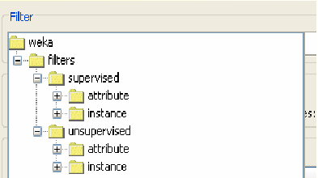
Preprocess Panel
Filter algorithms are classifed as
  Supervised – if the filter takes into account the class
  Unsuvervised – otherwise
  An in turn they are also classifed according to whether the filter applies to instances or attributes
Filter examples include discretisation (can be supervised or unsupervised, attribute selection (we will cover this one later in detail), etc.

Slide 10
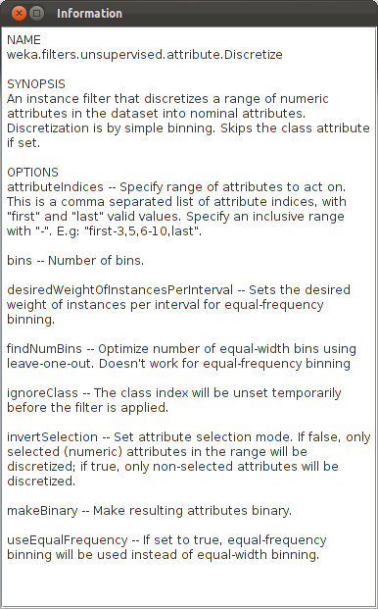
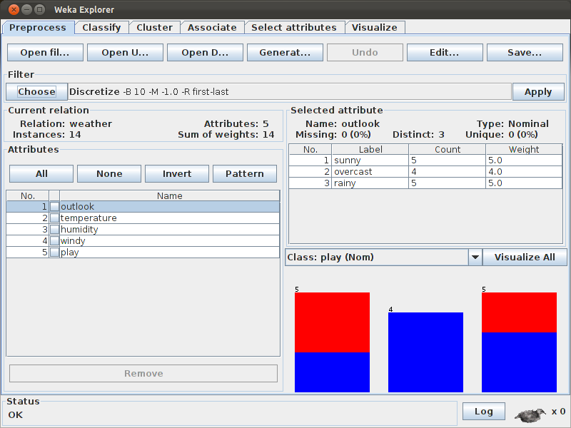
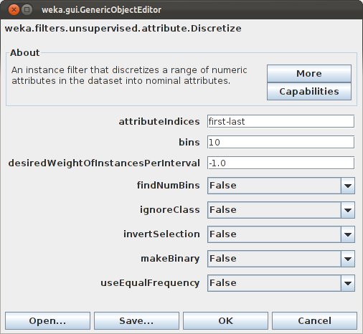
Unsupervised Discretize Filter Example

Slide 11
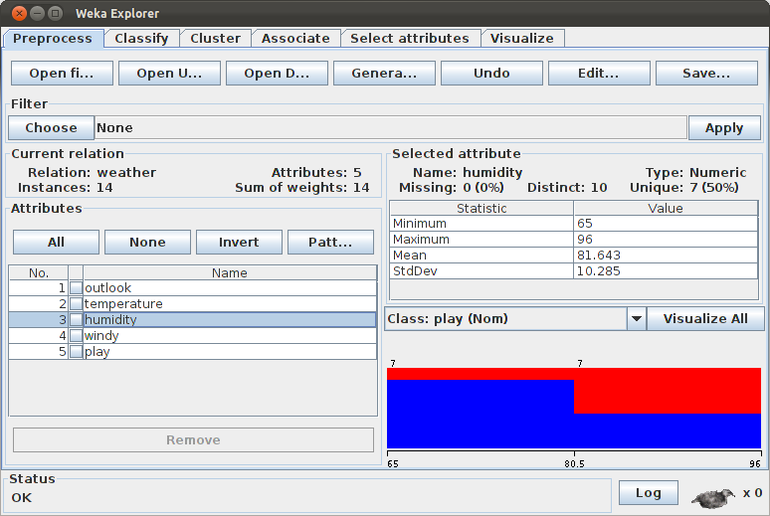
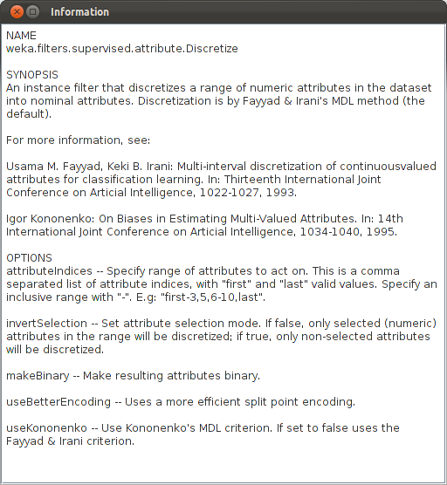
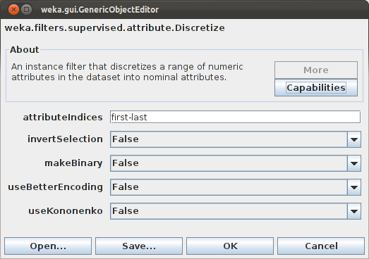
Discretize Supervised Filter Example

Slide 12
‘Classify’ Panel
Classification and regression Techniques:
Decission Trees: ID3, C4.5 (J48), ...
Regresssion Trees: LMT (M5), ...
Rules: PART, CN2, ...
Functions: Regression, Neural Networks, logistic regression, Support Vector Machines (SMO), ...
Lazy Techniques: IB1, IBK, ...
Bayesian Techniques: Naive Bayes
Meta-techniques

Slide 13
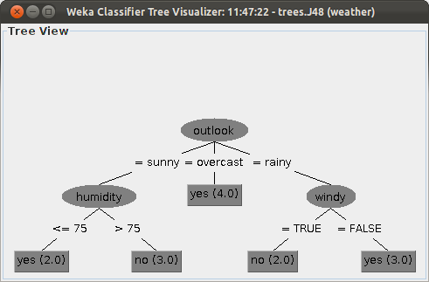
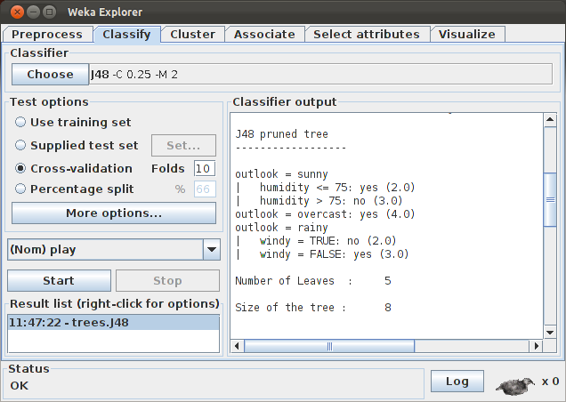
’Classify’ Panel – Trees (C4.5 – J48)

Slide 14
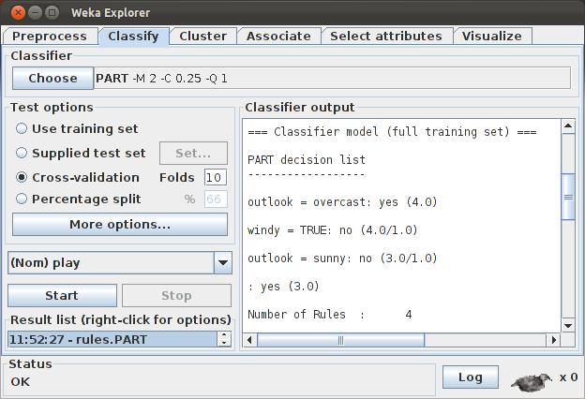
‘Classify’ Panel – Rules
We can generate rules from trees or there are other algorithms to generate rules directly

Slide 15
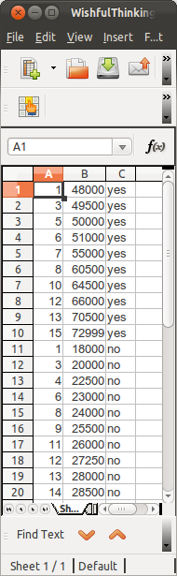
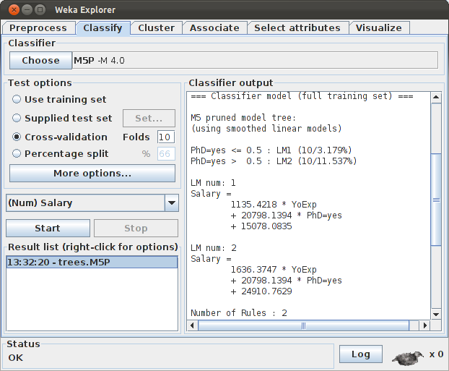
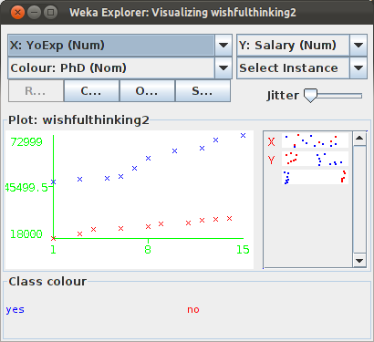
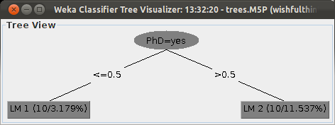
‘Classify Panel – Regression trees (M5P)

Slide 16
Lazy Techniques
Lazy techniques (also known as Collaborative Filtering or Instance-based Learning) do not build models, just retain instances.
Once a new instance needs to be classifed, these techniques search for 'similar' instances in the repository
Weka’s IBk implements k-NN.
Weka's IBk uses the Euclidean distance by default.
The sum of the squared differences between normalized attribute values is computed; this is then normalized by the number of attributes in the data; finally the square root is taken.
Following this, weighting can be applied to the distances (if selected).
  Normalising distances for all attributes so that attributes have the same impact on the distance function.
It may return k neighbours. If there are ties in the distance, neighbours are voted to form the final classification.

Slide 17
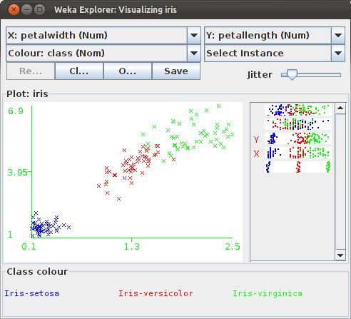
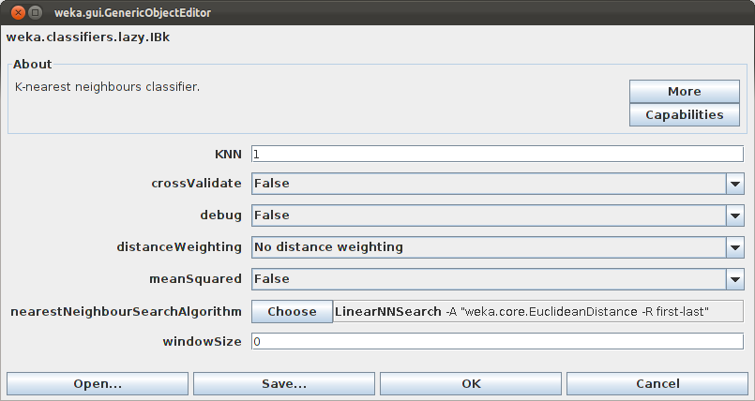
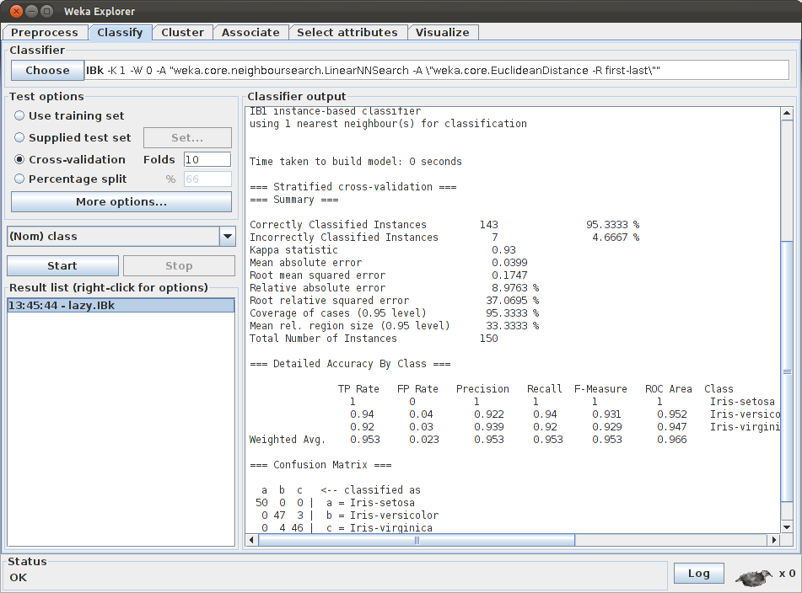
IBk

Slide 18
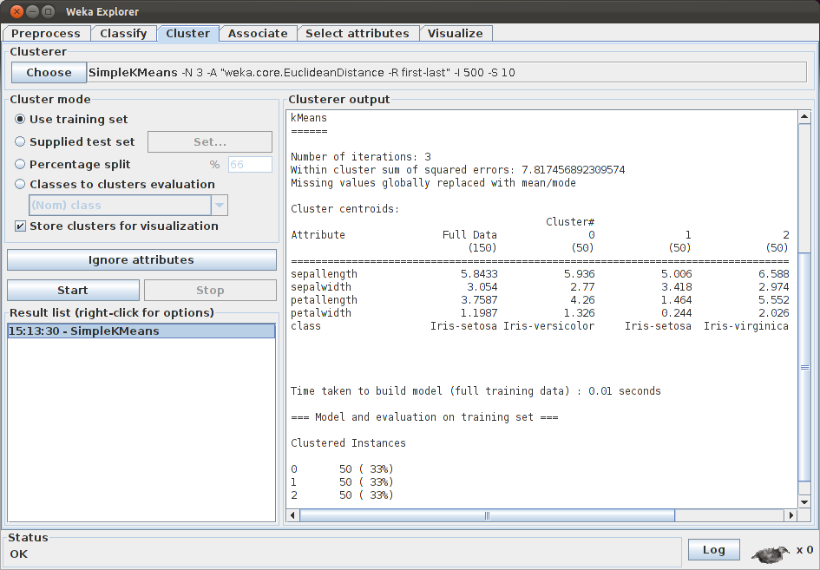
Cluster Tab

Slide 19
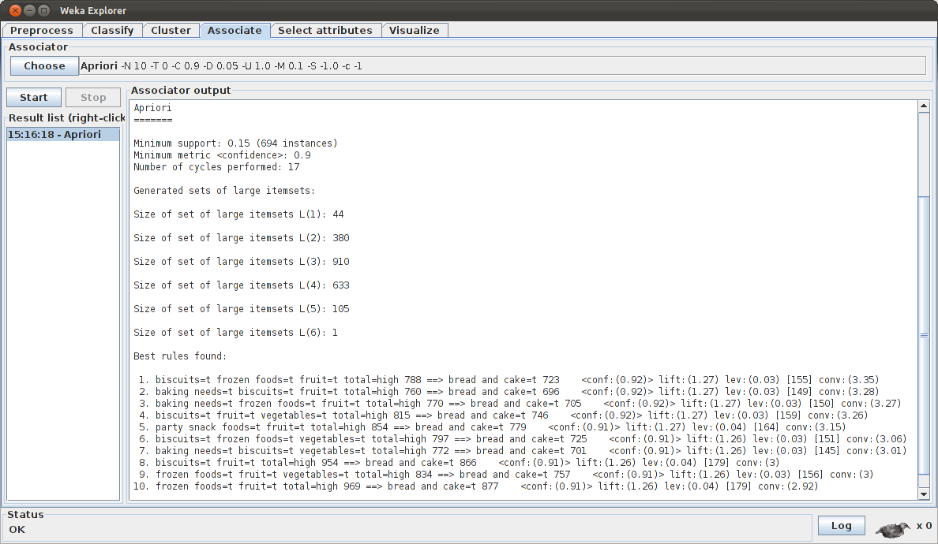
Association

Slide 20
Association

Slide 21
Attribute Selection
Feature selection is important in different ways:
  A reduced volume of data allows different data mining or searching techniques to be applied.
  Irrelevant and redundant attributes can generate less accurate and more complex models. Furthermore, data mining algorithms can be executed faster.
  We can avoid the collection of data for those irrelevant and redundant attributes in the future.
There exist two major approach in feature selection from the method's output point of view depending on the way that features are evaluated:
  Feature ranking, a.k.a. feature weighting, assesses individual features and assigns them weights according to their degrees of relevance
  Feature subset selection (FSS) evaluate the goodness of each found feature subset (Unusually, some search strategies in combination with subset evaluation can provide a ranked list).

Slide 22
Feature Ranking
Feature ranking algorithms category, one can expect a ranked list of features which are ordered according to evaluation measures
Each attribute correlation with the class is evaluated independenly of other attributes according to a statistical test (e.g.: χ-squared, Infogain, etc.)
A subset of features is often selected from the top of a ranking list. A feature is good and thus will be selected if its weight of relevance is greater than a user-specified threshold value,
or we can simply select the first k features from the ranked list.
This approach is efficient for high-dimensional data due to its linear time complexity in terms of dimensionality
Very fast method.
However, it cannot detect redundant attributes

Slide 23
Feature Subset Selection (FSS)
In the FSS category, candidate subsets are generated based on a certain search strategy:
Exhaustive, heuristic and random search
Each candidate subset is evaluated by a certain evaluation measure. If a new subset turns out to be better, it replaces the previous best subset. The process of subset generation and evaluation is repeated until a given stopping criterion is satisfied. Existing evaluation measures include:
  Consistency measure attempts to find a minimum number of features that separate classes as consistently as the full set of features can. An inconsistency is defined as to instances having the same feature values but different class labels.
  Correlation measure evaluates the goodness of feature subsets based on the hypothesis that good feature subsets contain features highly correlated to the class, yet uncorrelated to each other.
  Accuracy of a learning algorithm (Wrapper-based attribute selection) uses the target learning algorithm to estimate the worth of attribute subsets. The feature subset selection algorithm conducts a search for a good subset using the induction algorithm itself as part of the evaluation function.
The time complexity in terms of data dimensionality is, exponential for exhaustive search, quadratic for heuristic search and linear to the number of iterations in a random search

Slide 24
FSS – CFS (Correlation Based FS)
Correlation measure is applied in an algorithm called CFS that exploit heuristic search (best first) to search for candidate feature subsets.
One of the most frequently used search techniques is hill-climbing (greedy). It starts with an empty set and evaluates each attribute individually to find the best single attribute.
It then tries each of the remaining attributes in conjunction with the best to find the most suited pair of attributes. In the next iteration, each of the remaining attributes are tried in conjunction with the best pair to find the most suited group of three attributes.
This process continues until no single attribute addition improves the evaluation of the subset; i.e., subset evaluator is run M times to choose the best single attribute, M-1 times to find the best pair of attributes, M-2 times the best group of three, and so on.
E.g., if we have chosen 5 attributes through this method, the subset evaluator has been run M+(M-1)+(M-2)+(M-3)+(M-4) times.

Slide 25
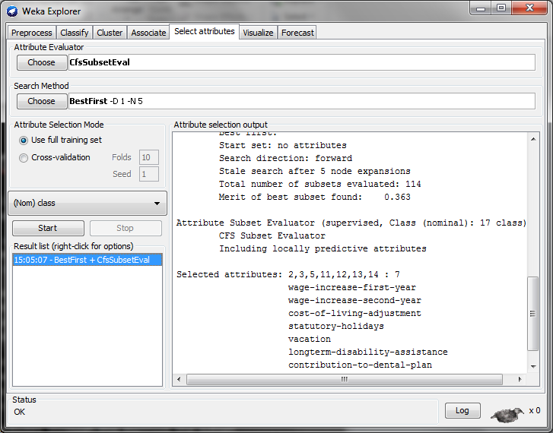
CFS Example

Slide 26
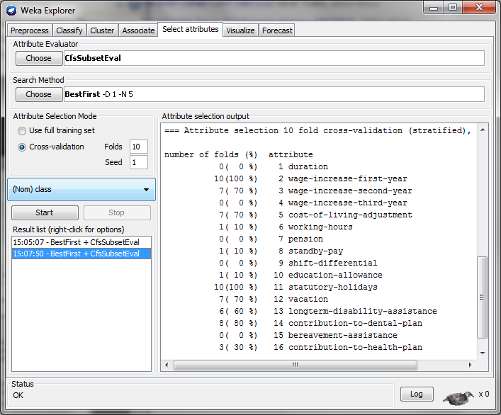
CFS – 10 CV

Slide 27
Exercise - Hay fever
Find the best possible model to recommend the type of drug for hay fever depending on the patient. The attributes collected from historical patients include:
  Age
  Sex
  BP Blood Pressure
  Cholesterol level
  Na: Blood sodium level
  K: Blook potasium level
  There are 5 possible drugs: DrugA, DrugB, DrugC, DrugX, DrugY
The dataset can be downloaded from:
http://www.cc.uah.es/drg/courses/datamining/datasets.zip
Hints:
Try C4.5, can you simplify the generated tree combining attributes?
Naive Bayes: can you improve the ‘default’ results with Feature Selection?

Slide 28
Exercise – Cost Sensitive Example
Using the German credit dataset:
http://www.cc.uah.es/drg/courses/datamining/datasets.zip
This dataset is composed of 20 attributes (7 numeric and 13 nominal) of clients of a bank requesting a credit.
Please, check for details of the in the file itself, including the provided cost matrix:
This cost matrix means that it is 5 times more costly to give credit to a person that won’t pay back than the other way around.
Check what happens with ZeroR, Naïve Bayes, Bagging
 | actual
predicted |  | good | bad
 | good | 0 | 1
 | bad | 5 | 0

Slide 29
Association Rules and dependencies
The Titanic dataset (titanic.arff) is composed of 4 attributes
Class (1st, 2nd, 3rd)
Age (adult, child)
Sex (male, femele)
Survived (yes, no)
describing the actual characteristics of the 2,201 passengers of The Titanic ("Report on the Loss of the ‘Titanic’ (S.S.)" (1990), British Board of Trade Inquiry Report_ (reprint), Gloucester, UK: Allan Sutton Publishing)
Using the Apriori algorithm extract information contained in this dataset
Modify the default parameters to obtain rules that consider ‘child’ in the Age attribute. As there is a small number of values containing samples of age = 0, those rules are filtered out with due to their low coverage

Slide 30
Exercise – Clustering
Using the employees dataset:
http://www.cc.uah.es/drg/courses/datamining/datasets.zip
Checks the results for k Means usign 3 clusters.

Slide 31
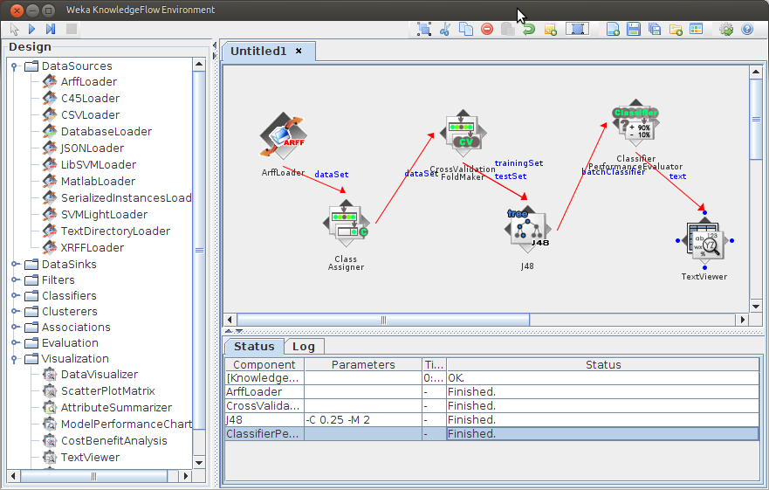
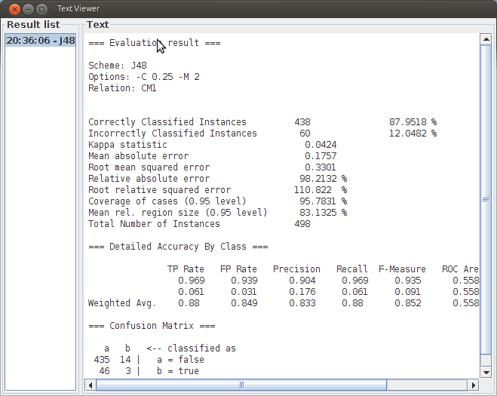
KnowlegeFlow
Visual running of experiments. Example of running J4.8 (C4.5)

Slide 32
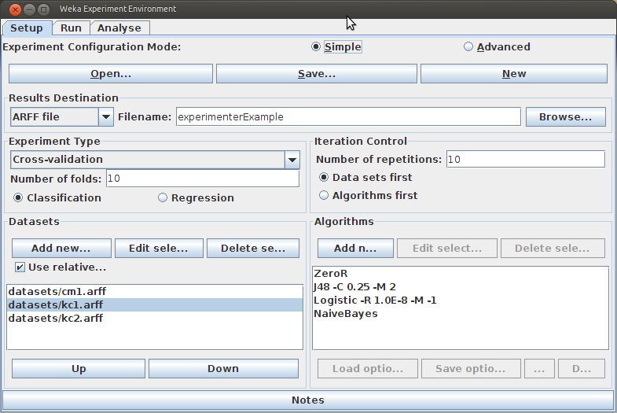
Experimenter
Allow us to compare multiple algorithms
Typically, 10 times 10-CV

Slide 33
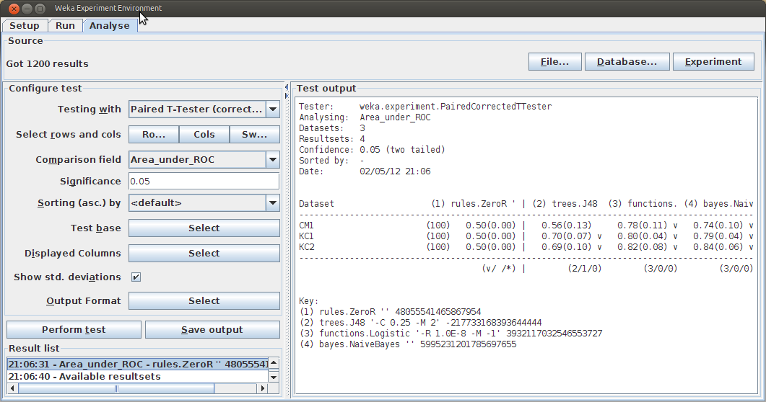
Experimenter – Output
After Running the experiment (Run tab) and loading the generated file (Analyze tab)

