Slide 1
Introduction to Software Engineering
Daniel Rodríguez
daniel.rodriguezg@uah.es

Slide 2
Lecture Objectives
Describe what is Software Engineering and briefly introduce its associated activities
To present some facts and figures regarding software
To outline what was the software crisis, its causes and its effects
Examples of a ‘few’ failures
Define basic terminology, including a notion of quality
Describe software and type of application areas
To introduce the Killer-Robot scenario

Slide 3
What is Software Engineering (SE)?
IEEE Standard Glossary of Software Engineering Terminology IEEE Std 610.12-1990, 1991
    The application of a systematic, disciplined, quantifiable approach to the development, operation, and maintenance of software; that is, the application of engineering to software.
    The study of approaches as in (1)

Slide 4
SE: Other Definitions
Software Engineering is the intelligent application of proven principles, techniques, languages, and tools to the cost effective creation and maintenance of software that satisfies users needs (Davis)
The technological and managerial discipline concerned with systematic production and maintenance of software products that are developed on-time and within cost estimates (Fairley)
Multi-person construction of multi-version software (Ghezzi et al.)

Slide 5
Software
Computer Programs and associated documentation.
Software Engineers are concerned with developing software products (i.e., S/W that can be sold to a customer –a.k.a. client– ).
Categories of client and software product:
  Generic (e.g., Word Processesors)
  Bespoke (customized) (e.g., Billing systems)
    (Many systems are customized versions of generic packages)
Application Areas:
  System software, Real-time software, Business software, Engineering & scientific software, Embedded software, Personal computer software, Artificial intelligence software

Slide 6
SE: History
‘Software Engineering’ term proposed in a NATO conference in 1968 held to discuss the ‘software crisis’
Software Crisis: new languages and cheaper hardware allowed the construction of complex applications without methodologies for systematic development.
  Results: Schedule slippage, Budget overrun, Unmet specifications, Unreliability, Poor performance, Low usability, Costly maintenance, Unmaintainable systems, Non-scalability, etc.
Notes:
The software crisis resulted directly

Slide 7






Student Projects vs. Soft Eng
Typical length < 1K lines of code
Started and finished by same person
Changed by original programmer if at all
Majority of time spent programming
Used only by people familiar with the problem
Little cost involved
Penalty for failure is lower grades
> 1,000 lines of code - typically 100,000 up to 1-10 million
Team where personnel may change
Changed by different people
Programming is only one of a number of activities
Users may not understand computers
Large sums involved
Failure could have dire consequences
Notes:
Biggest program that you have written?
Biggest program that you have worked on?
Biggest project team that you have been part of?
Longest project that you have worked on?
Most people who have used your work?
Longest that your project has been in production?

Slide 8
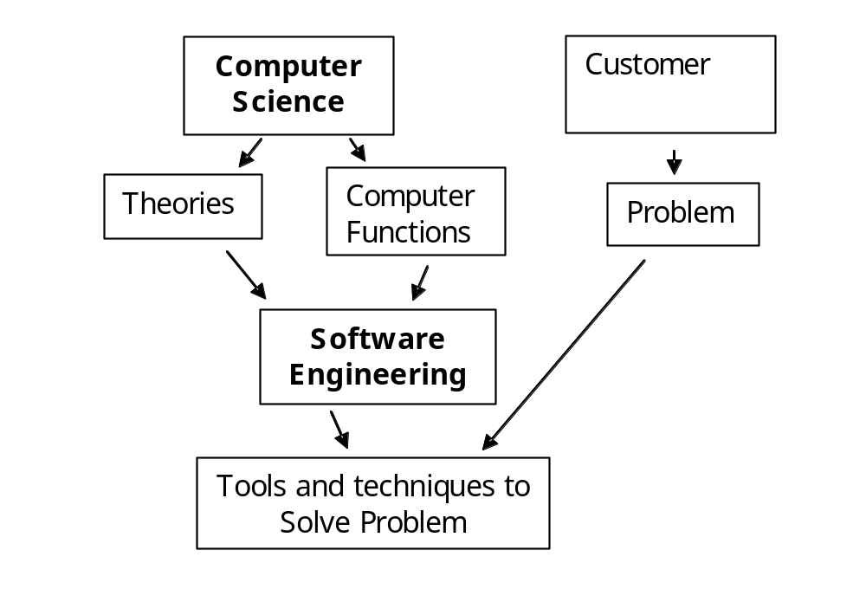
Computer Science vs. Soft Eng
Notes:
Computer Science is concerned with the theories and methods which underlie computers and software systems whereas software engineering is concerned with the practical problems of producing software (Sommerville)

Slide 9
Hardware vs. Software Costs
100
90
80
70
60
Hardware
50
Development
Maintenance
40
30
20
10
0
1960
1980
2000

Slide 10
Software Development Costs
16%
20%
10%
9%
33%
67%
20%
9%
16%
Approximate relative costs
Planning………………………………..10%
Requirements……………………….. 9%
Specification………………………… 9%
Design…………………………...……. 16%
Coding………………...………………. 20%
Unit Test…………………………….. 20%
Integration/System Test ………. 16%
Approximate relative costs
Development ....................... 33%
Maintenance ....................... 67%

Slide 11
Software Explosion
“The amount of code in most consumer products is doubling every 2 years” - Director of Software Technology, Philips
10% growth in system size per year
Evolving role of software in every aspect of society
US Manned Spaceflight Programme - approximate millions of instructions:
  early 1960s : Mercury 2 MoI
  mid 1960s : Gemini 4 MoI
  1970 : Apollo 10 MoI
  mid 1980s : Space Shuttle 40 MoI
  late 1990s : Space Station 80 MoI

Slide 12
Software Costs
The world figure for software development in 1985 was estimated to be $140 billion - Boehm 1987
The world cost of software development in 1999 will be approaching $700 billion
Each line of NASA space shuttle’s flight control system costs $1,000
Each year in the US, 2% of GNP is spent on software maintenance
Each year in the UK, £1 billion is spend on software maintenance

Slide 13
Software Engineering Topics
Lifecycle stages: feasibility study, requirements analysis & specification, design, implementation, testing, handover, maintenance and support
Management activities: project planning, scheduling and controlling, quality assurance, verification and validation, documentation, configuration management, risk and cost analysis, cost estimation, personnel management
Personnel skills: team, technical, communication, management, ethical
Support/enabling activities: methods, tools, procedures, paradigms, metrics, standards, professional bodies
Resources: people, equipment, tools
Skills: computer science, engineering, management, team work, report writing and communication, economics/accounting
Quality Assurance

Slide 14
Analysis vs. Synthesis
Analysis vs. synthesis of a problem
  Analysis consist of breaking down a problem into pieces that we can deal with
  Synthesis consist of putting together of a large structure from small building blocks

Slide 15
Terminology
Method or technique: procedure for producing a result
Tool: instrument or automated system for accomplishing something
Procedure: recipe for combination of tools and techniques
Paradigm: style of doing something

Slide 16
What is Good Software?
Quality – as a way to distinguish good software from bad
  It depends on the context
Quality at least in 3 ways:
  Quality of the Product (e.g., McCall, etc.)
  Quality of the Process (e.g., ISO, CMM, etc)
  Quality of the Product in the Context of the business (ROI – return on investment)

Slide 17
Garvin’s Perspectives on Quality
Transcendental view: something we recognize but can’t define
User view: fitness for purpose
Manufacturing view: conformance to specification
Product view: tied to inherent product characteristics
Value-based view: depends on customer’s willingness to pay

Slide 18
Error, Fault, Failure
Error: human mistake
Fault: result of mistake, evidenced in some development or maintenance product
Failure: departure from the system’s required behavior

Slide 19
Some Software Failures
Therac-25 (radiation and X-ray machine) killed several patients
The London Ambulance Service computerised dispatch system experienced problems within 3 hours of its operation; failed completely within 10 days.
The Vancouver Stock Index lost 575 points over a 22 month period because of round-off errors
SAAB JAS 39 Gripen Military Aircraft crashed on runway
The opening of Denver Airport was significantly delayed due to errors in the Baggage Handling Software. Heavy monetary losses.
The London Stock Exchange’s Taurus Development designed to revolutionise share trading foundered at a cost of hundreds of millions of pounds (estimated at £75 million)
IRS (US Internal Revenue Service) was inadequate to the workload and had to be replaced just after its introduction
President Reagan’s Strategic Defense Intitiative (SDI)
Etc…

Slide 20
Systems Approach
System as a collection of entities, activities, description of relationships among entities and definition of the boundary. We must:
  Identify activities and objects
    Activity – ‘something’ that happens in a system
    Entity – elements involved in the activities
  Define the system boundary
    what is included in a project and what is not
  Consider nested systems, system interrelationships.

Slide 21
An Engineering Approach – Software Development process
Decide if it can be done
Feasibility
Schedule when
Project Planning
Find out what needs to be done
Requirements Analysis
Document what needs to be done
Requirements spec.
Define how to do it - high level
Architectural Design
Define how to do it - algorithms
Detailed Design
Make it work - code
Implementation
Check it works - individual bits
Unit Testing
Check it works - in combination
Integration Testing
Check it works & performs- complete
System Testing
Handover to customer
Install
Modify it
Maint. & Support

Slide 22



Stakeholders – Who does SE?
DEVELOPER
Builds
system
Sponsors system
development
£££
needs
Software system
Contractual
obligation
Needs
CUSTOMER
USER
Uses
system

Slide 23
Development Roles
Project Manager
Project Planning
Analyst
Requirements Analysis
Requirements spec.
Designer
Architectural Design
Programmer
Detailed Design
Implementation
Tester
Unit Testing
Integration Testing
System Testing
Trainer
Install
Maint. & Support

Slide 24
The Nature of Change
Key factors altering SE practice (Wasserman, 1996)
  criticality of time-to-market for commercial products
  shifts in economics of computing (lower HW, higher development/maintenance costs)
  availability of powerful desktop computing
  extensive local- and wide-area networking
  availability and adoption of OO technology
  graphical user interfaces
  unpredictability of waterfall model of development

Slide 25
The Case of the Killer-Robot
A scenario developed by Richard G. Epstein that combines software engineering and computer ethics
Intended to reinforce software engineering issues introduced in the lectures
Places the topics covered in the lectures into an integrated framework
Introduces you to computer ethics
Promotes realisation into what can go wrong in a software project and the consequences of it
This is essentially a self-study exercise

Slide 26
Key Notes
SE Goal is to develop high quality software
SE is a multi-disciplined activity requiring many skills
SE is a developing discipline that is ESSENTIAL for effective software development in all application areas
Software disasters have happened and are still happening
Successful projects must meet business, functional, technical and quality requirements, as well as cost and time constraints
Projects may fail for technical, managerial and personnel related factors or a combination of these

