Slide 1
Implementation
CS2E2
Daniel Rodríguez
d.rodriguezgarcia@rdg.ac.uk
Room 136

Slide 2
Lecture Objective
Describe programming standards and procedures
Understand how the design is used to frame the code
Understand what should be included as part of the documentation

Slide 3
Coding Standards
Standards for you
  Organise thoughts and documenting code
  Return to work after long periods of time
Standards for others
  After production, changes will be performed
Matching design with implementation
  Correspondence between design and implementation

Slide 4
Programming Guidelines
Control Structures
Algorithms
Data Structures
  Keeping the program simple
  Using data structure to determine a program structure
General guidelines

Slide 5
Programming Guidelines:
Control structures
benefit = minimum;
if (age < 75) goto A;
benefit = maximum;
goto C;
if (AGE < 65) goto B;
if (AGE < 55) goto C;
A: if (AGE < 65) goto B;
benefit = benefit * 1.5 + bonus;
goto C;
B: if (age < 55) goto C;
benefit = benefit * 1.5;
C: next statement
Modular:
  Test
  Maintenance
  Reuse
if (age < 55) benefit = minimum;
elseif (AGE < 65) benefit = minimum + bonus;
elseif (AGE < 75) benefit = minimum * 1.5 + bonus;
else benefit = maximum;

Slide 6
Programming Guidelines: Algorithms
Flexibility converting design to code
Efficiency may have hidden costs
  cost to write the code faster
  cost to test the code
  cost to understand the code
  cost to modify the code

Slide 7
Programming Guidelines:
Data Structures
Keeping the program simple
  Information hiding
  Control of component interfaces
Using the data structure to determine a program structure
  Data structures can influence:
    the organisation and flow control
    language (lists: LISP)

Slide 8
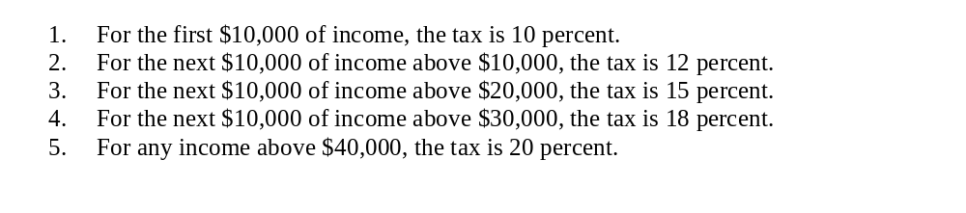
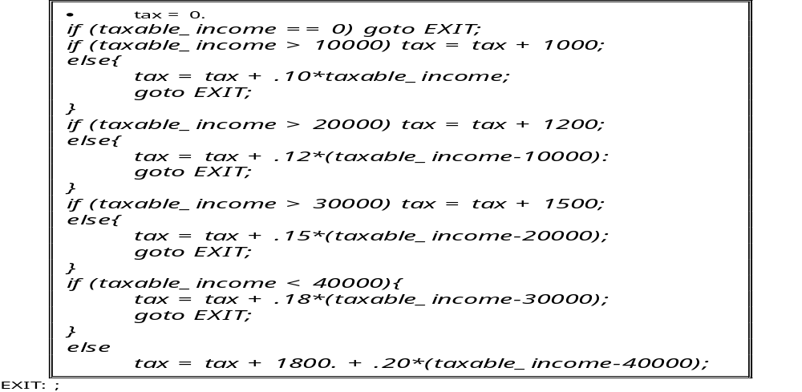
Keep the program simple (1)

Slide 9
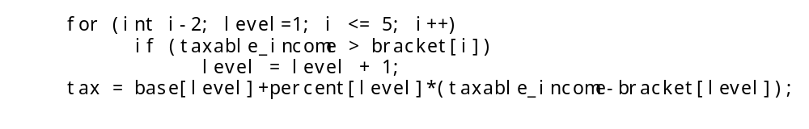
Keep the program simple (2)
Table 7.1. Sample tax table.
Bracket
Base
Percent
0
0
10
10,000
1000
12
20,000
2200
15
30,000
3700
18
40,000
5500
20

Slide 10
Programming Guidelines:
General Guidelines
Localize input and output
  Separate them from the rest of the code
Include pseudo-code
  Pseudo-code to adapt the design to programming language
Revise and rewrite, rather than patch
  Find problems related to design
Reuse
  Producer reuse: to be reused in subsequent applications
  Consumer reuse: using component developed for other applications

Slide 11
Documentation
Internal documentation
  Within the code
External documentation
  Written at programmers level
  To be read for those who never look at the actual code

Slide 12
Internal documentation
header comment block
  What, who, where, when, why, how
other program comments
meaningful variable names and statement labels
format to enhance understanding
  Pretty printing
document data

Slide 13
Example - Header Comment block
*********************************************
* Name : ModuleName
* Date : 05.12.99
* Author : John Smith
*
* Purpose : Do something.
*
* History : 24.12.02: Property “a" added
* 05.12.99: new
*
* Known Bugs: -
*******************************************

Slide 14
External documentation
Part of the overall system documentation
  Describe the problem
  Describe the algorithm
  Describe the data
    data flow diagrams

Slide 15
Keynotes
Programming standards need to be followed
Two types of reuse, producer and consumer
Internal and external documentation to be be included

