Slide 1
Testing
CS2E2
Daniel Rodriguez
d.rodriguezgarcia@rdg.ac.uk
Room 136 – ext 7640

Slide 2
Lecture Objectives
To explain the concepts & purpose of verification, validation & testing activities
To review different types of error occurring in a program and link them to levels of reliability
To discuss the different levels of testing
To distinguish between top-down and bottom-up testing
To give some steps to successful testing
To discuss the nature of test plans & how to log and summarise test results

Slide 3
How does software fail?
Wrong requirement:
  not what the customer wants
Missing requirement
Requirement impossible to implement
Faulty design
Faulty code
Improperly implemented design

Slide 4
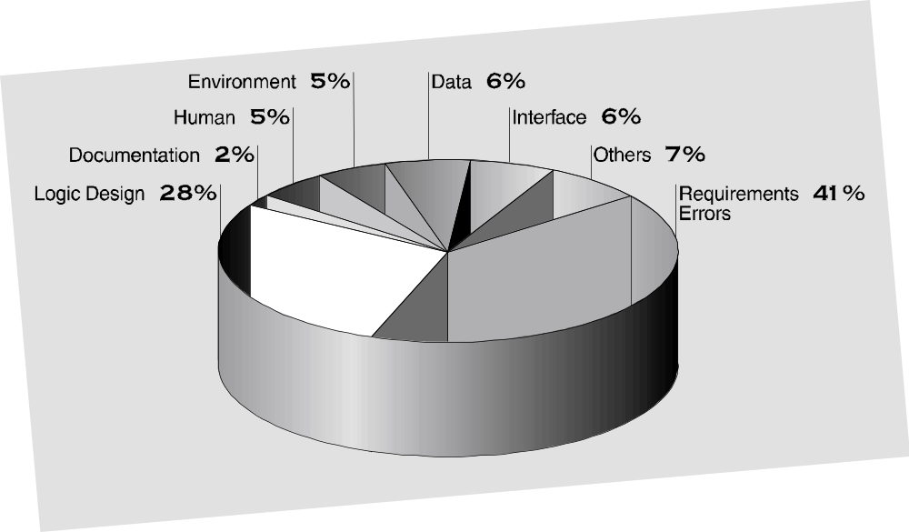

Slide 5
Definitions
Requirements Validation
  Process of checking that a document or piece of software accurately reflects the customer requirements - i.e.
    ARE WE BUILDING THE RIGHT SYSTEM?
Software Verification
  Process of ensuring that the product of one phase satisfies the product of a previous phase
  Checking that the software produced is a faithful implementation of the requirements specified
  Assessment of the quality of the implementation
    ARE WE BUILDING IT RIGHT?
Software Testing
  Process of executing a software system with data to ensure it performs as expected

Slide 6
Terminology
Error: human mistake
Fault: result of mistake, evidenced in some development or maintenance product
Failure: departure from the system’s required behavior
Fault identification (testing):
  what fault caused the failure?
Fault correction or removal (debugging):
  change the system to take out the fault

Slide 7
Testing vs. Debugging
Testing is the process of showing the presence of a software error
Debugging is the process of discovering the location of an error and its subsequent modification
Debugging may be difficult
  Symptom & cause may be geographically remote
  Symptom may (temporarily) disappear when another error corrected
  Symptom may be caused by ‘non-errors’
  May be caused by human error
  May be a result of timing problems
  May be difficult to accurately reproduce input conditions
  Symptom may be intermittent
  May be due to distributed causes
Testing
Iterative
Process
Debugging

Slide 8
What sort of Faults?
Syntax fault
  Violation of the grammatical rules of the programming language
Run-time fault
  Cause abnormal program behaviour and stop program execution
Logic or algorithmic fault
  Incorrect translation of either the problem statement or the algorithm
Functional fault
  Program does not do what is requested of it
Performance or Throughput fault
  System does not meet performance requirements
Others
  Hardware fault, Standards and procedures fault, Timing or coordination fault, Documentation fault

Slide 9
Failures
Usually classified by severity
  E.g. for real-time systems (Riley, 95):
    Catastrophic – involve lost of lives or injuries causing serious and permanent incapacity
    Critical – injuries without lost of life / environmental damage
    Significant – failures cause light injuries
    Minor – neither personal injuries nor reduction in the level of safety
  E.g. in other systems:
    Aesthetical or negligible, minor, major

Slide 10
Testing Issues: Test Organisation
Unit Test
Design
Specification
System
Functional
Requirements
Other SW
Requirements
Customer
Requirements
specification
User
Environment
Unit Test
Integration
Test
Function
Test
Performance
Test
Acceptance
Test
Installation
Test
Unit Test
Integrated
Modules
Functioning
System
Verified &
Validated
Accepted
System
System in Use
Unit Test

Slide 11
Unit Testing
Focuses on smallest unit of software design - procedure / function / module
  Interfaces; Local data structures; Boundary conditions
  All independent paths ; All error handling paths
  Encompasses black box and white box testing
Examining the Code
  code walkthroughs
    Programmer lead the control of the discussion
  code inspections
    Against a prepared list of concerns
Proving the code is correct
  Formal proof techniques
  Symbolic execution
  Automated theorem proving
Notes:
Focuses on smallest unit of software design - procedure / function / module
Tests the following:
Interfaces; Local data structures; Boundary conditions
All independent paths ; All error handling paths
Encompasses black box and white box testing
Involves drivers / stubs

Slide 12
Testing Components
Black-box testing
White-box testing
  Test thoroughness
    Statement testing
    Branch testing
    Path testing
    Definition-use testing
    All-uses testing
    All-predicate-uses/some-computational-uses testing
    All-computational-uses/some-predicate-uses testing

Slide 13
Integration Test
Can occur with unit, modules or sub-systems
  Involves checking that unit-tested modules and subsystems which have been tested alone, actually interface correctly with the software system into which they are to be built
  Approaches
    Big bang!
    Top-down
    Bottom-up
    (Combination)
Notes:
11

Slide 14
Integration Testing Strategies
A
B
C
D
E
F
G
H
I
J
K
L
M
Top-down
  Test sub-program A first
  Write dummy procedures (stubs) for B, C, D
  Once problems with A eliminated, progress to sub-program B
  Write stubs for E, F, G, H etc.
Bottom-up
  Test E independently
  Write ‘drivers’ to give procedure E the input it requires from B
  Test F independently etc.
  Once E, F, G, H tested, subsystem B can be tested, using a driver for A
Big-Bang
  Write and test A, B, C, D, E, F, G, H, I, J, K, M all together
Sandwich
  Combination of top-down and bottom-up

Slide 15
System Testing
Tests, demonstrations and analyses to check that fully exercised the computer-based system is in accordance with the requirements specification of the complete system
  Not just concerned with software
  Areas involved include:
    Functionality/operational testing
    Performance testing
    Acceptance testing
    Installation testing
    Others:
      Recovery testing
      Security testing
      Stress testing
      Safety testing
      Interface testing
Notes:
14

Slide 16
Function Test
Ignores structure and focuses on functionality
  Determine if functions described by the requirements specification are actually fulfilled
  Result: Functioning system

Slide 17
Performance Test
Addresses the non-functional requirements
Types:
  Stress
    Evaluated to its limits in the number of users/devices, etc
  Volume
    Large volumes of data
  Configuration
    Various software and hardware configuration
  Compatibility
  Regression
  Etc.

Slide 18
Acceptance Test
Testing performed on the completed software / system
Custom built software
Closely related to the requirements specification
Performed in conjunction with the user
Black box activity
On basis of correct functioning of these tests user formally accepts the software
Notes:
13
Alpha and beta testing
Testing performed on the completed software / system
Software developed as a product for many users
Alpha testing : conducted at the developer’s site by a customer in a controlled environment
Beta testing: conducted at one or more customer sites with a ‘live’ application

Slide 19
Automated Testing Tools
Code analysis
  Static analysis
    code analyzer
    structure checker
    data analyzer
    sequence checker
  Dynamic analysis
    program monitor
Test execution
  Capture and replay
  Stubs and drivers
  Automated testing environments
Test case generators

Slide 20
Testing & Test Strategies
Testing:
  Is the destructive process of trying to show the presence of errors in a program
  It is impossible to prove that a program does not contain errors by testing it
  A test can only detect the presence of errors
  A successful test is one that DOES detect errors
  It is impossible to exhaustively test a program
  Testing (including V+V activities) throughout the software lifecycle contributes to high quality software products
Test Strategy
  Integration of test case design into a well planned series of steps
  Incorporates
    Test planning
    Test case design
    Test execution
    Resultant data collection
    Evaluation of data

Slide 21
Steps to Successful Testing
Select what is to be measured by the test
    Determine the goal of the test
Decide how whatever is being tested is to be tested
    What test approach is to be used
Develop the test cases
    Set of test data to execute the unit etc.
Determine what the expected or correct result of the test should be and create the test oracle
    Predicted results for a set of test cases = oracle
Execute the test cases
    Carry out the tests (using test harness)
Compare the results of the test to the test oracle
    Find out the cause of any deviation
DOCUMENT EVERYTHING: - BEFORE, DURING, AFTER
Notes:
15

Slide 22
Test Plan Contents
Test Plan
  Test plan identifier
  Purpose and scope of testing - items & features
  Testing strategy to be employed
  Pass/fail criteria
  Test deliverables
  Schedule for testing
  Overhead software
  Environment and resources
  Testing personnel
  Approvals

Slide 23
Key Points
Requirements validation is the process of ensuring the system specification accurately reflects the customer requirements - RIGHT SYSTEM
Software verification is the process of ensuring that the software being built meets the specification - RIGHT PROCESS
Testing is the destructive process of discovering errors in a program
Debugging is the process of locating the error and correcting it
Errors within software have parallels in the level of reliability
A number of different levels of testing must be planned and undertaken from unit to acceptance testing
Remember to document everything concerning testing, before, during and after
Notes:
16

