Slide 1
Software Configuration Management
CS2E2
Daniel Rodriguez
d.rodriguezgarcia@rdg.ac.uk
Room 136 – ext 7640

Slide 2
Lecture Objectives
To discuss the need for software configuration management (SCM) and what it involves
To identify the key elements of software configuration management
To outline the key sub-disciplines of software configuration management
To distinguish between change, version and configuration control
To identify categories of tools to assist the configuration management process

Slide 3
A Definition of SCM
A key management discipline for controlling the evolution of complex software systems
Consists of 4 sub-disciplines
  Configuration Identification
  Configuration Control Change Management
  Status Accounting
  Configuration Auditing
The process of identifying and defining the configuration items in a system, controlling the release and change of these items throughout the lifecycle, recording and reporting the status of configuration items and change requests, and verifying the completeness and correctness of configuration items.
Notes:
During the development of software, change must be managed and controlled in order to improve quality and reduce error.
Software Configuration Management (SCM) is an umbrella activity that is applied throughout the software process

Slide 4
Causes and Effects
Why do we have such problems with software?
  Size and complexity
  Long lifetime
  Rapid evolution
  Version explosions
  Poor documentation
  Difficult co-ordination
Lack of software project visibility
Late, over budget, unreliable, non-conforming software
→ Costly maintenance
First law of SE:
  The system will change, and the desire to change it will persist throughout the lifecycle

Slide 5
SCM - A Solution
With SCM you:
  Know what program, version etc. you are working on, what they do etc.
  Know where you are in a project (work done, work to be done, i.e. you have visibility)
  Know which versions of a system are with which customers etc.
SCM has its roots in the hard engineering disciplines
Now both a technical and managerial discipline
Becoming progressively more automated
Notes:
WHY IS CONFIGURATION MANAGEMENT CRITICAL TO SUCCESS?
Accelerate integration and turn-around cycles. When software component integration is efficient and painless, it can occur more
Decrease unplanned rework. Unplanned rework affects a project’s cost and schedule. Such rework can be the direct result of a flawed configuration management strategy. The classic example is accidentally over-writing someone else’s changes to a document or code.
Improve impact analysis to support quality management. Design changes can ripple through many areas and not all are easily detected. When areas are overlooked, estimates will be inaccurate and executing the design change will not be smooth. Some tools facilitate this analysis. Others facilitate relating a defect to the ultimate source of a problem for post-correction analysis.
Improve fallback and recovery. Effective configuration management can greatly reduce the impact of a disaster such as a major hardware failure or virus corruption. It also supports the less spectacular but more frequent need to fall back to previous versions due to changed minds or design flaws.
Configuration management is instrumental for achieving quality objectives.
Software changes are inevitable
One goal of software engineering is to improve how easy it is to change software
Configuration management is all about change control.
Every software engineer has to be concerned with how changes made to work products are tracked and propagated throughout a project.
To ensure quality is maintained the change process must be audited.

Slide 6
Key Elements 1
Configuration
  The set of interrelated SCIs from which the system is composed
Program families
  The set of closely related but distinct systems arising from changes made to configurations of the system throughout its life
Software Configuration Item (SCI)
  Basic building block of a configuration
  E.g. specification documents, source code files, object code files, command files, database files, test procedures
  SCIs spawn other SCIs
  Must be uniquely identified
  Must be able to change relatively independently of other SCIs
  Aggregates of SCIs form baselines
  Baselines represent configurations at determined points in time

Slide 7
Key Elements 2
Baseline
  A stable, unchanging “frozen” version of a configuration
  Reference points or milestones in the development of a system
  Should be formally defined at the end of each stage in the lifecycle
  Should be associated with the production of a physical item
  Provide an inventory of the state of a product at a specific point in time
  Have three connected functions
    As a measurable progress point
    As a basis for subsequent development and control
    As a measurable point for assessing quality and integrity of a system
Library
  A common and controllable store for the elements of a software system that provides a basis for sharing and control of SCIs
Derivation
  Records precisely and accurately the change made to a SCI - what, when, why, by whom - bug detection / previous releases
Notes:
A baseline is "a specification or product that has been formally reviewed and agreed upon, that thereafter serves as the basis for further development, and that can be changed only through formal change control procedures." (IEEE Std. 729)
The baseline is the shared project data base. It is an SCM task to maintain the integrity of the set of artifacts. An approach to the integrity issue is to require approval for adding items to the baseline. A second part to maintaining integrity is dealing with modifications to items in the database.

Slide 8
Key Elements 3
Versions
  Arise from change made to SCIs
  Changes arise from corrections, adaptions, enhancements
  Versions may be revisions or variants
Revisions
  SCI produced by changing another SCI
  Sequential, superseding and cumulatively record development history
Variants
  SCI that is indistinguishable from another SCI under a given abstraction, i.e. alternatives
Version group
  Changes to a SCI collectively form a version group
  Relationships form a tree structure
Notes:
Version An instance of a system which is
functionally distinct in some way from other
system instances
Variant An instance of a system which is
functionally identical but non-functionally
distinct from other instances of a system
Release An instance of a system which is
distributed to users outside of the development
team

Slide 9
Diagram of SCM: 4 Facets
What is my system
configuration?
Configuration
Management
Your system configuration
consists of the following items: (item₁, item₂, .… item_{m})
Identification
How do I control
changes to my
configuration?
Control
The procedures for
making changes are:
(step₁, step₂, ...step_{n})
Status
Accounting
Auditing
What changes
have I made to
my system?
Your system configuration
and related changes at
this time are (item₁, item₂
... item_{m}) + (change₁,
change₂, .... change_{n,}
pending change₁,...
pending change_{p})
Does the system
I am building satisfy
the stated needs?
Your system as currently
built differs from the
stated needs and
derivative specification
as follows (difference₁,
difference₂, .. difference_{s})
Notes:
Four Facets of SCM
Configuration Identification
Configuration Control and Change Management
Configuration Auditing
Status Accounting

Slide 10
Configuration Identification
Definition and unique labelling of
  SCIs
  Relationships
  Baselines
  Changes made
Unique identifiers
Must not change
Should be meaningful
May have basic and composite objects
“Snapshot” of the system

Slide 11
Configuration Control and Change Management
The dynamic nature of software means that there will always be the need to make and control changes
Once the baseline has been established and corresponding SCIs and configurations frozen, changes must be formally controlled
Control must be at the levels of:
  The change control process of single SCIs
  The resulting versions
  The entire configurations (system building / release control)
Notes:
Change Management
SCM provides the opportunity to review the history of the development activity by highlighting what has changed and with what frequency.
Change Control
Change control involves procedures and tools to bring order to the change process. Larger projects have a formal Change Control Board whose responsibility it is to review and approve or disapprove change. It is the CCB responsibility to provide the mechanism to maintain orderly change processes

Slide 12
Change Control
Driven by change requests (proposals)
For large systems a combination of human procedures and automated tools is used
Involves:
    Documentation (change proposal)
    Organisational body (change control authority)
    Control procedures (guidelines, standards)
The process
    Identifying and defining change
    Evaluating the change
    Implementing the change
Gives rise to
    New versions of SCIs which themselves must be controlled
Associated documents
    Incident report
    Change request
    Change notice
    Impact assessment

Slide 13
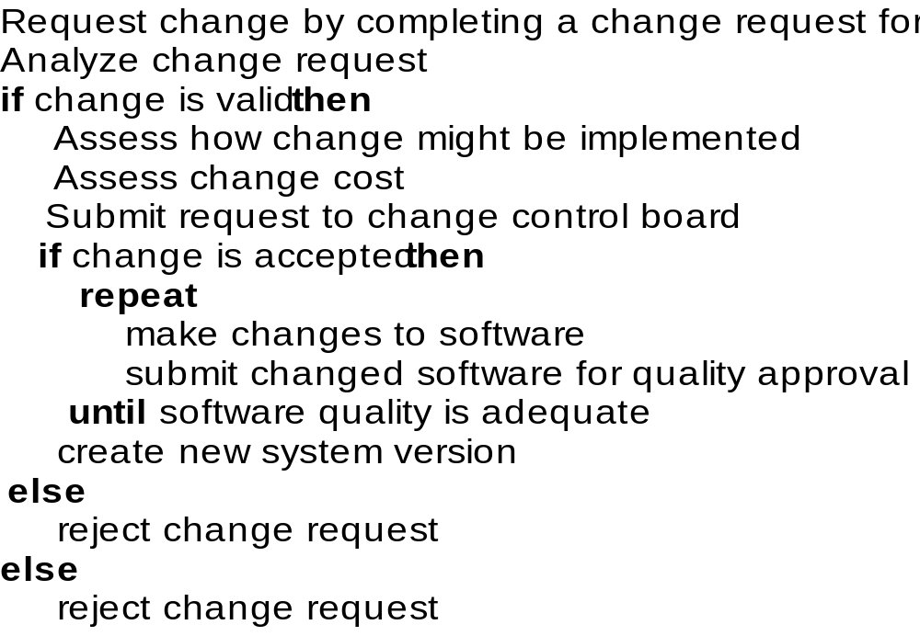
Change Control Process

Slide 14
Incident /Change Request
Incident Report and Change Request are suggestion for improvement of the software
  Requests can come from users, customers, or management
  Change requests should be carefully analyzed as part of the maintenance process before they are implemented
  Some changes requests must be implemented urgently due to their nature
    fault repair, system environment changes, urgently required business changes
Template
  Location: within-system identifier (module/document name)
  Timing
  Symptom
  End result: failure caused by the fault
  Cause: type of human error that led to fault
  Severity (scale)
  Cost: time and effort to locate and correct

Slide 15
Impact Assessment
Change management and Incident reports
  Require modification to the software or documentation
  require evaluation in terms of cost, schedule, and technical impact

Slide 16
Version Control
Control of versions of a SCI arising from changes made to that SCI
Concerned with production and use of a naming scheme
  Reflect type of SCI
  Reflect position in version tree
  Must be visible to users and developers
Concerned with planning new releases - when does a version become a release?
p.1
p.2
p.3
c.1
1.0
1.1
1.2
2.0
2.1
3.0
1.2.1
Notes:
A configuration for a particular system is called a version.
A system is typically assembled and tested in stages called builds.
Version control works to help manage the configuration items needed for particular versions during the development process.
Configuration Objects are baselined
before object is baselined it changes many times
after baseline all modifications are controlled
at baseline it becomes Version 1.0
Subsequent changes become new versions
> Version 1.1 -> Version 1.1.1 then 1.1.2
> Version 1.2 etc.
>Version 2.0 etc.

Slide 17
Change/Version Control Tools
Use of tools can automate and control the creation, storage, retrieval, logging, definition and merging of versions
Features include:
  Control of check-out / edit / check-in cycle
  Preventing unauthorised changes
  Prevents conflicting changes
  Recording of information about changes made
  Maintenance of history of changes
  Automatic incrementing of revision numbers
  Space efficient storage of versions
  Retrieval of any version of any file
  Display of difference between versions

Slide 18
Check-out / Edit / Check-in
Check-in
SCI
Modified
Version
SCI
Baselined
Version
Unlock
Audit
Info
Ownership
Info
Access
Control
Software
Engineer
Project
Database
SCI
Extracted
Version
Lock
SCI
Baselined
Version
Check-out
Notes:
Access control governs who has authority to access and modify a configuration item.
Synchronization control helps ensure that parallel activity does not overwrite changes made by one another.
Check-in and check-out support the notion of access and synchronization control.

Slide 19
Configuration Control
A configuration is a set of SCIs, where each SCI comes from a different version group, selected on the basis of some criteria
Configuration control is concerned with combining SCIs to a single unit (e.g. executable program)
Also known as system building / synthesis
Configuration control
  Selects versions to be used (one from each version group)
  Ensures that all SCIs are included
  Ensures that correct tools are used (compiler, linker etc.)
N.B. not all SCI combinations will be valid
Used for building up different releases of a system as well as the initial system
Notes:
A configuration for a particular system is called a version.
A system is typically assembled and tested in stages called builds.

Slide 20
Status Accounting
Mechanism for recording and reporting SCIs in a system
Answers the following questions
  What happened?
  Who did it?
  When did it happen?
  What else will be affected?
A CSA entry is made each time
  A SCI is assigned a new or updated identification
  A change is approved by the CCA
Provides an administrative history of the way a system has evolved
Enables the state of a system to be reported
  Improves communication among people involved
Notes:
Configuration Audit
This is a process to verify that the baseline is complete and accurate, that changes made are recorded, that recorded changes are made, and that the configuration items used in a version or build are documented in the configuration correctly.

Slide 21
Audit
Essentially a quality assurance process
Find and report process
Assess technical and administrative integrity of a product
Establishes that
  Correct procedures have been adhered to
  Changes have been made in a controlled manner
  No inconsistencies exist
  All related SCIs have been properly updated
  Baselines meet their requirements
Notes:
Simply the maintenance of records of all baseline components: where they come from, the current version, the history of changes, and pending changes.
Has the change specified been made? Has any additional modification been incorporated?
Has the technical correctness been assessed?
Has the change been reflected in the relevant documents?
Has the change been reflected in the Configuration Management database?
Have all related SCIs been properly updated?

Slide 22
Tools for SCM
Until recently SCM was entirely a manual set of procedures
Problems with manual systems now that software systems are larger and more complex
  Cumbersome to use
  Unable to keep pace with rate of system changes
  Unable to keep track of volume of data produced
  Easily corrupted
  Do not work in practice
  Too much of a cost overhead
  Need control system for paperwork produced
What can automation give us?
  Greater control
  Cost efficiency
  Less tedium
  Less disruption from real work

Slide 23
Types of Tools
Just about the entire SCM process can now be automated
Types of Tools
  Single function tools
    e.g. CVS, RCS, SCCS, CMS, MMS, make
    Address one aspect of the SCM process
  Configuration management systems
    e.g. Lifespan, CCC, Changeman
    Address the whole SCM process
  Programming environments & IPSES
    e.g. Eclipse, ISTAR, BIS-IPSE
    Offer more than just SCM
Which type of SCM tool is best?
  Depends on your requirements
  Generally seen as a trade off between comprehensibility and flexibility

Slide 24
Key Points
SCM is the task of keeping control of the various components (SCIs) which go to make up the system (configuration)
At any one time there may be several versions of the system (including those in development, test and live use by one or more customers)
Components may include source and object code, database structure and data, tests, documentation, any correspondence associated with the project etc.
Each system will be built from different versions of the components
It is essential to be able to identify, control, status account and audit these different system and component versions
At any time anyone should be able to find out what exists and where it is stored, and preferable which version of the system each item relates to.
It should also be possible to trace back the history of the source code and documentation
A check-out/edit/check-in cycle may be used to help make controlled changes
Control must be at SCI, version and configuration level

