Slide 1
Risk Management
2/CS/E8/F8
Daniel Rodríguez
d.rodriguez-garcia@rdg.ac.uk
Room 136

Slide 2
Lecture objectives
To define What is Risk?
To examine types of software project risk
how to minimise risk
To discuss Risk Analysis
Portfolio Risk Management
Techniques for Managing Risk
Notes:
2

Slide 3
Terminology
Risk as the “chance of injury, damage, or loss” (Webster)
  risk is the chance that something will happen to prevent the project from meeting its targets
Risk impact
  The lost associated with a risk
Risk probability
  Likelihood of the risk
Risk control
  Actions to reduce or eliminate risk
Risk exposure
  Risk impact x risk probability

Slide 4
Risks
Risk strategies
  Reactive (not advised)
  Proactive (recommended)
Risk Categories
  Project risks affect schedule or resources
  Product risks affect the quality or performance of the software being developed
  Business risks affect the organisation developing or procuring the software

Slide 5
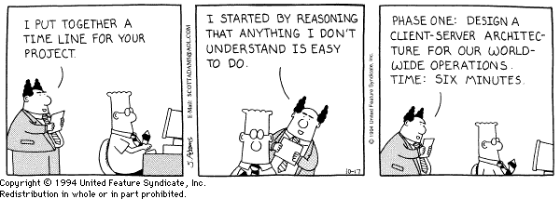
Project Risk Example

Slide 6
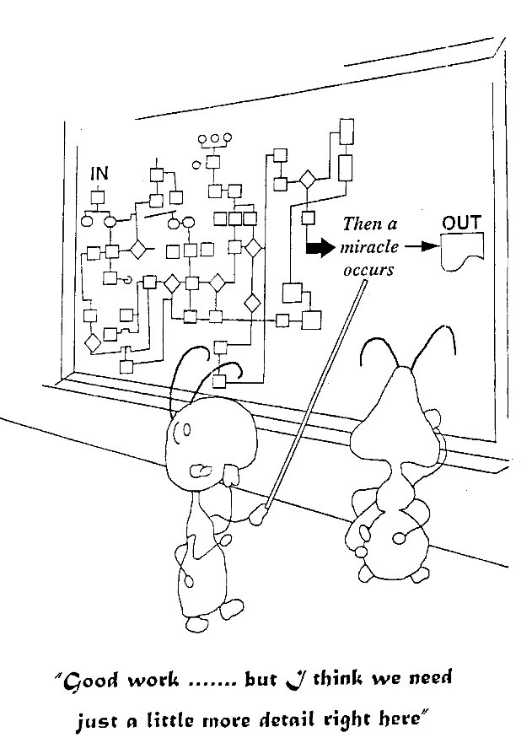
Product Risk Example

Slide 7
The Laws of Misrule
Murphy’s Law
  Whatever can go wrong, will go wrong
O’Halloran’s Corollary to Murphy’s Law
  And will go wrong at the worst possible time
McGuire’s Lemma
  Everything takes longer than expected
Software Developers are optimists
Humans are inherently bad at estimating
Notes:
Foreseeable events whose occurrence could cause system degradation or failure
Risks concern future happenings
Risk involves change
Risk involves choice
Futile to try to eliminate risk
Questionable to minimise risk

Slide 8
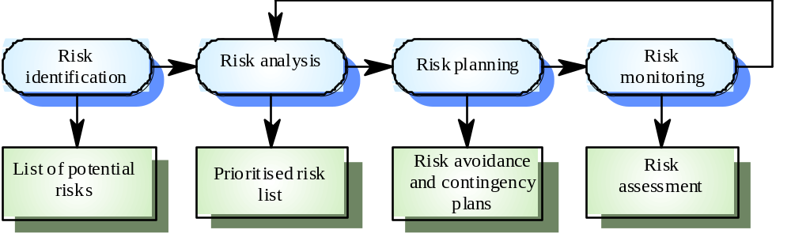
Risks Process
Risk identification
  Identify project, product and business risks
Risk analysis
  Assess the likelihood and consequences of these risks
Risk planning
  Draw up plans to avoid or minimise the effects of the risk
Risk monitoring
  Monitor the risks throughout the project
Notes:
Define measures of success and set targets. Specify what is required for the project to be considered a success.
Identify risks
Recognize how the project can fail to meet the targets.
Analyze risks
Decide which risks to focus on.
Mitigate risks
Decide what actions to tae to stay on target.
Monitor and report risks
Provide visibility for the results of risk management.

Slide 9
Risk Identification I
Application factors
  Organic, embedded, semi-detached; Size
Business Impact
  Effect of product on company revenue
  Number of other systems with which product must be interoperable
Staff factors
  Experience and skills
  Appropriateness of experience
  Staff satisfaction and turnover rates
Project Methods
  Use of well specified and structured methods
  Familiarity with use of method
Notes:
Technology
Late delivery of hardware or support software, many reported technology problems
People
Poor staff morale, poor relationships amongst team member, job availability
Organisational
organisational gossip, lack of action by senior management
Tools
reluctance by team members to use tools, complaints about CASE tools, demands for higher-powered workstations
Requirements
many requirements change requests, customer complaints
Estimation
failure to meet agreed schedule, failure to clear reported defects

Slide 10
Risk Identification II
Hardware/software factors
  New vs. existing hardware
  Development vs. target platform
Changeover factors
  All-in-one vs. gradual/parallel running
Supplier factors
  Reliance on suppliers
Environment factors
  Likelihood of changes in environment
Customer factors
  Have you worked with the customer in the past
  Is the customer technically knowledgeable in the product area

Slide 11
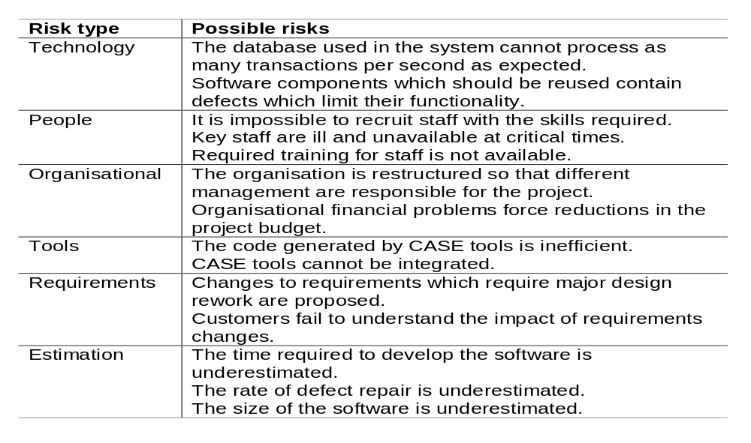
Examples: Risks and risk types

Slide 12
Risk Analysis
Assess probability and seriousness of each risk
  Likelihood x impact - risk exposure
  Example:
    Probability may be very low (<10%), low (10-25%), moderate (25-50%), high (50-75%) or very high (75-100%)
    Risk effects might be catastrophic, serious, tolerable or insignificant (most of the time measured in cost)
Take into account
  Confidence of risk assessment
  Compound risks
  Number of risks
  Cost of action

Slide 13
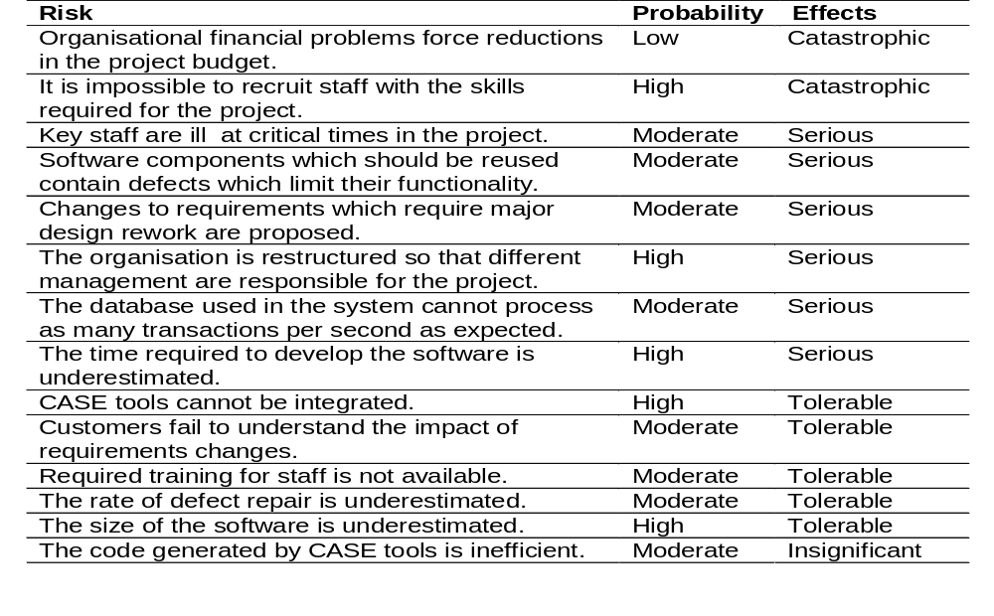
Risk Analysis Example

Slide 14
L(UO) = $0.5M
P(UO) = 0.75
Find Critical Fault
$0.375M
L(UO) = $30M
P(UO) = 0.05
Don’t Find Critical Fault
$0.375M
$1.975M
L(UO) = $0.5M
P(UO) = 0.20
$0.375M
No Critical Fault
Regression Testing?
L(UO) = $0.5M
P(UO) = 0.25
Find Critical Fault
$0.125M
L(UO) = $30M
P(UO) = 0.55
Don’t Find Critical Fault
$16.5M
$16.725M
L(UO) = $0.5M
P(UO) = 0.20
$0.1M
No Critical Fault

Slide 15
Risk Planning
Consider each risk and develop a strategy to manage that risk
Avoidance strategies
  The probability that the risk will arise is reduced
  identify the risk and re-plan to eliminate it.
Minimisation strategies
  The impact of the risk on the project or product will be reduced
Contingency plans
  If the risk arises, contingency plans deal with that risk
Deflection - try to pass the risk on to someone else.
  Insurance - pass the risk directly to a third party.
  Bonding - deposit money in an independent account; if one party defaults, the other collects the bond.
  Contract - sub-contract work and responsibility, penalty clauses

Slide 16
Risk Management Strategies
Personnel shortfalls
  Staffing with top talent; job matching; team building; training and career development; early scheduling of key personnel
Unrealistic time and cost estimates
  Multiple estimation techniques; design to cost; incremental development; recording and analysis of past projects; standardisation of methods
Developing wrong software functions
  Improved project evaluation; formal specification methods; user surveys; prototyping; early user manuals
Late changes to requirements
  Stringent change control procedures; high change threshold; incremental development
Shortfalls in external supplied components
  Inspections; formal specifications; contractual agreements; quality assurance procedures and certification
Shortfalls in externally performed tasks
  Quality assurance procedures; competitive design or prototyping; team building; contract incentives
Development technically too difficult
  Technical analysis; cost-benefit analysis; prototyping; staff training and development
Notes:
Gold plating
Requirements scrubbing; prototyping; cost-benefit analysis; design to cost
Developing the wrong user interface
Prototyping; task analysis; user involvement
Real-time performance shortfalls
Simulation; benchmarking; prototyping; tuning; technical analysis

Slide 17
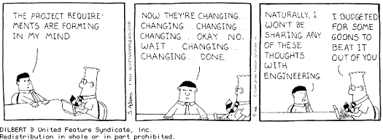

Slide 18
Risk monitoring
Assess each identified risks regularly to decide whether or not it is becoming less or more probable
Also assess whether the effects of the risk have changed
Each key risk should be discussed at management progress meetings

Slide 19
Risk Management Plan
Identifies risks associated with a project.
  Why is the risk significant?
  What is to be done to reduce it?
  When might the risk have an impact?
  Who is responsible for resolving the risk?
  How will the risk be reduced?
  How much will risk reduction cost?
Monitor risks against the plan.

Slide 20
Key notes
All software development efforts are subject to risk, but risk can be managed
Risk management is concerned with identifying risks which may affect the project and planning to ensure that these risks do not develop into major threats

