Slide 1
Designing the System
CS2E2
Daniel Rodríguez
d.rodriguezgarcia@rdg.ac.uk
Room 136

Slide 2
Lecture Objective
To describe the purpose of the architectural design (AD) phase
To define what the design process involves and what is meant by a physical model
To outline the physical model decomposition process
To highlight the influence of non-functional requirements on design
To introduce the fundamental design quality concepts & properties
To detail the format of an architectural design document (ADD)
To explain the purpose of the traceability matrix

Slide 3
Architectural Design Phase
Aims
  Point at which a physical solution is established to satisfy the requirements identified during analysis
  Requirements are transformed into definitions of software components and their interfaces
  Establishes the framework of the system
  That is, design is concerned with HOW
Input
  Software Requirements Document; Logical model
Creation of a good design requires
  Knowledge of the application domain
  Sound understanding of the requirements
  Knowledge of the tools and technology to be employed
  Understanding of good design principles

Slide 4
What Does Design Do?
Establishes control
Defines guidelines and structure
Defines the structure and relationship of the build tasks
Ensures overall conformance of the system
Enables evaluation of different designs
Also acts as validation of the requirements specification
Notes:
Establishes control
Dangerous to build systems without a properly defined structure - you will end up reworking them
Essential so that the system can be modified and maintained
Defines guidelines and structure
A good design will ensure that all the elements of the structure have a similar style and operation, both visibly to the user and to the other developers
Defines the standards and guidelines which the programmer must follow
Defines the structure and relationship of the build tasks
Explains how the different modules relate together, and how to interface between them
Defines an integration strategy which describes how to build the units up into a system
Essential so that different programmers can understand how their product fits into the whole system
Essential so that other teams building interfaces or testing can understand how the system is structured
Ensures overall conformance of the system
Ensures the design fits into the organisations overall architecture and will interface cleanly with other systems
Enables evaluation of different designs
Evaluates several options and documents the reasons for the choices made
Also acts as validation of the requirements specification
Remember development is an iterative process

Slide 5
Conceptual Design
Tells the customer what the system will do
Answers:
  Where will the data come from?
  What will happen to the data in the system?
  What will the system look like to users?
  What choices will be offered to users?
  What is the timing of events?
  What will the reports and screens look like?
Characteristics of good conceptual design
  in customer language with no technical jargon
  describes system functions
  independent of implementation
  linked to requirements

Slide 6
Technical Design
Tells the programmers what the system will do
Includes:
  major hardware components and their function
  hierarchy and function of software components
  data structures
  data flow

Slide 7
Ways to Create Designs
Modular decomposition
Data-oriented decomposition
Event-oriented decomposition
Outside-in design
Object-oriented design

Slide 8
Three Design Levels
Architecture: associates system components with capabilities
Code design: specifies algorithms and data structures for each component
Executable design: lowest level of design, including memory allocation, data formats, bit patterns
Notes:
Architectural design
Definition of an architecture for the software that satisfies the requirements (may also be called preliminary or high level design)
Defines the relationships among the major structural elements of the program/system
e.g. specification of building blocks; interfaces between blocks; composition of subsystems
Procedural design
Transforms the structural elements of the program architecture into a procedural description of software components
Precise specification of processing including sequence/activation of events, exact decision points, repetitive operations etc
Specification of an algorithm for each software component in the architecture (detailed or low level design)
Interface design
Specification of the human-computer interface
Input devices; screen design; help systems; reports etc.
May also need to address specification of interface design with external systems
Data design
Definition of data structures required to implement the software
e.g. file structures, record structures, linked lists etc.

Slide 9
Architectural Design Styles
Pipes and filters
Object-oriented design
Implicit invocation
Layering
Repositories
Interpreters
Process control
Client-server

Slide 10
Pipes and Filters
Pipe
Filter

Slide 11
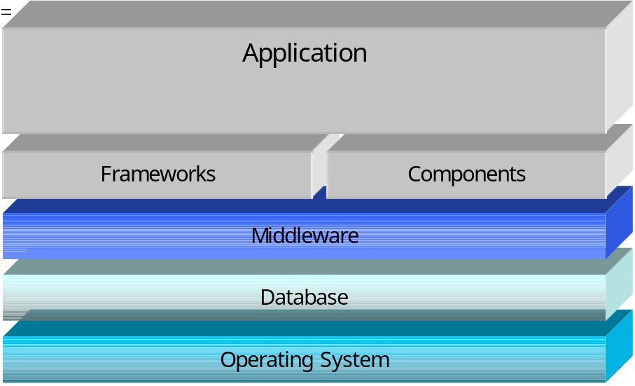
Layering

Slide 12
Repositories
Knowledge Source
Knowledge Source
Repository
Knowledge Source
Knowledge Source
Notes:
Repositories
- shared data

Slide 13
Process Control
Process
Controller
Process
Controller

Slide 14
Other Styles
Client/Server
N-versioning
Presentation Layer
Business Logic
Database

Slide 15
Important Design Issues
Modularity and levels of abstraction
Collaborative design
Designing the user interface
  metaphors, mental model, navigation rules, look and feel
  cultural issues
  user preferences
Concurrency
Design patterns and reuse

Slide 16
Fundamental Design Concepts: Characteristics of Good Design
Functional Decomposition & Independence
Abstraction
Information Hiding
Modularity
Component independence
  coupling
  cohesion
Fan-in
Fan-out
Factoring
Exception identification and handling
Fault prevention and tolerance
  active
  passive
Notes:
Functional Decomposition & Independence
Top-down decomposition of the problem by systematically (stepwise) refining the description of the solution into ever smaller constituent parts and actions
Controls complexity through information hiding
Abstraction
A view of an object that focuses on the information relevant to a particular purpose and ignores the irrelevant/low level details. Should be possible to view hierarchical designs at various levels of detail/abstraction
Information Hiding
Technique of encapsulating software design decisions in components so that the interfaces to the components reveal as little as possible about its inner workings
Modularity
The degree to which a system or program is composed of discrete components such that a change in one component has minimal impact on other components.
Decomposition into sub-problems reduces complexity of overall problem
Composition from reusable components prevents re-inventing the wheel
Understandability as a separate unit enables easier builds, changes and reuse
Confining changes to individual modules rather than system-wide minimises the likelihood and impact of side effects
If aberrant effects can be contained within a module, the impact on the rest of the system will be reduced
Cohesion
The degree to which a module performs one and only one task; high cohesion is good - leads to robust, adaptable and maintainable software
Coupling
The number of connections that exist between two modules and hence the degree of independence between them; low coupling is good - maximises reusability and maintainability and simplifies interfaces
Fan-in
The number of components that call a component - maximise fan-in - reusability increases
Fan-out
The number of components that a component calls
Keep numbers small (7 max) except in case statements where more is OK
Factoring
Measures lack of duplication in software - identify utility software common to all components

Slide 17
Techniques for Improving Design
Reducing complexity
Design by contract
Prototyping design
Fault-tree analysis

Slide 18
Design Evaluation & Validation
Mathematical validation
Measuring design quality
Comparing designs
  one specification, many designs
  comparison table
Design reviews

Slide 19
Design Reviews
Preliminary design review
  examines conceptual design with customer and users
Critical design review
  presents technical design to developers
Program design review
  programmers get feedback on their designs before implementation

Slide 20
Questions For Any Design Review
Is it a solution to the problem?
Is it modular, well-structured, and easy to understand?
Can we improve the structure and understandability?
Is it portable to other platforms?
Is it reusable?
Is it easy to modify or expand?
Does it support ease of testing?
Does it maximize performance, where appropriate?
Does it reuse components from other projects, where appropriate?
Are the algorithms appropriate, or can they be improved?
If this system is to have a phased development, are the phases interfaced sufficiently so that there is an easy transition from one phase to the next?
Is it well-documented, including design choices and rationale?
Does it cross-reference the components and data with the requirements?
Does it use appropriate techniques for handling faults and preventing failures?

Slide 21
Documenting the Design
design rationale
menus and other display-screen formats
human interfaces:
  function keys, touch screen descriptions, keyboard layouts, use of a mouse or joystick
report formats
input:
  where data come from, how they are formatted, on what media they are stored
output:
  where data are sent, how they are formatted, on what media they are stored
general functional characteristics
performance constraints
archival procedures
fault-handling approach

Slide 22
Influence of Non-Functional Requirements
Performance requirements
System/external interface requirements
Operational/human interface requirements
Resource Requirements
Security Requirements
Quality Requirements
Reliability Requirements
Maintainability Requirements
Safety Requirements
Notes:
Performance requirements
Designer must identify the components that are used to provide the service implied by the performance requirements and specify the performance of each component
May need to prototype to confirm feasibility of solution
System/external interface requirements
Designers must define the physical mechanism for the control and data flows
protocols, subroutine calls, interrupts, file and record formats etc.
Must design interface to minimise coupling
Minimise number of separate items flowing into and out of the components
Minimise the number of separate routes into and out of the components
Operational/human interface requirements
Should define
Ergonomic aspects
Screen layouts
Help system
Resource Requirements
May affect choice of programming language & high-level architecture
Design of single processor system vs. multiprocessor system
Security Requirements
May affect hardware, operating system, design of interfaces, design of database componentsPortability Requirements
Can severely constrain the architectural design by forcing the isolation of machine dependent features
Beware of performance restrictions through portability
Quality Requirements
Can affect
Choice of design methods
Decisions about reuse
Choice of tools
Type of design review
Reliability Requirements
May need to consider
Reuse of components whose operational reliability has been proven
Fault tolerance; redundancy; voting
Identical hardware & software; identical hardware & different software; different hardware and software
Maintainability Requirements
Consider
Emphasis on design quality guidelines
Selecting high-level programming language
Minimising volume of code that has to be maintained
Providing tools that allow modifications to be made easily
Assigning values to parameters at run-time
Building in factors that allow faults to be located quickly
Provision of remote maintenance facilities
Safety Requirements
Ensure people and property not damaged
During normal operation or following a failure
Transfer of control to identical redundant system
Transfer of control to a reduced capability backup system
Graceful degradation

Slide 23
Basic Design Principles
The design process should not suffer from ‘tunnel vision’
The design should be traceable to the analysis model
The design should not reinvent the wheel - make use of design patterns
The design should ‘minimise the intellectual distance’ between the software and the problem as it exists in the real-world
The design should exhibit uniformity & integration
The design should be structured to accommodate change
The design should be structured to degrade gently, even when abnormal data, events, or operating conditions are encountered
Design is not coding, coding is not design
The design should be assessed for quality as it is being created
The design should be reviewed to minimise conceptual (semantic) errors

Slide 24
Specification of Architectural Design
Assigning functions to components
  State its objective or characteristic actions
  Derive from functional requirements in the SRD - reference them
  Describe internal processing in terms of the control & data flow to lower level components (structure charts etc.); normal and abnormal behaviour
  Use pseudo code/Structured English/natural language at lowest level
  Define data processing can be defined by listing the data that the component deals with, and the operations that the component performs e.g. create read update etc.
Definition of data structures
  Characteristics of each part (e.g. name, type dimension); be meaningful & unambiguous
  Relationships between parts
  Range of possible values of each part
  Initial values of each part and how initialised
  Accessibility of data structures to components - impacts on coupling
Definition of control flow
  Describe from initialisation to termination
  Describe calls, interrupts, messages
  Control flow may be sequential, parallel or a combination - must be considered at AD stage
  Control flow may be synchronous or asynchronous
Definition of computer resource utilisation
  Must define resources such as CPU speed, memory, storage, system software needs.

Slide 25
Remember
Do not design beyond the capability of the programmers or testers or available technology
Watch for any drift in quality or progress - have regular monitoring and review facilities - informal and formal
Beware of changes to requirements during the design stage that take away effort from the main design activity
Ensure users are involved - invite users to be involved in reviewing the design - use design prototypes where appropriate
Don’t end the design stage too early
DOCUMENT everything
Design specifications
  There may be one complete design specification, or there may be a summary specification containing references to other more detailed design documents.
  It may be the case that detailed specifications are developed for each program - in other cases it is possible to define a template for all the related modules (e.g. simple reports) and then just document a few specific cases
  The amount of design documentation depends on your system, but remember a team of programmers should be able to implement or maintain the system from your design.

Slide 26
Key Notes
Design is concerned with HOW to implement the requirements
Design encompasses high-level, detailed and interface design
Good designs require knowledge of the domain, understanding of the requirements; competence with the tools and techniques; understanding of good design principles
For clarity and ease of understanding the process of abstraction should be used
For ease of extensibility, flexibility and maintainability a modular approach should be used
Modules should have high cohesion and low coupling
Time spent at the design phases reduces later lifecycle costs
The product of the design phase is the Architectural Design Document

