Slide 1
Designing the System
CS2E2
Daniel Rodríguez
d.rodriguezgarcia@rdg.ac.uk
Room 136

Slide 2
Lecture Objective
To describe the purpose of the architectural design (AD) phase
To define what the design process involves and what is meant by a physical model
To outline the physical model decomposition process
To highlight the influence of non-functional requirements on design
To introduce the fundamental design quality concepts & properties
To detail the format of an architectural design document (ADD)
To explain the purpose of the traceability matrix

Slide 3
Software Design
  General definition of design
    “… the process of applying various techniques and principles for the purpose of defining a device, a process, or a system in sufficient detail to permit its physical realization.”
  Goal:
    To produce a model or representation that will later be built
  Engineering or Art?

Slide 4
Architectural Design Phase
Aims
  Point at which a physical solution is established to satisfy the requirements identified during analysis
  Requirements are transformed into definitions of software components and their interfaces
  Establishes the framework of the system
  That is, design is concerned with HOW
Input
  Software Requirements Document; Logical model
Creation of a good design requires
  Knowledge of the application domain
  Sound understanding of the requirements
  Knowledge of the tools and technology to be employed
  Understanding of good design principles

Slide 5
What Does Design Do?
Establishes control
Defines guidelines and structure
Defines the structure and relationship of the build tasks
Ensures overall conformance of the system
Enables evaluation of different designs
Also acts as validation of the requirements specification
Notes:
Establishes control
Dangerous to build systems without a properly defined structure - you will end up reworking them
Essential so that the system can be modified and maintained
Defines guidelines and structure
A good design will ensure that all the elements of the structure have a similar style and operation, both visibly to the user and to the other developers
Defines the standards and guidelines which the programmer must follow
Defines the structure and relationship of the build tasks
Explains how the different modules relate together, and how to interface between them
Defines an integration strategy which describes how to build the units up into a system
Essential so that different programmers can understand how their product fits into the whole system
Essential so that other teams building interfaces or testing can understand how the system is structured
Ensures overall conformance of the system
Ensures the design fits into the organisations overall architecture and will interface cleanly with other systems
Enables evaluation of different designs
Evaluates several options and documents the reasons for the choices made
Also acts as validation of the requirements specification
Remember development is an iterative process

Slide 6
Software Design Model
Functional
model
Information
model
Behavioral
model
Data design
Design
Architectural
design
Code
Other
requirements
Integrated
& validated
software
Procedural
design
Program
modules
Test

Slide 7
Conceptual vs. Technical Design
WHAT
HOW
CONCEPTUAL
TECHNICAL
DESIGN
DESIGN
function
System
form
designers
Customers
System
builders
[Pfleeger, 98]
Notes:
Conceptual design:
Characteristics:
Written in customer’s language
It contains no technical jargon
Describes the functions of the system
Independent of implementation
Linked to requirements document
Technical Design
description of the major hardware components and their functions
hierarchy and function of software components
data structures and data flow
Ways to create design:
Modular decomposition
Data-oriented decomposition
Event-oriented decomposition
Outside-in design
OOD

Slide 8
Conceptual Design
Tells the customer what the system will do
Answers:
  Where will the data come from?
  What will happen to the data in the system?
  What will the system look like to users?
  What choices will be offered to users?
  What is the timing of events?
  What will the reports and screens look like?
Characteristics of good conceptual design
  in customer language with no technical jargon
  describes system functions
  independent of implementation
  linked to requirements

Slide 9
Technical Design
Tells the programmers what the system will do
Includes:
  major hardware components and their function
  hierarchy and function of software components
  data structures
  data flow

Slide 10
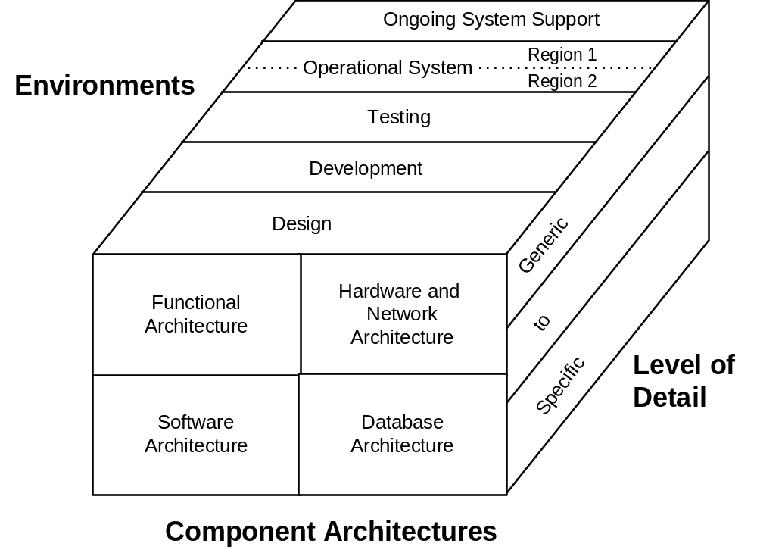

Slide 11
Ways to Create Designs
Modular decomposition
Data-oriented decomposition
Event-oriented decomposition
Outside-in design
Object-oriented design

Slide 12
Three Design Levels
Architecture: associates system components with capabilities
Code design: specifies algorithms and data structures for each component
Executable design: lowest level of design, including memory allocation, data formats, bit patterns
Notes:
Architectural design
Definition of an architecture for the software that satisfies the requirements (may also be called preliminary or high level design)
Defines the relationships among the major structural elements of the program/system
e.g. specification of building blocks; interfaces between blocks; composition of subsystems
Procedural design
Transforms the structural elements of the program architecture into a procedural description of software components
Precise specification of processing including sequence/activation of events, exact decision points, repetitive operations etc
Specification of an algorithm for each software component in the architecture (detailed or low level design)
Interface design
Specification of the human-computer interface
Input devices; screen design; help systems; reports etc.
May also need to address specification of interface design with external systems
Data design
Definition of data structures required to implement the software
e.g. file structures, record structures, linked lists etc.

Slide 13
Architectural Design
“ The primary objective of architectural design is to develop a modular program structure and represent the control relationships between modules.” [Pressman]
Software Architecture
  The hierarchical structure of procedural components & the structure of data
  Transition between analysis and design
Combines program and data structure by defining interfaces that allows data to flow throughout the program
“Holistic view” of software

Slide 14
Architectural Design Styles
Pipes and filters
Object-oriented design
Implicit invocation
Layering
Repositories
Interpreters
Process control
Client-server

Slide 15
System Models
Data
Function
Procedure/Behavior
OOA/P
Data Driven Models
  Data Flow
Function Driven Models
  Real-Time
  Transaction

Slide 16
Data Design
The primary activity during data design is to select logical representations of data objects identified during the requirements definition and specification phase. The selection process may involve algorithmic analysis of alternative structures in order to determine the most efficient design or may simply involve the use of a set of modules that provide the operations upon some representation of an object. [Wasserman]
  Identify the program modules that operate upon the logical data structures
  Data design leads to better program structure, effective modularity, & reduced complexity
Notes:
First activity - most important(?)
Great impact on software quality

Slide 17
Procedural Design
  After data & program structure have been established, becomes necessary to specify procedural detail without ambiguity
  Design Notations
    Structured programming
    Graphical design notation
    Tabular design notation
    Program design language (PDL)
Notes:
Structured Programming -
Three constructs - (sequence, condition, repetition) with predictable structure
Limit procedural design to small number of operations
Takes advantage of chunking to enhance readability, testability, human understanding
Graphical design notation
Flow-charts (draw sequence, if-then, selection, repetition) p.343
Can get overly complex by relying only on structured constructs
Box diagrams (draw sequence, if-then-else, repetition, selection) p.346
Tabular Design
Decision table (rules, conditions, actions, T/F, X marks action) p.349
PDL = pseudocode (keywords, free syntax of natural language, data declaration facilities, subprogramdefinition and calling

Slide 18
Important Design Issues
Modularity and levels of abstraction
Collaborative design
Designing the user interface
  metaphors, mental model, navigation rules, look and feel
  cultural issues
  user preferences
Concurrency
Design patterns and reuse

Slide 19
Fundamental Design Concepts: Characteristics of Good Design
Functional Decomposition & Independence
Abstraction
Information Hiding
Modularity
Component independence
  coupling
  cohesion
Fan-in
Fan-out
Factoring
Exception identification and handling
Fault prevention and tolerance
  active
  passive
Notes:
Functional Decomposition & Independence
Top-down decomposition of the problem by systematically (stepwise) refining the description of the solution into ever smaller constituent parts and actions
Controls complexity through information hiding
Abstraction
A view of an object that focuses on the information relevant to a particular purpose and ignores the irrelevant/low level details. Should be possible to view hierarchical designs at various levels of detail/abstraction
Information Hiding
Technique of encapsulating software design decisions in components so that the interfaces to the components reveal as little as possible about its inner workings
Modularity
The degree to which a system or program is composed of discrete components such that a change in one component has minimal impact on other components.
Decomposition into sub-problems reduces complexity of overall problem
Composition from reusable components prevents re-inventing the wheel
Understandability as a separate unit enables easier builds, changes and reuse
Confining changes to individual modules rather than system-wide minimises the likelihood and impact of side effects
If aberrant effects can be contained within a module, the impact on the rest of the system will be reduced
Cohesion
The degree to which a module performs one and only one task; high cohesion is good - leads to robust, adaptable and maintainable software
Coupling
The number of connections that exist between two modules and hence the degree of independence between them; low coupling is good - maximises reusability and maintainability and simplifies interfaces
Fan-in
The number of components that call a component - maximise fan-in - reusability increases
Fan-out
The number of components that a component calls
Keep numbers small (7 max) except in case statements where more is OK
Factoring
Measures lack of duplication in software - identify utility software common to all components

Slide 20
Design Document
Introduction
  Problem Statement
  Document Overview
Revised Requirements
System Models
  Data
  Function
  Procedure
Conceptual Design
  Architecture Diagram
  Description
Detailed Design
  Data Design
  Procedural Design
UI Design
Sources
Appendix

Slide 21
Design Reviews
Preliminary design review
  examines conceptual design with customer and users
Critical design review
  presents technical design to developers
Program design review
  programmers get feedback on their designs before implementation

Slide 22
Key Notes
Design is concerned with HOW to implement the requirements
Design encompasses high-level, detailed and interface design
Good designs require knowledge of the domain, understanding of the requirements; competence with the tools and techniques; understanding of good design principles
For clarity and ease of understanding the process of abstraction should be used
For ease of extensibility, flexibility and maintainability a modular approach should be used
Modules should have high cohesion and low coupling
Time spent at the design phases reduces later lifecycle costs
The product of the design phase is the Architectural Design Document

