Slide 1
Project Management: Progress
CS2E2
Daniel Rodríguez
d.rodriguezgarcia@rdg.ac.uk
Room 136 – ext 7640

Slide 2
Lecture Objectives
Discuss the need for Project tracking and controlling
To explain the Earned Value technique

Slide 3
Progress Management
We need to know the actual state of projects
  how much of the work is complete?
  how much money will the project spend before it is complete?
Project management must be used to prevent problems rather than fixing them.
  Parkinson’s Law: The project cost whatever resources are available
  90% syndrome (student syndrome)
  Variations in productivity
    Differences among people
    Working Days are not 24 hours shifts

Slide 4
Earned Value
Earned Value System
Earned Value Performance Management
Earned Value Project Management
History:
  US DoD (Department of Defence)
  C/S CSC Cost Schedule Control System Criteria
  60’s
  DODI 7000.2 -> 5000.2 -> 5000.2R
  Part of PMBOK (www.PMI.org)
    Project Management Body of Knowledge
    IEEE Std 1490-1998

Slide 5
Earned Value – Characteristics
Earned Value allows us
  to monitor the actual status of a project
  extrapolate both cost and schedule for estimating the project completion in a graphical way.
Benefits of Earned Value include (Christensen):
  Single management system
    Progress Measurement
  Integration of cost and schedule
  Early warning of trouble
  Accurate predictor of final cost
  Reduce information overload
    Good summary for project managers

Slide 6
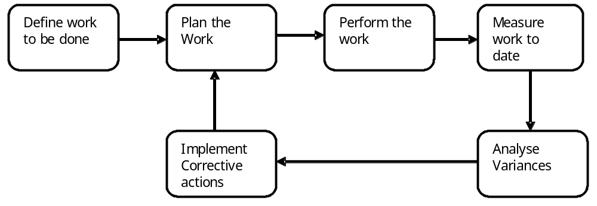
Methodology
Define the work to be done - Work Breakdown Structure
Plan the work - Gantt, Network activity, etc.
Carry out planned work
Measure planned work
Analyse and implement corrective actions

Slide 7
Measurements
Productivity Measures:
  IEEE Std 1045-1992
  Input: effort (hours)
  Output: Lines of Code (LoC), Funcion Points, Documents, etc.
Cost Measures:
  We need to consider
    Different types of work (direct, support)
      Direct Delivered, Direct non-delivered, Support
    Measure extra time
      Pressure: Productivity and Motivation
Type of employee
Type of Activity:
  Management, Analysis, Design, Implementation, etc.

Slide 8
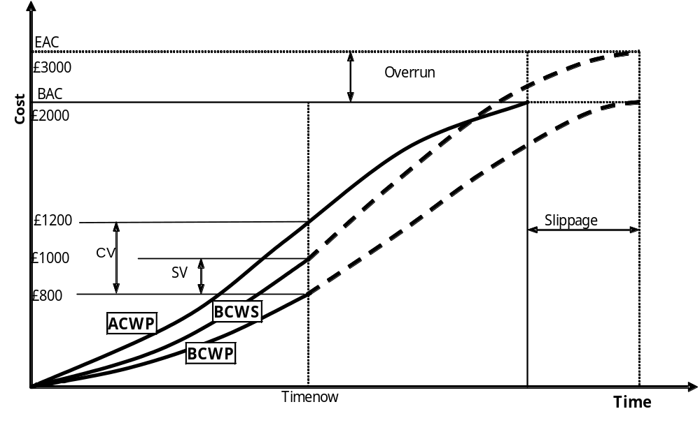
Earned Value Structure

Slide 9
Earned Value Plan
Budget at Completion (BAC)
  Original Cost estimate
  The sum of all BCWS (all direct and indirect costs)
  What the project should cost
Budgeted Cost for Work to be Performed (BCWP)
  Each task in the WBS is assigned a BCWP based on its individual cost.
  Project BCWP is total of all task BCWP
  Also called Earned Value

Slide 10
Earned Value Status
Timenow/Data date/Progress Date
  Indicate up to what date the progress has been recorded
Percentage Completed (PC)
Budgeted Cost for Work Performed (BCWP)
  Real Cost (amount payable) incurred executing the work to achieve the reported progress
  BCWP = PC * BAC
Actual Cost of Work Performed (ACWP)
  It is the real cost of the work completed so far

Slide 11
Earned Value Forecast
Estimate at Completion (EAC)
  It is a revised budget for the activity, work package or project based on current productivity (Cumulative actuals + estimate to complete - best guess at final cost) and produced periodically
  Calculated by extrapolating the performance from time to the end of the project
    Assumed same rate of productivity
  EAC = (ACWP * BAC)/BCPW = ACWP / PC
Budget Variance = BAC – EAC
Estimate to Complete (ETC) = EAC – ACWP
  Useful to compare fund available with the cost to complete

Slide 12
Earned Value Variances
Schedule or cost deviation from a specific plan
Used by all levels of management to verify budgeting and scheduling
Must compare scheduling and budget variance at the same time
  Cost variance: deviations from the budget – not a measure of work scheduled vs work completed
  Schedule variance: deviations from work planned – not a measure of changes in cost
Threshold Variances
  Used to flag problem areas. To attract attention (e.g. +/- 5%)
  Threshold Variances also depends on a number of factors such as life-cycle phase, Length of life-cycle phase, Length of project, type of estimate, accuracy of estimate

Slide 13
Cost/Schedule Variance
Cost Variance: CV = BCWP – ACWP
  If CV < 0, then cost overrun
Schedule Variance: SV = BCWP – BCWS
  If SV < 0, then behind schedule
Both CV and SV are usually expressed as percentages to allow simple comparison:
  CVP = (BCWP – ACWP)/BCWP
  = CV/BCWP
  SVP = (BCWP – BCWS)/BCWS
  = SV/BCWS

Slide 14
Performance Indices
Ratios used to determine the status of a project
Measured as a percentage of BCWP
Cost Performance Index (CPI)
  CPI = BCWP/ACWP
    CPI > 1.0 - good performance
    CPI < 1.0 - overspending
Schedule Performance Index (SPI)
  SPI = BCWP/BCWS
    CPI > 1.0 - good performance
    CPI < 1.0 - behind schedule

Slide 15
Example
Plan to spend £100 in each of first 4 weeks
Actuals at end of week 4: £325
  BCWS = £400 ACWP = £350
What conclusions can you draw?
  CV = BCWP – ACWP
  CV = £400 - £350 = £50
  Under budget
Is project on schedule?
  Suppose BCWP is £300K
  SV = BCWP – BCWS
  SV = £300 - £400 = -£100
  Behind schedule

Slide 16
Earned Value Table
Earned Value data can be expressed in a table. Steps:
  Set up table and list the WBS
  Input BAC
  Calculate BCWS
  From data – obtain PC and ACWP
  Calculate BCWP, SV, CV, EAC
  Sum columns: BAC, BCWS, BCWP, ACWP, EAC
  Calculate total PC, SV and CV
WBS | BAC | BCWS | PC % | BCWP | ACWP | SV | CV | EAC
1.1 | 2000 | 1000 | 40 | 800 | 1200 | -200 | -400 | 3000
1.2
Total

Slide 17
Earned Value Graph
Steps:
  Draw the BCWS
  Draw the BCWP
  Draw the ACWP and extrapolate to the new end date of the project and EAC
  Draw SV and CV variances
  Analyse

Slide 18
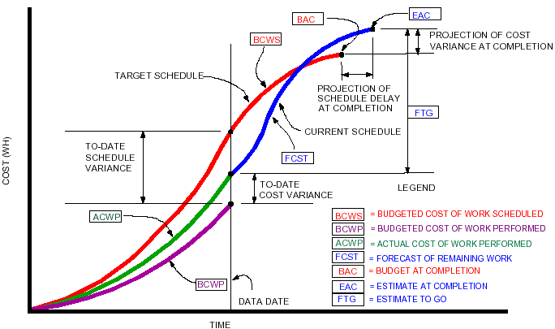
Earned Value Graph

Slide 19
Performance Problems
BCWP calculations rely on “percent complete”
Determining % Complete
    How do you know how much cost/time has really been planned for tasks that are in progress?
  Allocate by percent time spent
    but what if you spend more time than allocated?
  Small tasks (to avoid 90% syndrome)
    0/100 % - Allocate 100% at start or at the end of task
    50/50 % - Allocate 50% at start of task, 50% at end of task
  Allocate value at Milestones

Slide 20
Example - How is this project going?
Project composed of 6 tasks
  Plan 100 hours and one week per task
Week | Hours (Cost) | Task1 | Task2 | Task3 | Task4 | Task5 | Task6
1 | 100 | 100% | 0% | 0% | 0% | 0% | 0%
2 | 40 | 100% | 60% | 0% | 0% | 0% | 0%
3 | 40 | 100% | 100% | 10% | 0% | 0% | 0%
4 | 60 | 100% | 100% | 100% | 0% | 0% | 0%

Slide 21
Example - Gantt
W1
W2
W3
W4
W5
W6
W7
Id
task
1
T1
100%
2
T2
100%
3
T2
100%
4
T4
0%
5
T5
0%
6
T6
0%

Slide 22
Example - Measuring Effort
Under Schedule but…
Under Budget
 | Weekly Values (Hours) |  |  |  | Accumulated Values (Hours)
 | W1 | W2 | W3 | W4 | W1 | W2 | W3 | W4
BCWS | 100 | 100 | 100 | 100 | 100 | 200 | 300 | 400
ACWP | 100 | 60 | 50 | 90 | 100 | 160 | 210 | 300
BCWP | 100 | 40 | 40 | 60 | 100 | 140 | 180 | 240

Slide 23
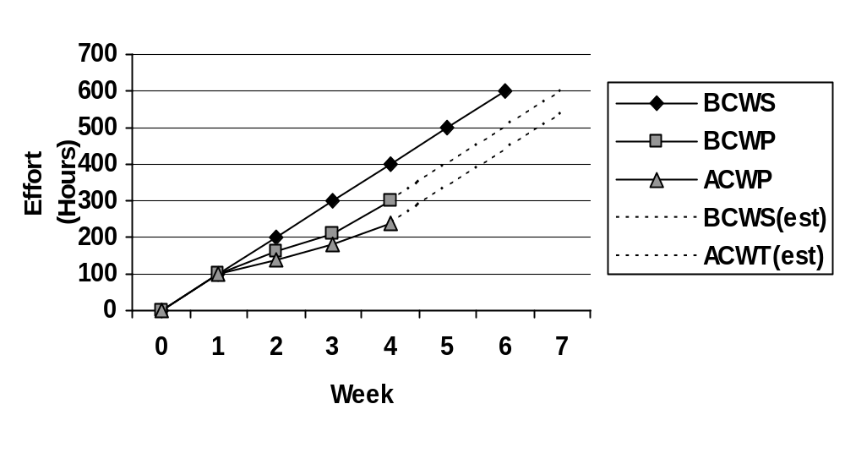
Example - Earned Value Graph

Slide 24
Key notes
There is a need to control projects after planning
Both cost and schedule variance must be analyzed
Earned Value can be used to analyze progress of a project using both cost and schedule
Further Reading:
  http://www.acq.osd.mil/pm/

