Slide 1
Refactoring
Software Engineering
Daniel Rodriguez / M Satpathy
(Slides based on F. Castor and others)

Slide 2
What is Refactoring?
Refactoring is the process of taking an object design and rearranging it in various ways to make the design more flexible and/or reusable. There are several reasons you might want to do this, efficiency and maintainability being probably the most important. (Ralph Johnson)
For Fowler et al [Fowler, p.53,] for refactoring:
  Refactoring (noun): a change made to the internal structure of software to make it easier to understand and cheaper to modify without changing its observable behavior.
  Refactor (verb): to restructure software by applying a series of refactorings without changing its observable behavior.

Slide 3
Refactoring
From previous definitions, refactoring…
  changes the structure of the code while preserving the overall semantics
    towards a better design, more understandable and reusable code.
    provides a technique for cleaning up code
For example:
  Reducing near-duplicate code
  Improved cohesion, lessened coupling
  Improved parameterization, understandability, maintainability, flexibility, abstraction, efficiency etc …

Slide 4
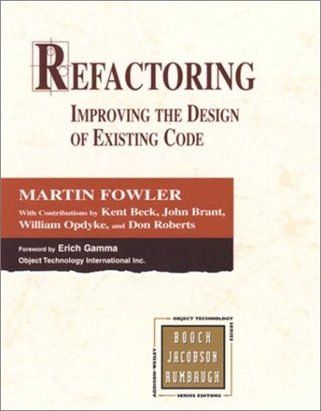
Refactoring
Refactoring: Improving the Design of Existing Code,
  by Martin Fowler et al.,1999, Addison-Wesley
Catalogue of code transformations with motivation, explanation, variations, and examples
  Bad smells, i.e., things to look out for, “anti-patterns”
  Refactorings, i.e., what to do when you find them
Related to
  OO design patterns
  XP (extreme programming)
www.refactoring.com

Slide 5
If it works, don’t fix it?
“When should I refactor? How often? How much time should I dedicate to it?”
  It should be done along with the development!
    Refactor when a “bad smell” arises
      It is normal to arrange code constantly
        (Fowler et al)
The rule of three (XP)
  When coding the same idea:
    The first time, just do it.
    The second time, wince!
    The third time, refactor!

Slide 6
Bad smell: Duplicated code
Same expression in two methods in the same class?
  Make it a private ancillary routine and parameterise it
    Refactoring: Extract method
Same code in two related classes?
    Refactoring: template method
      Push commonalities into closest mutual ancestor and parameterize
Same code in two unrelated classes?
  Ought they be related?
    Refactoring: Extract class, Pull up method:
      Introduce abstract parent
  Does the code really belongs to just one class?
    Refactoring: Extract method: Make the other class into a client
Etc…

Slide 7
Bad smell: Long method
Usually means:
  Trying to do too many things
  Poorly thought out abstractions and boundaries
Think carefully about the major tasks and how they inter-relate
  Refactoring: Extract method
    Break up into smaller private methods within the class
  Refactoring: Extract class/method
    Replace data value with object
    Delegate subtasks to subobjects that ‘know best’

Slide 8
Other Bad smells…
Long method
  Fowler’s heuristic: When you see a comment, make a method
Large class
  too many different subparts and methods
Long parameter list
  It make methods difficult for clients to understand
Switch statements
  This is an example of a lack of understanding polymorphism and a lack of encapsulation.
  Solution: Replace conditional with polymorphism, replace type code with subclasses
Etc…
Notes:
Often, a comment indicates:
The next major step
Something non-obvious whose details detract from the clarity of the routine as a whole.
In either case, this is a good spot to “break it up”.
Comments
XP philosophy discourages comments, in general:
Instead, make methods short and use long identifiers
Fowler is not so critical, tho.
In the context of refactoring, Fowler claims that long comments are often a sign of opaque, complicated, inscrutable code.
They aren’t against comments so much as in favour of self-evident coding practices.
Rather than explaining opaque code, restructure it!
(Extract method/class, [many others applicable] …)
Comments are best used to document rationale
i.e., explain why you picked one approach over another.

Slide 9
Code Examples: Extract Method
When a fragment of code can be grouped
Transforms the code into methods
Bad Smells:
  Long method, repeated code

Slide 10
Example: Extract Method
void printOwing() {
Enumeration e = _orders.elements();
double outstanding = 0.0;
// print banner
System.out.println(“***********************”);
System.out.println(“**** Customer Owes ****”);
System.out.println(“***********************”);
// calculate outstanding
while(e.hasMoreElements()) {
Order each = (order)e.nextElement();
outstanding +=each.getAmount();
}
// print details
System.out.println(“name:” + _name);
System.out.println(“amount:” + outstanding);
}

Slide 11
Extract Method
void printBanner() {
System.out.println(“***********************”);
System.out.println(“**** Customer Owes ****”);
System.out.println(“***********************”);
}
double getOutstanding() {
Enumeration e = _orders.elements();
double result = 0.0;
while(e.hasMoreElements()) {
Order each = (order)e.nextElement();
result +=each.getAmount();
}
return result;
}
void printDetails(double outstanding) {
System.out.println(“name:” + _name);
System.out.println(“amount:” + outstanding);
}
void printOwing() {
printBanner();
double outstanding = getOutstanding();
printDetails(outstanding);
}

Slide 12
Example: Split Temporary Variable
(...)
double temp = 2 * (_height + _width);
System.out.println(temp);
temp = _height * _width;
System.out.println(temp);
(...)
(...)
final double perimeter = 2 * (_height + _width);
System.out.println(perimeter);
final double area = _height * _width;
System.out.println(area);
(...)
Notes:
Quando usar:
Quando uma variável temporária recebe mais de uma atribuição, mas não está num loop e o valor atribuído não depende do seu valor atual
O que faz:
Cria uma variável temporária para cada atribuição
Maus cheiros:
Métodos longos
Dificuldade para entender as responsabilidades da variável

Slide 13
Example: Move Method
class Account {
(...)
private AccountType _type;
private int _daysOverdrawn;
double overdraftCharge() {
if(_type.isPremium()) {
double result = 10;
if(_daysOverdrawn > 7)
result += (_daysOverDrawn – 7) * 0.85;
return result;
}
else return _daysOverdrawn * 1.75;
}
}
class AccountType {
(...)
double overdraftCharge(int daysOverdrawn) {
if(isPremium()) {
double result = 10;
if(daysOverdrawn > 7) result += (daysOverDrawn – 7) * 0.85;
return result;
}
else return daysOverdrawn * 1.75;
}
}
Notes:
Quando usar:
Quando um método tem mais a ver com outra classe do que com aquela na qual ele está
O que faz:
Cria um novo método com um corpo similar na classe que ele usa mais. O método antigo pode ser removido ou modificado para realizar delegação
Maus cheiros:
Inveja de características
Classe longa

Slide 14
Example: Extract Class
class Person {
(...)
private String _name, _phonePreffix, _phoneNumber;
public String getName() {
return _name;
}
public String getHomePreffix() {
return _phonePreffix;
}
public String getHomeNumber() {
return _phoneNumber;
}
public void setHomeNumber(String arg) {
_phoneNumber = arg;
}
}

Slide 15
Extract Class
class Person {
(...)
private String _name;
private TelephoneNumber _homePhone = new TelephoneNumber();
public String getHomePreffix() {
return _homePhone.getPreffix();
}
public String getHomeNumber() {
return _homePhone.getNumber();
}
public void setHomeNumber(String arg) {
homePhone.setNumber(arg);
}
}
class TelephoneNumber {
(...)
private String _preffix, _number;
public String getNumber() {
return _number;
}
public String getPreffix() {
return _preffix;
}
public void setNumber(String arg) {
_number = arg;
}
}

Slide 16
Example: Rename Method
When the name of a method do not reveal its purpose
(...)
public String getTelephoneNumber() {
return (“(“ + _phonePreffix + “)” + _phoneNumber);
}
(...)
(...)
public String getTelephoneNumber() {
return getOfficeTelephoneNumber();
}
public String getOfficeTelephoneNumber() {
return (“(“ + _phonePreffix + “)” + _phoneNumber);
}
(...)

Slide 17
Example: Pull Up Method
When methods in the subclasses return the same result
Move the code to the superclass
Bad smell: Repeated code
Customer
addBill(dat:Date, amount:double)
lastBillDate
Regular Customer
createBill(Date)
chargeFor(start:Date, end:Date)
Preferred Customer
createBill(Date)
chargeFor(start:Date, end:Date)

Slide 18
Pull Up Method
Customer
addBill(dat:Date, amount:double) createBill(Date) chargefor(start:Date, end:Date)
lastBillDate
Regular Customer
chargeFor(start:Date, end:Date)
Preferred Customer
chargeFor(start:Date, end:Date)

Slide 19
Finding Refactorings via Change Metrics
Serge Demeyer, Stéphane Ducasse, Oscar Nierstrasz, Finding Refactorings
via Change Metrics, In proceedings OOPSLA'2000, ACM Press
Heuristics for Finding Refactorings usign OO metrics

Slide 20
A few metrics…
NOM: Number of methods in class.
NIV: Number of instance variables
NCV: number of class variables defined by class.
Etc.
Heuristics:
  Notation ‘d X’ = ‘subtract the metric-X of component-Y in one version from metric-X of component-Y in the subsequent version’. Example, ‘compute the change in HNL on class View’ corresponds to the following function:
  d HNL(View) = HNL(View, ver n + 1) - HNL(View, ver n)

Slide 21
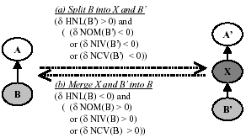
Split into Superclass /
Merge with Superclass

Slide 22
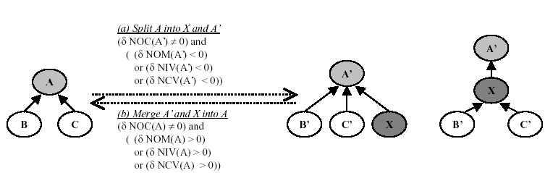
Split into Subclass /
Merge with Subclass

Slide 23
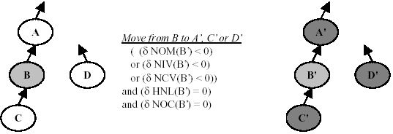
Move to Other Class (Superclass, Subclass or Sibling Class)

Slide 24
Summary
Refactoring is used to improve code
  Fowler, M., Beck, K., Opdyke, W., Roberts, D. Refactoring: Improving the Design of Existing Code. Reading, MA: Addison-Wesley, 1999.
    Fowler et al book summarizes “best practices” of OOAD examples
There are tools to automate the process
  Some use OO metrics
    Serge Demeyer, Stéphane Ducasse, Oscar Nierstrasz, Finding Refactorings via Change Metrics, In proceedings OOPSLA'2000, ACM Press

