Slide 1
Executable Platform Independent Models for Data Intensive Applications
Grzegorz Falda, Piotr Habela, Krzysztof Kaczmarski, Krzysztof Stencel, Kazimierz Subieta

Slide 2
Presentation outline
Context of this research:
  MDA promises;
  executable models
Required features of the language
Precise behaviour in UML2
Language and Tool implementation
Conclusions

Slide 3
PROMISES OF THE MDA

Slide 4
MDA and its aims
Rise the level of abstraction [Grady Booch]:
  “Someday soon, the idea of writing an application in Java or C++ will seem as absurd as writing an application in assembler does today. And the code generated from an Executable UML model will be as uninteresting and typically unexamined as the assembler pass of a third generation language compile is today”
The “modelling” language now needs to gain fully precise semantics…

Slide 5
Executable models: Executable UML
A profile of UML allowing the developer to define the behaviour of a single subject matter in a sufficient detail that it can be executed and tested. [Mellor, Balcer]
Formal action semantics => model compilers:
  Testing the model
  Producing executable code

Slide 6
Potential benefits of executable models
Faster target platform code construction
More automated maintenance and porting
Early testing and debugging
Prototyping and validating with final users
Disambiguate the UML specifications – a reference implementation
Notes:
Assuring the executable semantics of a language is of key importance for the role the MDA assumes for platform-independent models.
Particularly, the following benefits can be indicated…

Slide 7
Project challenge and open questions
Validate the promises of the MDA approach
  Executable models
  Code generation
  Improved maintenance
  Reusing existing modelling standards
Address the needs of data-intensive business apps development
  Handling persistent data
  Integrating with the business modelling solutions
  Addressing the prototyping and GUI layer development
  Approachable for business stakeholders
How precise is UML semantics?
Notes:
The main questions the project should answer to include:
Whether the precise models in UML can indeed constitute a next step in raising the level of abstraction (machine code -> assembly languages -> 3GLs -> Executable modelling?)
To what extent the MDA promises can be fulfilled in our area of appplication: code generation, maintenance, development time testing
Whether the existing MDA-related standards are mature enough to serve that role
How to address business application-specific needs: persistent data, GUI development, business process driven modelling and design ?

Slide 8
REQUIRED FEATURES OF THE LANGUAGE

Slide 9
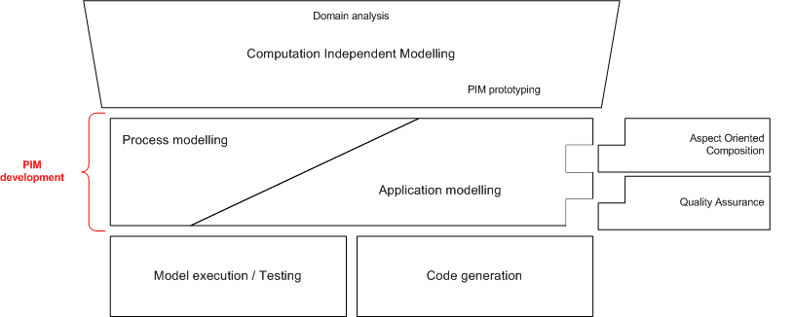
Model layers in VIDE
CIM
PIM
PSM
code
Notes:
VIDE covers with its functionality three layers:
Computation independent modelling – opening the toolset towards business analyst and stakeholders
Platform-independent modelling – offering mainly the precise means of specifying executable application behaviour (aspect oriented composition and quality defect detection provide additional support to this activity). This layer is the main focus of the project.
Finally, the model execution and target platform code generation is also addressed.

Slide 10
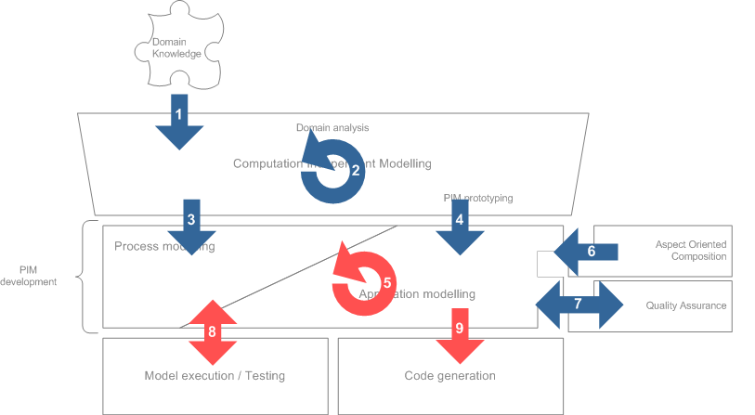
Functionality covered by VIDE software
Notes:
The realization of that functionality requires numerous transformations or updates of CIM and PIM. They are intended to support the following functionality:
Collecting informal requirements and domain descriptions and supporting their refinement towards CIM
CIM development
Reusing CIM elements and their refinement towards process definition
Reusing parts of CIM to serve as a starting point of PIM level application mode
PIM development (structure and behaviour)
Aspect-oriented modelling and composition inside PIM
PIM-level quality defect discovery
Model execution inside the development tool
Code generation – for executing and modifying outside the VIDE tooling.
In this presentation we focus on the three marked workflows: PIM development, model execution and (partially) on code generation.

Slide 11
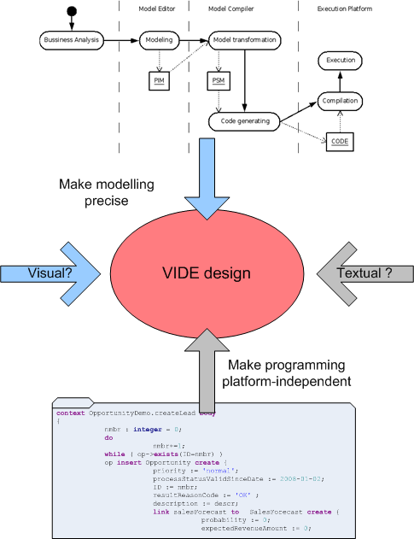
Design considerations for the language
How to make it familiar to UML developers?
How to make it convenient for programmers?
How to balance the visual and textual syntax?
How to make expression construction more intuitive?

Slide 12
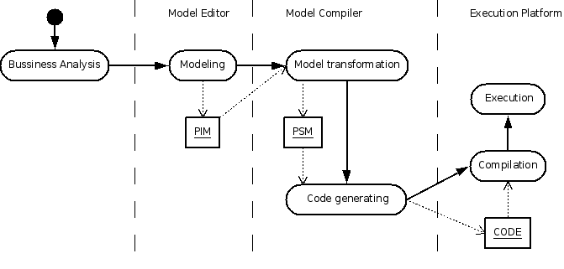
PIM – Execution Workflow
PIM – platform independent model
PSM – platform specific model

Slide 13
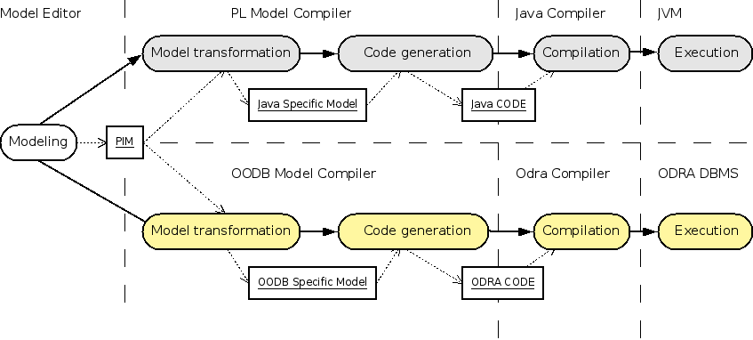
PIM must support information for all possible platforms

Slide 14
ADAPTING UML2

Slide 15
Precise behaviour constructs in UML2
Contained in Actions and Activities units
Large number of constructs
  E.g. Activities support flow-oriented and structural behaviour
Lack of concrete syntax standardized
Very rudimentary support in UML tools
  Rarely used actually
  Some bugs in standard specification and implementation prove it
Standard-compliant metamodel implementation on the Eclipse available!

Slide 16
Selecting UML subset to implement
Structured Activities as the basis
Most of the actions – to realise:
  Data updates
  Control flow
  Exception handling

Slide 17
Problems and limitations
Specifying the way of handling structural elements’ instances
No simple solution for object initialization
Representing item processed inside ExpansionRegion

Slide 18
LANGUAGE AND TOOL IMPLEMENTATION

Slide 19
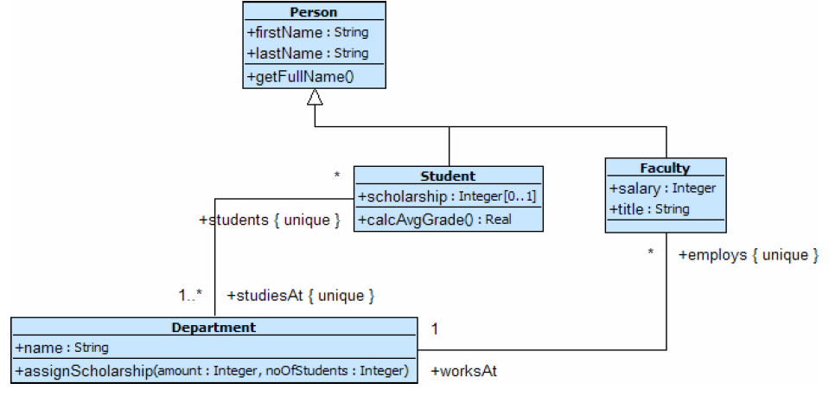
Textual language inside UML
dept->select(name=’SE’).employs
foreach { f |
f unlink worksAt;
f link worksAt to dept->select(name =’IS’);
}
context Students::Department.assignScholarship(
amount : Integer, noOfStudents : Integer) body {
students->sortedBy(s|-s.calcAvgGrade()).subSequence(1,noOfStudents)
foreach { s |
if (s.scholarship->size()=0)
s.scholarship insert amount;
else s.scholarship += amount;
}
}
Aimed at straightforward mapping onto respective Activities and Actions inside the metamodel
Style aligned with the syntax of OCL
  ... That plays the role of expression language here
Examples...

Slide 20
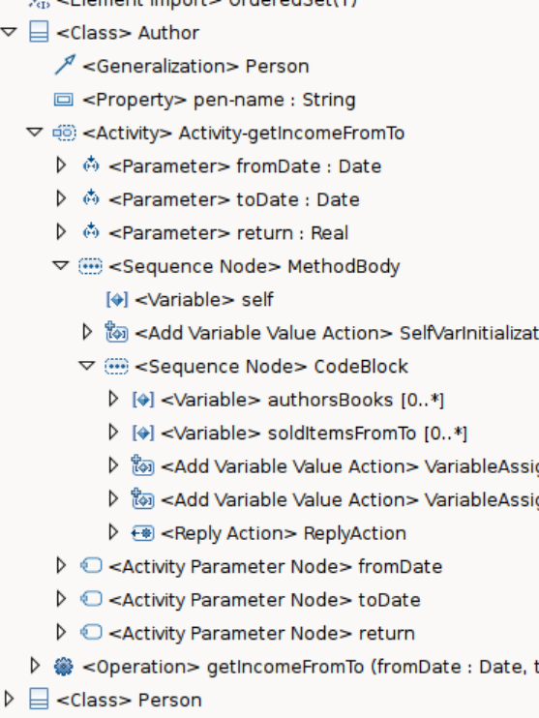
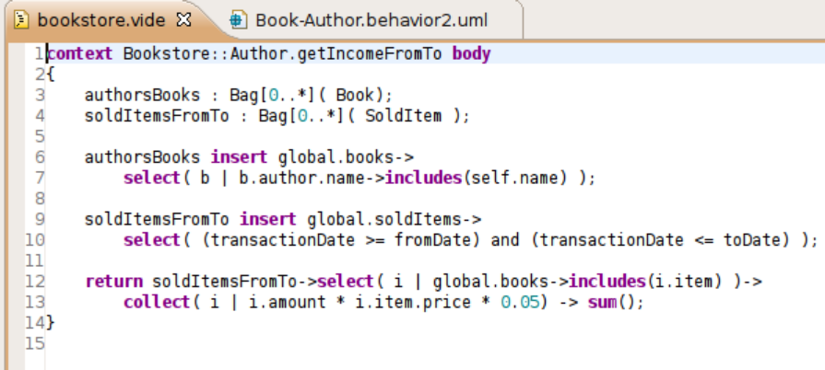
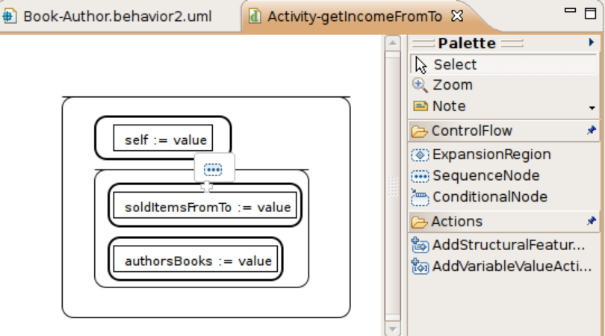
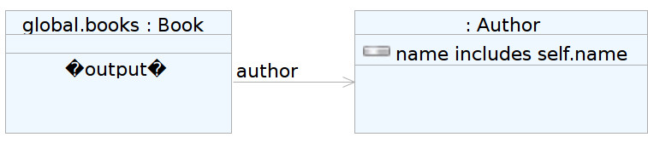
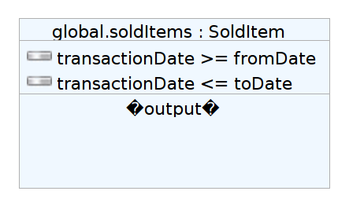
Integrated Editors

Slide 21
Model Execution Workflow for ODRA Platform
Behavior
PIM
VIDE
Textual
SBQL
AST
SBQL
CODE
ODRA
Server
VIDE
Visual
ODRA
DDL
UML
Structures

Slide 22
CONCLUSIONS

Slide 23
Conclusions
Making UML models executable through complete code generation seems feasible
  Though the complexity and the need for inputs may differ depending on specific platform
Many semantic details of UML2 need to be refined to make model interchange feasible
A more DBMS-originated insight into the OMG modelling specifications could make them more broadly applicable

