Slide 1
Modeling input space for testing scientific computational software: a case study
Sergiy A. Vilkomir, W. Thomas Swain, Jesse H. Poore
University of Tennessee, USA
Kevin T. Clarno
Oak Ridge National Laboratory, Oak Ridge, TN, USA

Slide 2
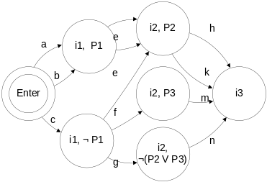
Comparison of two types of software
Software model
Inputs
Interactive
system
Test
cases
Tool
Outputs
Inputs
Input space model
Computational
software
Combinatorial
test case generation
Test
cases
Tool
Outputs

Slide 3
Tasks
to create a model of a large input space with dependencies among input parameters.
to generate test cases from the model

Slide 4
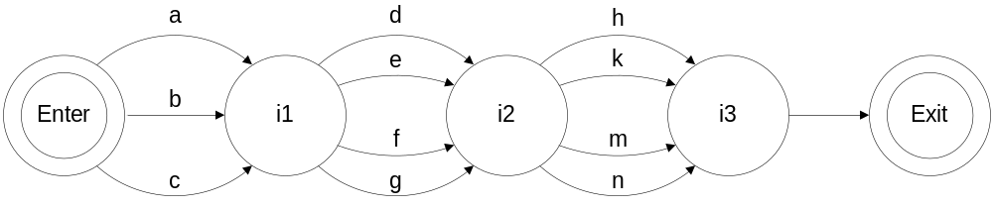
Input space without dependencies
i1∈{a, b, c}
i2∈{d, e, f, g}
i3∈{h, k, m, n}

Slide 5
Graph
a node represents an input parameter (the fact that the value of a parameter is fixed)
an arc represents a specific input value.
Each path through the graph (a sequence of arcs) represents a test case, i.e. a combination of input values.
When probabilities of input values are added for each arc, the graph becomes a Markov Chain model.
existing Markov chain tools for automation of test cases selection can be used (in particular, JUMBL)

Slide 6
Dependencies
Dependencies mean that not all combinations of input parameters are valid.
The task is to create a graph in such a way that all valid and only valid combinations are represented.
Example: i1∈{a, b} ⇒ i2∈{d, e}

Slide 7
Modeling dependency between two parameters
Let x and y be input parameters with domains X and Y: x∈X (x takes values from X) and y∈Y (y takes values from Y).
We define the dependency between x and y as a one-one function f : Q(X)→C(Y) where
  Q(X) is a partition on X: Q(X)={X1, …, Xk} is a set of non-empty subsets of X such that for all j, m with 1≤j,m≤k, j≠m, ∪ Xj = X and Xj ∩ Xm=∅.
  C(Y) is a cover of Y: C(Y)={Y1, …, Yk} is a set of subsets of Y (including possibly the empty set) such that for all j with 1≤j≤k, ∪ Yj= Y (without restriction on intersection).
X
f:
X₁
Y
Y₁
X₂
Y₂
If x∈X_{i} then y∈Y_{i}=f(X_{i})
Y₃
X₃

Slide 8
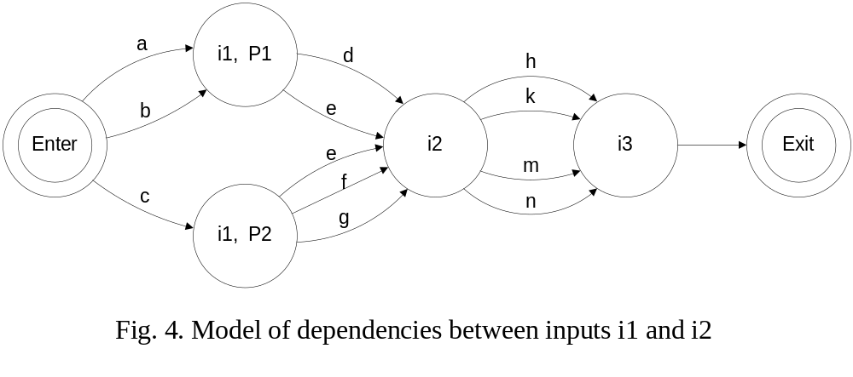
i1∈{a, b}⇒ i2∈{d, e}, i1∈{c}⇒ i2∈{e, f, g}.
f : Q(X)→C(Y)

Slide 9
Dependencies among several parameters
i2∈{d, e}⇒ i3∈{h, k},
i2∈{f}⇒ i3∈{m},
i2∈{g}⇒ i3∈{n}

Slide 10
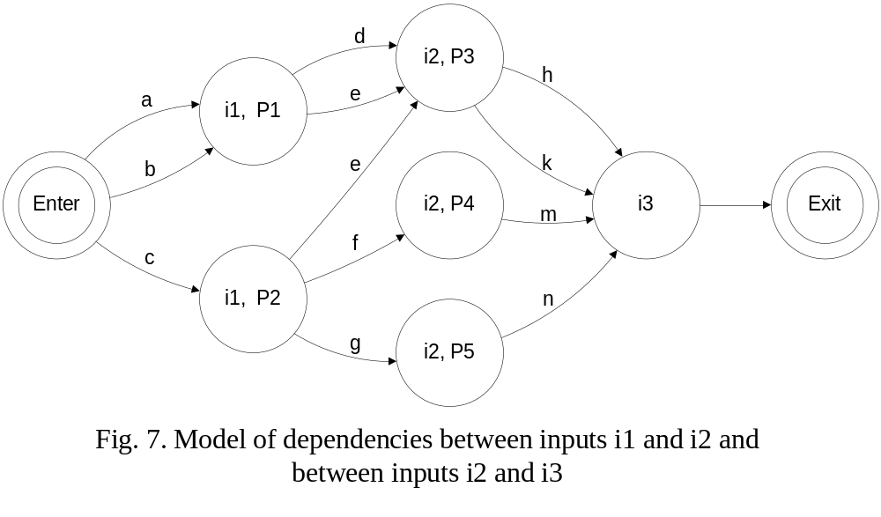
Dependencies among several parameters
f : Q(X)→C(Y)

Slide 11
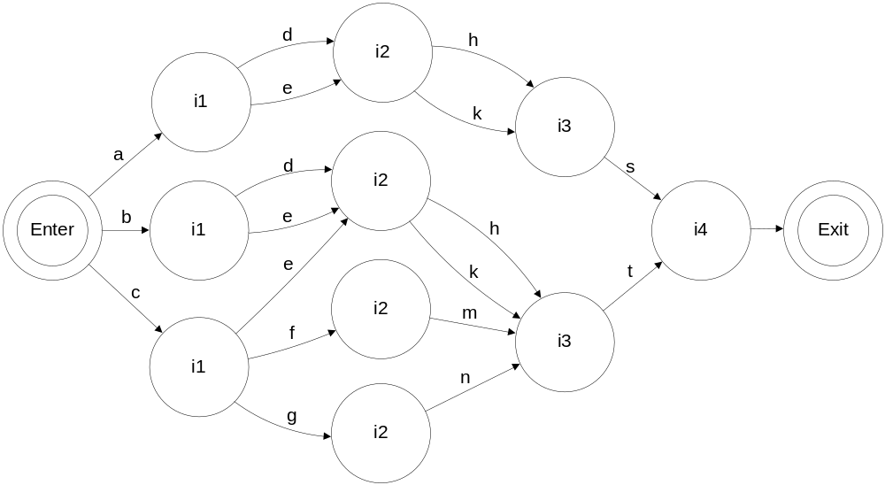
Dependencies among several parameters
f₁₋₂ : Q₁(X)→C₁(Y)
f₁₋₄ : Q₂(X)→C₂(Y)
i4∈{s, t}
(i1=a) ⇒ (i4=s)
¬(i1=a) ⇒ (i4=t)

Slide 12
Main challenge
To keep the “small” size of the model
Without thinking on the size:
    The task to generate all valid combinations is trivial
    Explicit result – all valid combinations
    This “solution” is unpractical because of an exponential growth of the model
Our approach provides (not always) a linear growth
(Q₁₁∧C₁₁∨Q₁₂∧C₁₂ )∧(Q₂₁∧C₂₁∨Q₂₂∧C₂₂)∧(Q₃₁∧C₃₁∨Q₃₂∧C₃₂)∧ …

Slide 13
NEWTRNX Case Study
The NEWTRNX transport solver was developed in Oak Ridge National Laboratory for high-fidelity modeling of nuclear fission energy systems.
The primary function of the solver is to provide the heat generation distribution of neutrons.

Slide 14
“Setting problem definition” function
mode - type of the problem (isotropic or forward).
nSpherical - number of harmonics moments used to represent the anisotropic scattering source.
quadrature - type of quadrature set utilized (level-symmetric or product).
nSn - level-symmetric quadrature set order (even numbers).
nAziProd - azimuthal (2d) portion of the product quadrature set.
npolar - polar (1d) portion of the product quadrature set (3d is the product of nAziProd and nPolar).

Slide 15
Dependency among “quadrature” and
“nSn”, “nAziProd” and “npolar”
If “quadrature” equals “symmetric” then only parameter “nSn” is used and “nAziProd” and “npolar” are not used.
If “quadrature” equals “product” then parameters “nAziProd” and “npolar” are used but “nSn” is not used.

Slide 16
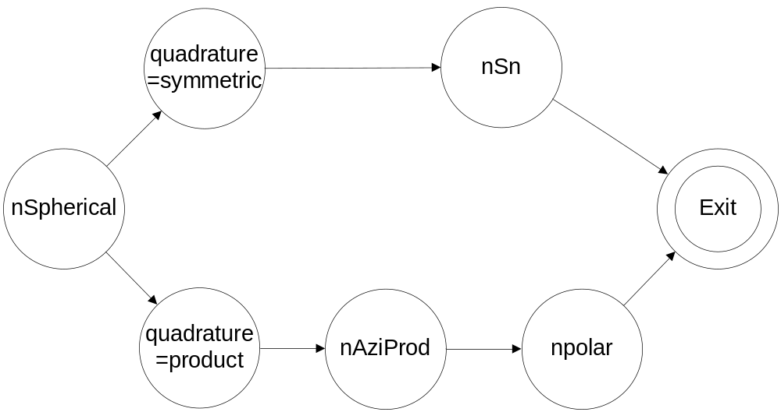
Dependency among “quadrature” and
“nSn”, “nAziProd” and “npolar”

Slide 17
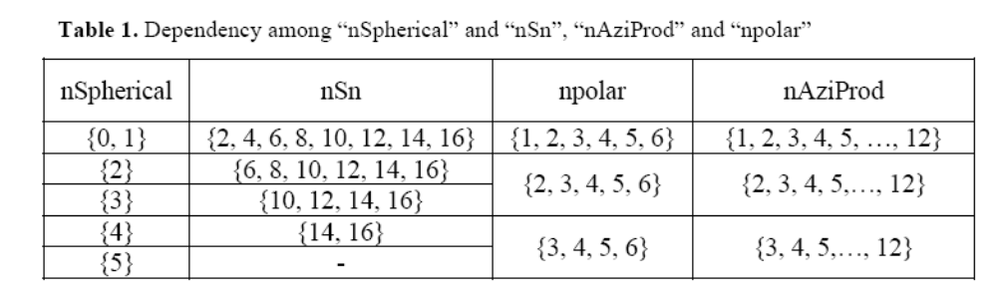
Dependency among “nSpherical” and “nSn”, “nAziProd” and “npolar”

Slide 18
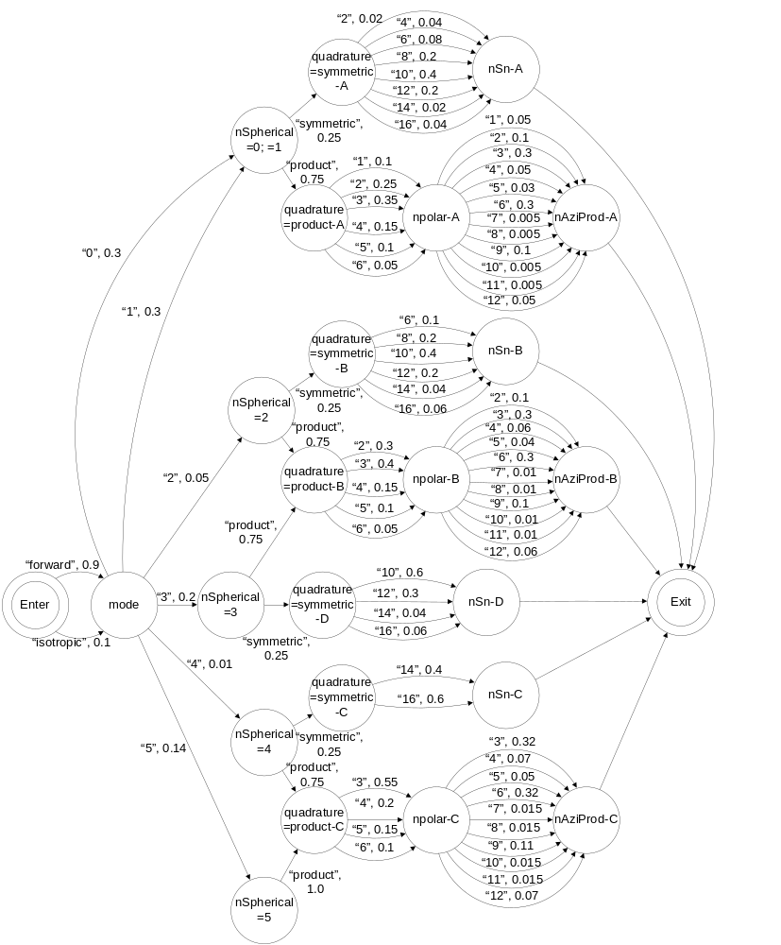

Slide 19
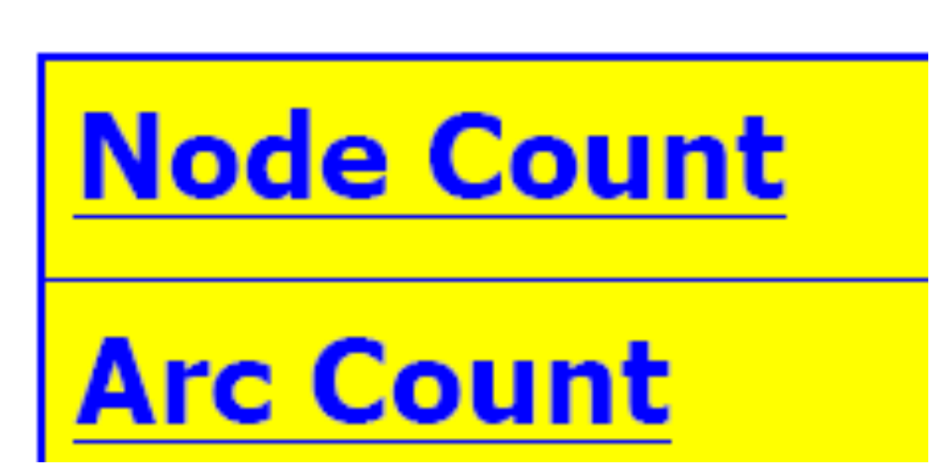
NEWTRNX model statistics

Slide 20
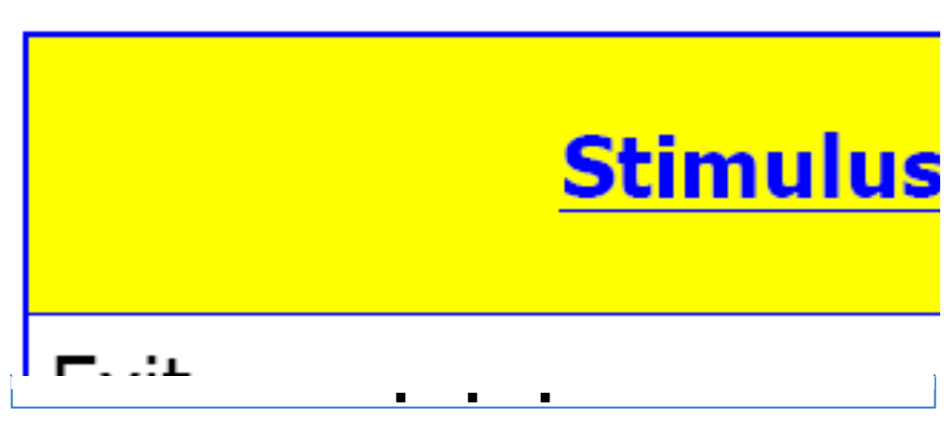
NEWTRNX stimulus statistics (fragment)

Slide 21
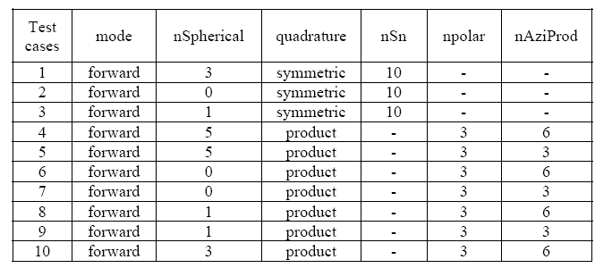
NEWTRNX weighted test cases

Slide 22
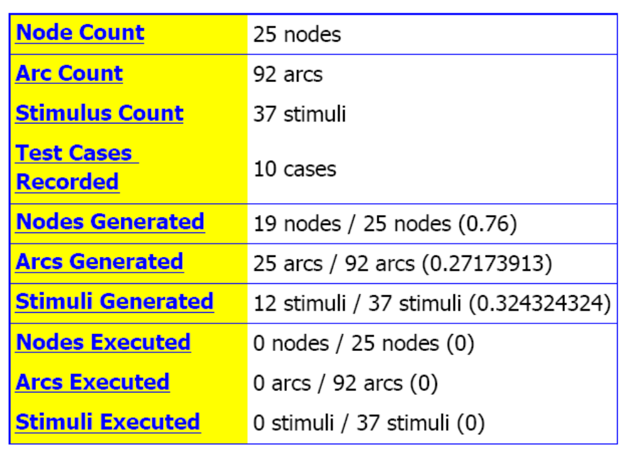
NEWTRNX model test case statistics

Slide 23
Thank you!
Questions?

