Slide 1


An Event-Based Approach to Reducing Coupling in Large-Scale Applications
Bartosz Kowalewski¹, Marian Bubak^{1,2}
Bartosz Baliś¹
1 Academic Computer Centre CYFRONET AGH
2 Institute of Computer Science, AGH

Slide 2
Outline
Motivation: improving the design of large-scale applications by applying event-based approach
Coupling and event-based approach
Event-based programming and Web services
Requirements for the WS-Notification-based Publish Subscribe Infrastructure (WSN-PSI)
Performance analysis
Possible applications
Summary and future work

Slide 3
Motivation
Large-scale applications:
  Tend to become more and more complex and hard to develop, and execute
  Need to be designed with care for low coupling
Solution:
  Apply event-based programming to Web services
  Implement a generic publish/subscribe infrastructure

Slide 4
Goals
Design and implement an extensible infrastructure for publication and subscription for events that would successfully compete with the traditional approaches (JMS, CORBA Notification Service)
Carry out performance analysis of various publish/subscribe solutions

Slide 5
Coupling
The degree of association between modules, components, subsystems, etc.
Loose coupling is to reduce the assumptions two parties make about each other when they exchange information
Treated as quality metrics for software design
Tight coupling can lead to problems in all phases of application's life cycle
Is a significant issue in large-scale distributed applications

Slide 6
Event-based programming
Event-based programming paradigm accentuates an entity that represents a situation, an occurrence of interest to third parties – an event object
Decreases coupling
Simplifies the interface
Introduces one-to-many and many-to-many interaction models
Enables one to use complex topologies (with intermediary services)

Slide 7
Events and Web services
Event-based programming has been around for many years and has become extremely popular
… but there is no single widely-accepted event-based standard for Web services
Available specifications are imperfect
Lack of comprehensive studies
Implementations are ineffective and hard to incorporate into existing applications

Slide 8
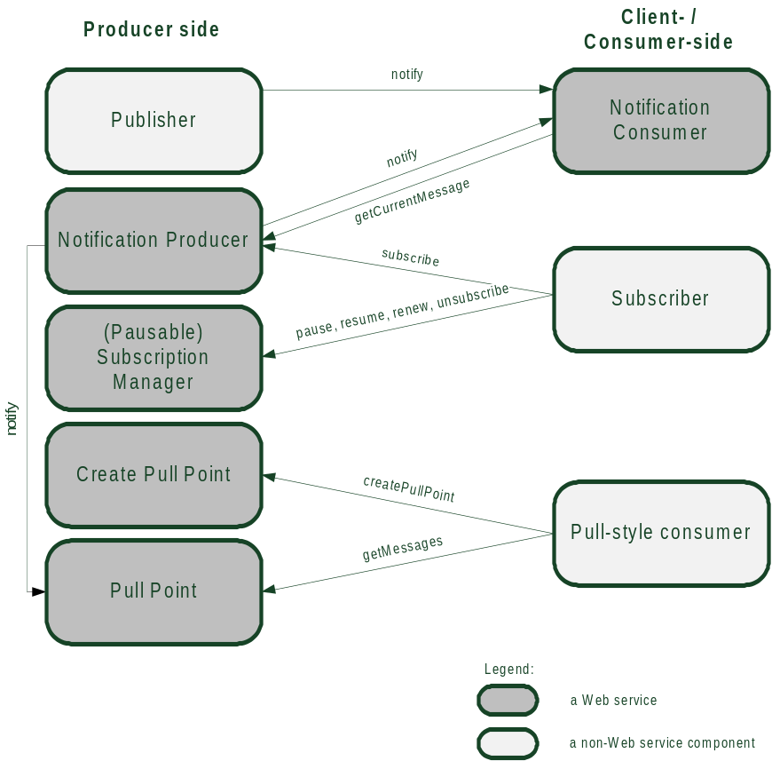
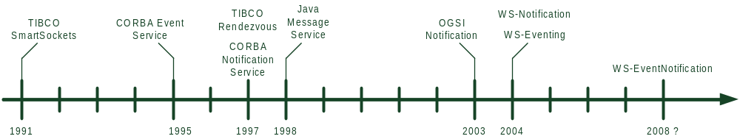
Events and Web services
OGSI-Notification
WS-Eventing
WS-Notification
WS-EventNotification

Slide 9
The current state of the art
Few solutions address the problem of event-based approach applied to Web services
There are some implementations providing publish/subscribe infrastructures built upon Web services:
  Apache Muse
  Apache Pubscribe
  ServiceMix
  WS-Messenger
None of them meets all of the fundamental requirements: configurability, extensibility, performance …
They all introduce mechanisms that aren’t covered by any of the specifications
Most of these solutions are inherent parts of larger, more complex solutions, and cannot run separately

Slide 10
Requirements analysis
Functional requirements:
  Well-defined message exchanges
  Dynamic reconfiguration of the environment
  Messaging brokers
  Topics
  Filtering
Non-functional requirements:
  Standards-based approach
  Performance
  Usability
  Extensibility
  Configurability
  Scalability

Slide 11
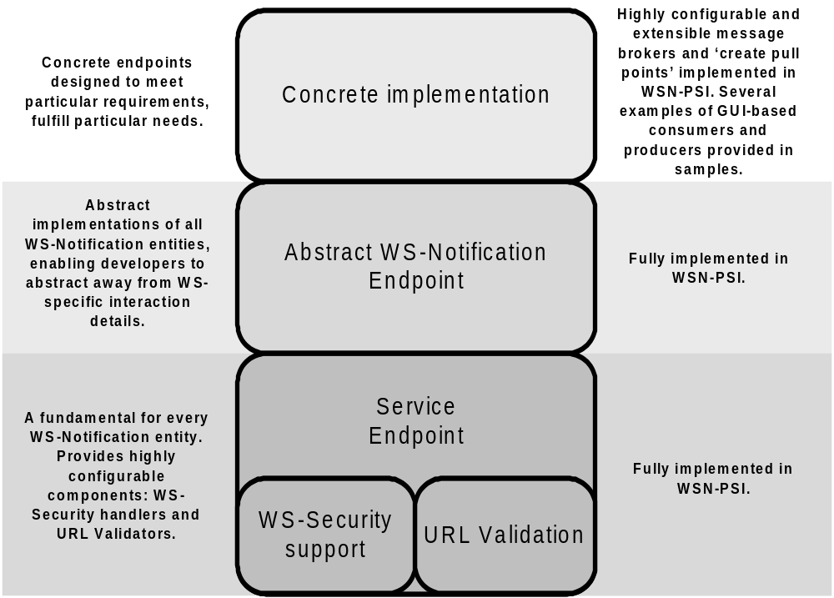
Design: WS-Notification-based entity

Slide 12
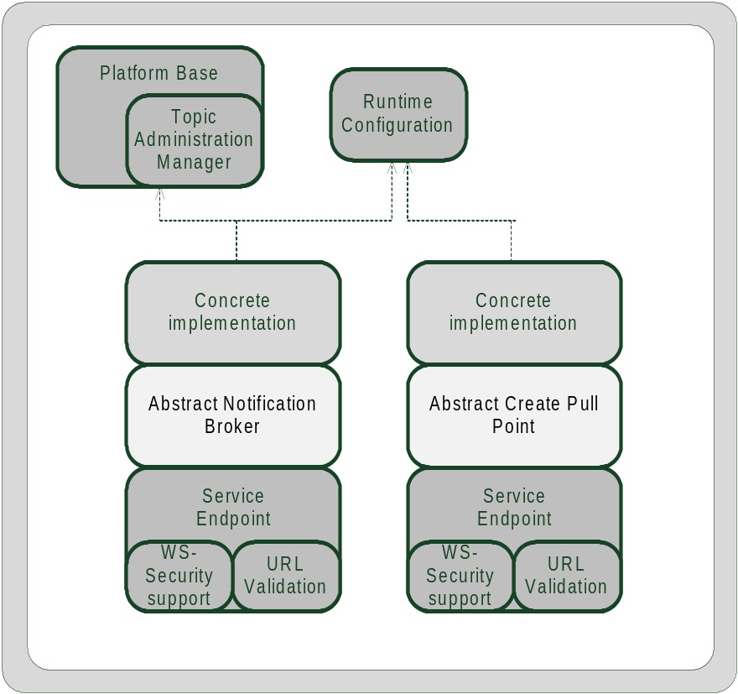
Design: Brokering system
Highly configurable
Enables one to choose the method of event notification dispatching
Complex topologies
Pull/push delivery modes
On-demand publishers

Slide 13
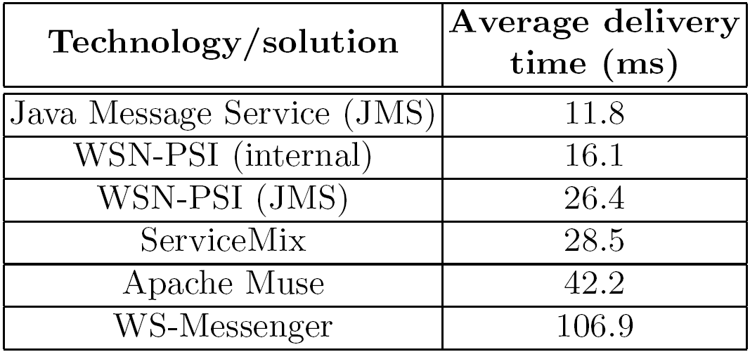
Performance analysis
Performance of Web services-based solutions may be nearly as high as in traditional distributed event-driven technologies
When additional mechanisms are enabled (filtering, QoS) performance dramatically decreases

Slide 14
Possible applications
100% WS-Notification compliant
Highly extensible and configurable
Provides many abstract stubs and sample applications
Embedded Web server
Support for WS-Security
These features make WSN-PSI highly usable and applicable to many scenarios
…but providing clients for languages other than Java is considered out of scope of this work

Slide 15
Summary and Future Work
The project:
  Provides Web service-based publish/subscribe infrastructure
  Meets tough performance requirements
  Can be used to decrease coupling in large-scale Web services-based applications
Next efforts are targeted at:
  Testing in a real grid environment
  Experimenting further with WS-* specifications
  Experimenting with several technologies
  Testing various topologies

Slide 16
References
On the Web:
http://virolab.cyfronet.pl/trac/gemini/wiki/WsnPsi
Other resources:
  Web Services Notification
  http://www.oasis-open.org/committees/tc_home.php?wg_abbrev=wsn
  Web Services Eventing
  http://www.w3.org/Submission/WS-Eventing/

