Slide 1

Exploring Cohesion, Flexibility, Communication Overhead and Distribution for WS Interfaces
Miguel Ángel Sicilia, Daniel Rodríguez
University of Alcalá, Madrid, Spain
Notes:
Para preparar la clase: leer

Slide 2
Outline
Introduction
  Web Services interface Design Issues
  Software metrics
Cohesion metrics
Case Study
Conclusions and Future Work

Slide 3
Introduction
In general, Computational Science (CS) applications:
  (i) rely on large amounts of data need to be transferred through the net, and
  (ii) the interfaces need to be flexible to serve the needs of different applications and research needs.
Web services (WS) provide a convenient way for making those datasets available, since they rely on a standard technology.
  However, there are many ways to devise a WS interface for a given dataset,
  The different interfaces vary in their properties related to cohesion, distribution, flexibility and communication overhead, among other parameters.
Here those properties are explored.
  Concretely, a cohesion metric is analysed as a way to characterize possible kinds of WS interface designs.

Slide 4
Web Services Interface Design Issues
Large amounts of data are made available through WS interfaces providing access to schemas containing the scientific data (e.g. bioinformatics).
WS are based on SOAP messaging over the HTTP protocol incorporates some additional overheads.
Depending on the design of the WS interfaces, client applications would require to issue a larger or smaller number of WS invocations, thus incurring in more or less overhead respectively.
  An extreme case occurs when a single WS retrieves all the data in a dataset, which reduces to the minimum the number of remote method calls but clearly compromises flexibility to build applications on top of it.
  In the opposite extreme, a design in which the data in each entity in the data model is provided by a separate WS provides maximum flexibility.
  In addition, some WS interface designs delegate query processing to the server while others only retrieve data (processing is done in the client).

Slide 5
Software Metrics
For Structured or Object Oriented systems many metrics exist to analyse previous properties and trade-offs.
  For example, OO metrics defined by Chidamber and Kemerer (C&H)
  Perepletchikov et al have analysed the design of 3 different designs for a Service Oriented Architecture (SOA) with traditional metrics such as Lines of Code and Cyclomatic Complexity
    As authors state, most OO metrics need to be adapted for Web services, mainly assuming that a class is a service or set of services (business process)
Designers facing the analysis or design of Web service interfaces could find beneficial the availability of metrics, indicators or guidelines for measuring designs flexibility, degree of distribution and communication overheads.

Slide 6

LCOM – Lack of Cohesion Metric
It is as a quality metric of the cohesiveness of a class by measuring the number of method pairs that do not have common instance attributes. More formally, LCOM measures the extent to which methods reference the class instance data.
  Let us consider a class C1 with n methods M1, M2, …, Mn. and let {Ij} = set of instance variables used by method Mi. There are n such sets {I1},...,{In}. Let P = {(Ii, Ij) | Ii ∩ Ij = Ø}, and Q = { (Ii, Ij) | Ii Ç I j≠ Ø}. If all n sets {I1},..., {In} are Ø then let P = Ø.
  For example, consider a class C with 3 methods (M1, M2, M3). Let {I1} = {a, b, c, d, e}, {I2} = {a, b, e}, and {I3} = {x, y, z}. {I1} ∩ {I2} is nonempty but {I1} ∩ {I3} and {I2} ∩ {I3} are null sets. LCOM is the number of number of null intersections – number of nonempty intersections), which in this case is 1
A high value of LCOM implies that there is a lack of cohesion, i.e., low similarity between the methods of a class and as a result, the class can be composed of unrelated objects.
Notes:
High cohesiveness of methods within a class is desirable, since classes cannot be divided and promotes the encapsulation. Low cohesiveness increases complexity, thereby increasing the likelihood of errors during the development process.

Slide 7
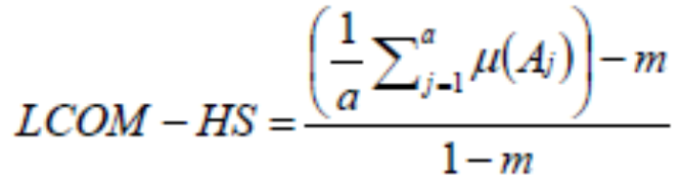
LCOM-HS
There are other reformulations. Henderson-Sellers defined, LCOM-HS, as follows.
  Let us consider a set of methods {MI} (I=1,…,m) assessing a set of attributes {Aj} (j=1,…,a) and the number of methods that access each attribute μ(Aj), then define LCOM-HS is defined as:
  The LCOM-HS range is between 0 and 2. If all methods access all attributes, then Σ μ(Aj) = ma, so that LCOM-HS = 0, which indicates perfect cohesion. If each method access only 1 attribute then Σ μ(Aj) = a and LCOM-HS = 1, which indicates already a high level of lack of cohesion.
  Therefore, for OO systems values near 0 are preferred for this metric, where most methods refer to most instance variables.
Notes:
that can be found in the literature since the original LCOM C&K metric has been criticized. For example, Henderson-Sellers [3] comments that two classes can have a LCOM=0 while one has more common attributes than the other. Also, there is no maximum value so it is difficult to interpret the values.

Slide 8
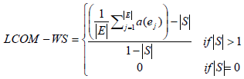
LCOM-WS
The same measure can be extrapolated to the case of Web services, if we consider methods to be Web Services, and attributes to be Entities in the data model. Therefore, the reformulated the H-S LCOM metric for WS, LCOM-WS, can be defined as:
  When all information is retrieved in a single service, the denominator is 0, so a separate definition is provided for it. Obviously, a single service retrieving all the data is fully cohesive according to the idea behind LCOM, but it lacks flexibility; the whole set of information, which many applications possibly do not need (at least at a give instant of time), is retrieved for all calls all the time.
  Ss with the original metric, minimum cohesion occurs when every entity has just one associated WS to retrieve the data from it, including intermediate tables. In this case, the result of the formula is 1, yielding a high lack of cohesion value. Regarding processing, the server acts as a simple processor of queries on single entities, and no join or other kind of expensive computations are carried out.

Slide 9
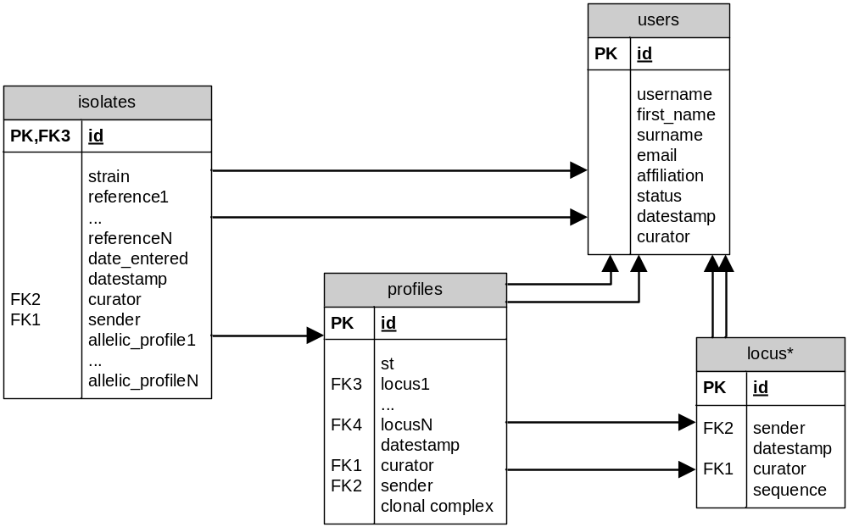
Case Study
Consider a data relational schema ξ formed by a group of entities, E={e1,…, en}, some of which are related by referential integrity constraints ej→ ek.
Multilocus Sequence Typing (MLST) database schema abstraction contains genetic information of different types of organisms.
Notes:
Then, a maximum cohesiveness (i.e., low LOC) in the WS interface will be achieved when the entire dataset is retrieved in a single WS, or horizontal portions of the dataset (subsets of the tuples in a table, for example) which take one piece of information for each of the entities.
Then, here communication overheads is minimal (but maximal latency, i.e., time to transfer the whole dataset or most of it), except for the case that horizontal slices are taken, e.g when the Web services are instructed to retrieve tuples in slice of say, 30 rows per call. Obviously, the case of minimal communication overhead approximately corresponds to download or bulk export functionality. In this case, C&K LCOM = 0, which means high cohesion.
form of a relational schema[2]. There are some attributes that occur several times depending on the kind of organism or information represented, e.g. allelic_profiles. Also, the table locus is actually a set of tables, but these issues do not affect our current analysis, since we can consider the tables to be conceptual entities accessed by the WS interface.
http://pubmlst.org/
[2] The data model is an abstraction on the documentation of the MLST database for the purpose of analysis, we do not claim it is actually the underlying data schema of the service

Slide 10
MLST WS Interface
WS | Entities read | Attributes retrieved | Multiplicity |  | Support iteration | Process
getIsolate | Isolates | all |  | 1
getIsolateCount | Isolates | none |  | 1 | yes
getIsolateFields | Isolates | none |  | N | yes
getRelatedIsolateIdsByProfil | isolates, profiles | id |  | N |  | join
getRelatedIsolateIdsByST | isolates | id |  | N |  | logical
… | … | … |  | … | … | …
getSTs | profiles | St |  | N
Notes:
Services marked with (*) have been excluded from the analysis since they are actually providers of URI-based ways of retrieving data, which is a mechanism not homogeneous with the rest of them. The column “attributes retrieved” identifies which attributes are the outputs of Web services. It should be noted that some of the services do not actually retrieve actual information, but information on the database schema or on the number of records (rows) contained in a table, these are marked as such in the “support iteration” column, since their intent is that of providing information for calling other services. Also, the column “processing” indicates which services are considered to retrieve information from several entities, thus involving a join or other kind of processing.

Slide 11
Analysis
Cases: | A single WS | A WS per entity | Actual interface | Actual interface+ 1 WS query | Actual interface+5 WS queries
LCOM-WS | 0 | 1 | 0.77 | 0.74 | 0.63
LCOM-CK | 0 | 6 | 274 | 270 | 254
Flexibility | Min | Max | Max | = | =
Communication overhead | Min | Max | Intermediate | Slightly increased | Slightly increased
Distribution | All client side | All client side | 6 out of 24 | 7 out of 25 | 11 out of 29
Notes:
If we apply the LCOM-WS and LCOM-CK metrics described above, the information can be contrasted with the design of the WS interface as showed in Table 2. Case (iii) in the Table is the counting for the interfaces analyzed in Table 1, and cases (i) and (ii) are the two “extreme” cases commented before. The contrast of cases (i) and (ii) shows that the former is measured as highly cohesive, but it provides the minimum flexibility since all the data is transferred in a single invocation. In contrast, the flexibility in case (ii) is maximum, in the sense that applications can obtain the concrete information blocks required down to the granularity of single entities (this can be seen considering the getIsolate, getAlleleSequence and getProfile services). For case (ii), cohesion is low, but cases of non-flexible interface might also yield intermediate cohesion values. For example, two Web services that obtain two unrelated parts of a data model would yield a LCOM-WS of 0.33. The first consequence then is that the studied cohesion metrics cannot be used to compare any arbitrary WS interface design when flexibility is a requirement. Flexibility is a property of design that can be inspected from the specification of WS.
Table 2 shows also how the two extreme cases coincide in that they rely all the processing of data to the client, but they are opposites in communication overhead and flexibility. It should be noted that some of the services in Table 1 provide server-side processing of considerable complexity, e.g. the blast service provides sequence matching through heuristics with no linear computational complexity in the worst case. Then, for interfaces with maximum flexibility, the increase in cohesion comes from the addition of services that require joining information from different entities or performing complex queries, which entails delegating workload to the server side. This idea could be used to explore metrics of distribution in Web service interfaces, which are relevant for the design of solutions to complex applications. It is important to consider that data servers on the Web could be facades for parallel computing or Grid systems, so that delegating to the server is the preferred way of developing the application. In that direction, a possible additional metric for distribution could be derived from the WMC (Weighted Methods per Class) metric proposed by C&K [1]. Figure 2 depicts this abstract relationship.

Slide 12
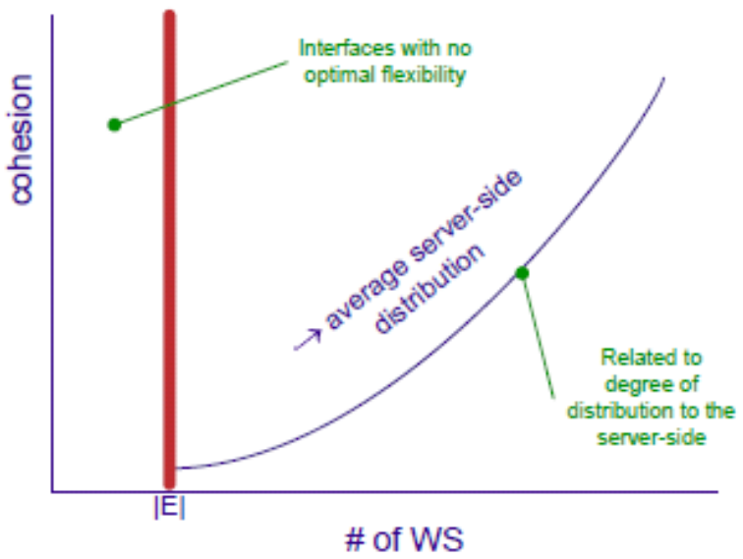

Slide 13
Conclusions and Future Work
The comparison of potential designs for WS interfaces reveals the importance of considering at least cohesion, flexibility, communication overload and distribution.
  Using the data entities as units, maximum flexibility is achieved in these interfaces by methods retrieving information for each of the entities, and measures of LOC decrease if additional query services are provided.
  These services are often used in WS interfaces to distribute part of the processing to the server side, since they could be executed at the client side after getting the data. The data gathered for the case study points out that flexible interfaces will yield high values of the LCOM metric, and the provision of additional query services make these figures lower. However, less flexible interfaces would yield better cohesion figures but loosing entity-based flexibility.
Future work will deal with measuring the actual impact of additional communication overload in these interfaces as well as defining new metrics that combine trade-offs between the different properties.

