Slide 1
Online Assessment
Information System
Danrong Li, Yuqi Tang

Slide 2
Description
Online information system for algorithm/programming classes in NYU
Have two kinds of users: teacher and students.
Our system documents students working on the online coding questions (eg. leetcode problems) that are assigned by their professors

Slide 3
Entity Description
Students,
Student information(student id, student name, password)
Classes
Class information(class id, class name)
Departments
Professors
Questions
Problems titles, descriptions etc.
Examples
Explanation of Questions
Constraints
Representing input type and range
Language
Java, C, Go, Python
Entity cluster: University

Slide 4
Relationship
With_details:
representing the score and language details of every student
Assigned:
Professor of a class assigns students with different algorithm questions
Instructed_by:
The classes are given by different departments
Offer_by:
The classes are given by different professors
Comment:
Everyone can leave comments on every question

Slide 5
Weak Entities
Have: Questions have input/output examples.
Follow: Questions should follow different constraints.
Both “Have” and “Follow” are dependent on Questions.

Slide 6
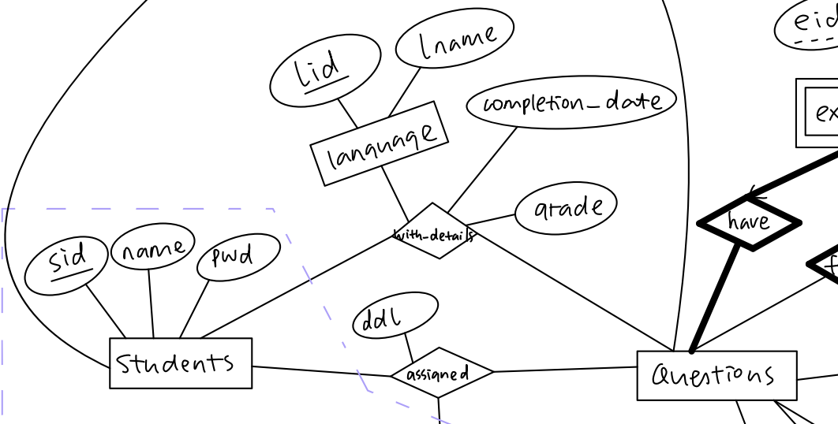
Business Rules -- Student and Questions
Students can be assigned any number of questions.
Questions can be completed by any number of students.
Students can complete any number of questions.
Students can use any number of languages to complete the question.
The languages can be used by any number of students to complete the questions.
Every detail will belong to exactly one student.

Slide 7
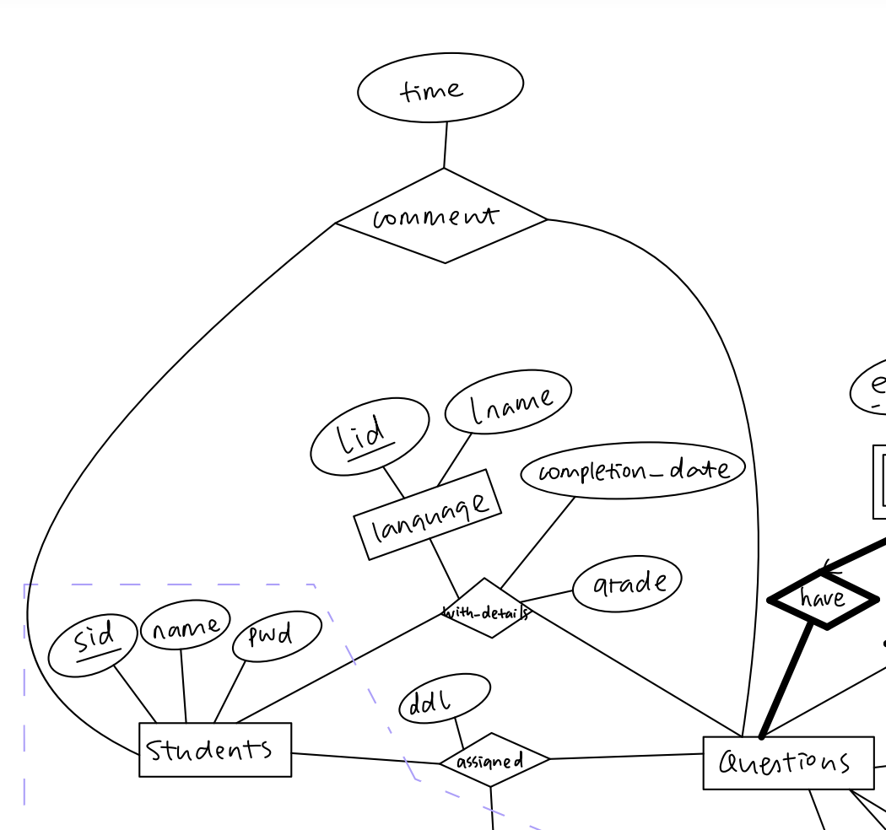
Business Rules -- Student and Questions
Students can comment on any number of questions.
Questions can be commented on by any number of students.
Every comment is made by exactly one student.

Slide 8
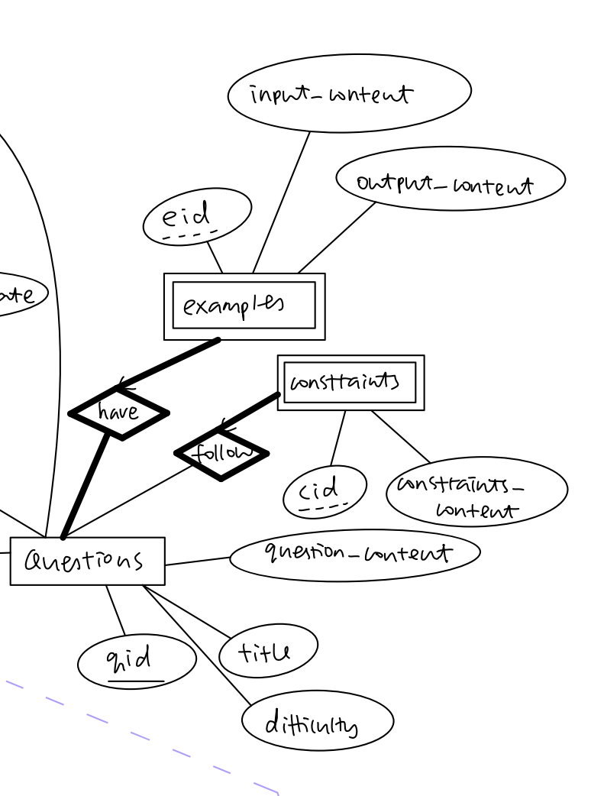
Business Rules -- Questions
All questions have examples.
And for every example, it only has 1 matching question.
Some questions follow constraints.
And for every constraint, it only has 1 matching question.

Slide 9
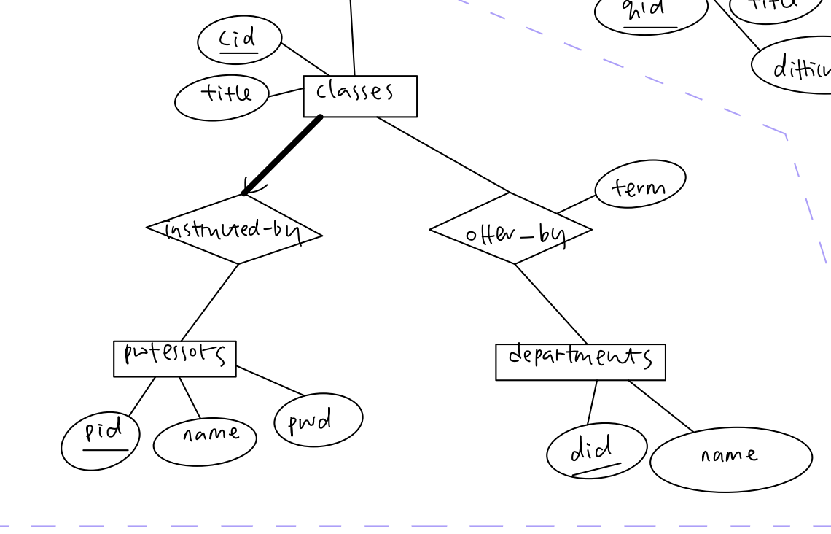
Business Rules -- Classes, Departments, Professors
Each class is instructed by exactly one professor.
Classes can be offered in any number of departments.
Departments can offer any number of classes.
Professors can instruct any number of classes.
Classes are offered by departments during different terms.
For each department, the most recent term of the course is recorded.

Slide 10
Data Source
Use leetcode problems as our questions.
NYU Albert course catalog to obtain our classes, departments and professors data.
Some trivial data, like the language, grade, date etc, we will make them up realistically.

Slide 11
User Interactions
Given a leetcode question id, list the question difficulty level, question title, question content, input example and output example.
Given a student name
List the number of questions the student completed. For each question completed, show the question id, completion timestamp, grade received and language used.
List all the assigned leetcode questions as well as their ddl.
Given a student name, list all the questions that he/she commented on before, as well as the timestamp.
Given a class name
List the number of students who took the class, as well as their names.
List all students who attempted the leetcode problems.(may complete after ddl)
List all students who have finished their assignments before ddl.
List the students’ performance(percentage of students completed the assigned problems before the ddl) in the class.
Given a term
List the number of classes offered in that term as well as the class names.
List the names of professors who are teaching in that term.
List the names of departments that are offering classes in that term.
Given a department name, list all the classes they provided.
Given a professor name
List the names of classes that are instructed by that professor.
List the questions that they assigned to their classes.

Slide 12
Thanks for watching!

