Slide 1
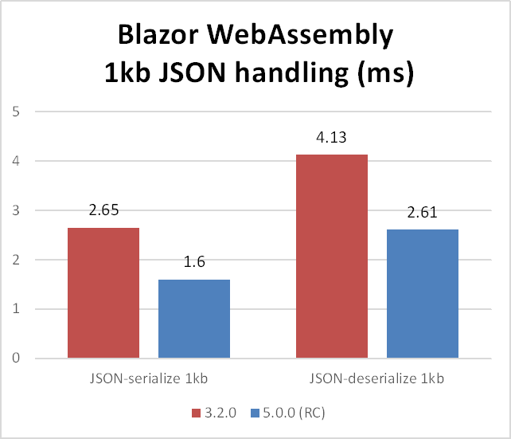
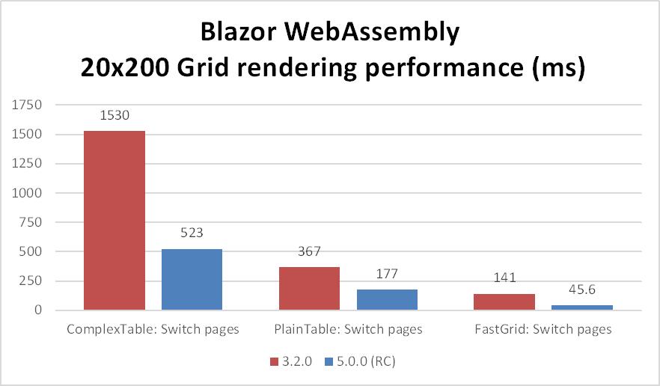
Blazor WebAssembly performance
2-3x faster component rendering and runtime execution

