Slide 1
Dive deep into ASP.NET Core 1.0
Daniel Roth
Senior Program Manager

Slide 2
A deep dive into . . .
Hosting
Request handling
Routing
MVC extensibility
Futures

Slide 3
Get Started with ASP.NET Core 1.0
Go to http://dot.net
Docs: https://docs.asp.net
Samples and code: https://github.com/aspnet

Slide 4
ASP.NET Core hosting
ASP.NET Core is just a bunch of libraries
Host in your own process (ex. a console app)

Slide 5
Setting up ASP.NET Core hosting
Build the host
Setup host services
Configure a server
Identify startup logic
Build the app RequestDelegate
Run the host
Start the server for the hosted app
Handle requests using the app RequestDelegate

Slide 6
Configuring hosting properties
Server
Server URLs
Startup
Content root
Web root
Environment
Application name

Slide 7
Hosting
Daniel Roth
Notes:
Setup ASP.NET Core hosting
Create a Startup class
Show various hosting properties
Switch to VS
Show how servers work
Show TestServer

Slide 8
Hosting in production
Kestrel is not yet hardened for internet facing traffic
Run Kestrel behind a mature reverse proxy
Ex IIS, Nginx, Apache, etc.
Proxy
Kestrel
Internet
Kestrel
Kestrel

Slide 9
Publishing to IIS
Install the new ASP.NET Core Module
Native IIS module that forwards request to your application
Supports forwarding client certs, Windows auth, IIS sub applications, app offline, logging
Setup module in web.config
New iis-publish tool will handle this for you
Point IIS at your app content root
Static files will only be served from the web root
Setup IIS integration for your ASP.NET Core host
webHostBuilder.UseIISIntegration()

Slide 10
ASP.NET Core Module (ACM)
1. IIS receives a request
2. ACM starts the app in a separate process (if it’s not already running)
The app no longer runs as w3wp.exe but as dotnet.exe or myapp.exe
3. ACM forwards the request to the application
4. The app processes the request and sends the response back to ACM
5. IIS forwards the response to the client

Slide 11
ASP.NET Core Module configuration
<?xml version="1.0" encoding="utf-8"?>
<configuration>
<system.webServer>
<handlers>
<add name="aspNetCore" path="*" verb="*"
modules="AspNetCoreModule" resourceType="Unspecified"/>
</handlers>
<aspNetCore processPath="dotnet" arguments=".\HelloWorld.dll"
stdoutLogEnabled="false" stdoutLogFile=".\logs\stdout" />
</system.webServer>
</configuration>

Slide 12
Env vars set by ACM for the host process
ASPNETCORE_PORT
Port to forward the request to
ASPNETCORE_APPL_PATH
Application path to forward the request to
ASPNETCORE_TOKEN
Pairing token to ensure only local requests from IIS get received

Slide 13
Hosting in IIS
Daniel Roth
Notes:
Open WebApplication3
Run in in IIS Express
Show web.config
Write some code that shows the server URLS and the ACM env vars
Publish the app and show the webconfig was updated

Slide 14
Request handling
Request handling pipeline defined in startup
Use middleware to process requests
Built RequestDelegate used to handle all requests
Lots of built-in middleware
Routing, authentication, static files, diagnostics, error handling, session, CORS, localization, custom

Slide 15
RequestDelegate
public delegate Task RequestDelegate(HttpContext context);

Slide 16
Middleware
app.Use(Func<RequestDelegate, RequestDelegate> middleware);

Slide 17
Middleware
public class MyMiddleware
{
public MyMiddleware(RequestDelegate next, …) { … }
public async Task Invoke(HttpContext httpContext, …) { … }
}
app.UseMiddleware<MyMiddleware>();

Slide 18
Middleware
Middleware1
Middleware2
Middleware3
Request
// logic
next();
// logic
next();
// logic
// more logic
// more logic
// more logic
Response

Slide 19
Request handling
Daniel Roth
Notes:
Write a middleware as an inline delegate from scratch
Two levels of lambdas! Inception – a dream within a dream
Show custom middleware implementation

Slide 20
Routing
Routing middleware calls into IRouter
IRouter creates a RequestDelegate for handled requests
RouteCollection iterates through a list of IRouters and stops when one handles the request
Route implements route templates and calls a target IRouter when the request matches
RouteBuilder creates a RouteCollection using a default IRouter for the target of added routes
MVC sets itself up as the default IRouter on the RouteBuilder
Supports link generation too

Slide 21
Routing
Daniel Roth

Slide 22
MVC: Application Parts
ApplicationPartManager is the one-stop shop for discovery logic in MVC
Controllers, View Components, Tag Helpers, Razor compilation references
Application parts are resources from which to discover features (ex assemblies)
Feature providers populate features from the application parts

Slide 23
MVC: Application Model Conventions
Application model is a representation of your MVC app that you can read and manipulate
Controller names, action names, action parameters, attribute routes, filters
Modify the application model with custom conventions
Ex Web API compat shim
Explore your app
Ex. Swagger

Slide 24
Application parts & conventions
Daniel Roth
Notes:
GenericControllers
Custom controller discovery logic for open generic controllers
Talk to adding additional application parts, like a dynamically loaded assembly
CustomRouting
Show that you can do something globally

Slide 25
Roadmap (subject to change!)
1.1 - Q4 2016 / Q1 2017
URL rewriting
Response caching
WebListener server (Windows only)
Middleware as MVC filters
Precompiled views
View Components as Tag Helpers
Improved Azure integration
1.2 - Q1 2017 / Q2 2017
WebSockets
SignalR
Web API security
“Razor Pages” (views without MVC controllers)

Slide 26
Futures
Daniel Roth
Notes:
URL Rewriting
Response Caching - Done!
Precompilation
Middleware as MVC filters
View Component Tag Helpers
Razor Pages teaser

Slide 27
Join us!
Code: https://github.com/aspnet/home
Docs: http://docs.asp.net
Live: http://live.asp.net

Slide 28
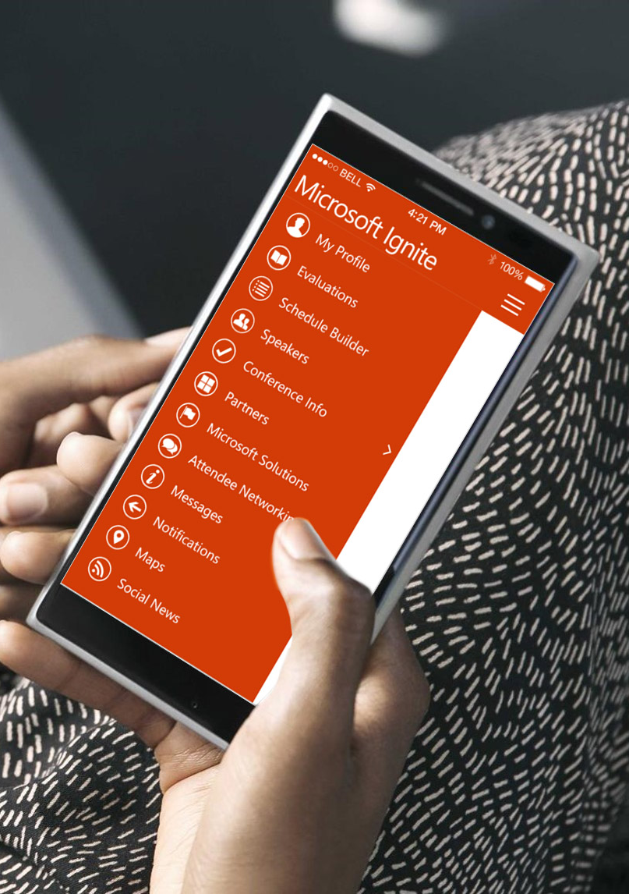
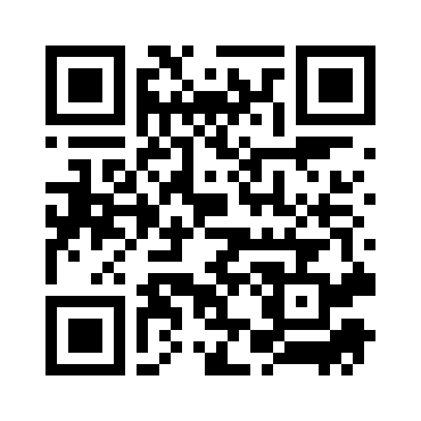
Please evaluate this session
Your feedback is important to us!
From your PC or Tablet visit MyIgnite at http://myignite.microsoft.com
From your phone download and use the Ignite Mobile App by scanning the QR code above or visiting https://aka.ms/ignite.mobileapp

