Slide 1
Explore web development with Microsoft ASP.NET Core 1.0
Daniel Roth
Senior Program Manager

Slide 2
ASP.NET Core (previously ASP.NET 5)
A new open-source and cross-platform framework for building modern cloud-based Web applications using .NET

Slide 3


ASP.NET Core and the Modern Web
Totally Modular
Faster Development Cycle
Seamless transition from on-premises to cloud
Choose your Editors
and Tools
Open Source with Contributions
OSS
Cross-Platform
Fast

Slide 4
Getting Started with ASP.NET Core 1.0
Go to http://dot.net
Docs: https://docs.asp.net
Samples and code: https://github.com/aspnet

Slide 5



ASP.NET Core in a Nutshell
Web
Forms
MVC
Web API
ASP.NET Core MVC
ASP.NET 4.6
(System.Web)
ASP.NET Core 1.0
(Microsoft.AspNetCore)
.NET Framework
.NET Core
Platform for .NET applications on Windows
Cross-platform, modular libraries & runtime optimized for server and cloud workloads

Slide 6
ASP.NET Core features
Hosting
Kestrel, Startup
Middleware
Routing, authentication, static files, diagnostics, error handling, session, CORS, localization, custom
Dependency Injection
Configuration
Logging
Application frameworks
MVC, Identity, SignalR (future)

Slide 7
ASP.NET frameworks - similar, but different
Web Pages
MVC
Web API
Razor
HTML Helpers
HTML Helpers
Controllers
Controllers
Actions
Actions
Filters
Filters
Model binding
Model binding
DI
DI

Slide 8
MVC + Web API + Web Pages = ASP.NET Core MVC

Slide 9
ASP.NET Core MVC
One set of concepts – remove duplication
Web UI and Web APIs
Built on ASP.NET Core
Supports .NET Core
Runs on IIS or self-hosted
Deep integration with DI
*NEW* Tag Helpers

Slide 10
Code
Daniel Roth
Notes:
Getting Started with .NET Core
- Get the .NET Core SDK/Tooling from https://dot.net
- dotnet new
- Show generated code in VSCode
- dotnet restore
- Talk to NuGet feeds and packages
- Show where packages get restored
- dotnet restore -v Information
- dotnet run (does a build)
- Show built output
Getting Started with ASP.NET Core
- https://asp.net/get-started
- Restore packages in VSCode
- Run in VSCode
Host config and startup
- Create empty app in VS
- Content root
- IIS integration
- Show that you can set the server URL and port
Middleware
- Setup static files
- Default files (talk to ordering)
- Talk to exception handling page
Logging
- Add the Debug logger
- Show the logging output (console and debug)
Configuration
- Create new Web App w/auth
- Talk to provider model
MVC
- Template route syntax
- Web API action with attribute routing
- C# 6 support
- Add var me = "me"; $"About {me}";
- Async views, @await
- @inject
- Tag Helpers
- Compare login views
- Show editor intellisense for styles and bound attributes
- Built-in tag helpers: environment, script

Slide 11
Roadmap (subject to change!)
1.1 - Q4 2016 / Q1 2017
URL rewriting
Response caching
WebListener server (Windows only)
Middleware as MVC filters
Precompiled views
View Components as Tag Helpers
Improved Azure integration
1.2 - Q1 2017 / Q2 2017
WebSockets
SignalR
Web API security
“Razor Pages” (views without MVC controllers)

Slide 12
Futures
Daniel Roth
Notes:
URL Rewriting
Response Caching - Done!
Precompilation
Middleware as MVC filters
View Component Tag Helpers
Razor Pages teaser

Slide 13
Related .NET Sessions
Explore web development with Microsoft ASP.NET Core 1.0 | Tuesday 10:45 AM | Daniel Roth
Dig into C# and Visual Basic code-focused development with Visual Studio | Tuesday 2:15 PM | Kasey Uhlenhuth
Explore the new, cross-platform .NET Core 1.0 | Wednesday 12:30 PM | Rich Lander
Maximize web development productivity with Visual Studio | Thursday 10:45 AM | Mads Kristensen
Access data in .NET Core 1.0 with Entity Framework | Thursday 4:00 PM | Rowan Miller
Develop, debug and deploy containerized applications with Docker | Friday 9:00 AM | Glen Condron, Steve Lasker
Dive deep into ASP.NET Core 1.0 | Friday 10:45 AM | Daniel Roth

Slide 14
Join us!
Code: https://github.com/aspnet/home
Docs: http://docs.asp.net
Live: http://live.asp.net

Slide 15
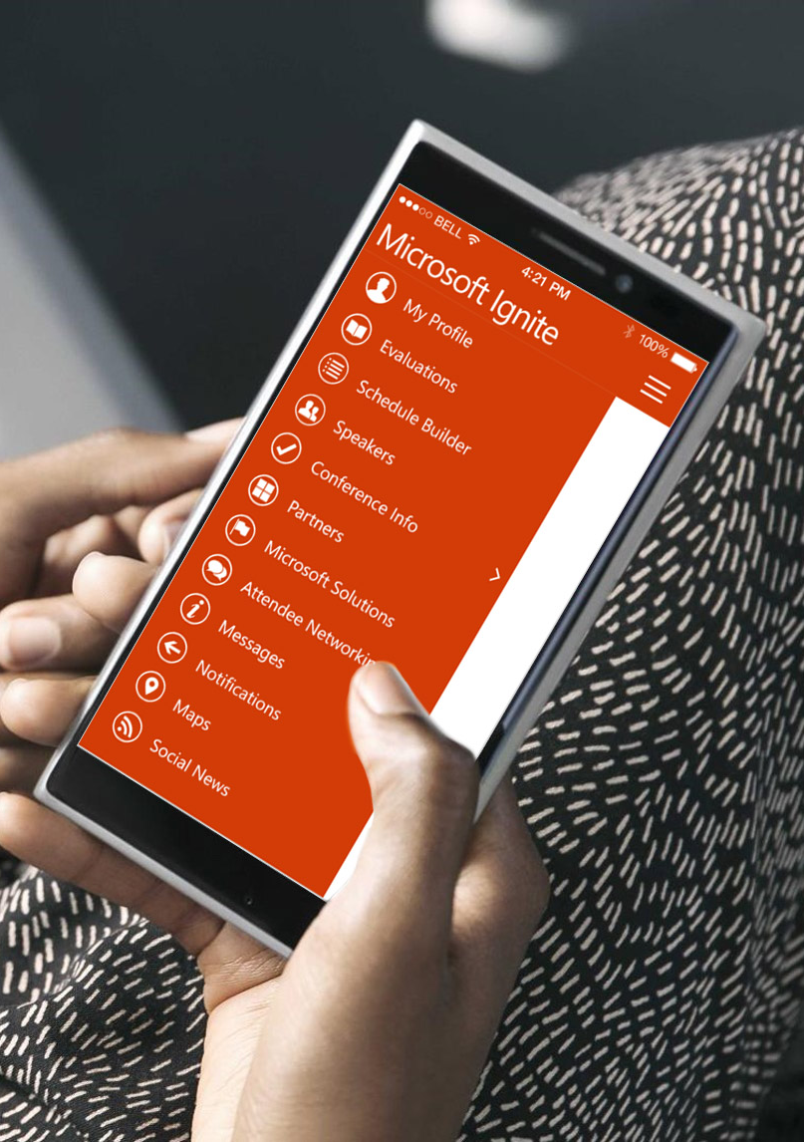
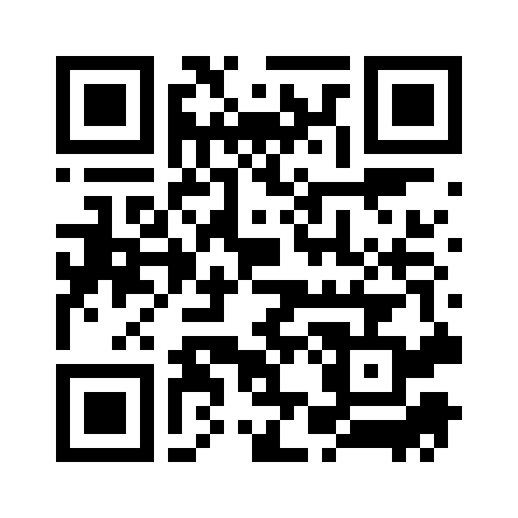
Please evaluate this session
Your feedback is important to us!
From your PC or Tablet visit MyIgnite at http://myignite.microsoft.com
From your phone download and use the Ignite Mobile App by scanning the QR code above or visiting https://aka.ms/ignite.mobileapp

