Slide 1
Authentication via Visible Light Communication
Dan Whitcomb

Slide 2

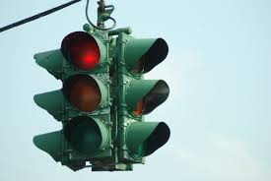
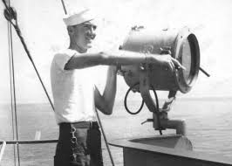
Visible Light Communication

Slide 3
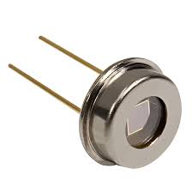
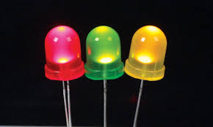
Modern day
LEDs:
Up to 500 Mb/s
Multichannel
Photodiodes

Slide 4
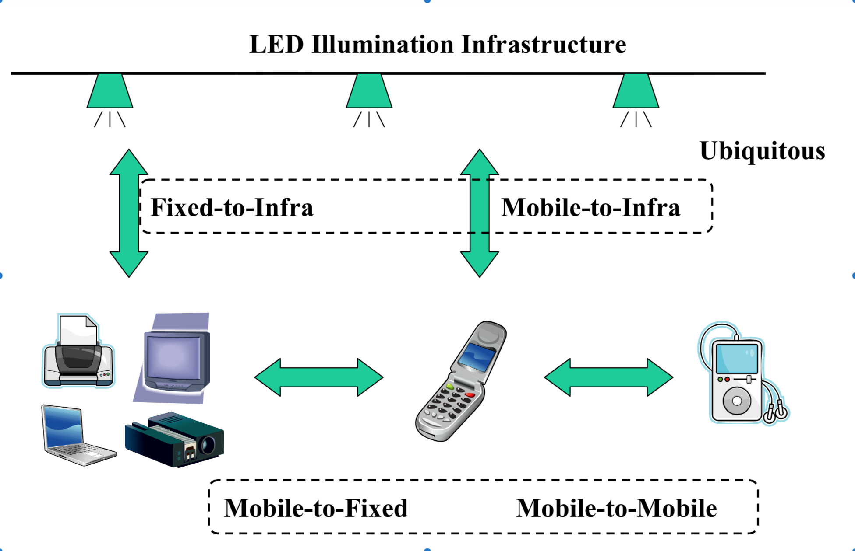

Slide 5
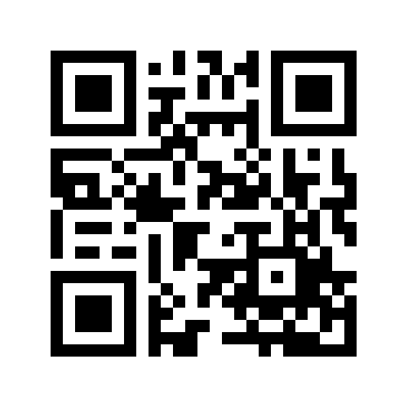
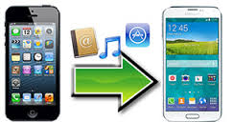
Mobile: Screen to Camera
Parallel Communications
Serial Communications
Notes:
----- Meeting Notes (11/18/14 12:24) -----
None of these options offer serial communication with devices that only one person has

Slide 6


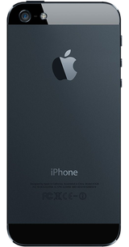
What does everyone have?

Slide 7
Mobile LED to Camera

Slide 8
Security Analysis
Advantages
Common device pairings
Small/localized transfer space
Others don’t know time of transfer (theoretically)
Disadvantages
Few unified transfer standards – not every application works together
Frame synchronization

Slide 9
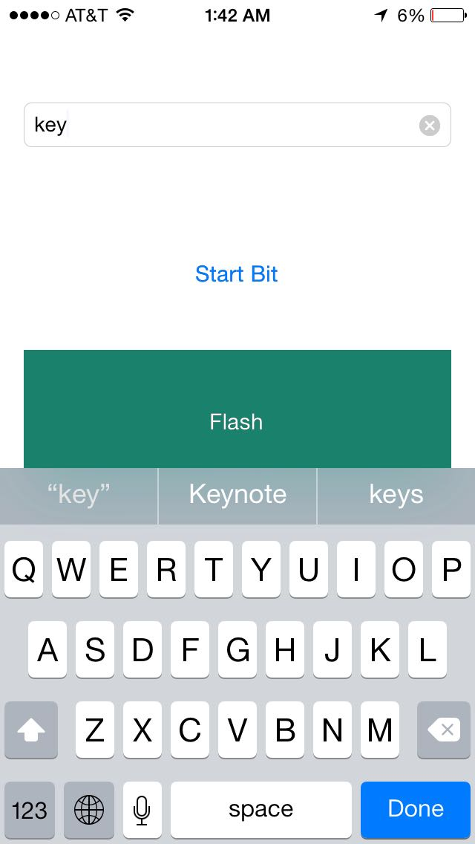
Method
iOS:
1. Converts ASCII string to binary
2. Flashes at time interval

Slide 10


Method
Mac OSX
OpenCV – computer vision library – does frame processing
Average brightness of ‘1’
Grayscale
Threshold
Avg Brightness – Standard Deviation
Repeat
OpenCV
Threshold to Zero Operation
Notes:
----- Meeting Notes (11/18/14 12:24) -----

Slide 11
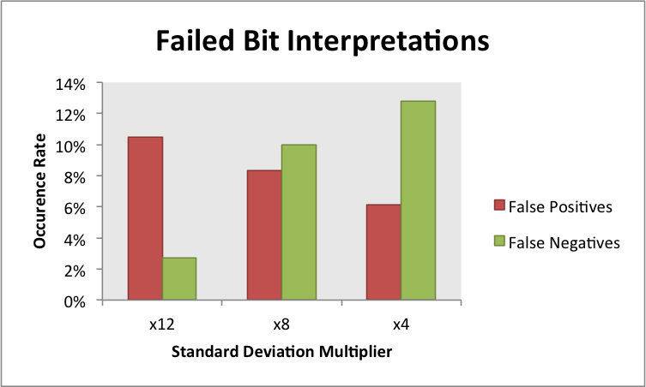
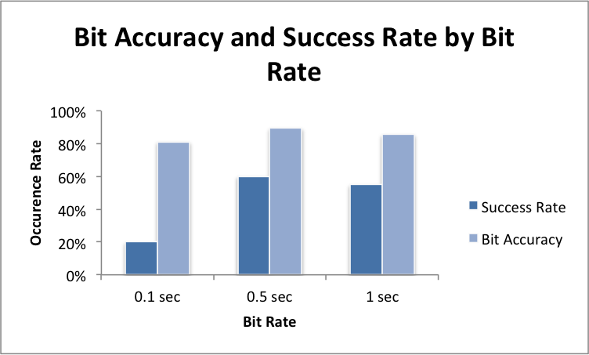
Testing
20 rounds per variable
9 bits – ASCII ‘w’ + 1 start bit – per test (001110111)
Varying bit analysis thresholds (std dev multipliers)
Varying bit rates
Results
Slow bit rate => Higher success rate
Bit accuracy not variable
Max 60% success rate per 8 bits @ 1 second

Slide 12
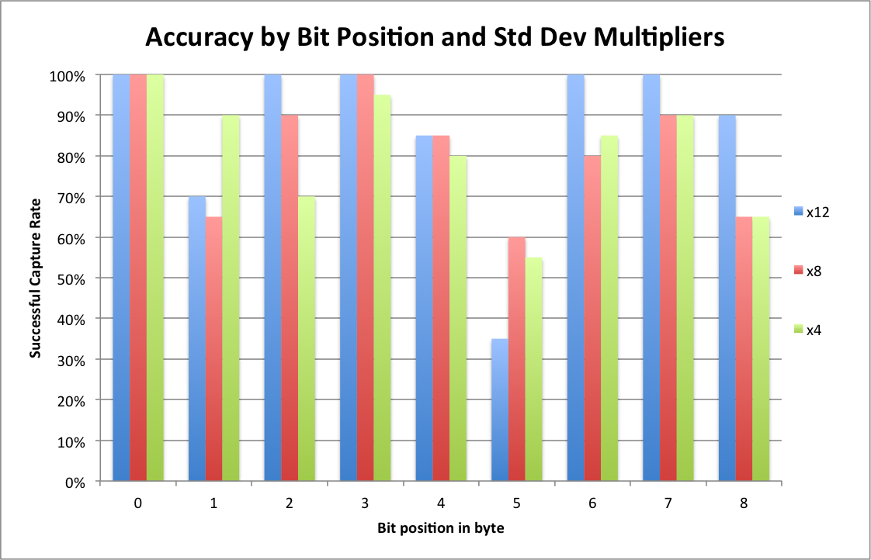
Analysis
Poor performance with larger keys
- 2bit/sec => 0.02%
success rate for 128 bit key
- 10bit/sec => 6.5536 ×
10^-10% success rate @
128bit key
Transfer rate limited by camera’s frame rate => can be decoded by looking
iSight camera ambient light sensor; auto adjustments
Changing to bits of different values is less accurate
‘w’ = 0 0 1 1 1 0 1 1 1

Slide 13
Verdict
My implementation not suitable for security needs
Useful in theory => photodiode in computer is necessary.

